Slide 1
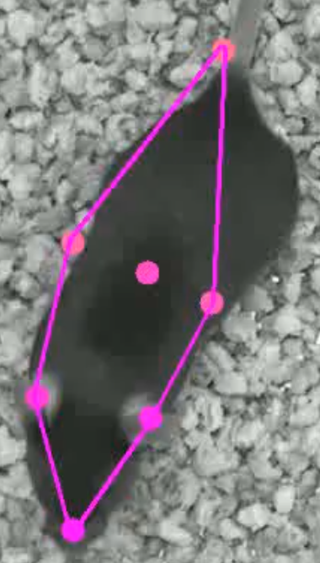
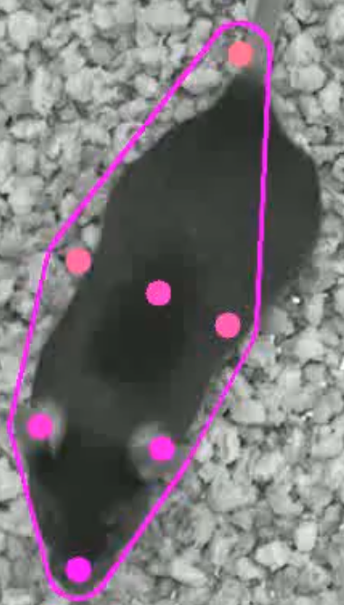
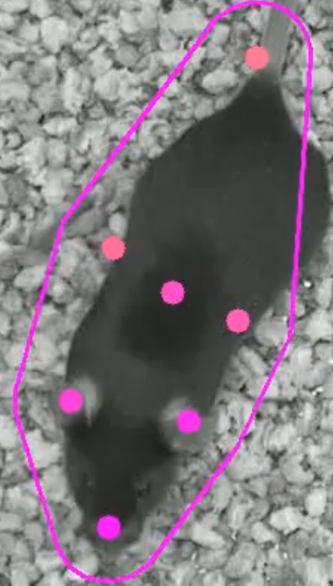
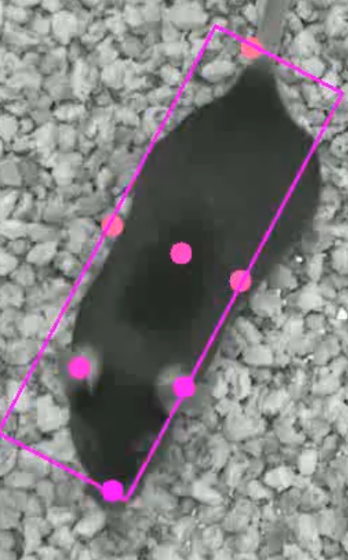
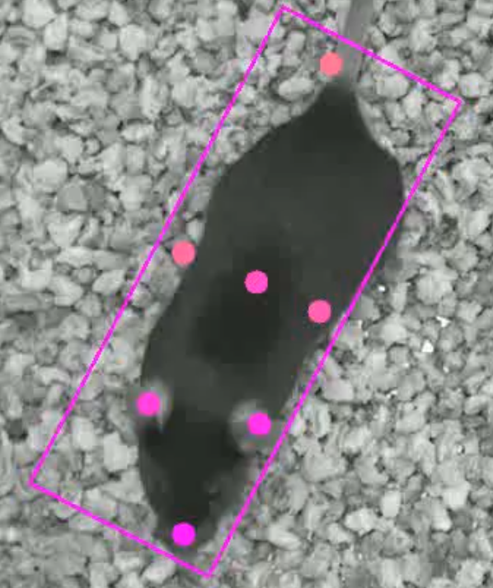
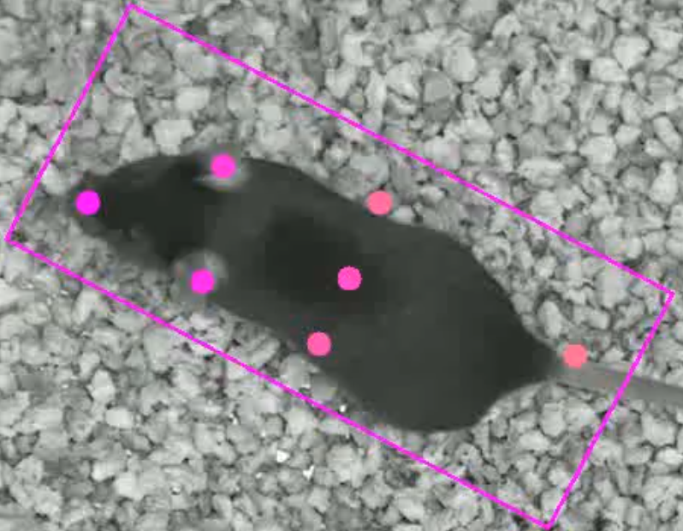
PARALLEL OFFSET / BUFFER (MM)
0
10
20
ENTIRE ANIMAL
FORCE RECTANGLE ✘
ENTIRE ANIMAL
FORCE RECTANGLE ✓

