Slide 1
Data bases
Introduction to Databases
SQL Databases
NoSQL Databases
MongoDB vs SQL
Chakroun Ahmed

Slide 2
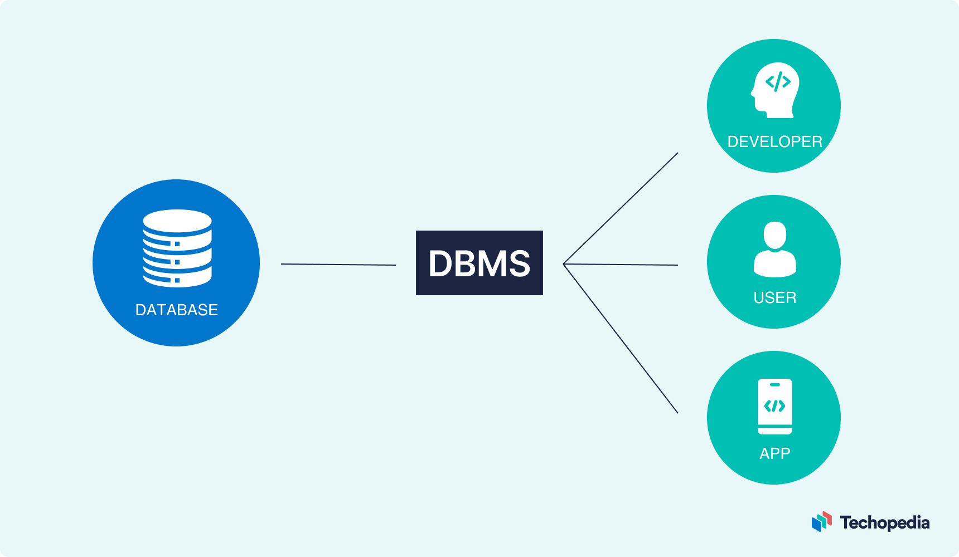
Introduction to Databases
Databases are organized collections of structured data that allow for efficient storage, retrieval, and manipulation of information. They are crucial components in modern software applications, serving as the backend for various systems like websites, mobile apps, enterprise applications, and more. Databases provide a way to store and manage data, making it easier to access and manipulate information as needed.
DBMS stands for Database Management System. It is software that enables users to interact with a database, providing an interface to store, retrieve, update, and manage data efficiently.
Two primary types of databases are SQL (relational) databases and NoSQL (non-relational) databases. Let's briefly explore the differences between these two types:

Slide 3
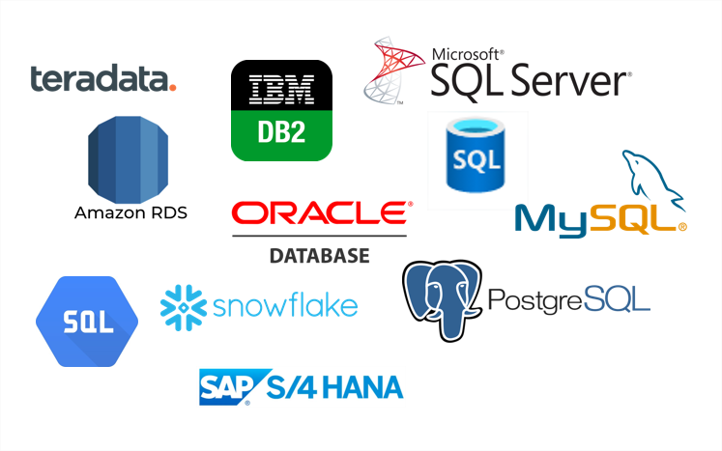
SQL Databases
Structure: SQL databases use a structured approach, where data is organized into tables with fixed schemas. Each table consists of rows and columns, similar to a spreadsheet.
Data Integrity: They enforce data integrity through predefined relationships and constraints, ensuring that the data follows specific rules.
Query Language: SQL (Structured Query Language) is used to interact with SQL databases. It is a standardized language that allows users to perform operations like insert, update, delete, and retrieve data from the database.
Transactions: SQL databases support ACID (Atomicity, Consistency, Isolation, Durability) properties, which guarantee that database transactions are processed reliably and without interference.
Examples of SQL databases include MySQL, PostgreSQL, Oracle, SQL Server, and SQLite.

Slide 4
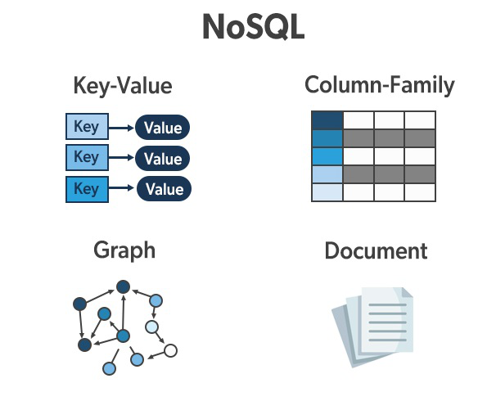
NoSQL Databases
Flexibility: NoSQL databases are designed to handle unstructured or semi-structured data. They do not require a fixed schema, allowing developers to store various types of data without predefined relationships.
Scalability: NoSQL databases are highly scalable and can handle large amounts of data and high-velocity data streams, making them suitable for big data and real-time applications.
Query Language: Different NoSQL databases use varying query languages. Some use SQL-like query languages, while others have their unique approaches.
Types: NoSQL databases can be further categorized into document stores, key-value stores, column-family stores, and graph databases, each optimized for different data models and use cases.
Examples of NoSQL databases include MongoDB (document store), Apache Cassandra (column-family store), Redis (key-value store), and Neo4j (graph database).

Slide 5
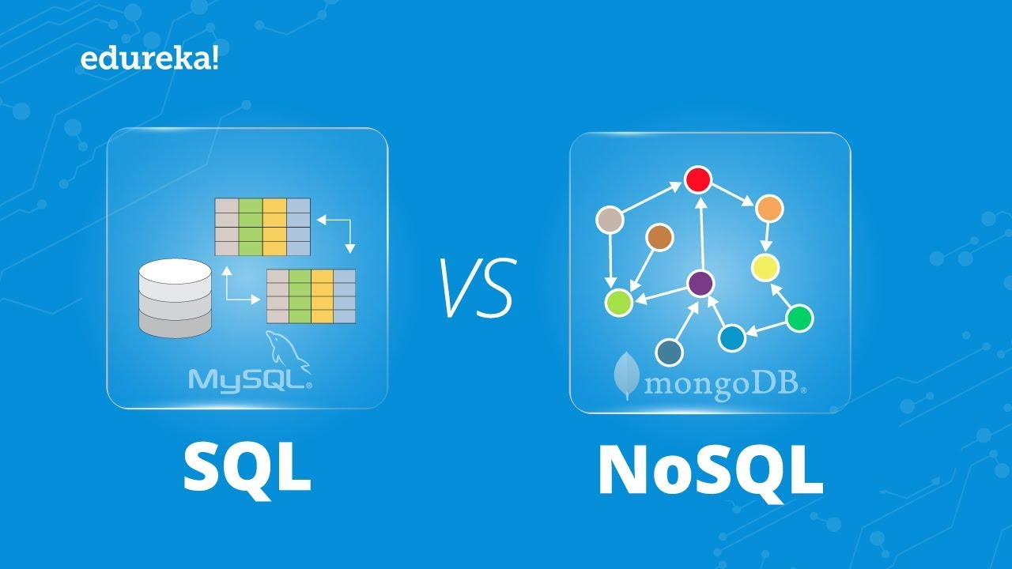
MongoDB vs SQL
To begin with the comparison, MongoDB is a Non-relational Database while SQL is a Relational Database. While MongoDB supports JSON querying, a SQL Database uses SQL query processing.
The basic characteristics make MongoDB a more dynamic and complex option that is fit for hierarchical data while a SQL Database remains more predefined and suited for other kinds of data storage.
Following are some aspects where some use case contrasts can be observed in MongoDB vs SQL Databases:

Slide 6
MongoDB vs SQL
MongoDB vs SQL: History
Development of MongoDB began in early 2007 when the company was designing a platform-as-a-service similar to Microsoft Azure. A New York-based company 10gen, which is now renamed MongoDB Inc was working on this software.
The Initial development focused on creating the PaaS. (Platform as a Service), but later in 2009 MongoDB was launched to the market as an open-source database server and is supported by the organization itself. In March 2010, the first production-ready version 1.4 was released. The latest and stable version of MongoDB is version 2.4.9, released on January 10, 2014.
There are numerous versions available for SQL. The original version of SQL was developed at the IBM San Jose Research Laboratory (now known as the Almaden Research Center). Initially, the language was called Sequel, in the early 1970s, it was implemented as part of the R project. Since then, the sequel language was developed, and gradually its name was changed to SQL.
In 1986, the American National Standards Institute (ANSI) published SQL as an updated standard 1992. The final ISO standard for SQL was published in 2008 and named SQL: 2008.SQL has established itself as the standard language for relational databases.

Slide 7
MongoDB vs SQL
MongoDB vs SQL: Storage of Data
Data storage is the primary function of a database and how your data is stored becomes significant when fetching and querying is considered.
In MongoDB, all individual records are stored as documents which are collections of fields with a dynamic schema. Here, each collection need not have the same set of fields which makes it more flexible than RDBMS.
In SQL Databases, records are stored in rows within a table which limits dynamic classification and storage of hierarchical data. However, SQL Relational data can be matched using common characteristics simplistically which can be beneficial depending upon your use case.

Slide 8
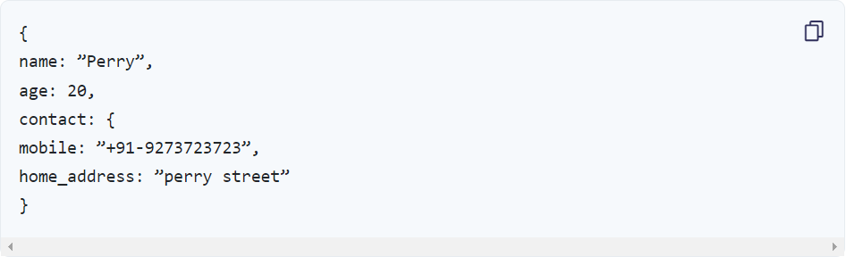
MongoDB vs SQL
MongoDB vs SQL: Representation, Reliability, and Accessibility
The difference in the way data is represented and interpreted in each makes a significant difference. MongoDB stores data in JSON format with key and value pairs for each entity whereas SQL Databases stores data as a record in a row of the table.
The representation of the storage of a single entity in the databases can be seen as follows:
MongoDB Document:

Slide 9

MongoDB vs SQL
SQL Databases Record:
While data is easily accessible and classifiable with a SQL Database, there are certain limitations to what can be stored and processed together. MongoDB uses a more complex approach to data storage while allowing complex processing as well. The data representation indicates that NoSQL doesn’t support any relations between different data types.
While MongoDB is more flexible and ensures high and diverse data availability, a SQL Database operates with the ACID (Atomicity, Consistency, Isolation, and Durability) properties and ensures greater reliability of transactions.

Slide 10
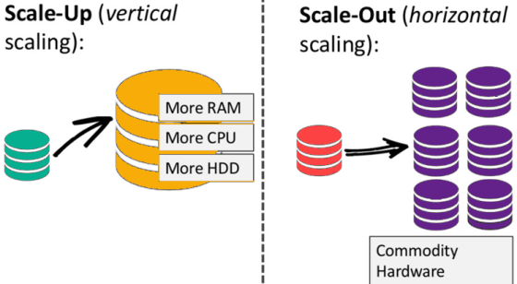
MongoDB vs SQL
MongoDB vs SQL: Scalability and Replication
Now coming to one of the most important factors that are crucial for businesses and organizations – the scalability and replication functions for wider access. It cannot be said that one of these is more scalable than the other unless the use case is determined.
SQL Databases facilitate Vertical Scaling, that is Scaling Up. You can scale up the RAM, CPU, and SSD capacities to upscale and add functionalities to your setup. While this can add some significant factors, it cannot be used to alter the framework and is restricted on that front. It facilitates easy data insertion and uses Slave and Master data replication.
MongoDB, on the other hand, would be better for Horizontal Scaling or Scaling Out. It is, therefore, preferred by those constantly looking to improve their frameworks, add more servers and expand their storage and set up. This process, known as Sharding, allows dealing with more flexible data and requires more detailed informational indexes and system capacities. Sharding is easily facilitated with MongoDB along with the use of Replica Sets for extending multiple copies of data for accessibility.

Slide 11
MongoDB vs SQL
Conclusion
In conclusion, it is fair to say that a SQL Database is more suited for businesses and industries that deal with structured and Relational data. It is great for websites with high traffic and facilitates a high-performing query engine. Data insertions, specialized web functions, quick processing, and robust reliability are some of the best features offered by SQL Databases.
MongoDB can be used by businesses and organizations of all sizes who are looking to scale out huge volumes of traffic as well as data. If you desire great speed and certain flexibility with the use of unstructured data within a schemaless environment, MongoDB is your go-to.
An element of automation with these databases can improve the functionality of your system even further and this is where Hevo saves the day!

