Slide 1
Monitoring Dark Web Marketplaces Using NLP
Presented by
Charles Jeremiah Chomba
8/8/2015

Slide 2
Project Overview
Objective: Use NLP to monitor dark web marketplaces for threat intelligence
Key techniques: Web crawling via Tor, text extraction, NLP analysis
Mapping to MITRE ATT&CK framework
Defense recommendations using NIST Cybersecurity Framework (CSF)

Slide 3
Tools & Technologies Used
Python
Requests & BeautifulSoup for web scraping
Tor Proxy for accessing onion sites
spaCy for NLP processing
Matplotlib & WordCloud for data visualization
MITRE ATT&CK & NIST CSF frameworks

Slide 4
Step 1: Data Collection
Access dark web marketplaces via Tor proxy
Crawl targeted onion sites and Ahmia search engine
Extract raw HTML data and discover new onion links

Slide 5
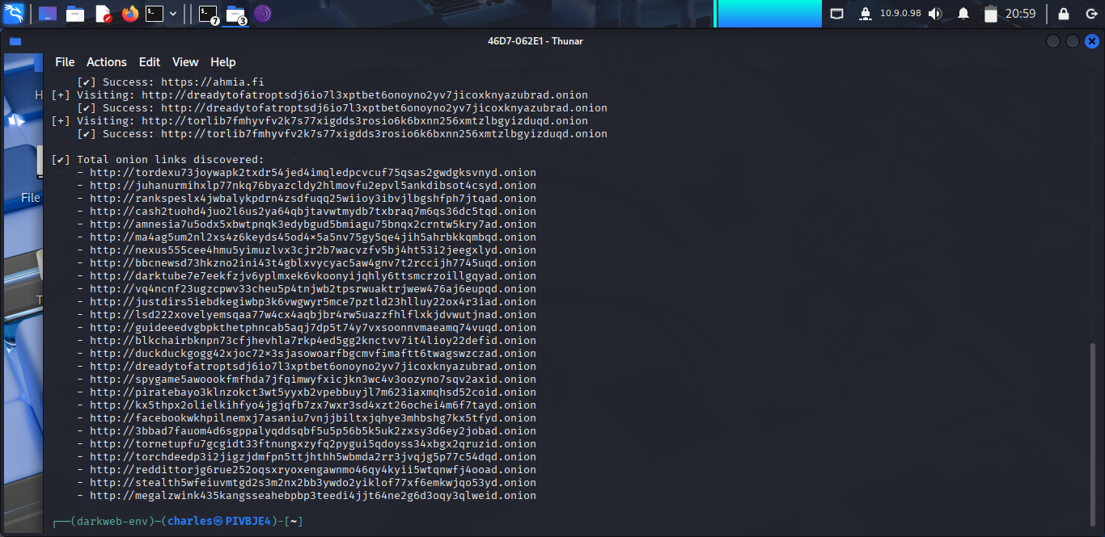
Step 1 Screenshot
Terminal output showing visited URLs and discovered onion links

Slide 6
Step 2: Data Processing & NLP
Clean and tokenize extracted text data
Use spaCy for named entity recognition & keyword extraction
Map findings to MITRE ATT&CK techniques

Slide 7
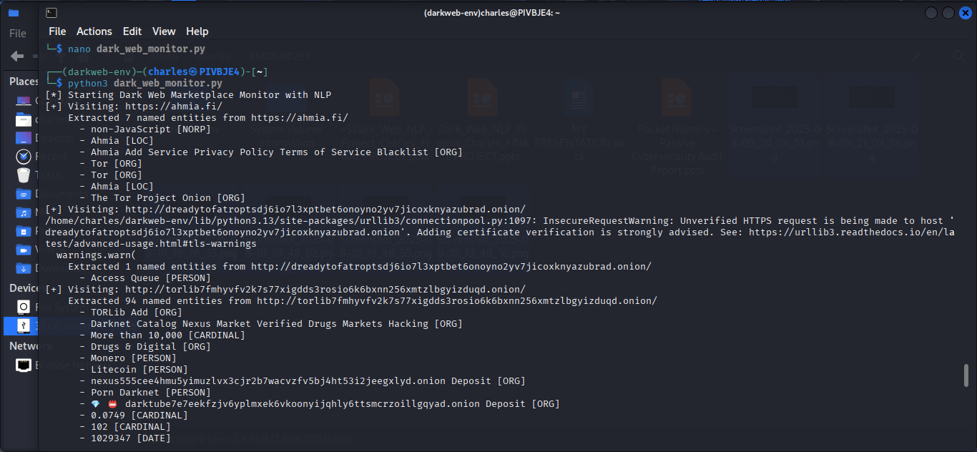
Step 2 Screenshot
Screenshot 2: recognized entities with highlighted text and labels.

Slide 8
Step 3: Visualization & Analysis
Generate word clouds from keywords
Create bar charts for frequent MITRE tactics detected

Slide 9
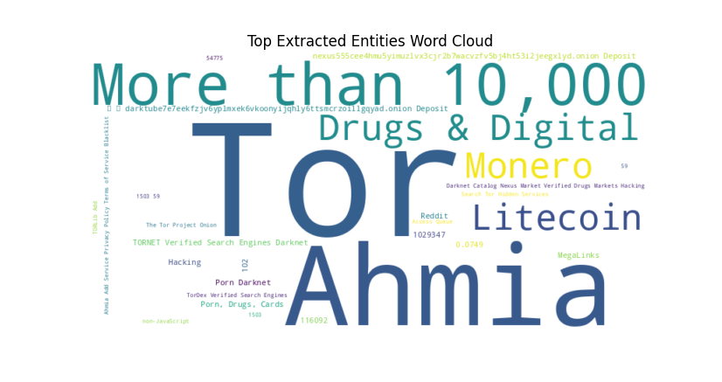
Step 3 Screenshot
Word cloud image showing top cyber threat keywords.

Slide 10
Step 4: Defense Recommendations
Use NIST CSF to propose mitigations based on MITRE findings
Examples: improved monitoring, access control, threat hunting

Slide 11
Challenges & Limitations
Access speed and reliability of onion sites
Data completeness and noise
Ethical and legal considerations in dark web monitoring

Slide 12
Conclusion
Successfully built a tool for dark web threat intelligence gathering
Combined Tor crawling, NLP, and cybersecurity frameworks for insights
Potential for further automation and real-time alerts

Slide 13
Appendix A: Python Scripts
Onion link crawler with Tor proxy configuration
Text extraction and CSV data logging
NLP processing and MITRE ATT&CK mapping scripts
Visualization scripts for word clouds and bar charts
Full code available upon request

Slide 14
Appendix B: Sample Data
Extracted raw text CSV samples
Mapped MITRE ATT&CK JSON results
Screenshots or excerpts to be added

Slide 15
Sample Data Screenshot
Insert Sample Data Screenshot Here

Slide 16
Questions?
Thank you for your attention.
Feel free to ask questions or provide feedback.

