Slide 1
(0, – 4) and (– 4, 5)

Slide 2
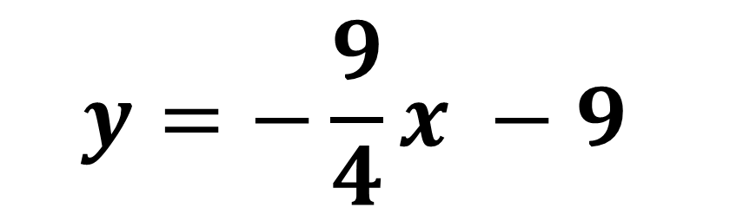
$$y=−\frac{9}{4}x −9$$

Slide 3
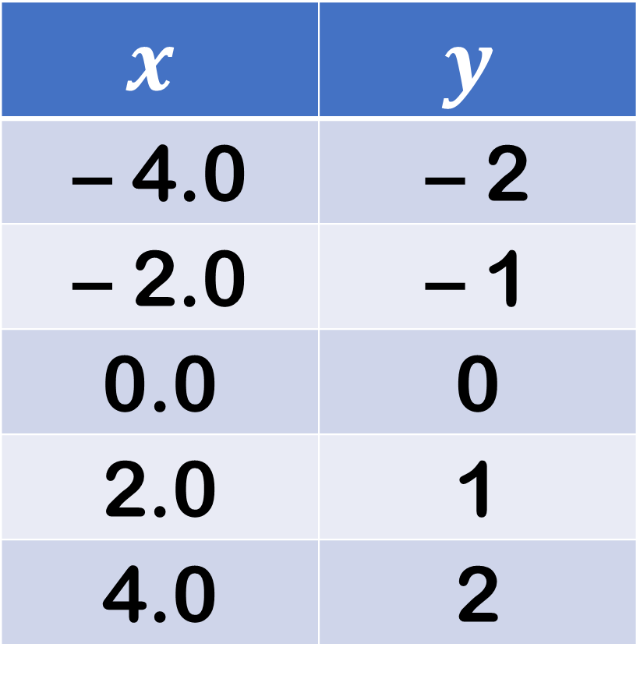
$$x$$ | $$y$$
– 4.0 | – 2
– 2.0 | – 1
0.0 | 0
2.0 | 1
4.0 | 2

Slide 4
10 –
–
8 –
–
6 –
–
4 –
–
2 –
–
|
-10
|
|
-8
|
|
-6
|
|
-4
|
|
-2
|
|
|
2
|
|
4
|
|
6
|
|
8
|
|
10
–
-2 –
–
-4 –
–
-6 –
–
-8 –
–
-10 –

Slide 5
10 –
–
8 –
–
6 –
–
4 –
–
2 –
–
|
-10
|
|
-8
|
|
-6
|
|
-4
|
|
-2
|
|
|
2
|
|
4
|
|
6
|
|
8
|
|
10
–
-2 –
–
-4 –
–
-6 –
–
-8 –
–
-10 –

Slide 6
10 –
–
8 –
–
6 –
–
4 –
–
2 –
–
|
-10
|
|
-8
|
|
-6
|
|
-4
|
|
-2
|
|
|
2
|
|
4
|
|
6
|
|
8
|
|
10
–
-2 –
–
-4 –
–
-6 –
–
-8 –
–
-10 –

Slide 7
10 –
–
8 –
–
6 –
–
4 –
–
2 –
–
|
-10
|
|
-8
|
|
-6
|
|
-4
|
|
-2
|
|
|
2
|
|
4
|
|
6
|
|
8
|
|
10
–
-2 –
–
-4 –
–
-6 –
–
-8 –
–
-10 –

Slide 8
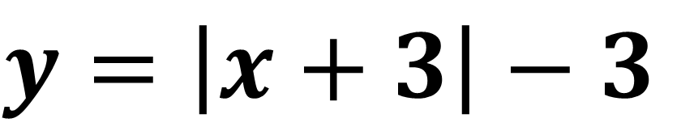
$$y=\left|x+3\right|−3$$

Slide 9
10 –
–
8 –
–
6 –
–
4 –
–
2 –
–
|
-10
|
|
-8
|
|
-6
|
|
-4
|
|
-2
|
|
|
2
|
|
4
|
|
6
|
|
8
|
|
10
–
-2 –
–
-4 –
–
-6 –
–
-8 –
–
-10 –

Slide 10
10 –
–
8 –
–
6 –
–
4 –
–
2 –
–
|
-10
|
|
-8
|
|
-6
|
|
-4
|
|
-2
|
|
|
2
|
|
4
|
|
6
|
|
8
|
|
10
–
-2 –
–
-4 –
–
-6 –
–
-8 –
–
-10 –

Slide 11
10 –
–
8 –
–
6 –
–
4 –
–
2 –
–
|
-10
|
|
-8
|
|
-6
|
|
-4
|
|
-2
|
|
|
2
|
|
4
|
|
6
|
|
8
|
|
10
–
-2 –
–
-4 –
–
-6 –
–
-8 –
–
-10 –

Slide 12
10 –
–
8 –
–
6 –
–
4 –
–
2 –
–
|
-10
|
|
-8
|
|
-6
|
|
-4
|
|
-2
|
|
|
2
|
|
4
|
|
6
|
|
8
|
|
10
–
-2 –
–
-4 –
–
-6 –
–
-8 –
–
-10 –

