Slide 1
Introduction to Algorithms
Lecture 12

Slide 2
Last Time
Shortest paths
Dijkstra’s algorithm
Breadth-First-Search
Depth-First-Search

Slide 3
Today’s Topics
Connected Components
Flow networks
Residual networks
Augmenting paths
Max-flow Min-cut theorem
Ford-Fulkerson algorithm
Edmond-Karp algorithm

Slide 4
Strongly Connected Component
Strongly Connected Component of digraph G = (V, E) is maximal set of vertices C ⊆ V such that all pairs of vertices of C are reachable from each other.
a
b
c
d
e
f
g
h

Slide 5
Strongly Connected Component
abe
cd
In analysis of certain types of engineering systems, want to examine state space and find whether appropriate states of system are reachable from one another and others appropriately unreachable.
fg
h

Slide 6
Strongly Connected Component
Note: G^{T} is transpose of G = (V, E). G^{T} = (V, E^{T}), so all edges have direction reversed. Can compute in Θ(V + E) from adjacency list, G and G^{T} have some strongly connected components.

Slide 7
Strongly Connected Component
Strongly-Connected-Components(G)
Call DFS(G) ⇒ f[u]
Compute G^{T}
Call DFS(G^{T}), but in main loop
consider vertices in decreasing
f[u] order.
Output vertices of each tree in
depth-first forest as s.c.c.
(V + E)
(V + E)
(V + E)
(V)
Total: (V + E)

Slide 8
Key Idea
Consider G^{SCC}: Strongly connected components of G represented as single vertex; edges in G^{SCC} correspond to edges in G.
a
b
c
d
abe
cd
⇒
fg
h
e
f
g
h
G
G^{SCC}

Slide 9
Key Idea
Lemma: C, C’ distinct S.C.C.’s with u, v ∈ C, u’, v’ ∈ C’, and path u~~~>u’ exists in G. Then v’~~~>v does not exist in G.
Proof: v’~~~>v existing ⇒ u~~~>u’~~~>v’ and v’~~~> v~~~>u.
Thus, u and v reachable from each other. Contradiction.
C’
C
u’
u
v
v’

Slide 10
Analysis
Notation: d(U) = min_{u∈U}{d[u]}
f(U) = max_{u∈U}{f[u]}
Lemma: Let C & C’ be distinct S.C.C’s of digraph G = (V, E). Let edge (u, v) ∈ E with u ∈ C and v ∈ C’. Then f(C) > f(C’) in G.

Slide 11
Analysis
Case 1: d(C) < d(C’)
By white path theorem, all vertices in C’ are
descendant of x and thus have earlier finishing time
f(C) = f[x] > f(C’)
x is first discovered
d[x] = d[C]
C
C’
x
exists white
path
u
v
white path
all white

Slide 12
Analysis
Case 2: d(C) > d(C’)
No vertex in C reachable from C’ (previous lemma), so at f[y], C is all white. Thus f(C) > f(C’)
So, whether we begin C or C’ first, C’ will always finish first!
C’
C
y is first discovered
y
white path to
all of C’
f[y] = f(C’)
u
v

Slide 13
Analysis
Corollary: Let C & C’ be distinct S.C.C’s of digraph G = (V, E). Let edge (u, v) ∈ E^{T} with u ∈ C and v ∈ C’. Then f(C) < f(C’) in G.

Slide 14
Strongly-Connected-Component
So, here’s how Strongly-Connected-Component works:
DFS of G^{T} starts with f(C) with maximum finishing time and explores this SCC completely.
By previous corollary, there are no edges leading out of this SCC in G^{T}.
When we finish, we start new tree with an element of next S.C.C (C), whose only edges out (if any) return to C’, which has already been finished.

Slide 15
Flow networks
Model fundamental notion of material being transported across finite-capacity channels
Examples: water, current, data, etc.
Single source/sink, multi-source/sink, “multi-commodity”

Slide 16
Flow networks
2
Model as network (digraph G = (V, E)) with:
“source” node s and “sink” node t
Non-negative capacities c(u, v)
If (u, v) ∉ E, then c(u, v) = 0.
v
3
3
s
3
2
t
1
3
1
u
2
2
3

Slide 17
Flow
Flow on G is a function f: V × V → R satisfying
Capacity constraint: f(u,v) ≤ c(u,v) ∀u,v∈V.
Flow conservation:
Skew symmetry: f(u,v) = −f(v,u).
Flow value, is total flow out of source.
Goal: Finding Maximum Flow Value.

Slide 18
Example
2:2
v
1:3
2:3
s
1:3
0:2
t
0:1
1:1
1:3
2:2
u
1:2
2:3
|f| = 1 + 2 = 3

Slide 19
Flow Cancellation
Without loss of generality, positive flow goes either from u to v, or from v to u, but not both.
The capacity constraint and flow conservation are preserved by this transformation.
INTUITION: View flow as a rate, not a quantity.
v
v
Net flow from
u to v in both
case is 1.
2:3
1:2
1:3
0:2
u
u

Slide 20
Flow Decomposition
Any feasible flow f on a network G can be decomposed into at most m cycles and s-t paths.
12:12
11:16
15:20
s
0:10
1:4
t
4:9
7:7
8:13
4:4
11:14

Slide 21
Residual Network
Residual Capacity of (u, v):
c_{f}(u,v) = c(u,v) – f(u,v) ≥ 0
Residual Network G_{f} is graph of edges with strictly positive residual capacity (that can support more flow)
Its edges come from G∪G^{T}, then |E_{f}| ≤ 2|E|.

Slide 22
Residual Network
G:
12:12
11:16
15:20
s
0:10
1:4
t
4:9
7:7
8:13
4:4
11:14
G_{f}:
12
5
5
4
15
s
11
11
3
t
5
7
5
8
11
4
3

Slide 23
Augmenting Path
An augmenting path is a path p from s to t in G_{f} (or “in G with respect to f”)
Increase flow in G by c_{f}(p) = min_{(u,v)∈p}c_{f}(u,v)
G_{f}:
12
5
5
4
15
s
11
11
3
t
5
7
5
8
11
4
3

Slide 24
Augmenting Path
G:
12:12
19:20
11:16
15:20
s
0:10
1:4
t
4:9
7:7
0:9
8:13
4:4
12:13
11:14

Slide 25
Augmenting Path
Suggests an algorithm (method):
Start with Zero Flow.
Find an augmenting path p in corresponding G_{f}.
Augment f by c_{f}(p) and loop.
(Ford-Fulkerson Algorithm)

Slide 26
Potential Problems
Convergence? Can it enter infinite loop? No, because we only accept augmenting paths.
Can we be guaranteed of finding an augmenting path if one exists? BFS finds all shortest paths from a source. If none are found to sink, then none exist.
Do we want a shortest path?
Do we want a longest path?
We really want a path of maximum capacity.
Global optimum? When no more augmenting paths can be found, how do we know we haven’t found a local optimum rather than the global optimum?

Slide 27
Properties of Flows
Lemma
For G=(V, E) a flow network and f a flow in G.
f(X, X) = 0 for all X ⊆ V.
f(X, Y) = − f(Y, X) for all X, Y ⊆ V.
f(X∪Y, Z) = f(X, Z) + f(Y, Z) for all X, Y, Z ⊆ V and X ∩ Y = Φ.
where f(X, Y) = Σ_{x∈X, y∈Y}f(x, y).

Slide 28
Illustrate Use
Flow is defined as net flow leaving source; show equal to that entering sink.
|f| ≡ f(s, V) = f(V, t).
Proof.
|f| ≡ f(s, V)
= f(V, V) – f(V–{s}, V)
= 0 + f(V, V–{s})
= f(V, t) + f(V, V – {s,t}) = f(V, t)

Slide 29
Illustrate Use
Slightly more intuitive proof:
|f| ≡ f(s, V) + f(V, t) – f(V, t)
= f(V, t) – (f(V, s) + f(V, t))
= f(V, t) – f(V, {s,t}) + f(V, V)
= f(V, t) + f(V, V – {s,t})
= f(V, t)

Slide 30
Cut
Cut is a partition of V into S and T = V – S with s ∈ S and t ∈ T.
Capacity of cut
Small capacity cuts serve as “barrier” to large flows.
A minimum cut of a network is that whose capacity is a minimum over all cuts in network.
Forward direction only

Slide 31
Cut
Lemma: Given any flow f, |f| = f(S, T) for and any (S, T).
Proof: f(S, T) = f(S, V) – f(S, S)
= f(s, V) + f(S – s, V)
= f(s, V) = |f|
This is like another conservation of flow idea
by definition for flow out of source (S={s})
already proven for flow into sink (T={t})
have proven for any partition (cut) dividing s, t

Slide 32
Cut
Corollary: The value of any flow is bounded above by the capacity of any cut.
f(S, T) ≤ c(S, T) for all cuts (S, T)
Proof:

Slide 33
The Max-Flow Min-Cut Theorems
The following are equivalent:
f is a maximum flow in G.
The residual network G_{f} contains no augmenting paths.
|f| = c(S, T) for some cut (S, T) of G.
Proof sketch
1⇒2 Augmenting path would allow flow in G to be increased above f, contradicting its being a maximum flow .

Slide 34
The Max-Flow Min-Cut Theorems
3⇒1 By corollary, |f| is bounded from above by the capacity of any cut, so |f| = c(S,T) means it can’t be increased.
2⇒3 G_{f} has no augmenting path. Let S = {u∈V:
∃path from s to u in G_{f}} and T = V – S.
s∈S and t ∈ T (otherwise would be augmenting path).
(S, T) is a cut.
c_{f}(u, v)=0 for u∈S, v∈T (otherwise v would be in S).

Slide 35
The Max-Flow Min-Cut Theorems
∴ f(u,v)=c(u,v), since c_{f}(u, v) = c(u,v) – f(u,v).
|f| = f(S, T) = c(S, T).
summation
path in G_{f}
s
u
v
S
T

Slide 36
Ford-Fulkerson Algorithm
f(u, v) ← 0 ∀u, v
while ∃ augmenting path p in G_{f}
do augment f by c_{f}(p)
Thus, the Ford-Fulkerson algorithm is guaranteed to result in successive improvements. When no more improvements are possible, the maximum flow has been found.

Slide 37
Ford-Fulkerson Algorithm
Notice: F-F doesn’t specify which path!
Analysis (with Integer Capacities):
Cost per path: O(E) using DFS or BFS
Thus run time is O(E |f*|), where f* is max flow
This is not polynomial in |V|, |E|!

Slide 38
Possible Efficiency Problem
10⁹
10⁹
10⁹-1
10⁹
s
1
t
s
1
1
t
1
10⁹
10⁹
10⁹
10⁹ -1
10⁹-1
10⁹-1
1
s
1
1
t
1
2*10⁹ iterations!
1
10⁹-1
10⁹ -1

Slide 39
Edmonds-Karp Algorithm 1
Modify Dijkstra’s algorithm to find an augmenting path of largest capacity.
Claim 1. In a graph with maximum s-t flow F, there must exist a path from s to t with capacity at least F/m.
Claim 2. Edmonds-Karp #1 makes at most O(m log F) iterations.
Running time: O(m² log n log F).

Slide 40
Edmonds-Karp Algorithm 2
Use BFS to find breadth-first augmenting path
Time to find an augmenting path Θ(V + E) ⇒ Θ(E) if all vertices reachable from source.
Claim: number of augmentations limited to Θ(VE)
⇒ Running time Θ(VE²).

Slide 41
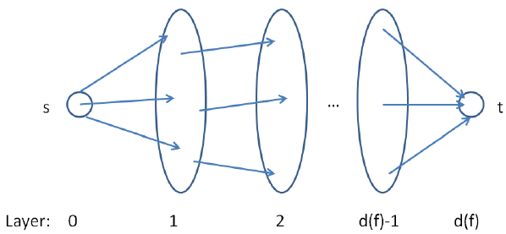
Level Graph
Definition. The level graph L_{G} of G is the directed breath-first search graph with root s with cross edges and back edges deleted. The level of a vertex u is the length of a shortest path from s to u in G.

Slide 42
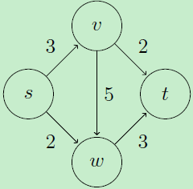
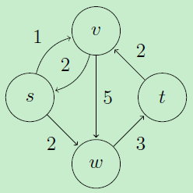
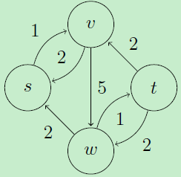
Level Graph - Example
V₀ = {s}
V₁ = {v, w}
V₂ = {t}
V₀ = {s}
V₁ = {v, w}
V₂ = {t}
V₀ = {s}
V₁ = {v}
V₂ = {w}
V₃ = {t}

Slide 43
Edmonds-Karp #2 Analysis
Monotonicity Lemma
Let δ(v) = δ_{f}(s, v)
= B-F distance from s to v in G_{f}.
Then δ(v) increases monotonically during E-K.
Suppose algorithm augments f to produce f’.
Prove by δ’(v) ≥ δ(v) induction on δ(v).

Slide 44
Monotonicity Lemma
Base: δ’(s) = δ(s) = 0
Inductive Step: Consider BF-path s→…u → v in G_{f’}
δ’(v) = δ’(u) + 1
(u, v) ∈ E_{f’} [What about E_{f}?]
Case 1: (u, v) ∈ E_{f}
Then δ(v) ≤ δ(u) + 1 [triangle ineq.]
≤ δ’(u) + 1 [induction]
= δ’(v) [BF path]

Slide 45
Monotonicity Lemma
Case 2: (u, v) ∉ E_{f}
Augmenting path must have included (v,u)
s→…v → u →… → t
Then δ(v) = δ(u) − 1 [BF path]
≤ δ’(u) − 1 [induction]
= δ’(v) – 2 [BF path]
< δ’(v)

Slide 46
Edmonds-Karp # 2 Analysis
Theorem: #Augmenting Steps in E-K algorithm is Θ(VE).
Proof: Let p be an augmenting path.
Residual capacity of some edge (u,v) ∈ p is c_{f}(p) = c_{f}(u, v) ⇒ (u,v) called critical
Augmentation removes (u,v) from critical path (for now, saturated)
Must wait until (v,u) augmented before re-appears.

Slide 47
Edmonds-Karp # 2 Analysis
Before p augmented (u,v): δ(v)=δ(u)+1 (p: BF path)
Before augmenting (v,u) later:
δ’(u) = δ’(v) + 1
≥ δ(v) + 1
≥ δ(u) + 2
⇒ δ(u) increases ≥ 2 between twice when (u,v) is critical. Each δ(u) starts ≥ 0, never decreases, and remains ≤ |V| − 1 until unreachable.
⇒(u, v) is critical at most Θ(V) times
Θ(E) edges in G_{f} ⇒ Θ(VE) augmentation

Slide 48
Blocking Flow
A flow f in G is blocking if every s-t path in G, the original graph, has some edge saturated.
Every maximum flow is obviously also a blocking flow.
Is every blocking flow a maximum flow? No.
How to efficiently find a blocking flow?

Slide 49
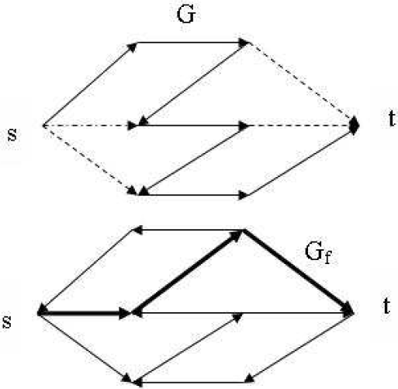
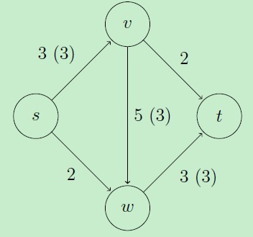
Blocking Flow

Slide 50
Dinic’s Algorithm – One Phase
Traverse the level graph from source to sink in a depth-first fashion.
Advance whenever possible and keep track of the path from s to the current vertex.
If we get all the way to t, we have found an augmenting path, and we augment by that path.
If we get to a vertex with no outgoing edges, we delete the vertex and retreat.

Slide 51
Dinic’s Algorithm - Initialize
Initialize.
Construct a new level graph L_{G}.
Set u = s and p = [s].
Go to Advance.

Slide 52
Dinic’s Algorithm - Advance
Advance.
If there is no edge out of u, go to Retreat.
Otherwise, let (u,v) be such an edge.
Set p = p||[v] and u = v.
If v ≠ t then go to Advance.
If v = t then go to Augment.

Slide 53
Dinic’s Algorithm - Retreat
Retreat.
If u = s then halt.
Otherwise, delete u and all adjacent edges from L_{G} and remove u from the end of p.
Set u = the last vertex on p.
Go to Advance.

Slide 54
Dinic’s Algorithm - Augment
Augment.
Let Δ be the bottleneck capacity along p.
Augment by the path flow along p of value Δ, adjusting residual capacities along p.
Delete newly saturated edges.
Set u = the last vertex on the path p reachable from s along unsaturated edges of p.
Set p = the portion of p up to and including u.
Go to Advance.

Slide 55
Time Complexity of Dinic’s Alg
Initialize: O(m) per phase. (BFS)
Advance: O(mn). (at most n advances before an augment or retreat)
Retreat: O(m + n). (at most n retreats)
Augment: O(mn). (at most m augments)
Each phase requires O(mn) time.
Total running time: O(mn²).

Slide 56
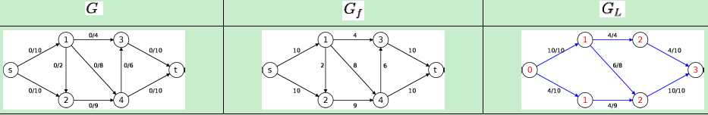
Dinic’s Algorithm – Example
The blocking flow consists of
{s, 1, 3, t} with 4 units of flow,
{s, 1, 4, t} with 6 units of flow, and
{s, 2, 4, t} with 4 units of flow.
The blocking flow is of 14 units and the value of flow is 14.
Each augmenting path in the blocking flow has 3 edges.

Slide 57
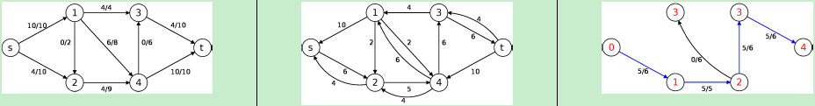
Dinic’s Algorithm – Example
The blocking flow consists of
{s, 2, 4, 3, t} with 5 units of flow.
The blocking flow is of 5 units and the value of flow is |f| = 14 + 5 = 19.
Each augmenting path has 4 edges.

Slide 58
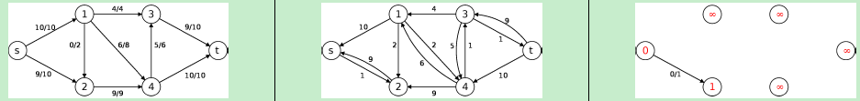
Dinic’s Algorithm – Example
Since t cannot be reached in G_{f}. The algorithm terminates and returns a flow with maximum value of 19.
Note that in each blocking flow, the number of edges in the augmenting path increases by at least 1.

Slide 59
Blocking Flow
Let d_{u} be the distance of node u to sink t.
Definition: An edge is called admissible if (u, v) ∈ E_{f} and d_{u} = d_{v} + 1.
Note: An admissible edge is on some shortest path to t.

Slide 60
Dinic’s Algorithm
f ← 0
while ∃s-t path in G_{f}
∀u∈V compute distance d_{u} to sink in G_{f}
find blocking flow f’ in graph G’ with
edges E’ = {(u,v) ∈ E_{f}:d_{u} = d_{v}+1},
capacity c_{f}(u,v).
f ← f + f’

Slide 61
Dinic’s Algorithm Analysis
Theorem 1 Blocking flows in acyclic graphs can be found in O(mn) time, but if fancy data structures are used, then they can be found in O(mlog n) time.
Lemma 2 The distance to the sink d_{s} strictly increases in each iteration of the algorithm.
Theorem 3 Dinic's algorithm can be implemented in O(mn²) time (Dinic 1970), or O(mnlog n) time (Sleater, Tarjan 1980).

Slide 62
Unit Capacity Graphs
Definition. A unit capacity graph has c_{e} for all edges e ∈ E.
Lemma 1. If graph is unit capacity, then Dinic’s algorithm takes O(min(m^{1/2}, 3n^{2/3})) iteration.
Lemma 2. We can find a blocking flow in unit capacity graph in O(m) time.
Theorem. In unit capacity graphs, the maximum flow can be found in O(m⋅ min(m^{1/2}, 3n^{2/3})) time.

Slide 63
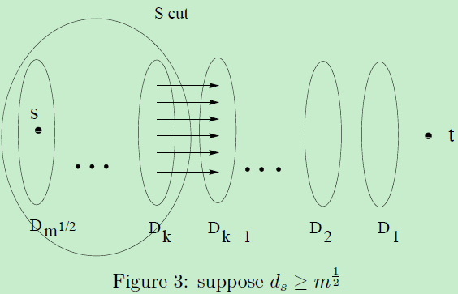
Proof of Lemma 1
Case 1:

Slide 64
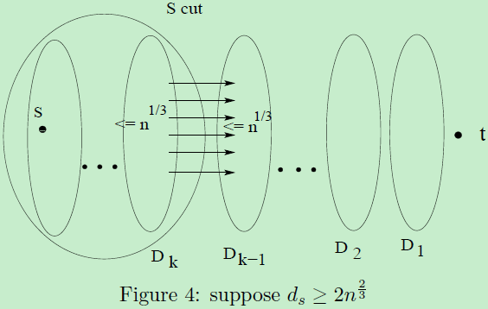
Proof of Lemma 1
Case 2:

Slide 65
Cuts in Graphs
Focus on undirected graphs
A cut is a vertex partition
Value is number (or total weight) of crossing edges

Slide 66
Minimum Cut
Smallest cut of graph
Cheapest way to separate into 2 parts
Various applications:
network reliability (small cuts are weakest)
subtour elimination constraints for TSP
separation oracle for network design
Not s-t min-cut

Slide 67
Contraction
Find edge that doesn’t cross min-cut
Contract (merge) endpoints to 1 vertex
Notes:
9

Slide 68
Contraction Algorithm
Repeat n - 2 times:
find non-min-cut edge
contract it (keep parallel edges)
Each contraction decrements #vertices
At end, 2 vertices left
unique cut
corresponds to min-cut of starting graph
Notes:
10

Slide 69
Notes:
11

Slide 70
Picking an Edge
Must contract non-min-cut edges
[NI]: O(m) time algorithm to pick edge
n contractions: O(mn) time for min-cut
slightly faster than flows
If only could find edge faster….
Idea: min-cut edges are few
Notes:
13

Slide 71
Randomize
Repeat until 2 vertices remain
pick a random edge
contract it
Notes:
14

Slide 72
Analysis I
Min-cut is small---few edges
Suppose graph has min-cut c
Then minimum degree at least c
Thus at least nc/2 edges
Random edge is probably safe
Pr[min-cut edge] ≤ c/(nc/2)
= 2/n
(easy generalization to capacitated case)
Notes:
15

Slide 73
Analysis II
Algorithm succeeds if never accidentally contracts min-cut edge
Contracts #vertices from n down to 2
When k vertices, chance of error is 2/k
thus, chance of being right is 1-2/k
Pr[always right] is product of probabilities of being right each time
Notes:
16

Slide 74
Analysis III
…not too good!
Notes:
17

Slide 75
Repetition
Repetition amplifies success probability
basic failure probability 1 - 2/n²
so repeat 7n² times
output the minimum size cut found in all the iterations
Notes:
18

Slide 76
How fast?
Easy to perform 1 trial in O(m) time
just use array of edges, no data structures
But need n² trials: O(mn²) time
Simpler than flows, but slower
Notes:
19

Slide 77
An improvement [KS]
When k vertices, error probability 2/k
big when k small
Idea: once k small, change algorithm
algorithm needs to be safer
but can afford to be slower
Amplify by repetition!
Repeat base algorithm many times
Notes:
20

Slide 78
Recursive Algorithm
Algorithm RCA ( G, n )
{G has n vertices}
repeat twice
randomly contract G to n/2^{½} vertices
RCA(G,n/2^{1/2})
(50-50 chance of avoiding min-cut)
Notes:
21

Slide 79
Main Theorem
On any capacitated, undirected graph, Algorithm RCA
runs in O*(n²) time with simple structures
finds min-cut with probability ≥ 1/log n
Thus, O(log n) repetitions suffice to find the minimum cut (failure probability 10⁻⁶) in O(n² log² n) time.
Notes:
22

Slide 80
Proof Outline
Graph has O(n²) (capacitated) edges
So O(n²) work to contract, then two subproblems of size n/2^{½}
T(n) = 2 T(n/2^{½}) + O(n²) = O(n² log n)
Algorithm fails if both iterations fail
Iteration succeeds if contractions and recursion succeed
P(n)=1 - [1 - ½ P(n/2^{½})]² = Ω (1 / log n)

Slide 81
Failure Modes
Monte Carlo algorithms always run fast and probably give you the right answer
Las Vegas algorithms probably run fast and always give you the right answer
To make a Monte Carlo algorithm Las Vegas, need a way to check answer
repeat till answer is right
No fast min-cut check known (flow slow!)

Slide 82
Application: Image segmentation
Image segmentation.
Central problem in image processing.
Divide image into coherent regions.
Ex: Three people standing in front of complex background scene.
Identify each person as a coherent object.

Slide 83
Image segmentation
Foreground / background segmentation.
Label each pixel in picture as belonging to foreground or background.
V = set of pixels, E = pairs of neighboring pixels.
a_{i} ≥ 0 is likelihood pixel i in foreground.
b_{i} ≥ 0 is likelihood pixel i in background.
p_{ij} ≥ 0 is separation penalty for labeling one of i and j as foreground, and the other as background.

Slide 84
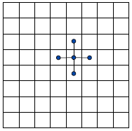
Image segmentation
Goals.
Accuracy: if a_{i} > b_{i} in isolation, prefer to label i in foreground.
Smoothness: if many neighbors of i are labeled foreground, we should be inclined to label i as foreground.
Find partition (A, B) that maximizes:
foreground
background

Slide 85
Image segmentation
Formulate as min cut problem.
Maximization.
No source or sink.
Undirected graph.
Turn into minimization problem.
Maximizing:

Slide 86
Image segmentation
Is equivalent to minimizing
or alternatively

Slide 87
Image segmentation
Formulate as min cut problem. G' = (V', E').
Add source to correspond to foreground; add sink to correspond to background
Use two anti-parallel edges instead of undirected edge.

Slide 88

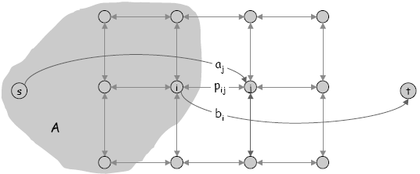
Image segmentation
Consider min cut (A, B) in G'.
A = foreground.
Precisely the quantity we want to minimize.

Slide 89
Edge Disjoint Paths
Disjoint path problem. Given a digraph G = (V, E) and two nodes s and t, find the max number of edge-disjoint s-t paths.
Def. Two paths are edge-disjoint if they have no edge in common.
Ex: communication networks.

Slide 90
Edge Disjoint Paths
Disjoint path problem. Given a digraph G = (V, E) and two nodes s and t, find the max number of edge-disjoint s-t paths.
Def. Two paths are edge-disjoint if they have no edge in common.
Ex: communication networks.

Slide 91
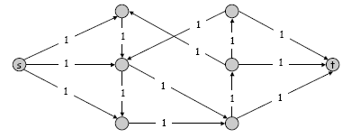
Edge Disjoint Paths
Max flow formulation: assign unit capacity to every edge.
Theorem. Max number edge-disjoint s-t paths equals max flow value.
Pf. →
Suppose there are k edge-disjoint paths P₁, . . . , P_{k}.
Set f(e) = 1 if e participates in some path P_{i}; else set f(e) = 0.
Since paths are edge-disjoint, f is a flow of value k.

Slide 92
Edge Disjoint Paths
Max flow formulation: assign unit capacity to every edge.
Theorem. Max number edge-disjoint s-t paths equals max flow value.
Pf. ←
Suppose max flow value is k.
Integrality theorem → there exists 0-1 flow f of value k.
Consider edge (s, u) with f(s, u) = 1.
by conservation, there exists an edge (u, v) with f(u, v) = 1
continue until reach t, always choosing a new edge
Produces k (not necessarily simple) edge-disjoint paths.

Slide 93
Matching
Input: undirected graph G = (V, E).
M ⊆ E is a matching if each node appears in at most one edge in M.
Max matching: find a max cardinality matching.

Slide 94
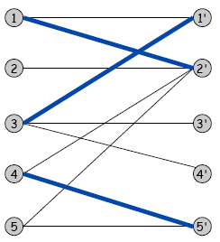
Bipartite Matching
Input: undirected graph G = (L ∪ R, E).
M ⊆ E is a matching if each node appears in at most one edge in M.
Max matching: find a max cardinality matching.
L
R

Slide 95
Bipartite Matching
Input: undirected graph G = (L ∪ R, E).
M ⊆ E is a matching if each node appears in at most one edge in M.
Max matching: find a max cardinality matching.
Max matching
L
R

Slide 96
Bipartite Matching
Max flow formulation.
Create digraph G' = (L ∪ R ∪{s, t}, E' ).
Direct all edges from L to R, and assign infinite (or unit) capacity.
Add source s, and unit capacity edges from s to each node in L.
Add sink t, and unit capacity edges from each node in R to t.

Slide 97
Bipartite Matching: Proof of Correctness
Theorem. Max cardinality matching in G = value of max flow in G'.
Pf. →
Given max matching M of cardinality k.
Consider flow f that sends 1 unit along each of k paths.
f is a flow, and has cardinality k.

Slide 98
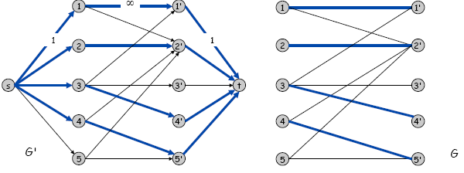
Bipartite Matching: Proof of Correctness
Theorem. Max cardinality matching in G = value of max flow in G'.
Pf. ←
Let f be a max flow in G' of value k.
Integrality theorem → k is integral and can assume f is 0-1.
Consider M = set of edges from L to R with f(e) = 1.
each node in L and R participates in at most one edge in M
|M| = k: consider cut (L ∪ s, R ∪ t)

Slide 99
Bipartite Matching: Running Time
Which max flow algorithm to use for bipartite matching?
Generic augmenting path: O(m|f*|) = O(mn).
Capacity scaling: O(m² logC ) = O(m²).
Shortest augmenting path: O(mn^{1/2}).

