Slide 1
Result Analysis System in C
Using Sorting and Basic Statistics
Presented by: NBKRIST[CSE-E]
Names and Rollno:
1.challa.Divyasri-24kb1a0583
2.Billu.deekshitha-24kb1a0558
3.Bontha.mamathasri-24kb1a0569
4.hemalatha-24kb1a0593
GUIDED BY:ASHOK SELVA KUMAR

Slide 2
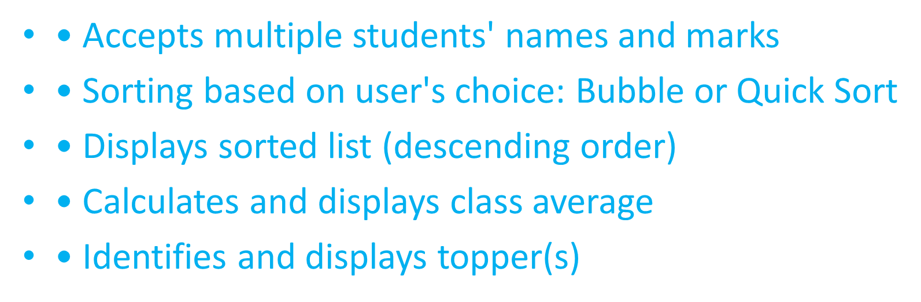
Objective
Build a program to:
• Input student names and marks
• Sort marks using Bubble Sort or Quick Sort
• Calculate class average
• Display topper(s)
Program Features

Slide 3
Key points:
For Bubble sort ,we loop through the array and compare adjacent elements ,swapping them if necessary.
For Quick sort ,we use a pivot to partition the array and then recusively sort the two parts.
in program we can use (.) operater because we can use it directly in structure.it can’t point any thing.

Slide 4
Real time application for bubble sort and quick sort: 1.bubble sort: a.classroom seating (ex:height wise) b.arranging books by size manually. 2.Quick sort: a.organizing a library b.database query optimization
Why use #define?
• Improves readability and avoids magic numbers
• Makes maintenance easier
• Used to define constants like MAX = 100
• Preprocessor replaces it before compilation

Slide 5
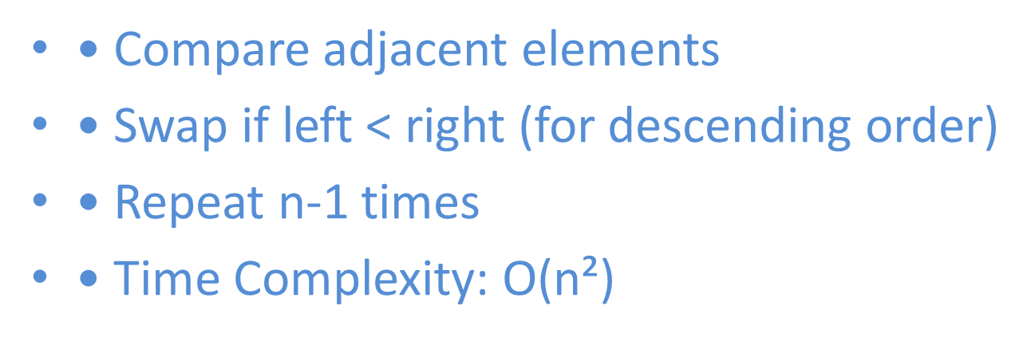
Student Structure in C
struct Student {
char name[50];
float marks;
};
• Stores name and marks for each student
Bubble Sort Logic

Slide 6
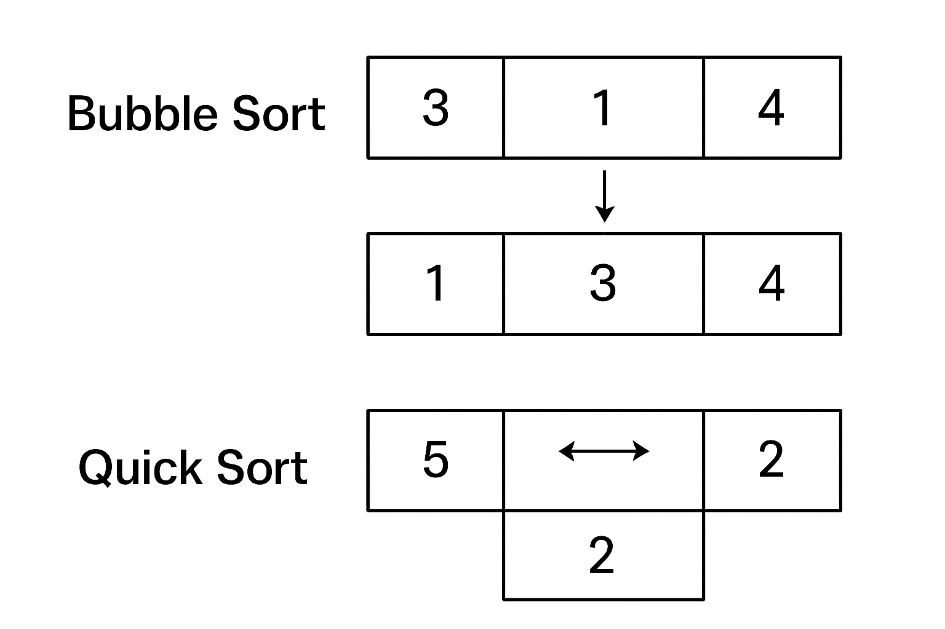
QUICK SORT LOGIC
Pick one number as “pivot”
Go through all other numbers and put:
bigger or equal numbers on left of the pivot.
smaller number on the right of the pivot
Now pivot is in the correct place .
Repeat the same steps for the left side and the right side.
Keep repearting until everything is sorted.
JUST EXAMPLE:

Slide 7
Algorithm: Result Analysis System
1. Start
2. Declare a structure Student with fields: name, marks
3. Input number of students (n)
4. For each student, input name and marks
5. Ask user to choose sorting method: Bubble or Quick Sort
6. If Bubble Sort:
- Use nested loops to compare and swap based on marks (descending)
7. If Quick Sort:
- Use pivot and partitioning to sort recursively (descending)
8. Display sorted list of students
9. Calculate total marks and compute average
10. Identify top mark and display all toppers
11. End

Slide 8
Sample Output
SOURCE CODE:https://onlinegdb.com/WbGZ4hCPV
• Sorted List:
padma: 92.0
yamini: 91.0
charishma: 85.0
• Class Average: 89.67
• Toppers: padma.

Slide 9
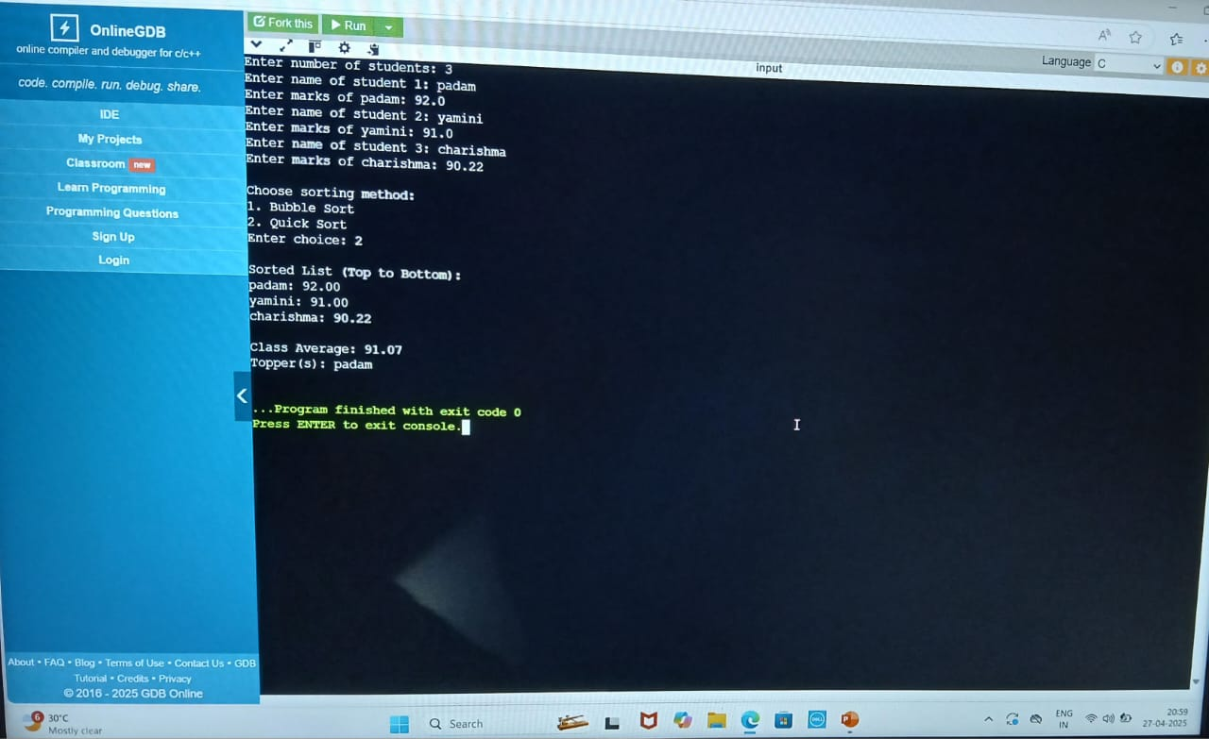

Slide 10
Conclusion
Bubble sort and Quick sort can both be easily applied to sort arrays of structures based on a specific filed (like marks in above case).
Bubble sort is simpler but slower for large datasets.
Quick sort is faster and more efficient for large datasets.
Finally we can display average marks in the class and topper list.

Slide 11
THANK YOU

