Slide 1
Zomato Delivery Operations Analytics Dashboard
Operational KPI Reporting & Delivery Performance Analysis
Tools Used:
Microsoft Excel
Pivot Tables
XLOOKUP
IF
COUNTIF
AVERAGEIFS

Slide 2
Project Overview
Analyzed Zomato delivery operations data to evaluate delivery performance and operational efficiency.
Cleaned and transformed raw data to improve reporting accuracy.
Designed KPI-based reporting for Total Orders, Average Delivery Time, Ratings, and Delayed Deliveries.
Performed analysis on city-wise orders, vehicle utilization, traffic conditions, weather impact, and festival impact.
Developed an interactive Excel dashboard using Pivot Tables and advanced Excel functions.
Generated actionable business insights to support operational decision-making.

Slide 3
Dataset Overview
Dataset Name: Zomato Delivery Operations Dataset
Total Records: 45,584
Key Attributes:
• Delivery Person Rating • City • Vehicle Type • Weather Conditions • Road Traffic Density • Festival Status • Delivery Time (Minutes) • Delivery Performance Data Preparation Activities: • Removed duplicate records • Handled missing values • Standardized data formats • Created analysis-ready dataset

Slide 4
Key Performance Indicators (KPIs)
KPI | Value
Total Orders | 45,584
Average Delivery Time | 26.29 mins
Average Rating | 4.63
Delayed Orders | 13,602
Avg Time (High Traffic) | 27.24 mins

Slide 5
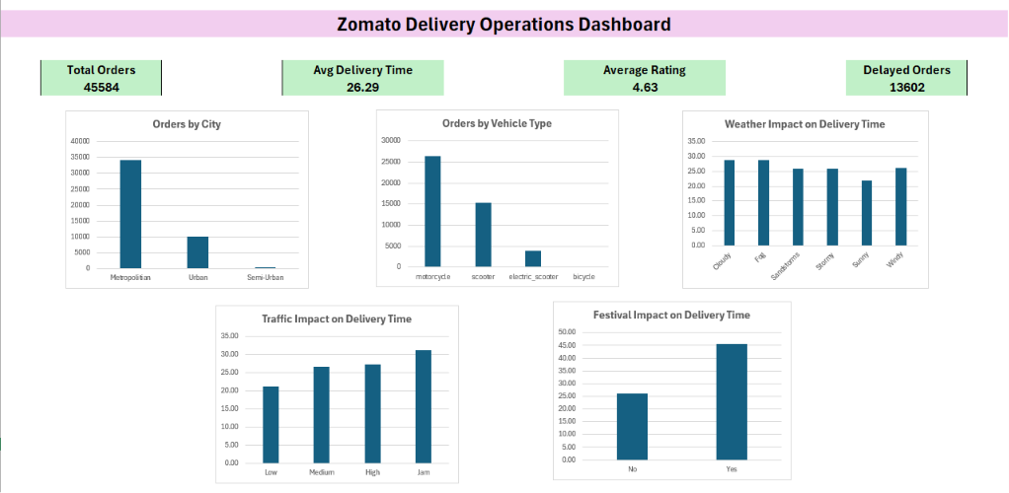
Interactive Dashboard

Slide 6
Key Insights & Conclusion
Metropolitan cities generated the highest order volume with 34,087 deliveries.
Motorcycles were the most utilized delivery vehicles with 26,429 deliveries.
Festival periods recorded significantly higher delivery times than non-festival periods.
Traffic jam conditions resulted in the highest average delivery times.
Weather conditions influenced delivery performance, with foggy conditions causing longer delivery durations.
Conclusion
This project demonstrates the use of Microsoft Excel for KPI reporting, operational analytics, dashboard
development, and business insight generation to support data-driven decision-making.

