Slide 1

LOADING...
Delivering apps at the speed of light

Slide 2
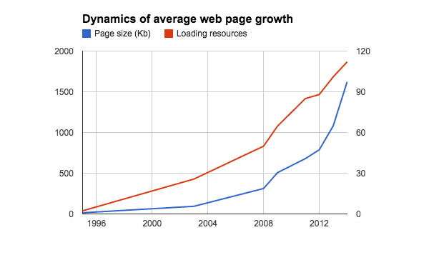
Average web site constantly growth

Slide 3
7 seconds to load
Is it a lot?

Slide 4
Delay perception
< 100 msec
100-300 msec
300 - 1000 msec
1+ sec
10+ sec
Instant response
Small delay
System works
Switching task
Cancelling operation

Slide 5
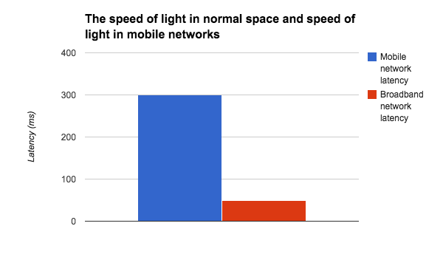
Feel happy on desktop
so why to optimize?

Slide 6
Everybody can wait, they said
47% expect for page to be loaded in 2 seconds;
57% will cancel loading after 3 seconds loading;
75% will never visit page which was responding for 4 seconds and more;
Google recommends to optimize pages in order to have less than 1 seconds loading time on broadband connection.

Slide 7
Optimizing loading speed is a wrong definition
Why?

Slide 8
Minimal Viable eXperience (MVX)
Time to interact (TTI)
Amount of network traffic
Number of requests
Size of Critical Path
Rendering minimal UI

Slide 9

How HTTP works?
Because engineer should
know how

Slide 10
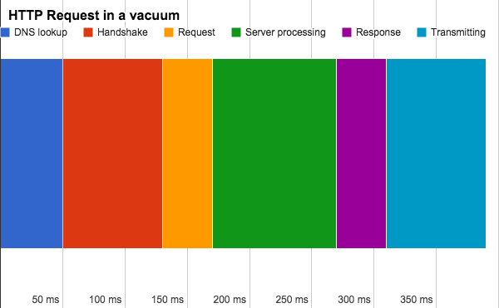
HTTP in action

Slide 11
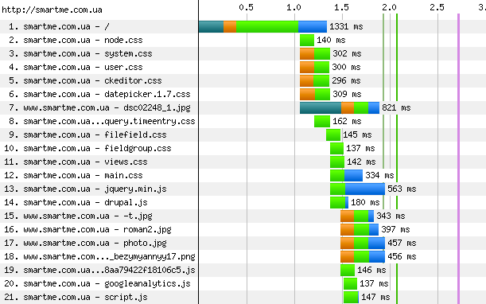

Slide 12
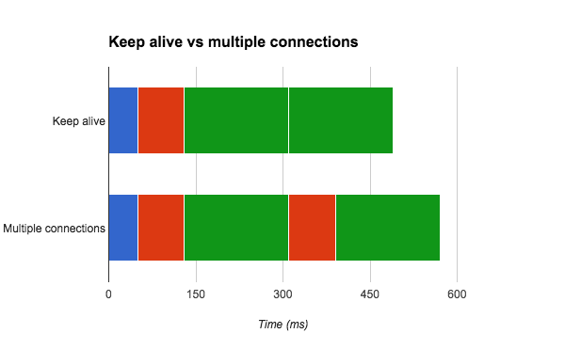
Keep alive

Slide 13
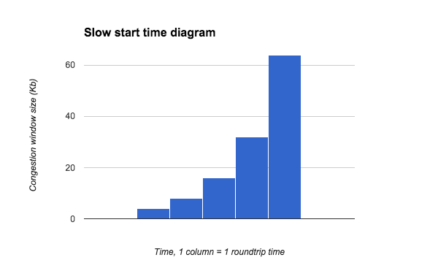
Slow start and congestion control

Slide 14
Decreasing files number
Because of congestion control

Slide 15

Concat JS and CSS
Because it is important
to have less files

Slide 16

Do image sprites
Because it is important
to have less files

Slide 17
Decreasing traffic
Ofcourse we should

Slide 18
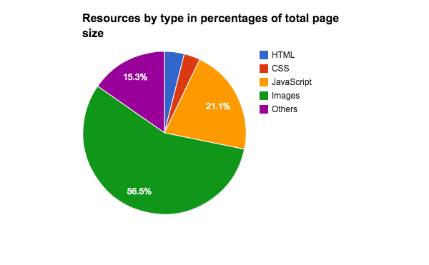
It is important to have less traffic

Slide 19

Enable GZIP
-80% to text files
-20% to page size

Slide 20
Set caching
headers
Up to -100%
Expires (how long is active)
Last-Modified

Slide 21
Minify JS
-60%

Slide 22
Minify CSS
-10%

Slide 23
Minify HTML
-5%

Slide 24
Minify images
-10% and progressive JPEGs

Slide 25
Loading order
Because JS and CSS loading
slows your down

Slide 26

CSS locks render
when loading
Insert CSS into header of
the page to prevent waiting
for it when the rest is done

Slide 27
JS locks parsing
when loading
Insert JS into the bottom
of the page to prevent parsing lock

Slide 28
CSS = TOP
JS = BOTTOM
But sometimes we do not need to load everything for minimal viable experience to start...

Slide 29

Critical path
First deliver things that
user need first (MVX)
in order to decrease TTI

Slide 30
The return of server rendering
And the start of isomorphic JavaScript

Slide 31

SPA renders on client
Loading HTML/JS/CSS
Initializing application logic
Loading application data
Rendering

Slide 32
SPA renders on server
Loading HTML/JS/CSS
Rendering

Slide 33

Server rendering is
cool but expensive
Let`s consider inline data delivery

Slide 34
window.MyApp.inlineData = {
//Server generated JSON goes here
};

Slide 35
SPA renders on client, data inlined
Loading HTML/JS/CSS
Initializing application logic
Rendering
Because actually data loading
takes long and inlining JSON is cheap

Slide 36
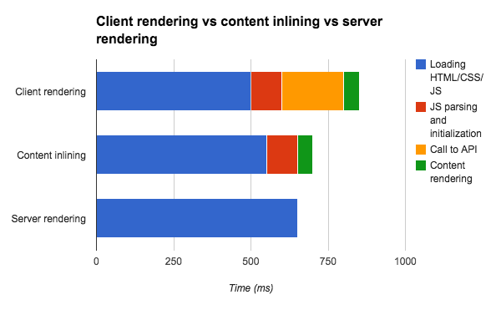

Slide 37
Two approaches of server rendering
Create HTML with NodeJS
Create HTML by rendering client - side code in headless browser, PhantomJS

Slide 38

HTTP 2 strength
Using single connection
for multiple files (multiplexing)
We do not need to concat anymore!

Slide 39

HTTP 2 weakness
Needs secure connection,
needsmore resources,
just got server support

Slide 40
Check list
Concat JS and CSS
Use image sprites and progressive JPEGs
Minify resources
Place CSS at top and JS at bottom
Enable caching headers
Enable GZIP
Do not use redirects

Slide 41
Check list
Use CDNs to place data closer to clients
Use server rendering or data inlining
Separate critical path if JS or CSS is larger than 15 Kb
Eat less cookies, they are being sent to server
Try prefetching and service worker

Slide 42

Nice tool for lazy
people
developers.google.com/speed/pagespeed/insights/

Slide 43

Nice tool for
diving into details
webpagetest.org

