Slide 1

Challenging native
Fast web applications development, profiling and optimization

Slide 2
Performance optimization is not only about making your current application faster. It is also about implementing things you were not able to do before...

Slide 3
Why HTML
if speed matters?

Slide 4
Unification — effective method to decrease diversity. Unification is a kind of systematisation. Aim for unification is to place elements in particular order building strict system which is comfortable to use. (c) Wikipedia

Slide 5

Unification
never stops

Slide 6


Try to distinguish modern Boeing and Airbus

Slide 7


Slide 8

Do you enjoy unified lamp holders? It was not like this in the beginning, but...

Slide 9

Only best
solutions survive

Slide 10
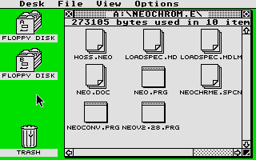

Slide 11
Why HTML?
Unification
Accessability and composability
Open platform, widely spreaded
Easy to find developer
Good tooling
Evolving quickly

Slide 12





Slide 13
HTML is the best candidate available
for unified UI definiton

Slide 14
Why not HTML?
Lack of native - like components
Native APIs availability
Performance

Slide 15
Why not HTML?
Lack of native - like components
Native APIs availability
Performance

Slide 16
Why not HTML?
Lack of native - like components
Native APIs availability
Performance

Slide 17
WEB is easy
Fast WEB is hard

Slide 18



Three phases of developer growth
Student (a little of knowledge)
Developer (practical knowledge and intuition)
Engineer (knows how it works and why should do this way or either)

