Slide 1

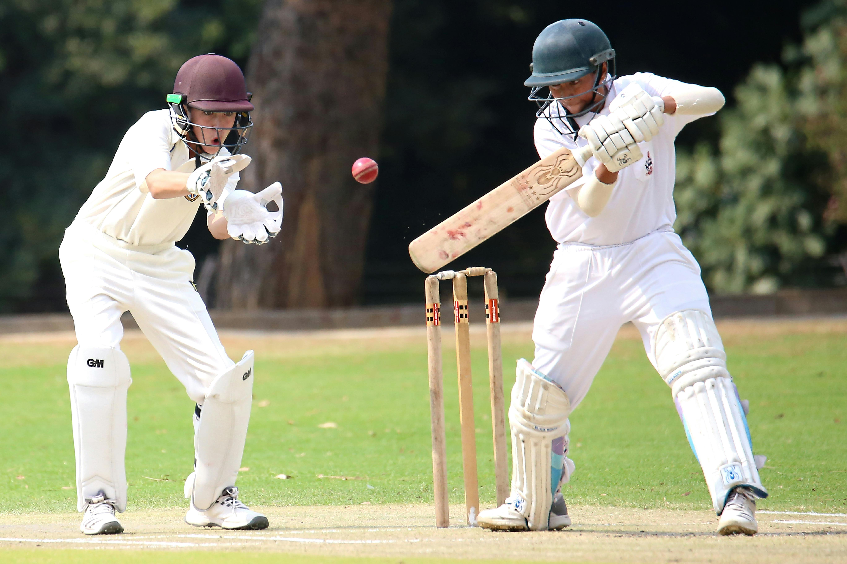
Project Title - IPL Data Analysis using Power BI
Labmentix
Name- Chama Kaushik
Domain- Data Analyst
Batch- DA/BA 15 August
Year: 2025

Slide 2
Introduction
The Indian Premier League (IPL) is one of the most popular T20 cricket leagues worldwide
Huge volumes of match data are generated each season.
Sports Analytics helps teams, coaches, and broadcasters gain insights.
Aim: Analyze IPL data and create interactive dashboards using Power BI.

Slide 3
Datasets Used
Matches Dataset: Team names, winners, toss details, stadiums, results, season.
Deliveries Dataset: Runs, wickets, bowlers, batsmen, fielders, dismissals.
Format: CSV files

Slide 4
Approach / Methodology
1. Data Collection – Matches & Deliveries datasets
2. Data Cleaning & Preparation
3. Data Modeling – Relationships in Power BI
4. Dashboard Creation – Visuals for batting, bowling, toss, venues
5. Insights Generation

Slide 5
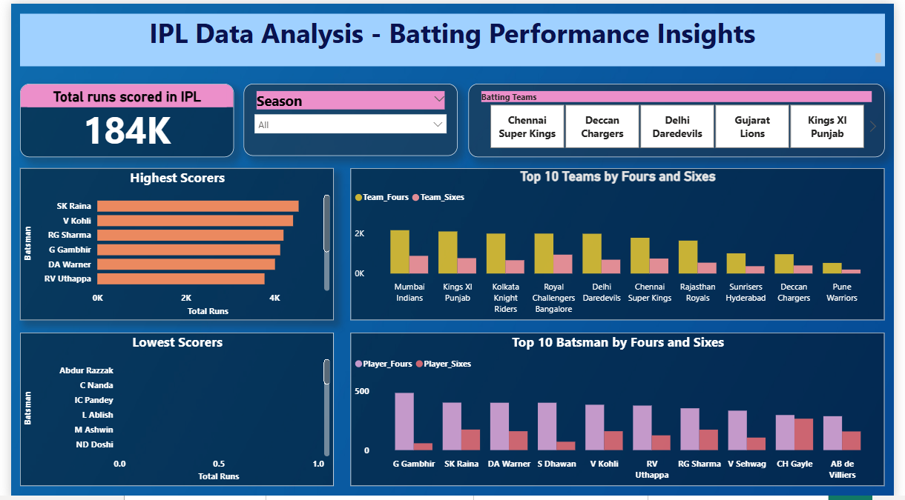
DASHBOARD -1

Slide 6
Batting Insights
Top run scorers → SK Raina, V Kohli, RG Sharma, G Gambhir, DA Warner
Lowest run scorers → Abdur Razzak, C Nanda, IC Pandey, L Albish
Team with Most Fours → Mumbai Indians
Team with Most Sixes → Royal Challengers Bangalore
Batsman with Most Fours → G Gambhir
Batsman with Most Sixes → CH Gayle

Slide 7
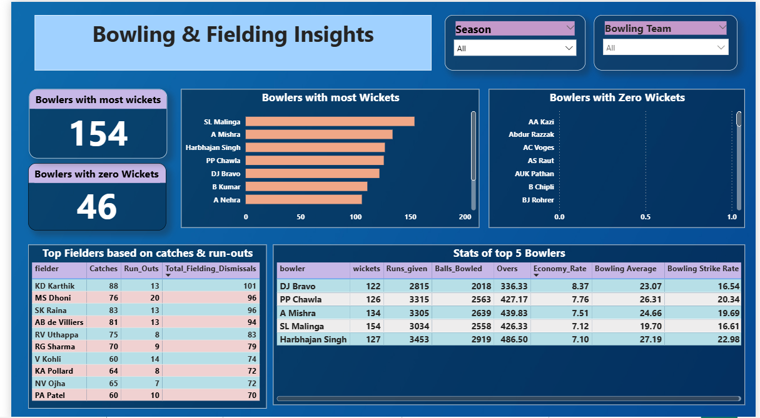
DASHBOARD-2

Slide 8
Bowling & Fielding Insights
Highest wicket-taker → SL Malinga (154 wickets)
Other top bowlers → A Mishra, Harbhajan Singh, PP Chawla, DJ Bravo
Bowlers with zero wickets → AA Kazi, Abdur Razzak, AC Voges, AS Raut
Best economy rates among top bowlers → Harbhajan Singh (7.10), SL Malinga (7.12)
Top fielder by dismissals → KD Karthik (101: 88 catches + 13 run-outs)
Other top fielders → MS Dhoni (96), SK Raina (96), AB de Villiers (94)
Virat Kohli & RG Sharma also among leading fielders

Slide 9
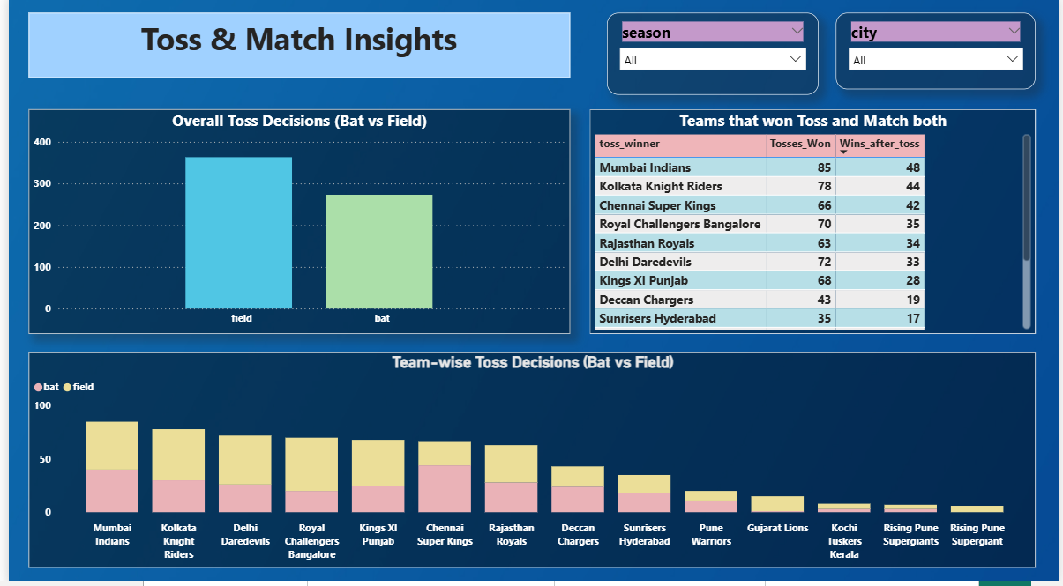
DASHBOARD - 3

Slide 10
Toss & Match Insights
Most common toss decision → Field first
Team that won the most tosses →Mumbai Indians (85)
Highest wins after winning toss → Mumbai Indians (48)
Kolkata Knight Riders & Chennai Super Kings also strong after toss wins
Team-wise toss choices vary → some prefer fielding, some prefer batting .

Slide 11
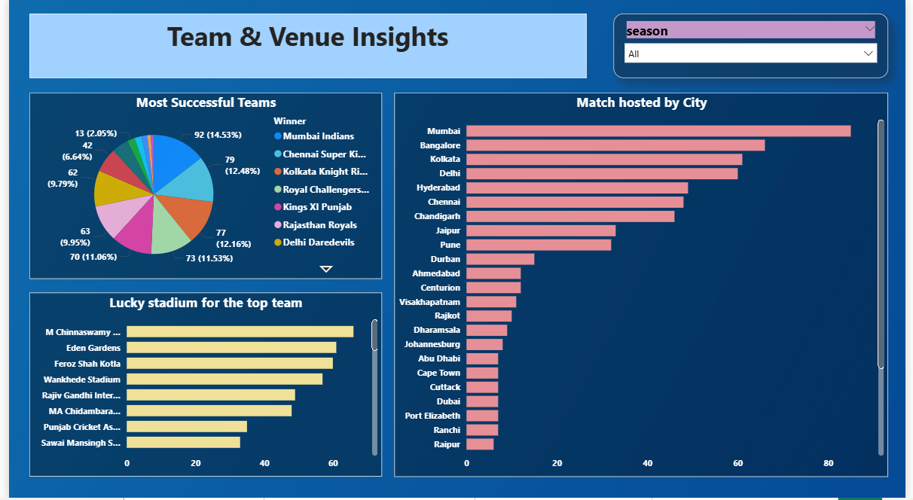
DASHBOARD - 4

Slide 12
Team & Venue Insights
Most successful team → Mumbai Indians (92 wins)
Followed by Chennai Super Kings (79) & Kolkata Knight Riders (77)
City with most matches hosted → Mumbai
Other top hosting cities → Bangalore, Kolkata, Delhi, Hyderabad
Lucky stadiums for top teams: M. Chinnaswamy, Eden Gardens, Feroz Shah Kotla, Wankhede

Slide 13
Recommendations
Teams should use venue data to decide their match plan.
Pick consistent players in the auction.
Have strong finishers and good bowlers in the team.
Focus more on fielding – catches and run-outs change matches.
Decide whether to bat or field after toss based on the ground and the opponent.

Slide 14
Conclusion
Data analytics reveals top performers and winning strategies in IPL.
Toss decisions influence outcomes but are not the only factor.
Stadiums and venues play a major role in team performance.
Power BI dashboards make IPL data easy to analyze interactively.
Sports analytics can enhance team strategies, fan engagement, and broadcasting decisions.

Slide 15
Thank You

