Slide 1

Social Impact Innovation
Startup School Session 2

Slide 2
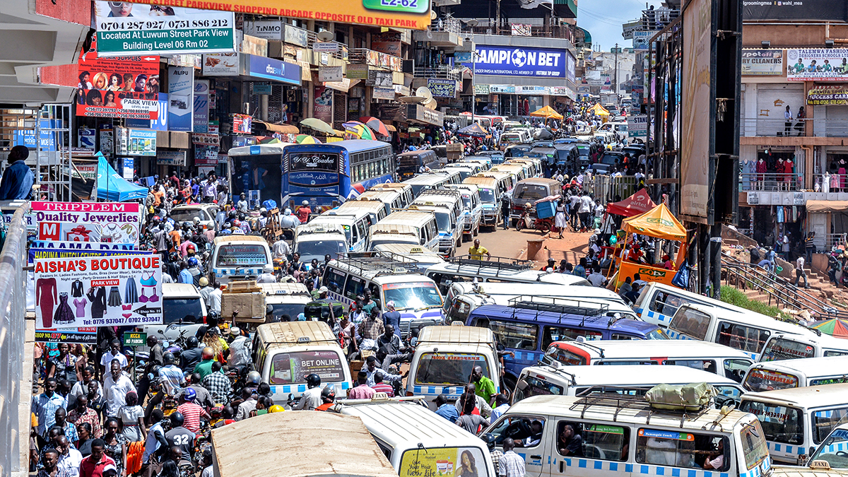
Innovation Topic:
The Traffic Problem

Slide 3
Write 3 things you may do to solve this problem
1.
2.
3.

Slide 4
Let’s try to
do this in a
more organised manner

Slide 5
2
3
Ideate
to Solve
Prototype a Solution
4
1
Share
and Learn
Define
with Empathy

Slide 6
Is Traffic actually the problem?
1
Define
with Empathy
Is it a problem if you are “sleeping at home”?
Is it a problem if you are “not in the country”?
Is it a problem for “street sellers”?
Is it a problem for ‘Indian Oil Company - IOC” chairman?
Traffic is not a problem, it’s just a phenomenon

Slide 7
Defining Problem Statements
1
Define
with Empathy
Person | Learnings from Observations | Learnings from Engagement | Problem Statements
travelling for work

Slide 8
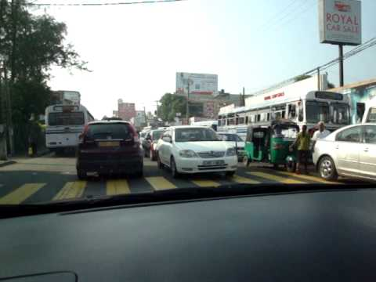
Observation
Time

Slide 9
Ideate to Solve
2
Ideate
to Solve
Problem Statement | Why does it happen? | What can be done to solve
People going to work has to spend too much of unproductive time on road, reducing the time they can spend on work and family. | Roads are not large enough for the amount of vehicles
 | People do not respect traffic rules
 | Productive work cannot be done while travelling

Slide 10
Ideate to Solve
2
Ideate
to Solve
Problem Statement | Why does it happen? | What can be done to solve

Slide 11
After ideation, you should ‘prototype’ and ‘share’ with users to validate. You will learn these steps in a later stage.

