Slide 1

GenMRP
Generating Optimized MRP Lot Sizes Using
Genetic Algorithm: Considering Supplier Deals
Supervised By
Dr. S.D. Dewasurendra
Mr. Lakshika Rajakaruna (IFS)
Nipuna Thanura
Udakara Rathnayake
GenMRP

Slide 2

Material Requirements Planning (MRP)
The production planning, scheduling, and inventory control system
Used to manage manufacturing processes
Answers the problems of:
When to buy?
What quantity?

Slide 3
Genetic Algorithms (GA)
A search heuristic algorithm
Mimics the process of natural evolution
Survival of the fittest
Ideal for highly constrained problems similar to MRP

Slide 4
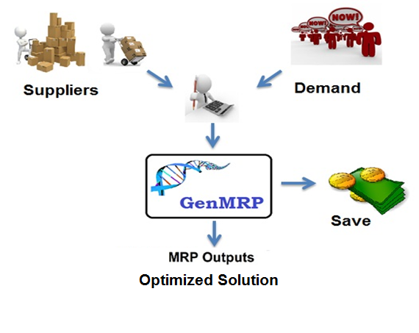
What is GenMRP?
Minimizes the total cost by deciding suitable suppliers and lot-sizes.
GenMRP

Slide 5
What is GenMRP?
Generates optimized MRP solutions
Considers
supplier discounts/deals
storage capacity limitations
Transportation/ Holding Costs
Answers
From whom to buy?
When to buy?
What quantity should be bought?
A genetic algorithm is used

Slide 6
Related Work
“MRP Lot Sizing Using Genetic Algorithms” L. Q. D.J Stockton, BPICS CONTROL, 1993
initial efforts
“Applying Genetic Algorithms for Inventory Lot-Sizing Problem with Supplier Selection under Storage Capacity Constraints” C. Woarawichai, K. Kuruvit, Paitoon V. ,2012
Has high relevance to ours
AiPlAN: Advanced Production Planning System
Notes:
http://www.swpark.or.th/index.php?option=com_jumi&fileid=11&Itemid=171&company_id=79

Slide 7
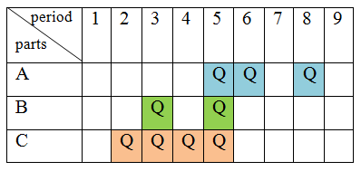
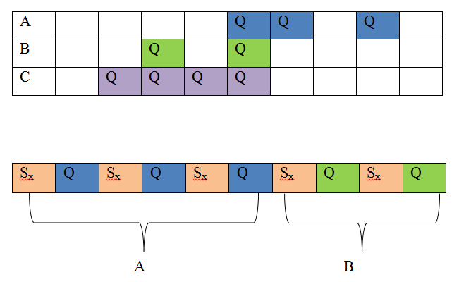
Methodology
Planned Order Release (POR)
Chromosome
Sx = Supplier
Q = Order Quantity
GenMRP

Slide 8
Algorithm Flow
Initial Population
Population
Calculate Fitness
Validation
Sorting
Elite 10%
Cross over
Mutation
GenMRP

Slide 9
Algorithm Flow
Initial Population
Population
Calculate Fitness
Initial Population
90% of the population is randomly filled
10% of the population is filled with quantities from Planned Order Release (POR)
POR doesn’t have suppliers
Suppliers are randomly filled
Calculate Fitness
Get the inverse of the total cost as the fitness
Validation
Check whether the solution can fulfill the demand.
Sort by Fitness
Simple insertion sort
Elitism
Allow the best 10% from the current generation to carry over to the next, unaltered.
Validation
Sorting
Elite 10%
Cross over
Mutation
GenMRP

Slide 10
Results

Slide 11
Results

Slide 12
Conclusion
This project present a method to get an optimized solution to multi-level, multi-product MRP problem
From whom to buy?
When to buy ?
What quantity should be bought?
More cost functions can be added directly to the database
Parallel computing is being implemented
This project is a continuation of an IFS project (by Mr. Lakshika Rajakaruna)
GenMRP

Slide 13
Thank You!

Slide 14
Extra
GenMRP

