Slide 1
Feasibility of using Machine Learning to Access Control in Squid Proxy Server
Supervised by Mr.Sampath Deegalla
Kanchana Ihalagedara
Rajitha Kithuldeniya
Supun weerasekara

Slide 2
Internet in Educational Institutes
Mainly for educational purposes.
What happens if users priority is not the intended purpose.
Network congestions
Wastage of resources
Affects individual user performance negatively

Slide 3
Blocking Web Sites in Proxy Server
Squid ACLs - Text file of blacklists
SquidGuard - External databases
DansGuardian - Content filter

Slide 4
World Wide Web is Growing
672,985,183 - 2013
968,882,453 - 2014
295,897,270
From www.internetlivestats.com
Manually blacklisting web sites is impossible
Related products are not updated with the growing web

Slide 5
Dynamic automated method
Automated web classification is required
Machine Learning is used in automated web classification

Slide 6
Over View of Our Solution
Copy client request
Check URL
Get web content
Classify web content
Update the blacklist

Slide 7
Machine Learning in Web Classification
Several web classification researches can be found
Frequently used algorithms
Naïve Byes
Support vector machine
Nearest neighbor
Classification requires a data set
Set of URLs labeled as educational or non educational

Slide 8
Data Collection & Preprocessing
Preprocess Squid server log
Preprocess DMOZ data set
Create labeled URLs
Get web content
Create training data set

Slide 9
Model Creation & Testing
Four models were created from WEKA(small data set)
Data set with two hundred records
10 – fold cross validation for testing
Algorithm | Accuracy(%)
PRISM | 74.5
C4.5 (J48 in WEKA) | 83.0
Naïve bayes | 95.0
Support Vector Machines | 95.5

Slide 10
Model Creation & Testing
Three models using Python (larger dataset)
Data set of 4000 records
Separate data set of 1000 records for Testing
Algorithm | Accuracy
Naïve Bayes multinomial | 92.9%
SVC | 77.5%
Linear SVC | 98.9%

Slide 11
Feature Selection in Linear SVC

Slide 12
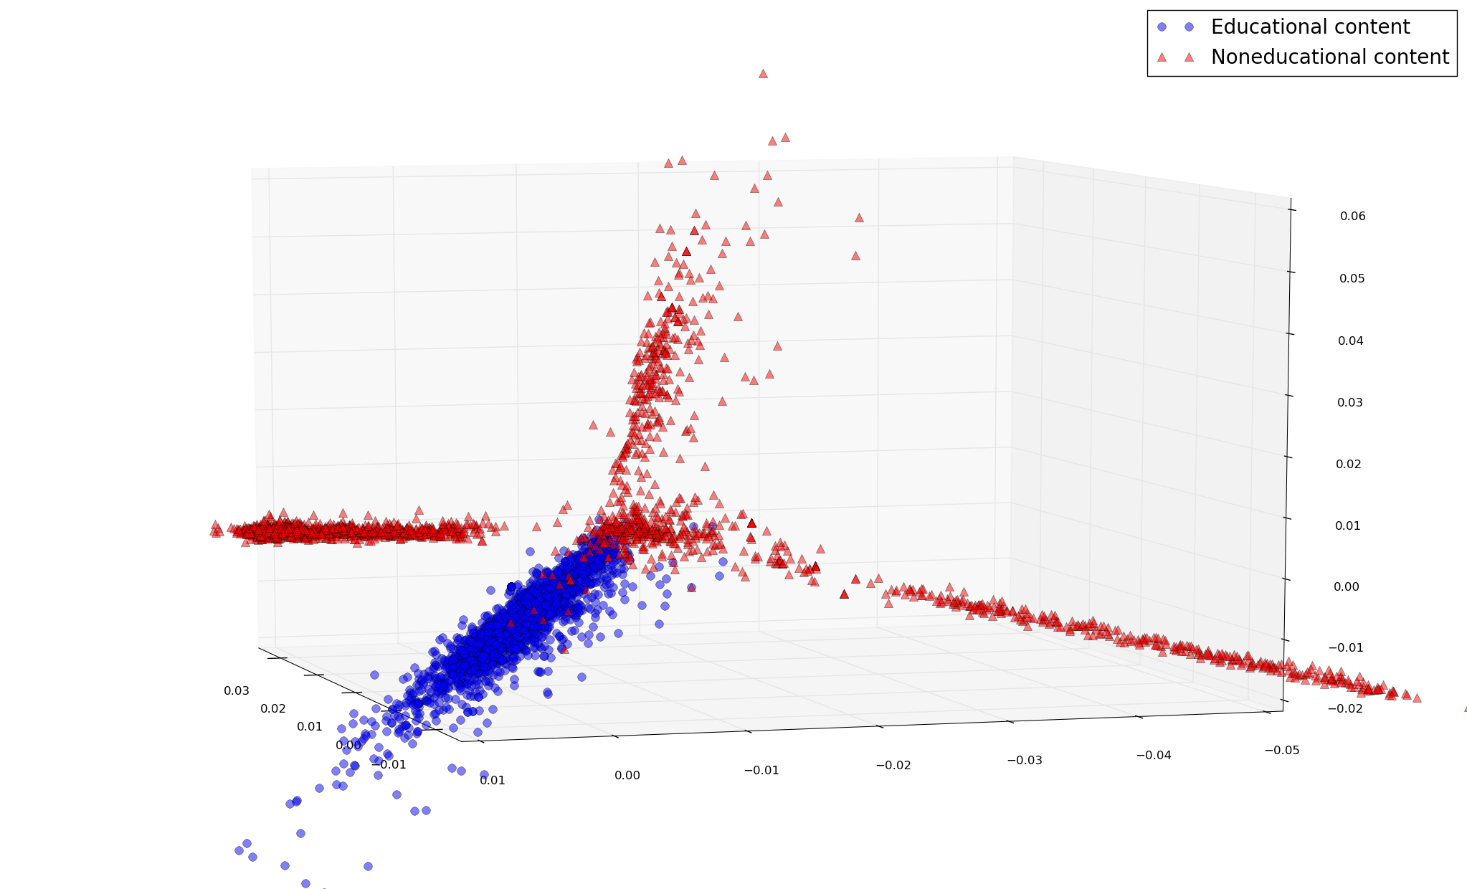
Principal Component Analysis

Slide 13
Future Work
Consider more content (Meta data)
Other Languages (Sinhala)
Image processing can be added

Slide 14
Thank You!

