Slide 1
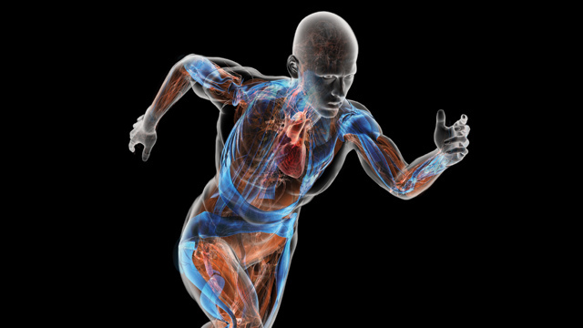
AN OPEN BIOMECHANICS SYSTEM USING COMMODITY HARDWARE
MadushaN ADHIKARI
Chathuranga BAMUNUSINGHE
Pumudika DISSANAYAKE

Slide 2
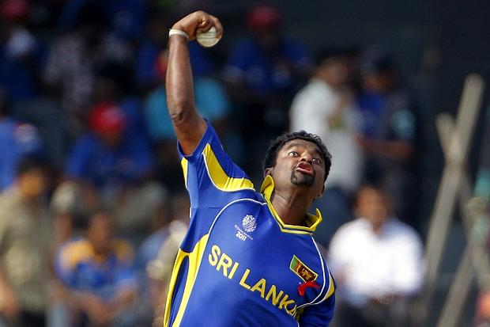
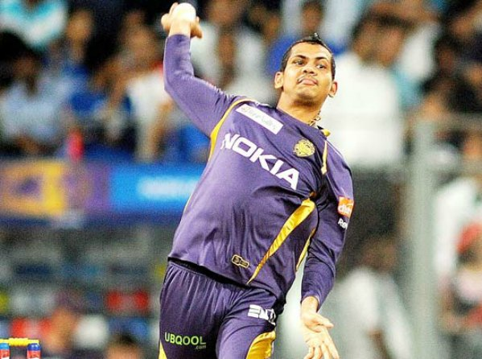
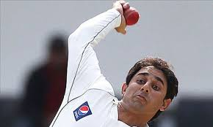
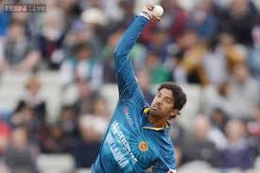
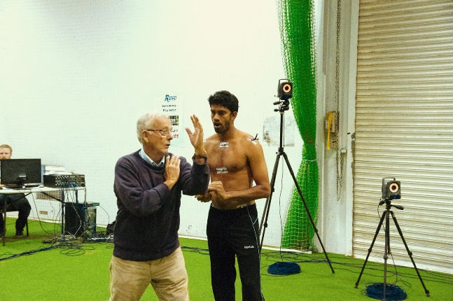
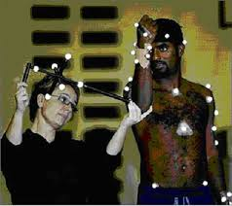
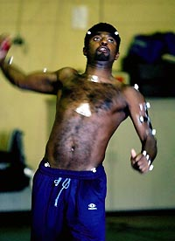
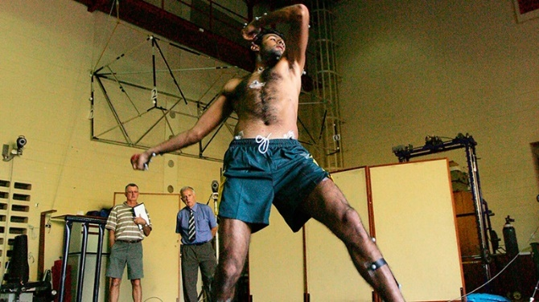
A PRACTICAL ISSUE

Slide 3
OBJECTIVE
Existing movement capturing systems (Vicon, Qualisys etc.) are expensive( > 10000 USD)
Need specially trained personnel and specially equipped laboratories in marker based systems
This approach will introduce a low cost markerless movement capturing and analysis system which has reasonable accuracy like in marker based systems

Slide 4
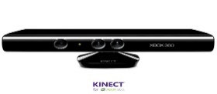
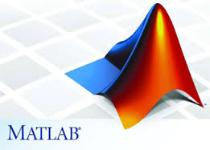

PROCESS OVERVIEW
Create .mot file to feed motion data into OpenSim and visualization
Kinect skeleton tracking and data capturing
Matlab calculations
Filtering
Acceleration calculation
Angle calculation

Slide 5
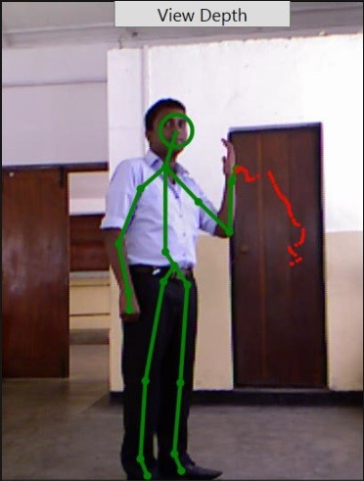
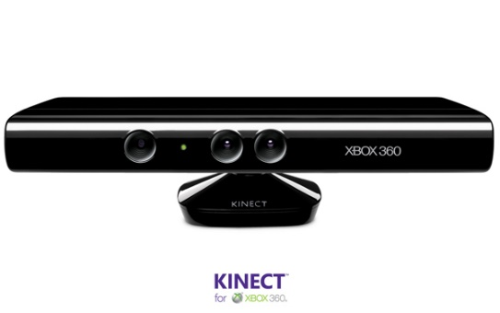
MICROSOFT KINECT DEVICE
Sensor system designed to be used with Xbox 360.
Less expensive compared to existing marker based systems.
Less computational processing to extract data compared to existing marker less systems.
Can get 3D coordinates of 25 different human joints at a time.

Slide 6
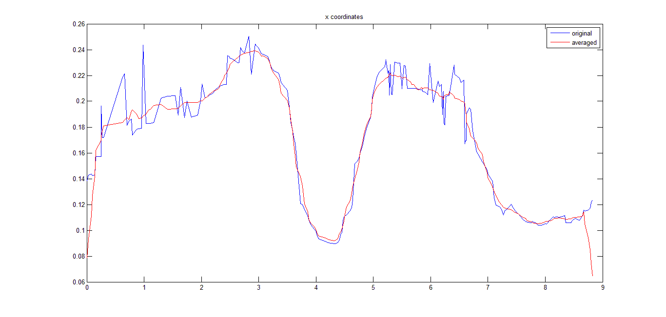
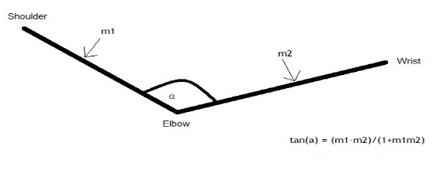
PRE PROCESSING
Filtering - Moving average filter
Acceleration calculation - Interpolation and differentiation for acceleration calculation
Angle calculation - Angle between two straight lines in 3D coordinate space

Slide 7
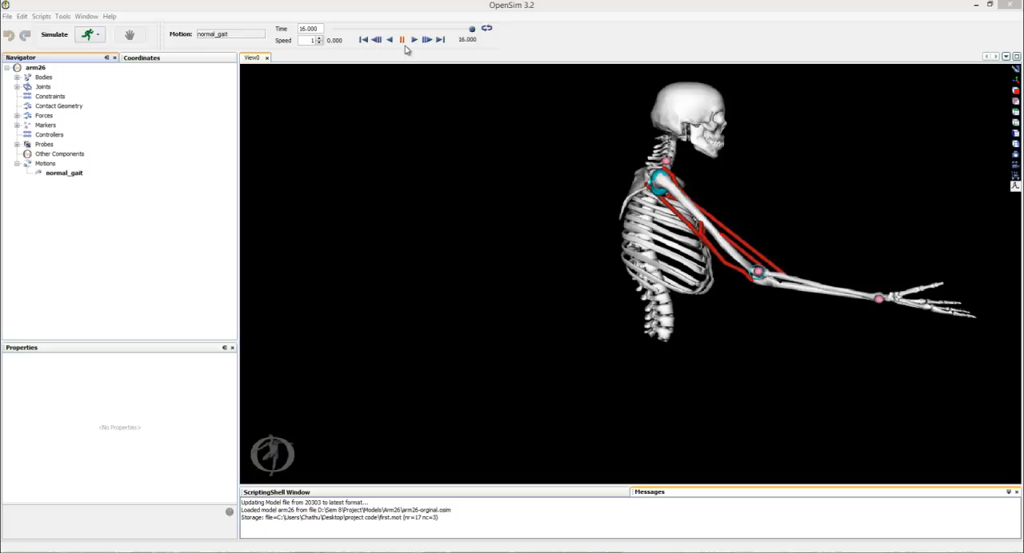

Slide 8
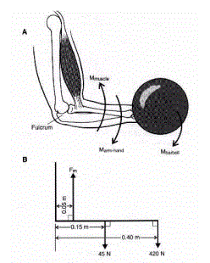
FORCE CALCULATION
Arm is considered as a rigid body
Standard free body diagrams & mass acceleration diagrams are used to calculate forces
Acceleration data and standard values of approximating the mass of the arm and center of mass

Slide 9
POTENTIAL APPLICATIONS
Force analysis using OpenSim
Validate results by comparing with rigid body analysis
Full body analysis using a complete model

Slide 10
THANK YOU

Slide 11


