Slide 1
SDN testbed for undergraduate education
Presenter : Weerawardhana J.L.M.N.
Department of Computer Engineering,
University of Peradeniya.

Slide 2
First things first
SDN stands for Software Defined Networks

Slide 3
Think of a network like this
Control plane
L2 switch
Data plane
Control plane
L3 switch
Control plane
Data plane
Control plane
L2 switch
Data plane
L2 switch
Data plane
Control plane
L2 switch
Data plane

Slide 4
Now a SDN
SDN Apps
SDN Apps
SDN Apps
Software Defined Network(SDN) Controller
Control plane
L2 switch
Data plane
Control plane
L3 switch
Control plane
Data plane
Data plane
Control plane
L2 switch
Data plane
L2 switch
Data plane
Control plane
L2 switch
Data plane

Slide 5
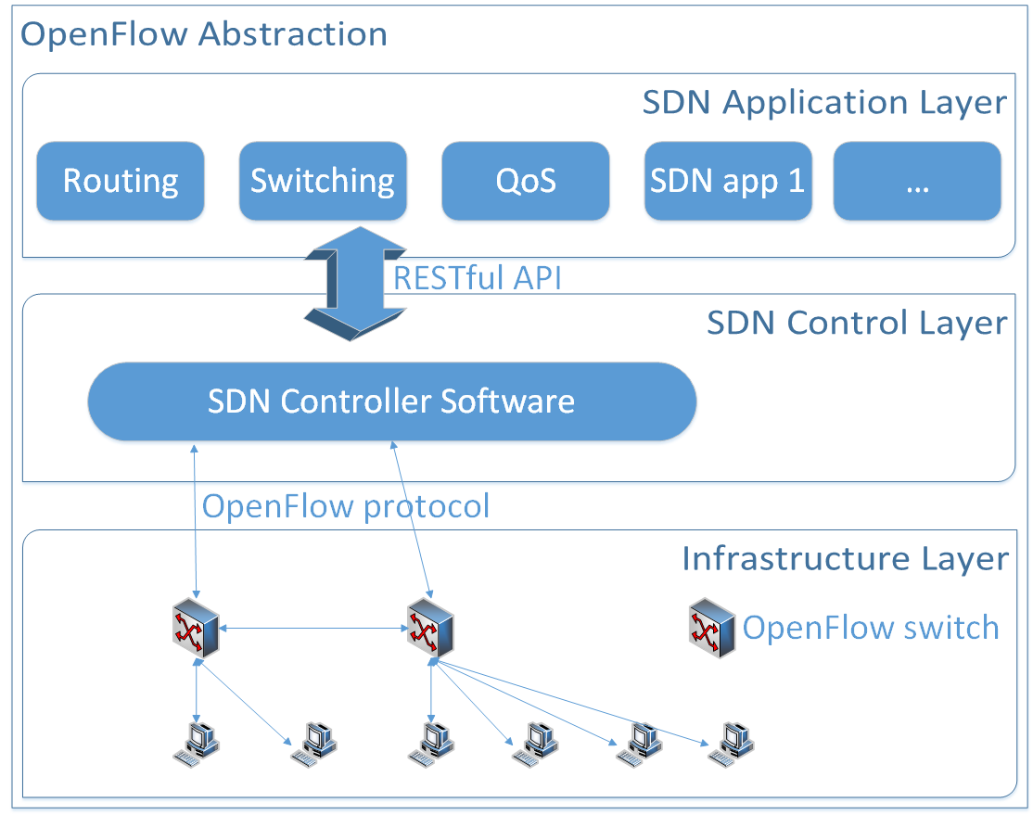
OpenFlow

Slide 6
The problem
The cost
SDN is a new trend
Lots of research going on
But OpenFlow capable switches are expensive
Solution
Small scale low cost SDN testbed
Using low cost hardware(Raspberry Pi)
With extensive documentation for reproducibility

Slide 7
The next problem
Complexity
Lots of competing standards
Poor documentation
And hard to understand for a beginner
Solution
Simple methodology to introduce SDN to beginners
Using our SDN testbed

Slide 8
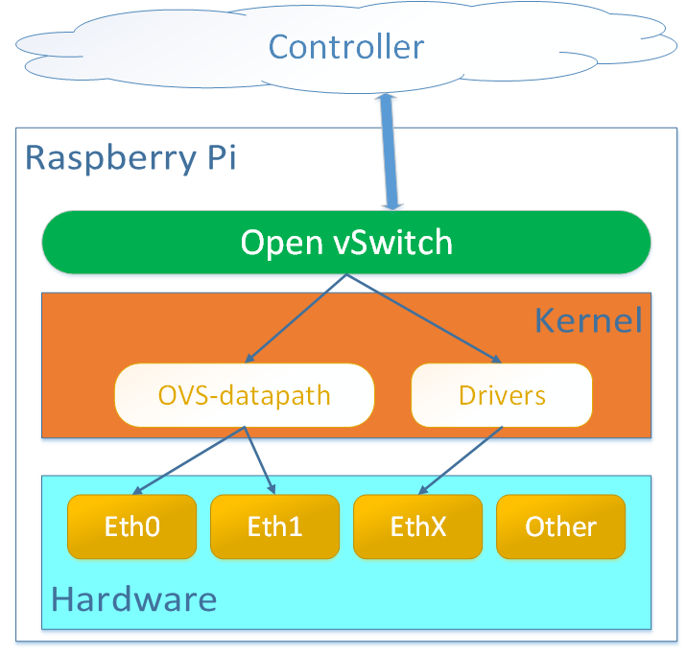
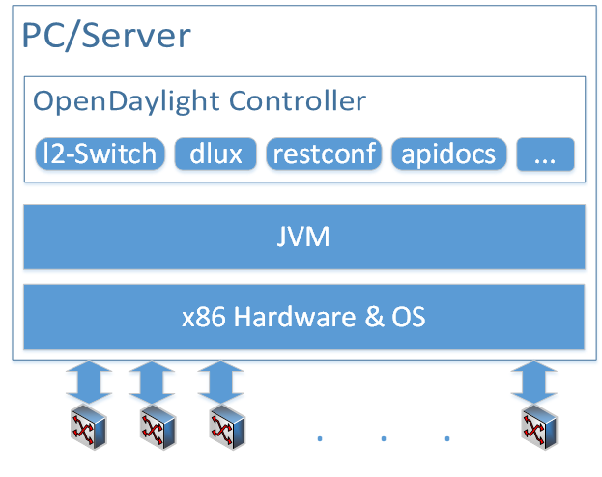
System Model
SDN switch
SDN controller

Slide 9
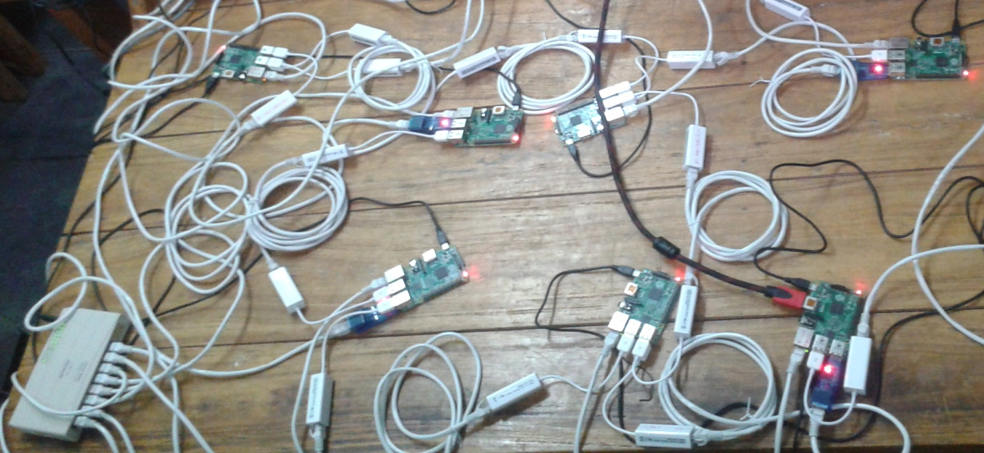
Features
Dynamic Flow forwarding rules
Firewall capabilities
Automatic host discovery

Slide 10
An example
Switch port | MAC src | MAC dst | Eth type | VLAN ID | IP src | IP dst | IP port | TCP sport | TCP dport | Action
1 | - | - | - | - | - | - | - | - | - | to IP1
- | - | - | - | 2 | - | - | - | - | - | drop
- | - | - | - | - | IP2 | IP4 | - | - | - | to IP4 Copy to controller
VID2
*
*
- | - | - | - | - | - | - | - | TP1 | TP4 | to TP4
No Match! Forward to the controller
IP2
TP1
*
*
IP4
TP4

Slide 11
Limitations
Low throughput
Slow processor
Slow ethernet over USB (100Mbit)
Stability
Weak physical connectors
Power problems
Software stability

Slide 12
Future
Full featured small-scale SDN
Traffic visualization
Dynamic resource allocation
Network function virtualization

