Slide 1
Independent Component Analysis (ICA)
A parallel approach

Slide 2
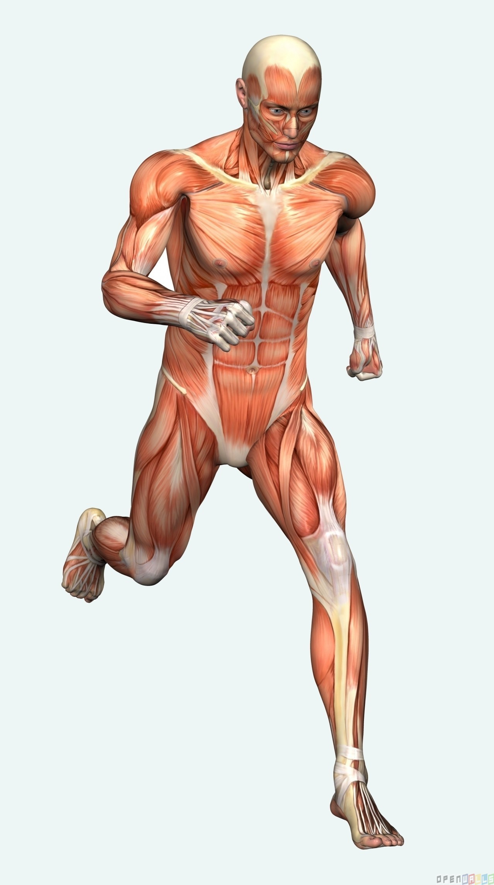
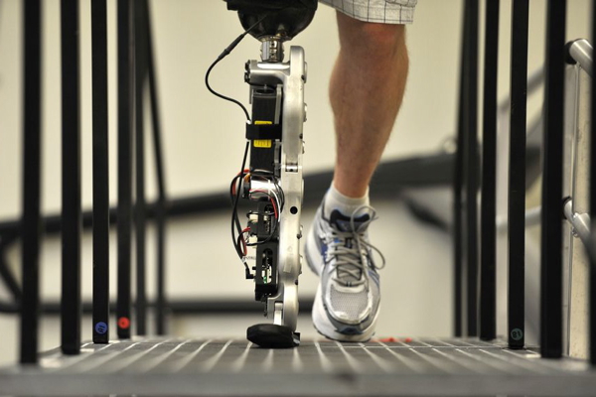
Motivation
Suppose a person wants to run
But he doesn’t have a leg
We need a computerized mechanism to control this bionic leg
Image from new.homeschoolmarketplace.com
http://images.dailytech.com/

Slide 3
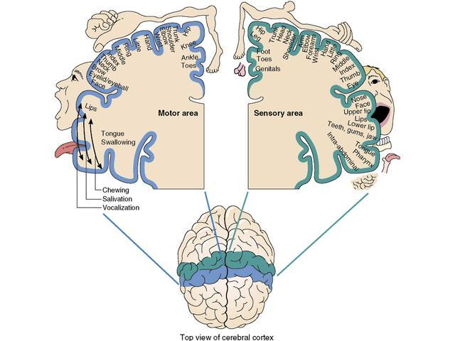
A characteristic of the brain
Right side of brain controls left leg, left side controls right leg

Slide 4
Problem we should solve
We need to identify the original source signals
We need to identify it fast

Slide 5
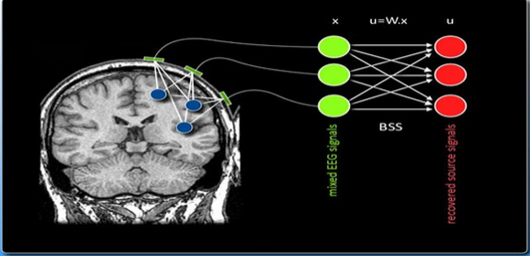
Problem one - Identifying signal Independent Component Analysis(ICA)
Blind Source Separation
X- what we observe
A - Mixing matrix(Depends on the source position)
S – Unknown original sources
s=Wx
s
x = As
A⁻¹x = A⁻¹As
A⁻¹x = s
s = Wx
Where W = A⁻¹
x = As
We don’t know both (A) and (s)

Slide 6
Problem two - Identifying it fast
FastICA algorithm
Fast and accurate

Slide 7
FastICA is still slow
Dataset - 118 sources and 15,000 samples taken within 15 seconds
Result - FastICA took about 4,700 seconds to solve this
This is about One and Half hours !

Slide 8
We improved FastICA
Used parallelism to improve the performance
Implemented in threading, parallel processing and hybrid version of threads and processes

Slide 9
FastICA algorithm
Pre processing
Centering data
Singular Value Decomposition
Initialize W matrix
Main loop
Dot products
Symmetric Decorrelation
Apply non-linear function(g) to the input matrix (x)
ex:- Cube(x) , tanh(x), log cosh(x)
Post Calculations
Wx = s

Slide 10
Amdahl's law
If we need to improve an algorithm, we need to improve the most time consuming serial part
ICA main loop consumed about 90% of total time for 118 source, 15000 sample set

Slide 11
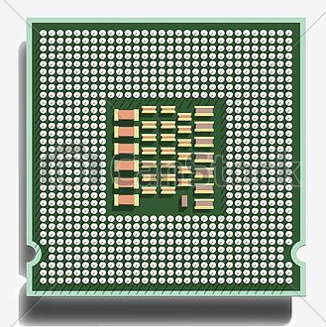
Paralleling the FastICA - Threading
(Apply non-linear functions to the input matrix (x) parallelly)
118 sources 15000 sample data set
118 * 3000
118 * 3000
118 * 3000
118 * 3000
118 * 3000
Thread 1
Thread 2
Thread 3
Thread 4
Thread 5
g(x)
g(x)
g(x)
g(x)
g(x)
118 * 3000
118 * 3000
118 * 3000
118 * 3000
118 * 3000
Main loop
product
product
product
product
product
118 * 118
118 * 118
118 * 118
118 * 118
118 * 118
Controller collect the matrixes and calculate W until it converges

Slide 12

Paralleling the FastICA - Processes
118 sources 15000 sample data set
118 * 3000
118 * 3000
118 * 3000
118 * 3000
118 * 3000
Process 1
Process 2
Process 3
Process 4
Process 5
g(x)
g(x)
g(x)
g(x)
g(x)
118 * 3000
118 * 3000
118 * 3000
118 * 3000
118 * 3000
Main loop
product
product
product
product
product
118 * 118
118 * 118
118 * 118
118 * 118
118 * 118
MPI used to distribute data within the cluster
Controller collect the matrixes and calculate W until it converges

Slide 13
Paralleling the FastICA - Hybrid
118 sources 15000 sample data set
118 * 5000
118 * 5000
118 * 5000
Process 1
Process 2
Process 3
Process 2
118 * 2500
118 * 2500
118 * 2500
118 * 2500
118 * 2500
118 * 2500
Thread 1
Thread 2
Thread 2
Thread 1
Thread 2
Thread 1
g(x)
g(x)
g(x)
g(x)
g(x)
g(x)
g(x)
Main loop
g(x)
g(x)
118 * 2500
118 * 2500
118 * 2500
118 * 2500
118 * 2500
118 * 2500
product
product
product
product
product
product
118 * 118
118 * 118
118 * 118
118 * 118
118 * 118
118 * 118
Thread controller
Thread controller
Thread controller
Process Controller collect the matrixes and calculate W until it converges

Slide 14
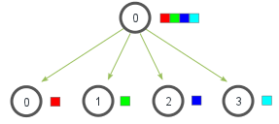

To Achieve High Levels of Parallelism
Input data decomposition (columns wise distribution)
What kind of granularity is matter ?
Critical Path
The longest directed path between any
pair of start and finish nodes
Degree of Concurrency
Maximum degree of concurrency
Average degree of concurrency
avg degree of concurrency = total amount of work
critical path length

Slide 15


To Achieve High Levels of Parallelism
Maximize data locality
Minimize volume of data exchange between threads or processes
Management of access of shared data

Slide 16
Experimental Setup
Test data set
118 sources and 298458 samples
taken from BCI Competition III (http://bbci.de/competition)
We used following machines to test our solution.
• Single Node (S) - 4 cores 8 threads
• High performance computer (HPC/H) - 16 cores and 32 threads
• MPI Cluster (M) - four single node machines
High Performance Computer
Intel(R) Xeon(R) CPU E5-2670 0 @2.60GHz cpu MHz : 2601.000
Cache size : 20MB
Memory Total: : 256GB
Single Node Computer
Intel(R) Core(TM) i5-3470 CPU @ 3.20GHz cpu MHz : 1600.000
Cache size : 6MB Memory
Total: : 4 GB

Slide 17
Result
Implementation | Execution time(Seconds) | Maximum Parallelism
Single Threaded (S) | 10069.9272 | 1 threads
Eigen Thread Enabled(S) | 1012.9345 | 32 threads
MPI(C) | 625.0176 | 8 processes
Multithreaded(H) | 81.0965 | 32 threads
Hybrid(C) | 408.8416 | 2 processes + 8 threads
The graph is in log scale

Slide 18
Conclusion
We need to identify the original source signals
FastICA gives the correct result
We need to identify it fast
For 300 seconds sample the calculation only took 81 seconds in high performance computer
But this is not a feasible solution
We need to find a cheap solution : Nvidia-CUDA
Future!

Slide 19
Thank you

Slide 20
Basic FastICA Algorithm
X
-
Whiting matrix
Feed data into
W
-
Sphering
Preprocessing
Input
FastICA main
matrix
data
loop
FastICA main
loop
Is FastICA
False
converged
True
If FastICA is converged then this will
return
source matrix

Slide 21
Multi-threaded FastICA algorithm

Slide 22
MPI and Multithreaded Algorithm

Slide 23
Results

Slide 24
S
Basic single threaded C++ solution
Reused allocated memory locations
Passed matrices by reference
Changed I/O functions
S
Improved single threaded C++ solution
We used Eigen library for matrix operations
At compile time, we can enable the threading in Eigen matrix calculations
Used the compiler optimizations
S
Eigen thread enabled version
Feed the data set for separate threads
ICA loop runs paralleled
Feed the data set for separate processes
ICA loop runs paralleled
H
Threaded ICA algorithm
C
Parallel processing in ICA algorithm
Feed the data set for separate processes
In each process, feed the data set for separate threads
Threading in parallel processes
C

Slide 25





Technologies/Tools and Libraries

Slide 26
