Slide 1



Fraud Detection with Data Mining
Mohammed Fawsan
UoP
Roshanth Gardiarachchi
(Dialog)
Sampath Deegalla
UoP
In collaboration with “IdeaMart( Dialog Axiata PLC)”

Slide 2
INTRODUCTION

Slide 3







What is Ideamart?
IdeaMart is a platform presented by Dialog Axiata PLC to developers and content providers to use the Dialog network based features via shared API’s and monetize their content/ideas.
http://www.ideamart.lk
http://www.allapps.lk

Slide 4


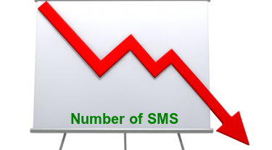

Problems faced By the IdeaMart Community

Slide 5
Hey Fawzan, We want to catch these scams. Shall we monitor apps individually?
Well…. No, I have a better idea.

Slide 6
Solutions
Creating an efficient Spam Filter for SMS
Unlike emails, SMS has very less information. So we are trying to apply the same techniques as emails with modifications.
REST API to integrate the Spam Filter with IdeaMart
Data Visualization & Statistics

Slide 7
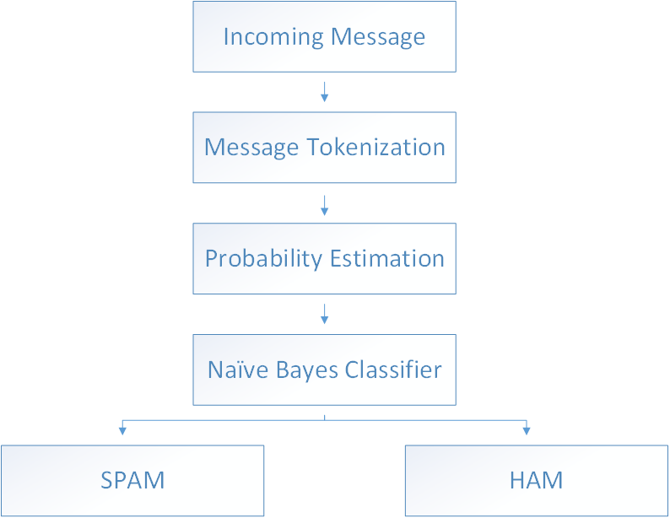
Methodology

Slide 8
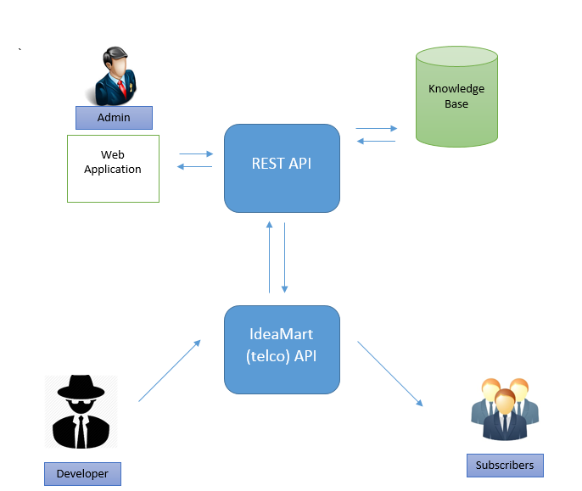
Integration

Slide 9
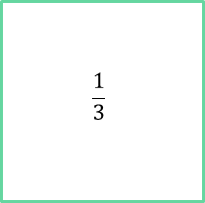
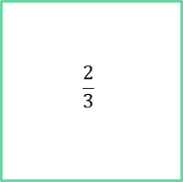
Training & Testing
SMS Log
(5574 Messages)
ROUND 1 |  | Test Messages
 |  | SPAM | HAM
Tagged Messages | SPAM | 99% | 1%
 | HAM | 9% | 91%
$$\frac{2}{3}$$
$$\frac{1}{3}$$
ROUND 2 |  | Test Messages
 |  | SPAM | HAM
Tagged Messages | SPAM | 94% | 6%
 | HAM | 9% | 91%
Training SMS Log
Testing SMS Log
Training Model
Knowledge Base
Testing Model
ROUND 3 |  | Test Messages
 |  | SPAM | HAM
Tagged Messages | SPAM | 94% | 6%
 | HAM | 9% | 91%
Expand the Knowledge Base
Results

Slide 10
Conclusion & Future Work
Spam Filter
92%
√

Slide 11
Conclusion & Future Work
Spam Filter
92%
√
Rest API
√

Slide 12
Conclusion & Future Work
Domain Knowledge
Spam Filter
92%
√
Combining Multiple Messages
Data Visualization
Rest API
√

Slide 13
Thank You

