Slide 1
Seating_&_capacity_analysis
File created on: 20/11/2021 8:07:51 PM

Slide 2
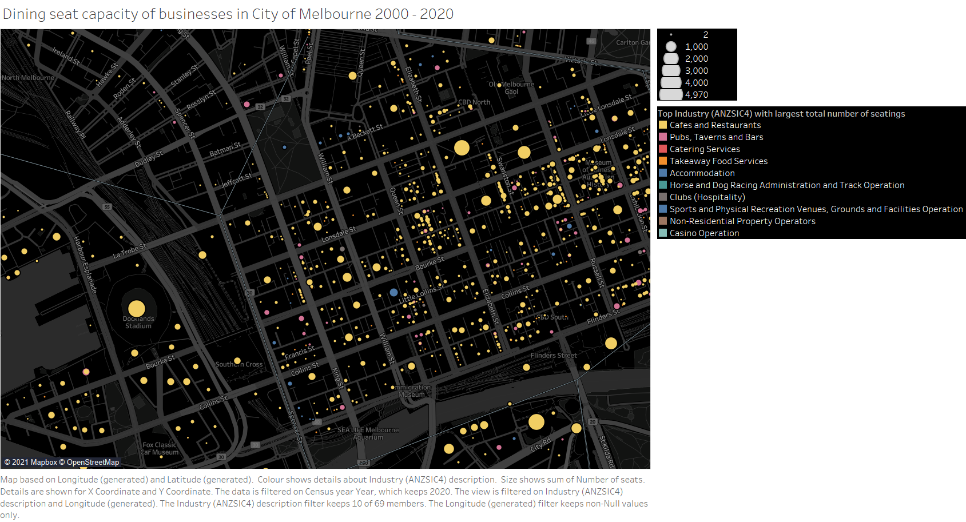

Slide 3
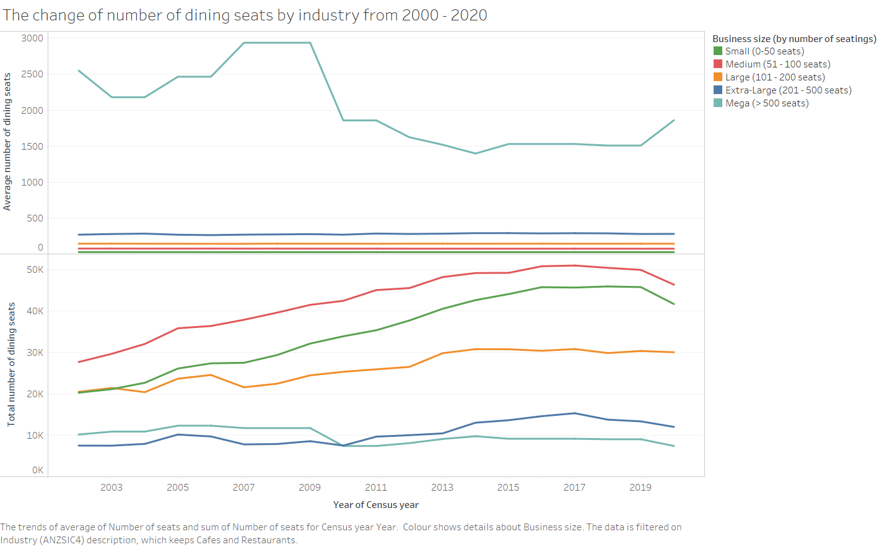

Slide 4
