Slide 1

Understanding Scalability Bugs in Large-Scale Software Systems
Bogdan “Bo” Stoica
18 November 2024

Slide 2
Joint work with …
Prof. Haryadi Gunawi
Prof. Shan Lu
Prof. Kexin Pei

Slide 3
Joint work with …
Prof. Haryadi Gunawi
Prof. Shan Lu
Prof. Kexin Pei
Jun Yang

Slide 4
Joint work with …
Prof. Haryadi Gunawi
Prof. Shan Lu
Prof. Kexin Pei
Jun Yang
Wordyka Nainggolan
Zahra Maharani
Marcellino Gaol
Natanael Siregar

Slide 5

An example: Cassandra-12281
1 node bootstrapping = 1min

Slide 6
An example: Cassandra-12281
1 node bootstrapping = 1min
1 node bootstrapping = 30min

Slide 7
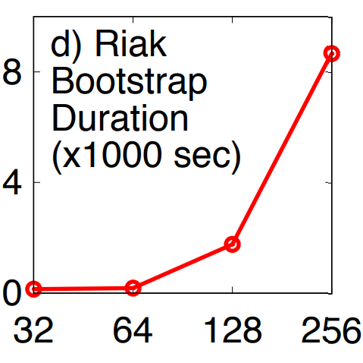
An example: Cassandra-12281
1 node bootstrapping = 1min
time
1 node bootstrapping = 30min
# nodes

Slide 8
An example: Cassandra-12281
1 node bootstrapping = 1min
time
1 node bootstrapping = 30min
# nodes

Slide 9
An example: Cassandra-12281
1 node bootstrapping = 1min
time
1 node bootstrapping = 30min
# nodes

Slide 10
An example: Cassandra-12281
1 node bootstrapping = 1min
Root cause: gossip protocol has cubic (!!) complexity
time
1 node bootstrapping = 30min
# nodes

Slide 11
An example: Cassandra-12281
1 node bootstrapping = 1min
Root cause: gossip protocol has cubic (!!) complexity
time
1 node bootstrapping = 30min
Observation: happens only at a “large enough” scale
# nodes

Slide 12
What are scalability bugs?
Definition: Latent faults that are scale dependent and whose symptoms surface in large-scale deployments (e.g., >100 nodes) but not likely in small/medium-scale (e.g., <100) deployments.

Slide 13
What are scalability bugs?
Definition: Latent faults that are scale dependent and whose symptoms surface in large-scale deployments (e.g., >100 nodes) but not likely in small/medium-scale (e.g., <100) deployments.

Slide 14
What are scalability bugs?
Definition: Latent faults that are scale dependent and whose symptoms surface in large-scale deployments (e.g., >100 nodes) but not likely in small/medium-scale (e.g., <100) deployments.

Slide 15
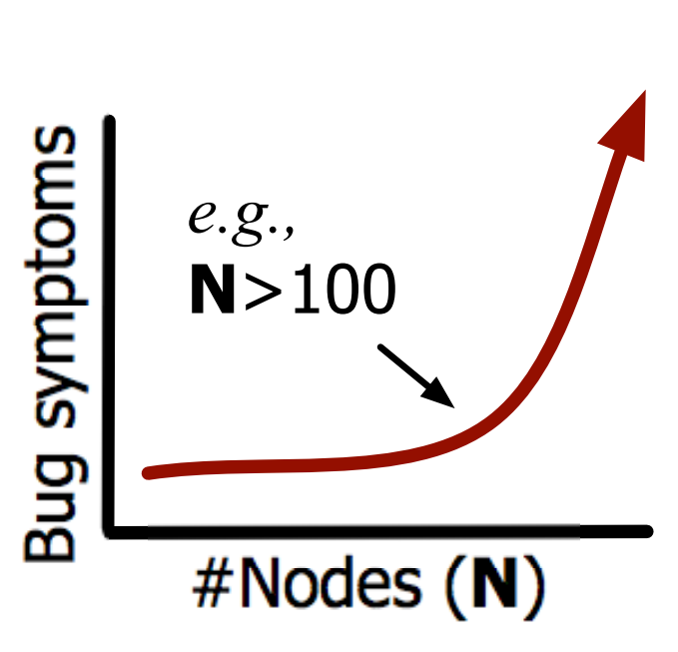
What are scalability bugs?
Definition: Latent faults that are scale dependent and whose symptoms surface in large-scale deployments (e.g., >100 nodes) but not likely in small/medium-scale (e.g., <100) deployments.

Slide 16
Scalability bugs data set
350+ bug reports
10 open-source systems

Slide 17










Scalability bugs data set
350+ bug reports
10 open-source systems

Slide 18

Scalability bugs data set
350+ bug reports
10 open-source systems
Reported in last 10+ years
Confirmed & fix

Slide 19
How scalability bugs happen?
Load e.g., # requests

Slide 20
How scalability bugs happen?
Load e.g., # requests
Data e.g., large workload

Slide 21
How scalability bugs happen?
Load e.g., # requests
Data e.g., large workload
Cluster e.g., # nodes

Slide 22
How scalability bugs happen?
Load e.g., # requests
Data e.g., large workload
Cluster e.g., # nodes
Fail e.g., # internal failures

Slide 23
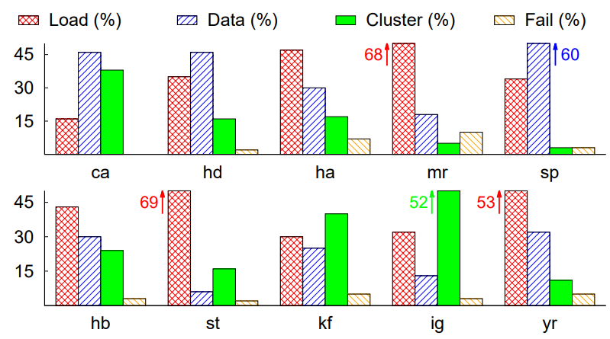
How scalability bugs happen?
Load e.g., # requests
Data e.g., large workload
Cluster e.g., # nodes
Fail e.g., # internal failures

Slide 24
How scalability bugs happen?
Load e.g., # requests
Data e.g., large workload
Cluster e.g., # nodes
Fail e.g., # internal failures

Slide 25
How scalability bugs happen?
Load e.g., # requests
Cancellation bugs [OSDI22]
Data e.g., large workload
Retry bugs [SOSP24]
Cluster e.g., # nodes
Fail e.g., # internal failures

Slide 26
Challenges detecting scalability bugs
Scalability bugs are difficult to test in-house
Notes:
Third -- retry implementations need to handle the side-effects of a failed task, like cleaning up the program state

Slide 27
Challenges detecting scalability bugs
Scalability bugs are difficult to test in-house
Require workloads, not just “unit” tests
Notes:
Third -- retry implementations need to handle the side-effects of a failed task, like cleaning up the program state

Slide 28
Challenges detecting scalability bugs
Scalability bugs are difficult to test in-house
Require workloads, not just “unit” tests
How to judge a scalability bug happened?
Notes:
Third -- retry implementations need to handle the side-effects of a failed task, like cleaning up the program state

Slide 29

Scalability bug reproducibility efforts
75 most recent reports, 48 reproduced, 27 unsuccessful

Slide 30
Scalability bug reproducibility efforts
75 most recent reports, 48 reproduced, 27 unsuccessful
Incomplete reports

Slide 31
Scalability bug reproducibility efforts
75 most recent reports, 48 reproduced, 27 unsuccessful
Incomplete reports
Resource mismatch

Slide 32
Scalability bug reproducibility efforts
75 most recent reports, 48 reproduced, 27 unsuccessful
Incomplete reports
Resource mismatch
Missing dependencies

Slide 33
Scalability bug reproducibility efforts
75 most recent reports, 48 reproduced, 27 unsuccessful
Incomplete reports
Resource mismatch
Missing dependencies
Poor test coverage

Slide 34

Scalability bug reproducibility efforts
75 most recent reports, 48 reproduced, 27 unsuccessful
Incomplete reports
Resource mismatch
traditional program analysis
+
Missing dependencies
LLMs
Poor test coverage

Slide 35
Scalability bug reproducibility efforts
75 most recent reports, 48 reproduced, 27 unsuccessful
Incomplete reports
Resource mismatch
traditional program analysis
+
Missing dependencies
LLMs
Poor test coverage

Slide 36

SOTA: test generation for correctness bugs
Iterative prompting with “feedback metrics”
Notes:
Third -- retry implementations need to handle the side-effects of a failed task, like cleaning up the program state

Slide 37
SOTA: test generation for correctness bugs
Iterative prompting with “feedback metrics”
Notes:
Third -- retry implementations need to handle the side-effects of a failed task, like cleaning up the program state

Slide 38

SOTA: test generation for correctness bugs
Iterative prompting with “feedback metrics”
Notes:
Third -- retry implementations need to handle the side-effects of a failed task, like cleaning up the program state

Slide 39

SOTA: test generation for correctness bugs
Iterative prompting with “feedback metrics”
Notes:
Third -- retry implementations need to handle the side-effects of a failed task, like cleaning up the program state

Slide 40

SOTA: test generation for correctness bugs
Iterative prompting with “feedback metrics”
Notes:
Third -- retry implementations need to handle the side-effects of a failed task, like cleaning up the program state

Slide 41
SOTA: test generation for correctness bugs
Iterative prompting with “feedback metrics”
feedback metrics (typically, coverage)
Notes:
Third -- retry implementations need to handle the side-effects of a failed task, like cleaning up the program state

Slide 42
Metric for correctness bugs
HDFS/DFSInputStream.java
bool createBlockReader():
1. while (true) {
2. try {
3. block = refreshBlock(block);
4. dnInfo = getDNInfFor(block);
5. if (dnInfo == null)
6. break;
7. }
8. catch (IOException e) {
9. LOG(“Failed to connect to “+
dnInfo.addr + “Retried ” +
++retryCount + “ times”);
10. addToDeadNodes(dnInfo.info);
11. }
12. }
Notes:
Identifying retry is challenging. Let’s take a look at to similar code snippets. You don’t have to read the entire code; but only observe that… (click)

Slide 43
Metric for correctness bugs
HDFS/DFSInputStream.java
bool createBlockReader():
1. while (true) { /* covered */
2. try {
3. block = refreshBlock(block); /* covered */
4. dnInfo = getDNInfFor(block); /* covered */
5. if (dnInfo == null)
6. break; /* covered */
7. }
8. catch (IOException e) {
9. LOG(“Failed to connect to “+
dnInfo.addr + “Retried ” +
++retryCount + “ times”); /* covered */
10. addToDeadNodes(dnInfo.info); /* covered */
11. }
12. }
Notes:
Identifying retry is challenging. Let’s take a look at to similar code snippets. You don’t have to read the entire code; but only observe that… (click)

Slide 44

Metric for correctness scalability bugs?
HDFS/DFSInputStream.java
bool createBlockReader():
1. while (true) { /* covered */
2. try {
3. block = refreshBlock(block); /* covered */
4. dnInfo = getDNInfFor(block); /* covered */
5. if (dnInfo == null)
6. break; /* covered */
7. }
8. catch (IOException e) {
9. LOG(“Failed to connect to “+
dnInfo.addr + “Retried ” +
++retryCount + “ times”); /* covered */
10. addToDeadNodes(dnInfo.info); /* covered */
11. }
12. }
Notes:
Identifying retry is challenging. Let’s take a look at to similar code snippets. You don’t have to read the entire code; but only observe that… (click)

Slide 45
Metric for correctness scalability bugs?
HDFS/DFSInputStream.java
bool createBlockReader():
1. while (true) { /* 100 times */
2. try {
3. block = refreshBlock(block); /* 100 times */
4. dnInfo = getDNInfFor(block); /* 100 times */
5. if (dnInfo == null)
6. break; /* 15 times */
7. }
8. catch (IOException e) {
9. LOG(“Failed to connect to “+
dnInfo.addr + “Retried ” +
++retryCount + “ times”); /* 3 times */
10. addToDeadNodes(dnInfo.info); /* 3 times */
11. }
12. }
Notes:
Identifying retry is challenging. Let’s take a look at to similar code snippets. You don’t have to read the entire code; but only observe that… (click)

Slide 46
Metric for correctness scalability bugs?
HDFS/DFSInputStream.java
bool createBlockReader():
1. while (true) { /* 100 times */
2. try {
3. block = refreshBlock(block); /* 100 times */
4. dnInfo = getDNInfFor(block); /* 100 times */
5. if (dnInfo == null)
6. break; /* 15 times */
7. }
8. catch (IOException e) {
9. LOG(“Failed to connect to “+
dnInfo.addr + “Retried ” +
++retryCount + “ times”); /* 3 times */
10. addToDeadNodes(dnInfo.info); /* 3 times */
11. }
12. }
Notes:
Identifying retry is challenging. Let’s take a look at to similar code snippets. You don’t have to read the entire code; but only observe that… (click)

Slide 47
LLM-backed stress test generation pipeline
Notes:
Third -- retry implementations need to handle the side-effects of a failed task, like cleaning up the program state

Slide 48
LLM-backed stress test generation pipeline
Execution frequency
Instruction count
Object allocation frequency
Queue contention
Notes:
Third -- retry implementations need to handle the side-effects of a failed task, like cleaning up the program state

Slide 49
LLM-backed stress test generation pipeline
Execution frequency
Instruction count
Object allocation frequency
Queue contention
Notes:
Third -- retry implementations need to handle the side-effects of a failed task, like cleaning up the program state

Slide 50
“Naïve” prompting
Ask the LLM to synthesize a stress test
Notes:
Third -- retry implementations need to handle the side-effects of a failed task, like cleaning up the program state

Slide 51
“Naïve” prompting
Ask the LLM to synthesize a stress test
Notes:
Third -- retry implementations need to handle the side-effects of a failed task, like cleaning up the program state

Slide 52
“Naïve” prompting
Ask the LLM to synthesize a stress test
Often, large execution path between input and manifestation
Notes:
Third -- retry implementations need to handle the side-effects of a failed task, like cleaning up the program state

Slide 53
Contrasting objectives prompting
Notes:
Third -- retry implementations need to handle the side-effects of a failed task, like cleaning up the program state

Slide 54
Contrasting objectives prompting
Provide the LLM with two complementary examples
Notes:
Third -- retry implementations need to handle the side-effects of a failed task, like cleaning up the program state

Slide 55
Contrasting objectives prompting
Provide the LLM with two complementary examples
Ask the LLM to reason about the differences
Notes:
Third -- retry implementations need to handle the side-effects of a failed task, like cleaning up the program state

Slide 56
Contrasting objectives prompting
Provide the LLM with two complementary examples
Ask the LLM to reason about the differences
Ask the LLM to synthesize a stress test
Notes:
Third -- retry implementations need to handle the side-effects of a failed task, like cleaning up the program state

Slide 57
Contrasting objectives prompting
Test #1
HDFS/DFSInputStream.java
bool createBlockReader():
1. while (true) {
2. try {
3. block = refreshBlock(block); /* 100 */
4. dnInfo = getDNInfFor(block); /* 100 */
5. if (dnInfo == null) /* 100 */
6. break; /* 15 */
7. }
8. catch (IOException e) {
9. LOG(“Failed to connect to “+
dnInfo.addr + “Retried ” +
++retryCount + “ times”); /* 3 */
10. addToDeadNodes(dnInfo.info); /* 3 */
11. }
12. }
Notes:
Third -- retry implementations need to handle the side-effects of a failed task, like cleaning up the program state

Slide 58
Contrasting objectives prompting
Test #1
Test #2
HDFS/DFSInputStream.java
HDFS/DFSInputStream.java
bool createBlockReader():
1. while (true) {
2. try {
3. block = refreshBlock(block); /* 100 */
4. dnInfo = getDNInfFor(block); /* 100 */
5. if (dnInfo == null) /* 100 */
6. break; /* 15 */
7. }
8. catch (IOException e) {
9. LOG(“Failed to connect to “+
dnInfo.addr + “Retried ” +
++retryCount + “ times”); /* 3 */
10. addToDeadNodes(dnInfo.info); /* 3 */
11. }
12. }
bool createBlockReader():
1. while (true) {
2. try {
3. block = refreshBlock(block); /* 2,000 */
4. dnInfo = getDNInfFor(block); /* 2,000 */
5. if (dnInfo == null) /* 2,000 */
6. break; /* 90 */
7. }
8. catch (IOException e) {
9. LOG(“Failed to connect to “+
dnInfo.addr + “Retried ” +
++retryCount + “ times”); /* 55 */
10. addToDeadNodes(dnInfo.info); /* 55 */
11. }
12. }
Notes:
Third -- retry implementations need to handle the side-effects of a failed task, like cleaning up the program state

Slide 59
Preliminary results …
Increased unit test exec frequency ~72% (34/48) bugs
Notes:
Third -- retry implementations need to handle the side-effects of a failed task, like cleaning up the program state

Slide 60
Preliminary results …
Increased unit test exec frequency ~72% (34/48) bugs
Only ~15% (7/48) bugs triggered
Notes:
Third -- retry implementations need to handle the side-effects of a failed task, like cleaning up the program state

Slide 61
Work in progress …
Increased unit test exec frequency ~72% (34/48) bugs
Only ~15% (7/48) bugs triggered (work-in-progress)
Ask the LLM to generate likely “scale” invariants
Notes:
Third -- retry implementations need to handle the side-effects of a failed task, like cleaning up the program state

Slide 62
Work in progress …
Increased unit test exec frequency ~72% (34/48) bugs
Only ~15% (7/48) bugs triggered (work-in-progress)
Ask the LLM to generate likely “scale” invariants
Ask the LLM to account for “environment effects”
Notes:
Third -- retry implementations need to handle the side-effects of a failed task, like cleaning up the program state

Slide 63
Key takeaways
Total: 205
Scalability bugs, broadly present & triggered

Slide 64
Key takeaways
Total: 205
Scalability bugs, broadly present & triggered
Scale is challenging to reproduce

Slide 65

Key takeaways
Total: 205
Scalability bugs, broadly present & triggered
Scale is challenging to reproduce
LLMs + test generation + observability =

Slide 66
Total: 205
Thank you!

