Slide 1




Hierarchical Federated Learning Based Smart Home Network Security System Using Chameleon Testbed
Kevin Kostage
Florida Gulf Coast University
Paulo Drefahl, Sean Peppers, Chengyi Qu, Wenbin Guo
Community Workshop on Practical Reproducibility In HPC
The 5th Chameleon User Meeting

Slide 2
Table of Agendas
Motivations & Problem
Deep Learning Intrusion Detection System
Federated Training (FL) vs. Hierarchal Federated Training (HFL)
Defenses & Enhancements for Federated & DNN Models
Limitations & Potential Solutions
Solution Approach
Chameleon Cloud Platform
System Architecture & Network Topology of HFL-NIDS
Application Scenarios
Evaluation
Experiment Trials
Preliminary Results & Methods
Conclusion
Experiences & Lessons Learned with Chameleon Cloud
Plans for Reproducibility
Notes:
As a brief overview of our project. First, I will introduce the background knowledge on geospatial video analytics in Unmanned Aerial System (UAS), the motivation of our project, and our previous works. Then I will discuss our investigation on network and drone simulators nowadays. According to that, I will present our proposed solution, which is a novel trace-based network and drone simulation framework. To test and show the usage of our project, we also introduce some experiments in practice as an idea of our project users. Lastly, I will conclude our project and discuss our future work. (CLICK)

Slide 3
Table of Agendas
Motivations & Problem
Deep Learning Intrusion Detection System
Federated Training (FL) vs. Hierarchal Federated Training (HFL)
Defenses & Enhancements for Federated & DNN Models
Limitations & Potential Solutions
Solution Approach
Chameleon Cloud Platform
System Architecture & Network Topology of HFL-NIDS
Application Scenarios
Evaluation
Experiment Trials
Preliminary Results & Methods
Conclusion
Experiences & Lessons Learned with Chameleon Cloud
Plans for Reproducibility
Notes:
As a brief overview of our project. First, I will introduce the background knowledge on geospatial video analytics in Unmanned Aerial System (UAS), the motivation of our project, and our previous works. Then I will discuss our investigation on network and drone simulators nowadays. According to that, I will present our proposed solution, which is a novel trace-based network and drone simulation framework. To test and show the usage of our project, we also introduce some experiments in practice as an idea of our project users. Lastly, I will conclude our project and discuss our future work. (CLICK)

Slide 4
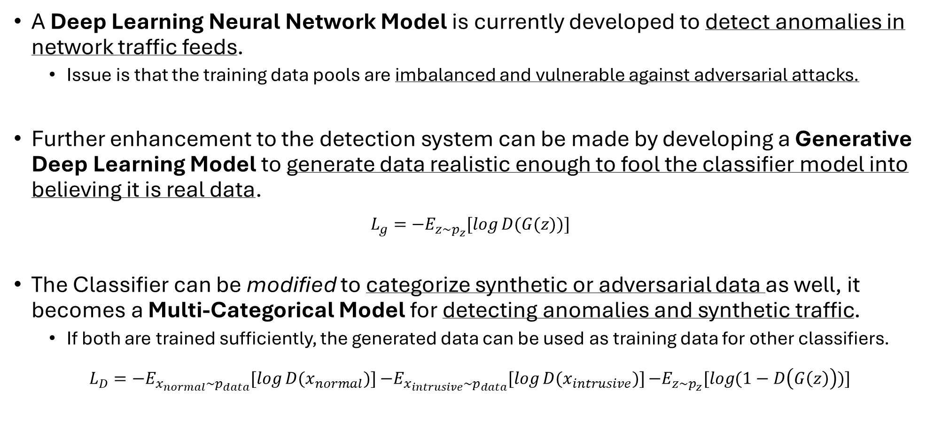
Background - Deep Learning Intrusion Detection System
A Deep Learning Neural Network Model is currently developed to detect anomalies in network traffic feeds.
Issue is that the training data pools are imbalanced and vulnerable against adversarial attacks.
Further enhancement to the detection system can be made by developing a Generative Deep Learning Model to generate data realistic enough to fool the classifier model into believing it is real data.
$$L_{g}=−E_{z\sim p_{z}}[\log{D(G(z))}]$$
The Classifier can be modified to categorize synthetic or adversarial data as well, it becomes a Multi-Categorical Model for detecting anomalies and synthetic traffic.
If both are trained sufficiently, the generated data can be used as training data for other classifiers.
$L_{D}=−E_{x_{normal}\sim p_{data}}[\log{D(x_{normal})}]$ $−E_{x_{intrusive}\sim p_{data}}[\log{D(x_{intrusive})}]$ $−E_{z\sim p_{z}}[\log{(1−D\left(G\left(z\right)\right))}]$

Slide 5
Federated Training vs. Hierarchal Federated Training
Federated Training: A training process where models are trained on multiple devices in parallel to be sent to a host server that will combine each model into a global model.
Devices connect as clients to a centralized host server to initiate training.
After localized-training, each device sends its model to the server, where they are aggregated into a single, robust model, which is then shared back to all devices.
Hierarchical Federated Training: In this approach, edge device servers send models to higher-level host servers for further aggregation and advanced training.
This setup allows servers to capture unique trends as clusters, enabling the partitioning of GAN models into isolated sub-models for targeted analysis.

Slide 6
Defenses for Federated & DNN Models
Differential Privacy: When the model is transmitted between the client and server, the parameters and trainable variables can still be intercepted and potentially reconstructed or changed.
Differential Privacy add noise to the model’s trainable parameter during the training process where only the host can decipher the noise to aggregate and return.
Adversarial Examples made by the Generative Model: To deceive machine learning models by introducing subtle perturbations to input data.
Can be provided back to the discriminator or another similar classifier to be trained against adversarial attacks.
Challenges with implementing these defenses are fine-tuning the parameters of the model and additional parameters such as noise budget and encryption schemes to lower resource usage and raise efficiency during training.

Slide 7
Enhancements for Federated & DNN Models
Model Compression & Pruning: Reduce model size and complexity by removing less important weights or layers.
Enhances efficiency, making models faster and more suitable for deployment on resource-limited edge devices.
Includes weight pruning, quantization, and knowledge distillation to reduce memory and computational needs without significant accuracy loss.
Balanced Synthetic data made by the generative model: The generator can provide synthetic data as balanced training data to models.
Worst case it can at least be used as adversarial examples if determined to be not realistic enough by cross-validation.
Optuna - Optimization Framework: Provides automated hyperparameter tuning, using efficient search algorithms to find optimal model configurations.
Reduces manual experimentation time, improving model accuracy and performance with optimal hyperparameters.
Can be used to tune learning rate, batch size, dropout rates, and other key parameters to enhance model training.

Slide 8
Limited Resources for Training the Detection System
Key challenges:
Training or fine-tuning the Generative Adversarial Network Model in a lightweight manner.
Using the Model in Inference Mode or to Generate Data on Edge Devices with low-performing hardware.
Fine-tuning security or utility enhancements on model to balance performance and computational load on the hardware resources
Possible Solutions:
Separate the training between the generative model and classifier model to two different hardware resources.
The Generative model will be pretrained and fine-tuned on remote and edge servers with better hardware resources.
The Classifier model will be pretrained on remote servers and fine-tuned on edge servers and devices.

Slide 9
Table of Agendas
Motivations & Problem
Deep Learning Intrusion Detection System
Federated Training (FL) vs. Hierarchal Federated Training (HFL)
Defenses & Enhancements for Federated & DNN Models
Limitations & Potential Solutions
Solution Approach
Chameleon Cloud Platform
System Architecture & Network Topology of HFL-NIDS
Application Scenarios
Evaluation
Experiment Trials
Preliminary Results & Methods
Conclusion
Experiences & Lessons Learned with Chameleon Cloud
Plans for Reproducibility
Notes:
As a brief overview of our project. First, I will introduce the background knowledge on geospatial video analytics in Unmanned Aerial System (UAS), the motivation of our project, and our previous works. Then I will discuss our investigation on network and drone simulators nowadays. According to that, I will present our proposed solution, which is a novel trace-based network and drone simulation framework. To test and show the usage of our project, we also introduce some experiments in practice as an idea of our project users. Lastly, I will conclude our project and discuss our future work. (CLICK)

Slide 10

Chameleon Cloud Platform
What is Chameleon Cloud?
A cloud computing platform designed for experimentation in networking, cloud services, and distributed systems.
Why the research needs Chameleon Cloud?
Provides flexible, powerful, & scalable resources, ideal for testing, training, & deploying federated learning models.
How will the system utilize Chameleon Cloud?
A Remote Server (CHI@UC/ CHI@ TACC servers) will be used to pretrain the models & act as high-level hosts for the federated training process
Edge servers (CHI@Edge) will act as the low-level hosts of the federated training process to fine-tune the models.

Slide 11
Necessity for Edge Servers Chi@Edge
Edge computing allows data to be processed closer to its source, reducing latency and improving real-time data handling.
Vital for applications requiring immediate analysis and response, such as IoT devices and autonomous systems.
By keeping sensitive data on edge devices, Chi@Edge enhances data security and user privacy while reducing network usage.
Limits exposure to cyber threats and meets compliance requirements for handling private data.
Reduces bandwidth usage, lowers operational costs, and makes systems less dependent on internet connectivity.
Chi@Edge supports the growth of IoT ecosystems by allowing efficient resource allocation and data management on a massive scale.
Makes it feasible to deploy numerous edge devices without overwhelming central resources.
Developing and using the models on CHI@Edge nodes allow others to easily reproduce the experiments conducted in this research.

Slide 12
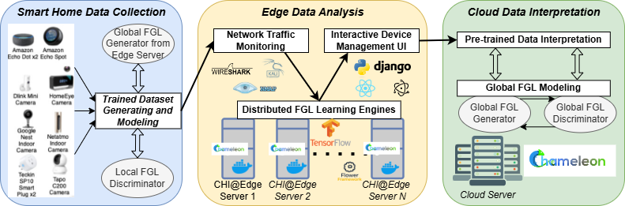
System Architecture Overview
Smart Home Data Collection
The edge devices will be responsible for collecting network traffic data
Low-level host servers could provide balanced synthetic generated data to conduct advance training after model aggregation before returning the model to the clients.
Another method to send data is to send packets of data on the network modeled by the generative model.
Edge Data Analysis
Edge Devices and low-level host servers will be distributed pretrained model to be fine-tuned.
Edge Devices will manage the interactive device management UI.
Edge Devices are also responsible for monitoring the network traffic and additional metrics such as usage.
Cloud Data Interpretation
The remote cloud servers will be responsible for pretraining the models and distributing them across the edge servers.
The remote nodes will be the high-level host server and manage the overall fine-tuning process.
Figure: Overview of The Hierarchical Federated Learning (HFL) Framework for Smart Home Data Collection, Analysis and Interpretation Using CHI@Edge and Chameleon Cloud Infrastructure

Slide 13
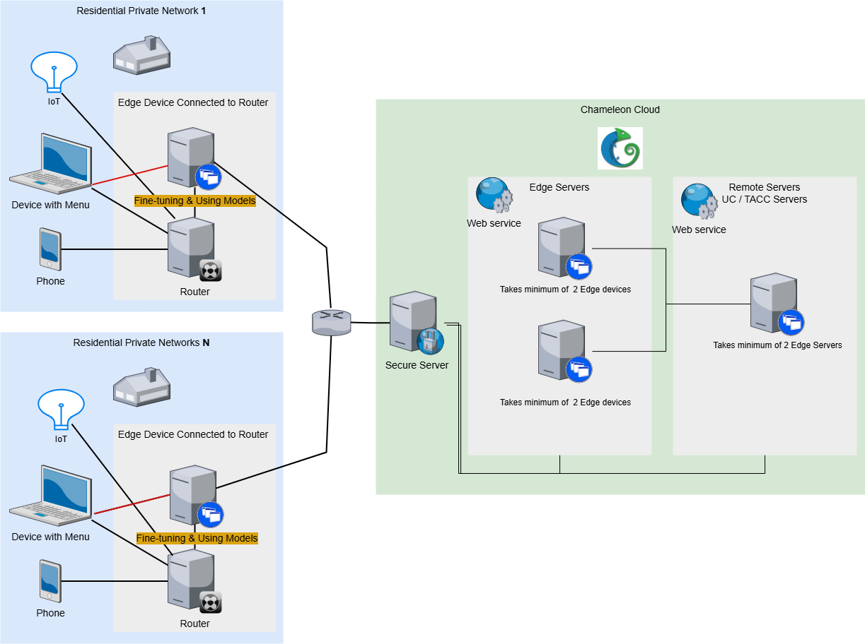
Network Topology
The Edge Device is connected to the router to read the network traffic feed of the whole private network.
A desktop or laptop can have the menu to interact with the Edge Device is deployed.
The Edge Device is the device responsible for reading the network traffic feed, providing additional insights about the network, and detecting network intrusions using the NIDS system
The Edge Servers and Remote Servers also have Web-Services to provide metrics and status of the Cloud Servers
The Edge Servers act as the host for the Edge Device Client Models, while the Remote Server act as the host for the Edge Server Client Models
To perform Federated Training, it takes a minimum of two Edge Devices or Servers as clients or connecting to the host server

Slide 14


Application Scenarios
Smart Home Network Security System:
Provides seniors and families with a secure, easy-to-manage environment by keeping sensitive data local and minimizing latency.
Can be scaled up to Private Network Security.
Possibly Enterprise Level.
Network Security in Drone Swarms or IoT Clusters:
Ideal for applications in defense, agriculture, and environmental monitoring where autonomous drones or IoT clusters need robust, decentralized network security, Connecting AR/VR to Drones in a secure manner, etc.
Each drone or IoT device in the swarm acts as a node that collects local network data and collaborates with other nodes to train a collective security model.
Edge servers or a primary node can aggregate models to identify intrusion patterns across the entire swarm.

Slide 15
Table of Agendas
Motivations & Problem
Deep Learning Intrusion Detection System
Federated Training (FL) vs. Hierarchal Federated Training (HFL)
Defenses & Enhancements for Federated & DNN Models
Limitations & Potential Solutions
Solution Approach
Chameleon Cloud Platform
System Architecture & Network Topology of HFL-NIDS
Application Scenarios
Evaluation
Experiment Trials
Preliminary Results & Methods
Conclusion
Experiences & Lessons Learned with Chameleon Cloud
Plans for Reproducibility

Slide 16
Experiment Trials
Experiment 1:
Testing deep learning model strategies & hierarchal federated learning training pipelines to determine most efficient computational load and best security.
Trial set 1: HFL Pipeline with dedicated IDS model & Non-Partitioned GAN model
Trial set 2: HFL Pipeline with a Partitioned GAN model
Trial set 3: HFL Pipeline with a Partitioned GAN model & Partitioned Training Strategy for Discriminator.
Experiment 2:
Testing Cyberattack scenarios with various defense strategies, utility enhancements, & hyperparameter tuning to improve models used in the system.
Trial set 1: Defense Strategies
Trial set 2: Utility Enhancements & Hyperparameter Tuning
Trail set 3: All
Key Measurements:
Hardware Performance Metrics: CPU/GPU Utilization, RAM & VRAM usage, Power/Battery Drain, Bandwidth, Latency
Model Performance Metrics: Accuracy, Precision, Recall, AUC-ROC, Log-Cosh
System Security: Detection, Detection-Latency, Resilience Against Interception & Adversarial Attacks

Slide 17
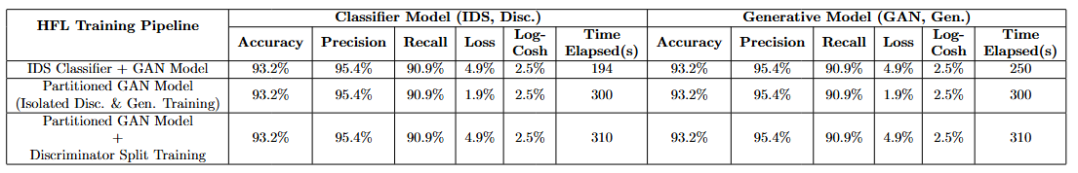
Preliminary Results & Methods - HFL Pipeline
These Experiment Trials Investigates Training:
GAN model to support other classifiers:
The GAN model can be fine-tuned centrally or in a hybrid-decentralized manner.
The Classifier model can be finetune in a hybrid-decentralized approach with advance training from the GAN model by augmenting its training data and providing adversarial training.
Stand-alone decentralized GAN that has separated the sub-models:
Training the GAN model with both sub-models together takes a lot of computational resources. Especially the Generator model.
Partitioning the GAN model to have the discriminator be fine-tuned hybrid-decentralized approach.
The generator will be fined-tuned centrally or in a hybrid-decentralized manner.
Partitioned GAN Model with a Discriminator with 2 phases of separate training:
The Discriminator is classifier that with an output dedicated to determining whether the data is fake or real. This can be selectively trained during the training process, allowing the model to train on classifying less computationally demanding outputs.
Discriminator Split Training describes the discriminator model having to split the training process between classifying anomalies in network traffic in a hybrid-decentralized manner and discriminating synthetic traffic centrally or in hybrid decentralized manner.
Each HFL Model Training Pipeline is tested to determine which is the most computationally efficient model & training strategy.
Table 1: Example Results of Various Attack Scenarios with Baseline Training Vs All Defenses Training Strategy

Slide 18
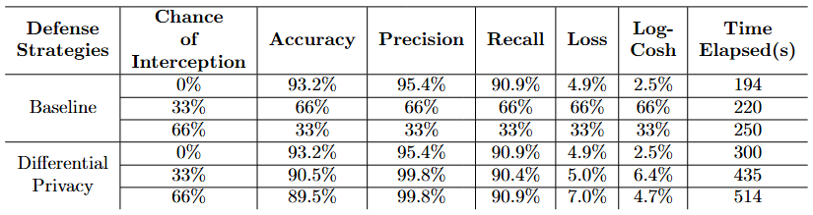
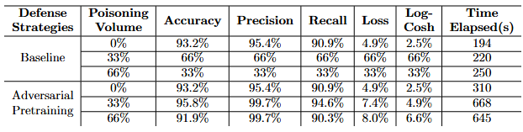
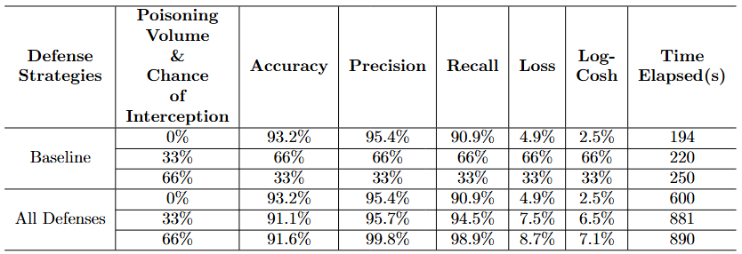
Preliminary Results & Methods - Model Defense Strategies
Methods
Attacks:
Feature Noise poisoned data is injected onto the node
Intercepting certain packets transmitted between certain clients and edge resources hosting the training process.
Defenses:
Adversarial data is added to the training data to each batch before fitting the model
A custom compiler by Tensorflow-privacy is made to implement differential privacy during training
The goal is to determine whether the defenses can withstand the attacks while still being computationally efficient.
Table 2: Example Results of MITM Attack Scenario with Baseline Training Vs Differential Privacy Training
Table 3: Example Results of Feature-Noise Data Attack Scenario with Baseline Training Vs Adversarial Pretraining
Table 4: Example Results of MITM & Feature-Noise Data Attack Scenarios with Baseline Training Vs All Defenses Training Strategy

Slide 19
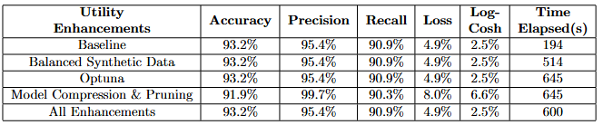
Preliminary Results & Methods - Model Enhancements
Each Utility Enhancement is tested by training the model with the enhancement added.
This is done by either initiating objects that will scan the models layer structure to optimize it, or by adding the synthetic data into the training data before fitting the model.
The goal of these trails is to determine which enhancements are computationally inefficient when training or using the model
Table 5: Example Results of Various Attack Scenarios with Baseline Training Vs All Defenses Training Strategy

Slide 20
Table of Agendas
Motivations & Problem
Deep Learning Intrusion Detection System
Federated Training (FL) vs. Hierarchal Federated Training (HFL)
Defenses & Enhancements for Federated & DNN Models
Limitations & Potential Solutions
Solution Approach
Chameleon Cloud Platform
System Architecture & Network Topology of HFL-NIDS
Application Scenarios
Evaluation
Experiment Trials
Preliminary Results & Methods
Conclusion
Experiences & Lessons Learned with Chameleon Cloud
Plans for Reproducibility
Notes:
As a brief overview of our project. First, I will introduce the background knowledge on geospatial video analytics in Unmanned Aerial System (UAS), the motivation of our project, and our previous works. Then I will discuss our investigation on network and drone simulators nowadays. According to that, I will present our proposed solution, which is a novel trace-based network and drone simulation framework. To test and show the usage of our project, we also introduce some experiments in practice as an idea of our project users. Lastly, I will conclude our project and discuss our future work. (CLICK)

Slide 21
Obstacles in Reproducibility
The provided Docker images with CUDA pre-installed by Chameleon are not compatible with the hardware installed and will not utilize the GPU during training.
Setting up CUDA on various devices with different GPUs is challenging.
Significant challenges were experienced in attempting to set up an experiment environment where I can securely test defense on the system.
Physical Edge Devices and IoT devices will have to be obtained to reproduce the same topology in the current research.
Distant Proximity to CHI@Edge Servers

Slide 22

Pathway to the Reproducibility
Devices in EagleCyberNest: Router, Jetson, & Sensors
Experiment 1: HiperGator – From UF. Topology:
Testbed in HiperGator, has no-so-powerful HPC.
HiperGator as edge server due to closer proximity to your physical devices in EagleCyberNest lab.
Experiment 2: Pure Chameleon platform
Cloud + Edge running fully on Chicago cites.
Experiment 3: Combine Edge and Cloud together – Florida + Chicago
Florida: Edge Server + Edge Devices;
Chicago: Edge Servers + Cloud Servers

Slide 23
Pathway to the Reproducibility – cont.
Standardized Experimental Setups/Testbed: Ensure consistent & secure environments for experiments by using standardized configurations and pre-configured setups that are custom or provided by Chameleon.
Overcome challenges in setting up CUDA on Chameleon nodes
Further Investigate configuring the network environment to be isolated & secure
Open-Source Code & Data, Version Control, & Comprehensive Documentation Methodologies: Check out the GitHub to track progress, latest documents, and source code of the research
Keko787/HFL-DNN-GAN-IDS

