Slide 1
ACADEMIC CALENDAR MANAGEMENT SYSTEM
Group 01
2018/E/022 Cumaranathunga P.I.A.
2018/E/031 Eranda A.H.
2018/E/091 Perera U.L.K.K.
2018/E/104 Sachintha D.C.
2018/E/108 Sathurjan J.
EC6060 SOFTWARE ENGINEERING

Slide 2
ROLE PLAYERS
Staff
Undergraduates
AR System Admin
IT Management
EC6060 SOFTWARE ENGINEERING

Slide 3
REQUIREMENT GATHERING
Basic information to be provided to the user
Semester start date
Semester end date
Holidays
Dead weeks
Mid semester exam timetable
End semester exam timetable
Alerts
course registration in coming weeks, started, ended
exam dates
academic progress (which academic week is currently ongoing etc.)
Microsoft work flow to send notifications
If someone failed a subject and when exam registration for that particular subject is in progress app should alert the user
AR is always the person who update the calendar.
Should be visible for both staff and students.
EC6060 SOFTWARE ENGINEERING

Slide 4
NON FUNCTIONAL REQUIREMENTS
Security
only authorized users have the eligibility for the system
Reliability
system should work properly under any traffic condition
Responsiveness
system should be responsive and user friendly
Cost-effective
system should be optimized and should worth for the hosting costs
EC6060 SOFTWARE ENGINEERING

Slide 5
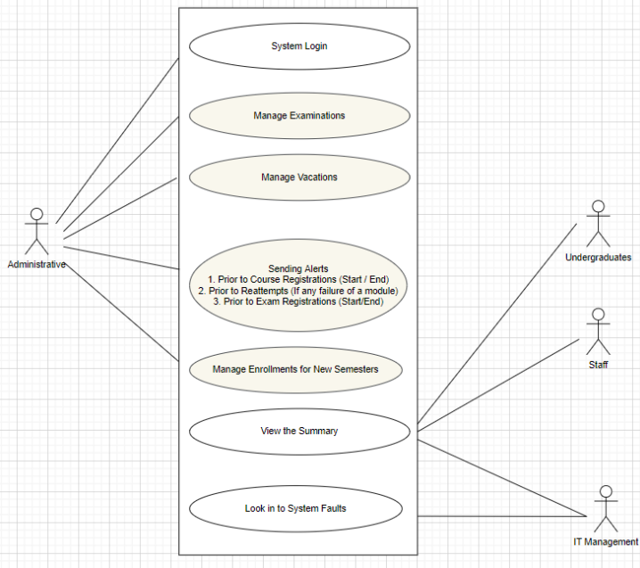
USE CASE DIAGRAM
EC6060 SOFTWARE ENGINEERING

Slide 6
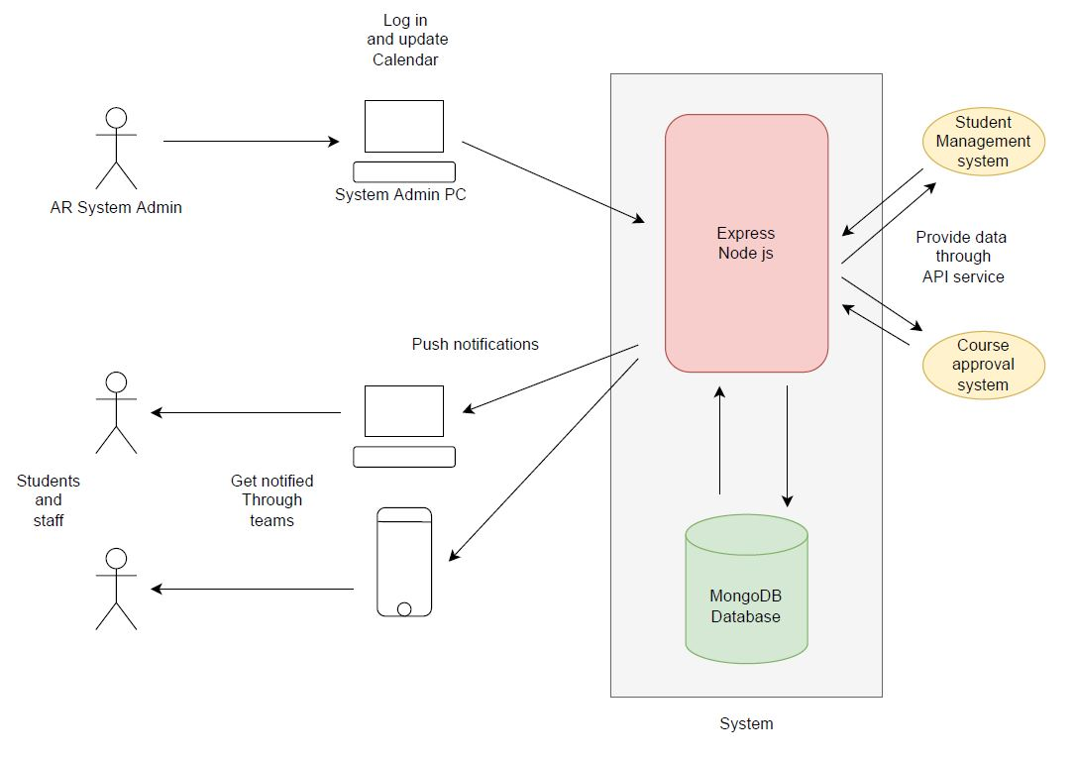
APPLICATION WORKFLOW
EC6060 SOFTWARE ENGINEERING

Slide 7
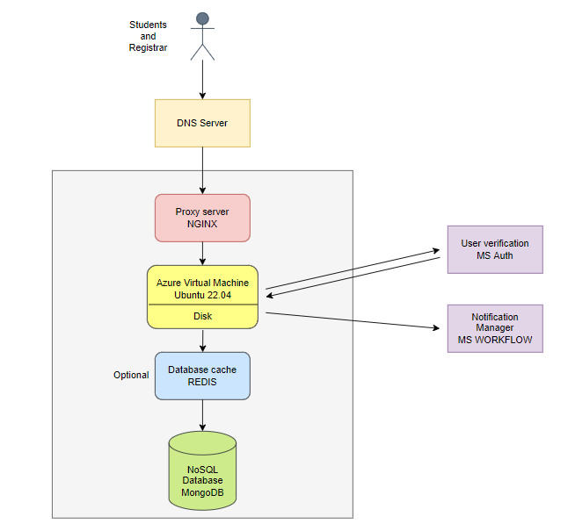
SYSTEM ARCHITECTURE
EC6060 SOFTWARE ENGINEERING

Slide 8
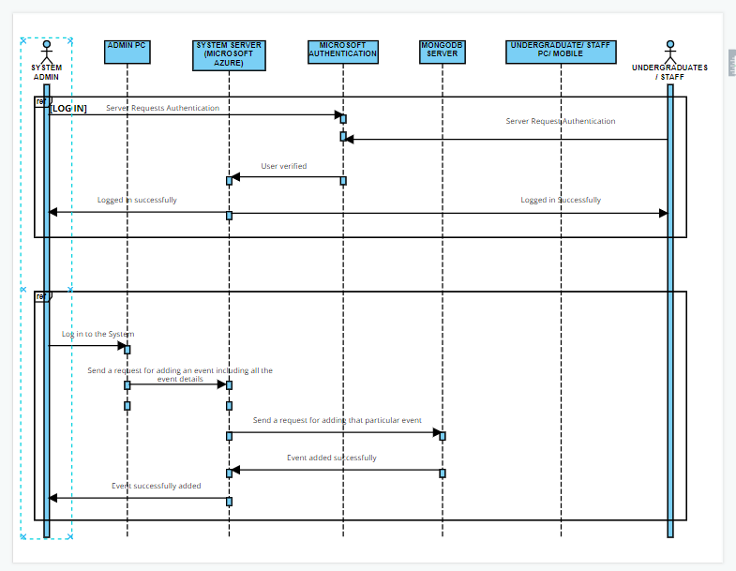
SEQUENCE DIAGRAM SIGN IN AND ADDING AN EVENT
EC6060 SOFTWARE ENGINEERING

Slide 9
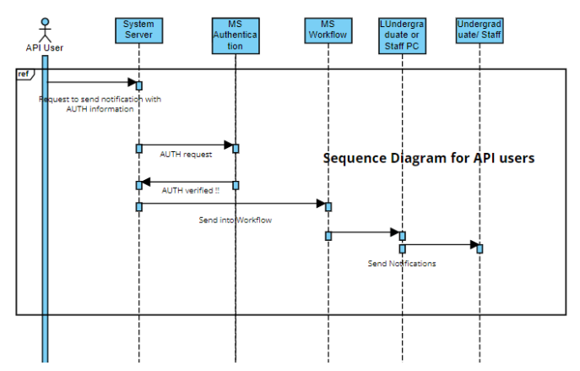
SEQUENCE DIAGRAM FOR API USERS
EC6060 SOFTWARE ENGINEERING

Slide 10
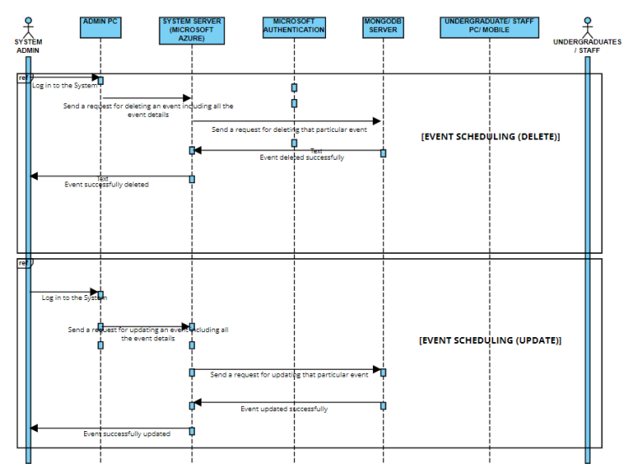
SEQUENCE DIAGRAM DELETING AND UPDATING AN EVENT
EC6060 SOFTWARE ENGINEERING

Slide 11
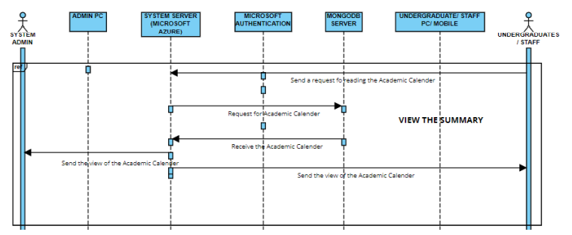
SEQUENCE DIAGRAM VIEW THE SUMMARY
EC6060 SOFTWARE ENGINEERING

Slide 12
CURRENT IMPLEMENTATION PROGRESS
Express server with CRUD operations
Mongo dB instance
Front end view (React)
Testcases for current APIs
EC6060 SOFTWARE ENGINEERING

Slide 13
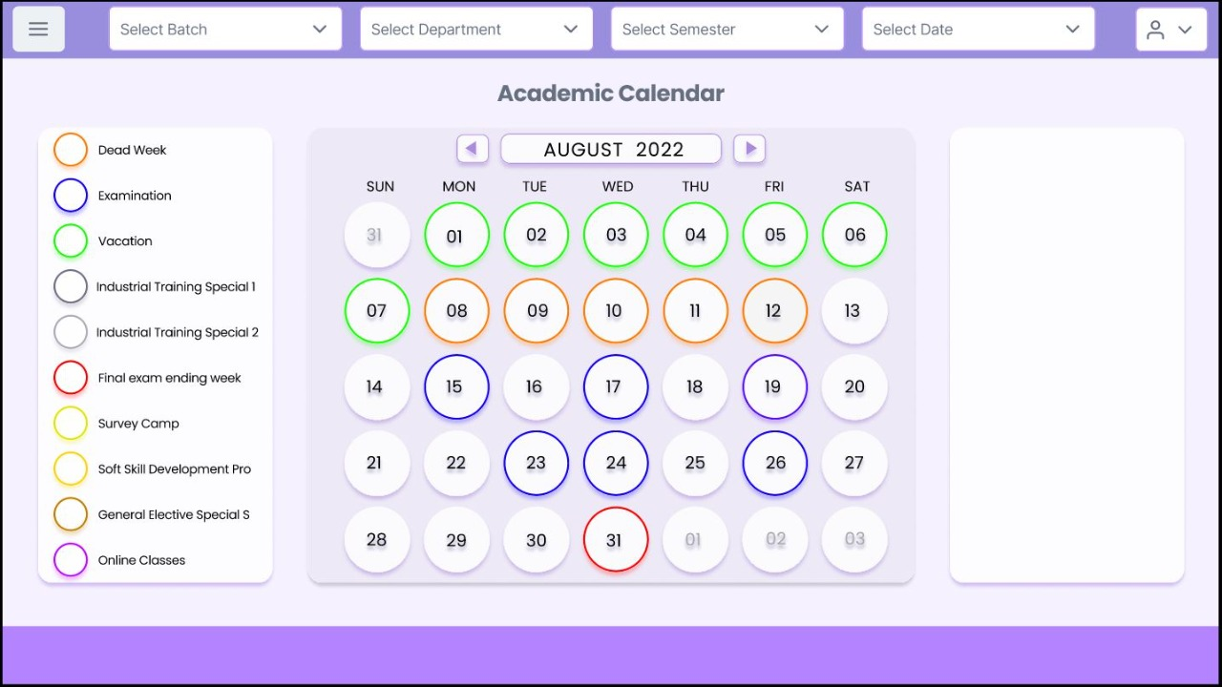
PROPOSED UI DESIGN
https://www.figma.com/file/IPv7RZ6prAhNObLnDxr76Z/Untitled?node-id=0%3A1
EC6060 SOFTWARE ENGINEERING

Slide 14
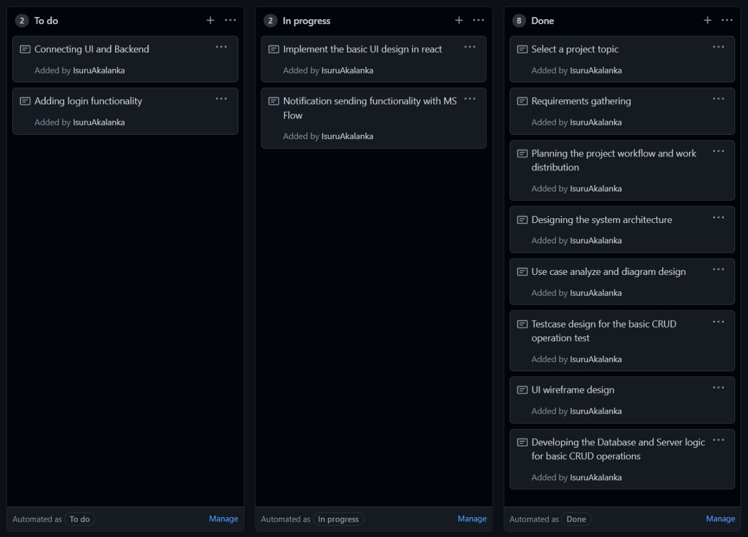
KANBAN BOARD
EC6060 SOFTWARE ENGINEERING

Slide 15
HOW WE COLLABORATED
EC6060 SOFTWARE ENGINEERING

Slide 16
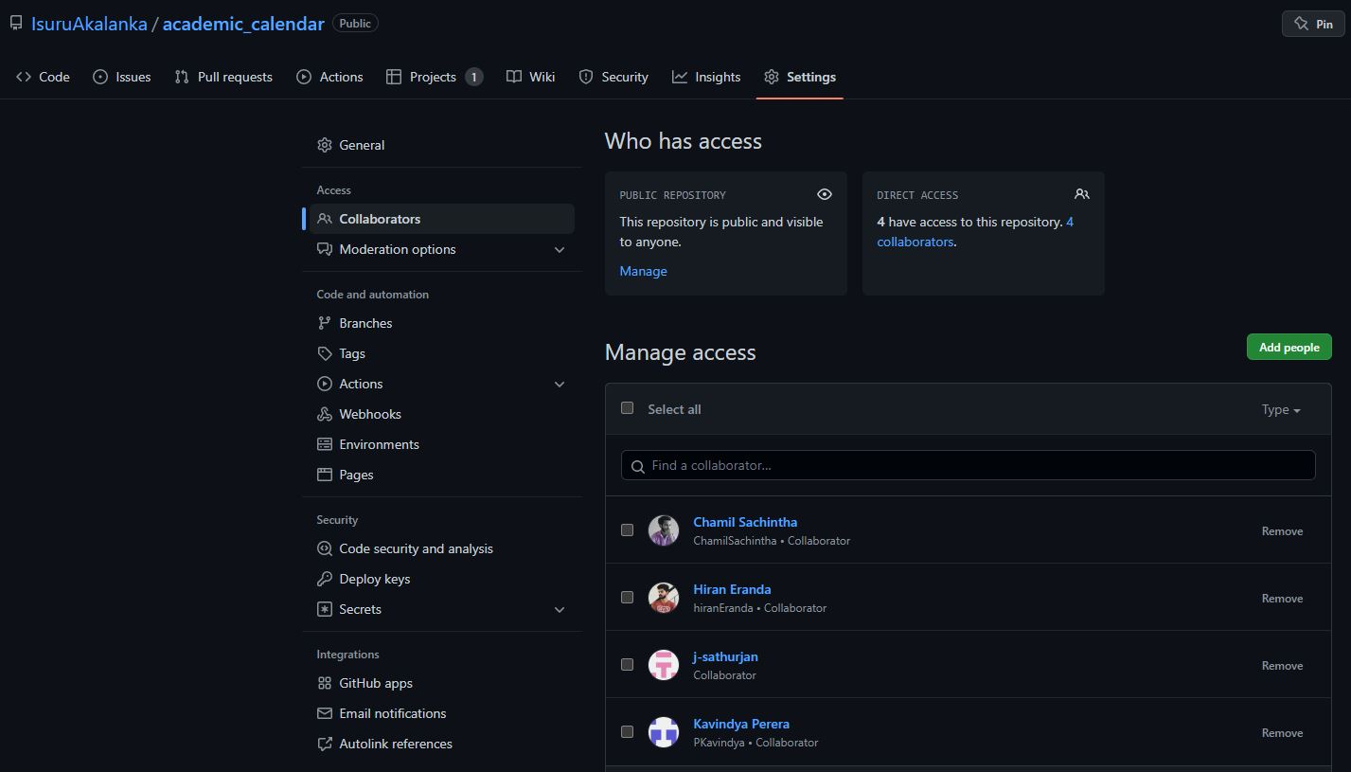
EC6060 SOFTWARE ENGINEERING

Slide 17
CONTRIBUTION
Completed
TASK | E022 | E031 | E091 | E104 | E108
Information gathering
Use case diagram
System architecture
UI design
Backend Implementation
Frontend implementation
EC6060 SOFTWARE ENGINEERING

Slide 18
THANK YOU
EC6060 SOFTWARE ENGINEERING

