Slide 1
ACADEMIC CALENDAR MANAGEMENT SYSTEM
2018/E/022 - Cumaranathunga P.I.A.
2018/E/031 – Eranda A.H.
2018/E/091 – Perera U.L.K.K.
2018/E/104 – Sachintha D.C.
2018/E/108 – Sathurjan J.

Slide 2
Requirement gathering
Basic information to be provided to the user
Semester start date
Semester end date
Holidays
Dead weeks
Mid semester exam timetable
End semester exam timetable
Alerts
course registration in coming weeks, started, ended
exam dates
academic progress (which academic week is currently ongoing etc.)
Microsoft work flow to send notifications
If someone failed a subject and when exam registration for that particular subject is in progress app should alert the user
AR is always the person who update the calendar.
Should be visible by both staff and students.

Slide 3
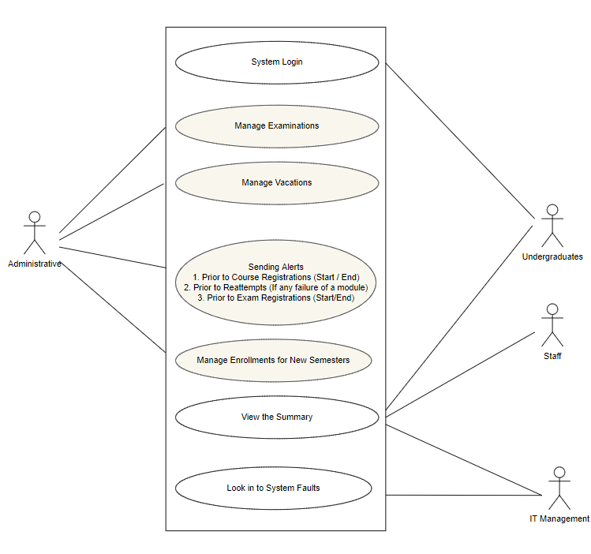
Use case diagram

Slide 4
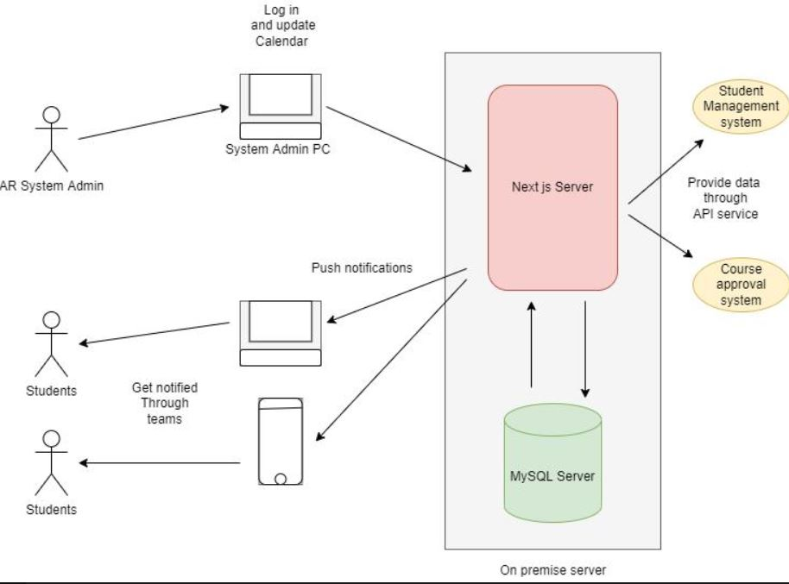
Application workflow

Slide 5
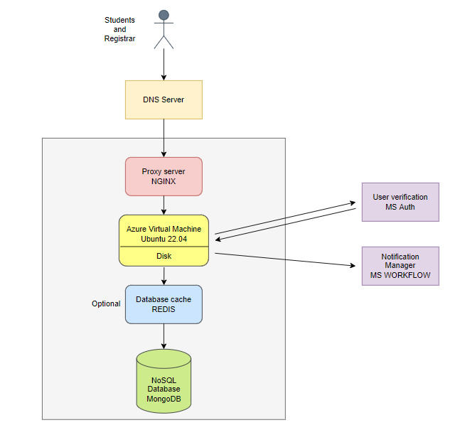
System Architecture

Slide 6
Current implementation progress
Express server with CRUD operations
Mongo dB instance
Front end view (React)
Testcases for current APIs

Slide 7
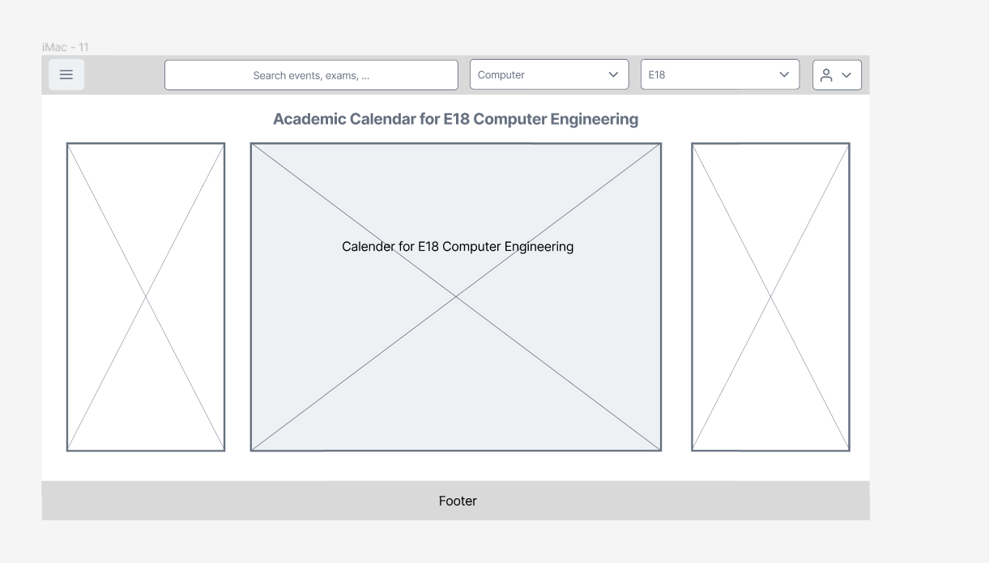
UI design
https://www.figma.com/file/xwCOSCV8gPAz2r6lvPhY1g/Untitled?node-id=0%3A1

Slide 8
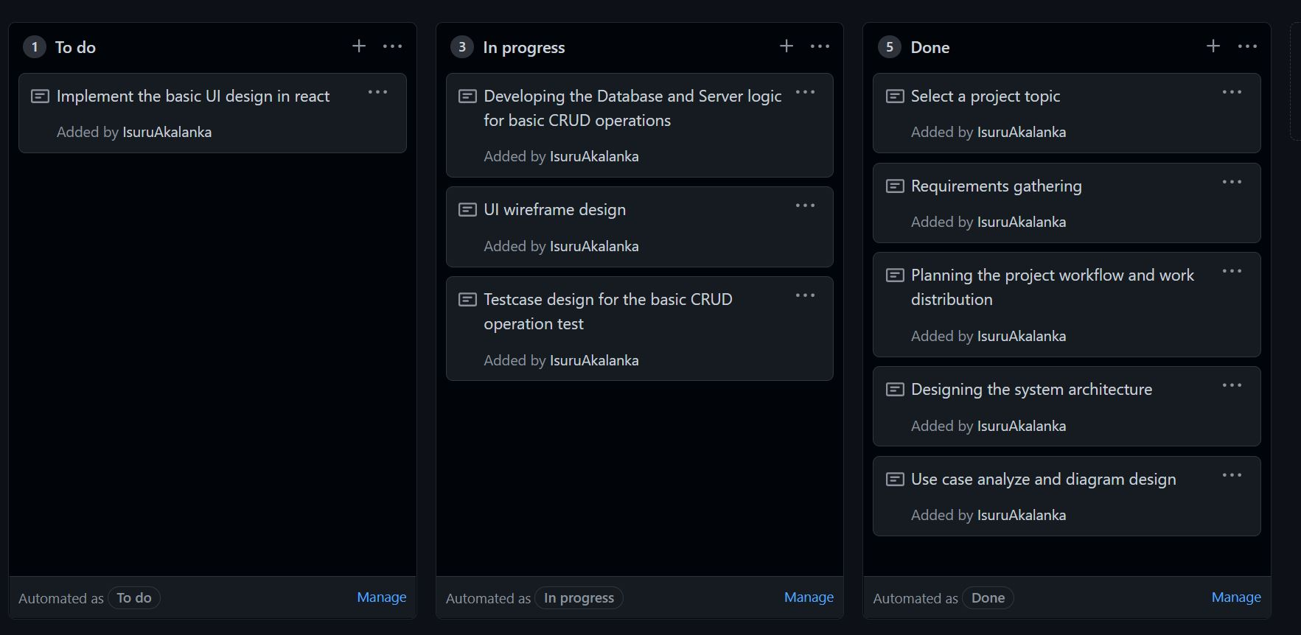
Kanban Board

Slide 9
How we collaborated?

Slide 10
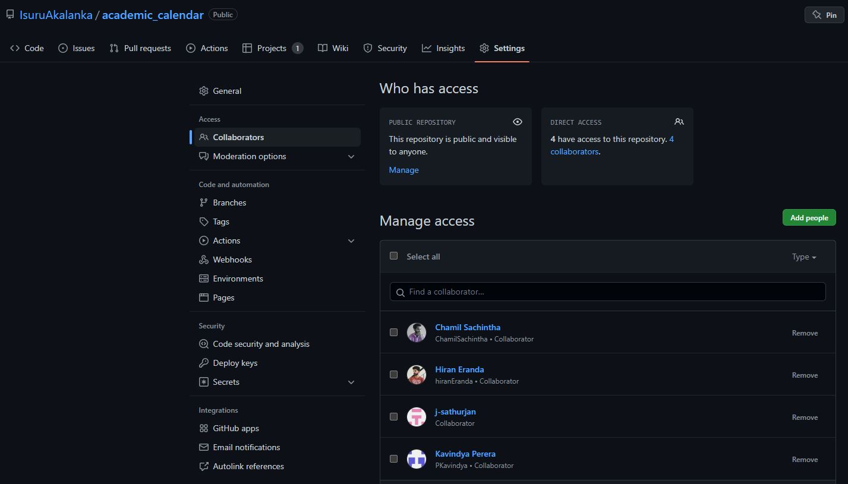

Slide 11
Contribution
 | E022 | E031 | E091 | E104 | E108
Information gathering
Use case diagram
System architecture
UI design
Backend Implementation
Frontend implementation
Completed
In progress
To-do

Slide 12
THANK YOU

