Slide 1

EXPLAINABLE DEEP LEARNING FRAMEWORK
FOR PNEUMONIA DETECTION AND CLASSIFICATION
USING TRANSFER LEARNING AND GRAD-CAM
Presented By
G. C. M. SEWWANDI
Supervised By
Ms. R. W. K. T. Rajapaksha
Index No
29002
Bachelor of Science (Honours) in Computer Science
Department of Computer and Data Science | NSBM Green University
Notes:
Good aftrenoon, respected panel members.
I am G. C. M. Sewwandi, and my student index number is 29002. I carried out my final-year research project under the supervision of Ms. R. W. K. T. Rajapaksha.
Today, I am here to present my research project titled "Explainable Deep Learning Framework for Pneumonia Detection and Classification Using Transfer Learning and Grad-CAM".

Slide 2




RESEARCH PROBLEM
Research problem: Pneumonia and other lower respiratory infections killed about 2.18 million people worldwide in 2021 (GBD 2021), yet existing models are mostly binary, offline and unexplained. No real-time tool sorts a chest X-ray into Normal, COVID-19, bacterial and viral pneumonia and shows its evidence with Grad-CAM.
Only binary answers
No working real-time tool
No trustworthy explanation
Most systems only say "pneumonia or not". They cannot separate bacterial from viral, which decides whether antibiotics are needed.
Reported systems stay as offline experiments.
Doctors cannot see why the model decided, and it looks confident even when it is wrong.
Why it matters: pneumonia must be treated by its cause, but radiologists are scarce outside large hospitals. In rural and low-income areas an expert reading is slow and costly, so treatment is often decided without one.

Slide 3

MOTIVATION
AND RESEARCH GAP
Limitations of existing work (Table 3.1)
Study | Classes | Explainability | Input check | Deployed
Rajpurkar et al. | Pneumonia vs rest | CAM, qualitative | None | No
Apostolopoulos | Binary, 3-class | None | None | No
Ozturk et al. | Binary, 3-class | Heatmaps, qualitative | None | No
Narin et al. | Binary COVID-19 | None | None | No
Chowdhury et al. | Normal, viral, COVID | Score-CAM, qualitative | None | No
This study | Four class | Grad-CAM, quantified | Mahalanobis, evaluated | Yes
Pneumonia is a leading cause of death, hardest on children under five and the elderly.
Cause decides treatment: bacterial needs antibiotics, viral usually does not, COVID-19 also needs isolation.
Chest X-ray is the cheap first-line test, but findings overlap and radiologists are scarce, above all in rural, low-income areas.
What is needed: a real-time four-class tool on ordinary hardware that refuses to answer when unsure and shows what it looked at.
Research gap: no evaluated chest X-ray system delivers real-time four-class decision support with a safeguard against invalid inputs and measured Grad-CAM explanations.
No reviewed system reports an input validity metric or an explanation localisation metric.
Notes:
Why does this matter? Pneumonia is a leading cause of death, especially for small children and older people. The cause decides the treatment: bacterial needs antibiotics, viral usually does not, and COVID-19 also needs isolation. The chest X-ray is the cheap first test, but the findings overlap and radiologists are scarce, most of all in rural and low-income areas, where a specialist opinion is slow and expensive.
So what is needed is a real-time four-class tool that runs on ordinary hardware, refuses to answer when the input is not valid, and shows what it looked at.
The table shows the limits of existing work.
So the research gap is: no evaluated chest X-ray system delivers real-time four-class decision support with an input safeguard and measured Grad-CAM explanations.

Slide 4
AIM, OBJECTIVES AND RESEARCH QUESTIONS
AIM Design, implement and evaluate an explainable, out-of-distribution aware framework for four-class pneumonia classification, delivered as a real-time decision support platform usable where radiologists are scarce.
Objectives
Research questions
RO1
Review existing systems (binary, offline, unexplained) and derive requirements
Main RQ To what extent can an explainable four-class classifier, rather than a binary one, be delivered as a real-time decision support system for settings short of radiologists, and made trustworthy through Grad-CAM and a OOD safeguard?
RO2
Compare three CNNs for four-class classification on one common split
RQ1
What performance and per class error structure do the three CNNs achieve on the four-class task?
RO3
Build the OOD safeguard and a real-time web and mobile platform with Grad-CAM
RQ2
Can inference time signals detect OOD inputs well enough to withhold a diagnosis, and at what cost?
RO4
Evaluate the safeguard, where explanations look, and the response time
RQ3
Do Grad-CAM explanations fall on the lungs and on class-relevant regions?
RO5
Recommend when it suits triage where radiologists are scarce
RQ4
Can the full system return a diagnosis and its explanation in real time?
Notes:
My aim follows directly from my general research question. Today there is no working four-class system, most are binary, and rural and low-income areas lack radiologists and money. So my aim is to design, build and evaluate an explainable, out-of-distribution aware framework for four-class pneumonia classification, and deliver it as a real-time platform that can be used where radiologists are scarce.
The five objectives divide that aim. RO1 reviews why existing systems are binary, offline and unexplained, and derives the requirements. RO2 compares three CNNs for the four-class task on one split. RO3 builds the safeguard and puts it, together with Grad-CAM, into a real-time web and mobile platform. RO4 evaluates the safeguard, where the explanations look, and the response time. RO5 gives recommendations on when it suits triage where radiologists are scarce.
My main research question asks how far a four-class classifier, instead of a binary one, can be delivered as a real-time decision support system for places without enough radiologists, and made trustworthy with Grad-CAM and a safeguard that needs no retraining. Each part has its own question: RQ1 is the four-class performance and errors, RQ2 is detecting invalid inputs and the cost to real scans, RQ3 is whether Grad-CAM looks at the lungs and the right regions, and RQ4 is whether the full system answers in real time.

Slide 5



PROPOSED SOLUTION AND RESEARCH CONTRIBUTION
CONTRIBUTIONS
Penultimate features
OOD check
Per class evidence
for the four-class task on one common split
Trained CNN, one forward pass
safeguard
Chest X-ray
Pre-softmax logits
Class probabilities
Measured XAI
logit Grad-CAM in the lungs, in-lung share disclosed
Feature maps
Grad-CAM + lung focus
Working platform
If the input is out of distribution the diagnosis is withheld; otherwise the class is shown with a lung-restricted heatmap and its in-lung share.
about 3 s per scan, with reports
Notes:
Here is my solution. One chest X-ray goes through the trained CNN in a single forward pass, and I use three outputs from it.
The penultimate features go to the out-of-distribution check. The pre-softmax logits give the class probabilities. The feature maps give Grad-CAM and the lung-focus measure.
If the input is out of distribution, the diagnosis is withheld. Otherwise the class is shown with a lung-restricted heatmap and the share of attention inside the lungs.
My contributions are per class evidence, a safeguard that needs no retraining, a measured explanation, and a working platform that answers in about three seconds on an ordinary computer without a GPU, with reports in English, Sinhala and Tamil, so it can be used where radiologists are scarce.

Slide 6



RESEARCH METHODOLOGY AND SYSTEM ARCHITECTURE
M1
M2
M3
M4
M5
M6
M7
M8
Problem identification
Literature synthesis
Data audit and split
Train three CNNs
Select model
OOD calibration
Platform integration
Evaluation
Artefact frozen after M6; the test partition is first opened at M8
Presentation tier
Upload X-ray
Backbone forward pass
Next.js + TypeScript PWA: upload, results, history, admin
features (256-d)
OOD
Application tier
PHP REST API: token auth, roles, MySQL, trilingual PDF report
logits = fW + b
softmax, energy
feature maps
Grad-CAM
Inference tier (contribution)
FastAPI + TensorFlow: OOD detector, logit Grad-CAM, lung field
Decision: OOD, withhold with reason; else class, heatmap, in-lung share
Notes:
My research is post-positivist, mostly deductive, and follows a design science strategy. The work had eight steps, M1 to M8. I froze the system after M6, the OOD calibration, and the test data was opened only at M8, so no result was used to tune the system.
The system has three tiers: a Next.js web app, a PHP REST API with MySQL and the PDF reports, and a FastAPI and TensorFlow inference service, which holds my contribution.
On the right is the inference pipeline. After the forward pass, the features give OOD, the logits give softmax and energy, and the feature maps give Grad-CAM.

Slide 7
IMPLEMENTATION AND EXPERIMENTAL SETUP
Dataset (Table 4.1)
Tools and training
Evaluation
Class | Total | Train | Val | Test
COVID-19 | 1,281 | 897 | 192 | 192
Normal | 3,271 | 2,289 | 491 | 491
Bacterial | 3,001 | 2,101 | 450 | 450
Viral | 1,656 | 1,159 | 248 | 249
Total | 9,209 | 6,446 | 1,381 | 1,382
Python, TensorFlow / Keras
NumPy (detector), OpenCV (lung field)
FastAPI, PHP REST, MySQL, Next.js
Two-stage transfer learning: frozen head, then fine-tune (LR 0.00001)
Adam, class weighted cross entropy, early stopping
Batch 32 / 24 / 16; input 224 or 300 px
One workstation, no GPU accelerator
Accuracy, macro precision, recall, F1, confusion matrix
AUROC, retention and flag rate for OOD
Held-out test set: 1,382 images, never used in training
Far probe: 60 synthetic images (noise, gradients, solid colour)
End to end latency over ten uploads
Ten functional and non functional test cases
Curated public collection, de-identified
Audit removed duplicate, corrupt and low resolution files
Stratified 70 / 15 / 15 split, reused by all three models and by calibration
Notes:
For data I used 9,209 public, de-identified chest X-rays in four classes, split 70, 15 and 15 percent in a stratified way. All three models and the calibration use the same split.
I used Python, TensorFlow and Keras, NumPy for the detector and OpenCV for the lung field. Training used two-stage transfer learning, Adam, a class weighted loss and early stopping, on one computer without a GPU.
For evaluation I used accuracy, macro precision, recall and F1, the confusion matrix, AUROC for the safeguard, a far probe of 60 synthetic images, latency tests and ten test cases.

Slide 8
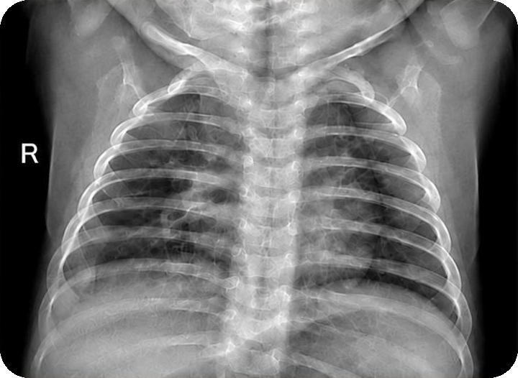
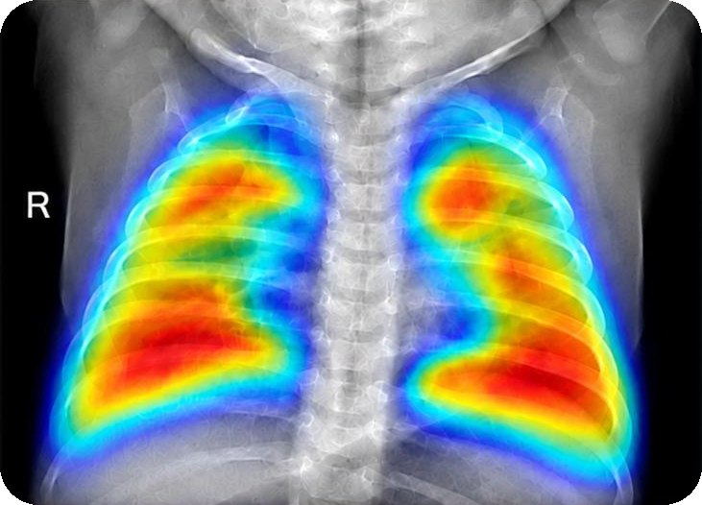
RESULTS AND EVALUATION
Model | Accuracy | Macro F1 | Macro recall
DenseNet121 | 85.31% | 0.844 | 0.845
EfficientNetV2B3 | 84.30% | 0.828 | 0.825
EfficientNetV2S | 80.54% | 0.798 | 0.812
System results
✓ PDF report: generated for every scan, with the Grad-CAM and result
✓ Three languages: report in English, Sinhala and Tamil
✓ Prediction history: every scan stored and reopened with its result
✓ Withheld diagnosis: invalid images get no diagnosis, also in history and report
✓ Secure access: role-based login; other users’ scans refused
✓ Real time: median 3.18 s per request.
Normal, 99.9%: in-lung share 0.350, caution shown
Notes:
These are my main results on 1,382 test images. DenseNet121 was best with 85.31 percent and a macro F1 of 0.844.
The chart shows COVID-19 and Normal are almost solved, but viral pneumonia is hard.
DenseNet121 achieved the highest or comparable performance across all classes. Therefore, I selected DenseNet121 for the system.

Slide 9
DISCUSSION, CONCLUSION AND FUTURE WORK
Good at screening, weak at the cause
Says "no" to wrong images
Shows where it looked
COVID-19 and Normal are almost always right. Most mistakes (69-76%) mix up bacterial and viral pneumonia.
A non-X-ray image gets no diagnosis. The check uses the model's own features, with no retraining.
Grad-CAM shows the lung areas used, and the system says how much attention was inside the lungs.
Answer to the main RQ: yes, with limits. A real-time helper for doctors where radiologists are few, not a replacement for a doctor.
Limitations
Future work
Only one public dataset and one training run per model
Grad-CAM not checked by a radiologist
Test with real X-rays of other diseases and real photos
Improve the bacterial vs viral separation
Train on lung-only images; test in real hospitals

Slide 10
KEY REFERENCES
[1] E. J. Topol, "High-performance medicine," Nature Medicine, 2019.
[7] M. E. H. Chowdhury et al., "Can AI help in screening viral and COVID-19 pneumonia?," IEEE Access, 2020.
[9] P. Rajpurkar et al., "CheXNet: Radiologist-level pneumonia detection on chest X-rays," arXiv, 2017.
[10] A. Nguyen et al., "Deep neural networks are easily fooled," CVPR, 2015.
[12] I. D. Apostolopoulos and T. A. Mpesiana, "Covid-19: Automatic detection from X-ray images," PESM, 2020.
[13] T. Ozturk et al., "Automated detection of COVID-19 cases using deep neural networks," CBM, 2020.
[14] A. Narin et al., "Automatic detection of coronavirus disease (COVID-19)," PAA, 2021.
[15] D. Hendrycks and K. Gimpel, "A baseline for detecting misclassified and OOD examples," ICLR, 2017.
[16] K. Lee et al., "A simple unified framework for detecting OOD samples," NeurIPS, 2018.
[17] W. Liu et al., "Energy-based out-of-distribution detection," NeurIPS, 2020.
[19] A. J. DeGrave et al., "AI for radiographic COVID-19 detection selects shortcuts over signal," Nat. Mach. Intell., 2021.
[24] G. Huang et al., "Densely connected convolutional networks," CVPR, 2017.
[26] M. Tan and Q. V. Le, "EfficientNetV2: Smaller models and faster training," ICML, 2021.
[30] R. R. Selvaraju et al., "Grad-CAM: Visual explanations from deep networks," ICCV, 2017.
[33] L. O. Teixeira et al., "Impact of lung segmentation on the diagnosis and explanation of COVID-19," Sensors, 2021.
Numbering follows the thesis reference list.
Notes:
These are the key references I mentioned, numbered as in my thesis: CheXNet and the COVID-19 studies, the out-of-distribution methods of Hendrycks, Lee and Liu, the shortcut learning study by DeGrave, and the DenseNet, EfficientNetV2 and Grad-CAM papers.

Slide 11

THANK YOU
Questions?
Notes:
Thank you very much for your attention. I am happy to answer your questions.

