Slide 1

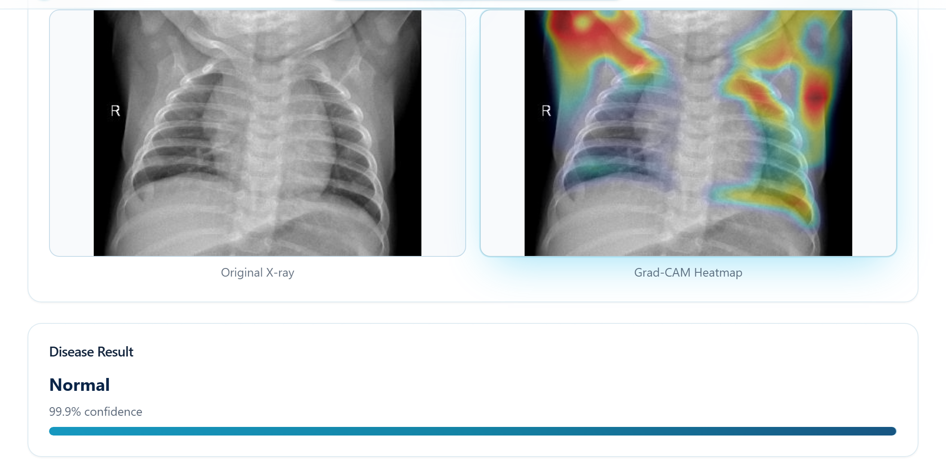
BSc (Hons) COMPUTER SCIENCE · FINAL YEAR RESEARCH PROJECT
An Explainable and Out of Distribution Aware Deep Learning Framework for Four Class Pneumonia Classification from Chest Radiographs
G. C. M. Sewwandi
Student ID 29002
Department of Computing · Faculty of Computing
NSBM Green University, Homagama, Sri Lanka · 2026

Slide 2
AGENDA
What this talk covers
01
02
03
The problem
Design and method
The platform
Why an accurate classifier is still not a safe one
Design science, the data, and the three components that carry the contribution
The delivered system, screen by screen
04
05
Evidence
Conclusions
Classification, input validity, explanation and system testing
What the evidence supports, what it does not, and what comes next
The contribution sits between the forward pass and the interface: the system decides whether it is entitled to answer before it answers.
LungVision AI · G. C. M. Sewwandi · 29002
2

Slide 3
01
The problem
Capability is no longer the binding constraint in chest radiograph decision support. Safety in deployment is.
Pneumonia aetiology drives different treatment
Most published systems are binary and closed world
A softmax classifier cannot decline to answer
3

Slide 4
BACKGROUND
Chest radiography is the first line, and it is hard to read
Why the aetiology matters
What the literature already establishes
Bacterial pneumonia normally requires antibiotics.
Pneumonia is a leading cause of mortality worldwide and falls hardest on children under five and elderly patients.
Viral pneumonia normally does not.
COVID-19 additionally triggers isolation.
Radiographic findings overlap across aetiologies, and radiologist availability varies sharply between institutions.
CheXNet matched practising radiologists on a single pneumonia label, so raw capability is available.
Why it is not solved by a binary model
Networks assign near certain labels to inputs unrecognisable to a human observer, and are systematically overconfident even in distribution.
A binary pneumonia detector cannot inform the antibiotic decision, because it does not separate bacterial from viral aetiology. The distinction that carries the clinical consequence is exactly the one a binary output discards.
A user offered a probability of 0.98 cannot tell a competent prediction from an incompetent one. The most dangerous errors are also the least visible.
LungVision AI · G. C. M. Sewwandi · 29002
4

Slide 5
PROBLEM STATEMENT
Two deficiencies persist across the reported systems
General problem · trust tracks confidence, not reliability
Specific problem · granularity and the closed world
Automated support is trusted in proportion to how confident it appears rather than how reliable it is.
Most published chest radiograph systems are binary, so they cannot support the antibiotic decision.
Networks are confidently wrong, and calibration does not fix it.
Softmax is closed world: a photograph, or a radiograph of an untrained condition, still returns a confident diagnosis.
The consequence is a system that transfers risk to the patient while appearing to reduce it.
Post hoc detection methods are mature, yet none has been carried into an evaluated chest radiograph system.
The property this project is built around
Softmax redistributes probability across the classes it was trained on, for every input it is ever shown. It expresses relative preference among those classes and never the absence of evidence for all of them.
LungVision AI · G. C. M. Sewwandi · 29002
5

Slide 6
LITERATURE REVIEW · THE GAP
No reviewed system checks input validity
Study | Classes | Explainability | Input validity check | Deployed
Rajpurkar et al. [9] | Pneumonia vs rest | CAM, qualitative | None reported | No
Apostolopoulos & Mpesiana [12] | Binary and three class | None reported | None reported | No
Ozturk et al. [13] | Binary and three class | Heatmaps, qualitative | None reported | No
Narin et al. [14] | Binary COVID-19 | None reported | None reported | No
Chowdhury et al. [7] | Normal, viral, COVID-19 | Score-CAM, qualitative | None reported | No
Huang & Liao [23] | Multi class chest disease | Limited | None reported | No
This study | Four class, bacterial vs viral | Grad-CAM from logits, lung restricted, quantified | Mahalanobis, energy and MSP, evaluated | Yes, full platform
Three derived requirements separate this design from every row above
DR4 the system must be able to refuse to answer
DR5 several validity signals compared, not one adopted
DR8 explanation localisation measured and disclosed
LungVision AI · G. C. M. Sewwandi · 29002
6

Slide 7
WHAT THE STUDY ASKS
Research question
To what extent can a post hoc and explainable framework that is aware of out of distribution inputs improve the clinical safety of automated four class pneumonia classification from chest radiographs, without retraining the underlying classifier?
RQ1
RQ2
RQ3
Performance and error structure
Input validity
Explanation localisation
What classification performance, and what per class error structure, do DenseNet121, EfficientNetV2B3 and EfficientNetV2S achieve under a common dataset and split?
Can inference time signals from an already trained classifier detect out of distribution inputs reliably enough to justify withholding a diagnosis, and at what cost to genuine scans?
Do the Grad-CAM explanations fall on the lung fields and on the regions clinically associated with each class?
LungVision AI · G. C. M. Sewwandi · 29002
7

Slide 8
WHAT THE STUDY SET OUT TO DO
Aim and objectives
Aim
To design, implement and evaluate an explainable four class framework that is aware of out of distribution inputs, to deliver it as a working clinical decision support platform, and to produce evidence about its performance, its input validity behaviour and where its explanations place their attention.
RO1
Identify the limitations of existing systems through a critical review, and derive design requirements from them
RO2
Analyse three architectures under a common dataset, split and transfer learning protocol, with per class metrics
RO3
Design and develop a post hoc safeguard that assesses input validity without retraining, integrated end to end
RO4
Evaluate the safeguard and the explanation: retention, separability, and where attention falls
RO5
Recommend the conditions under which such a framework is, and is not, suitable for screening and triage
LungVision AI · G. C. M. Sewwandi · 29002
8

Slide 9
WHAT THE STUDY DOES AND DOES NOT COVER
Scope and delimitations
In scope | Out of scope
Four class classification of Normal, COVID-19, bacterial and viral pneumonia | Other pathologies such as tuberculosis, effusion or nodules
Frontal chest radiographs from a curated public dataset | Lateral views, computed tomography, other modalities
Comparison of three named architectures under one protocol | Novel architecture design or training from scratch
A post hoc safeguard calibrated without retraining | Retraining or architectural modification for robustness
Grad-CAM with lung restriction and measurement | Lesion segmentation or automated reporting
Held out test split and a synthetic probe | Clinical trial or validation across hospitals
Web platform with authentication and reporting | Integration with hospital systems or records
The most significant delimitation
The single curated dataset. External validation across hospitals, devices and demographic groups is necessary before any clinical claim can be made.
LungVision AI · G. C. M. Sewwandi · 29002
9

Slide 10
02
Design and method
Knowledge is produced by building the artefact and then evaluating it against criteria fixed before any measurement existed.
Design science with experimental evaluation
One stratified split reused by every model and by calibration
Three components carry the contribution
10

Slide 11
METHODOLOGY
Research design
PARADIGM
Accuracy, recall, AUROC and in lung attention are objective quantities that can be estimated but not known exactly. Every measurement is reported with its sample size, and a disconfirming result is reported in the same terms as a confirming one.
Post positivist
APPROACH
The closed world property of softmax and the feature space method of Lee et al. yield a testable expectation, which was operationalised into thresholds and measured. The inductive element is kept separate.
Predominantly deductive
STRATEGY
The question asks to what extent a safeguard can improve safety, and that quantity does not exist until the safeguard has been built. Evaluation within it is experimental.
Design science
The freeze point
Calibration follows model selection and uses only training and validation data. Evaluation follows the freeze, so no result reported later was used to adjust the artefact that produced it.
LungVision AI · G. C. M. Sewwandi · 29002
11

Slide 12
DATA
One stratified split, reused by every model and by calibration
9,209
70 / 15 / 15
4
RADIOGRAPHS AFTER AUDIT
STRATIFIED SPLIT
CLASSES
duplicate, corrupted and low resolution files removed first
6,446 train · 1,381 val · 1,382 test
Normal, COVID-19, bacterial, viral
Class | Total | Train | Validation | Test
COVID-19 | 1,281 | 897 | 192 | 192
Normal | 3,271 | 2,289 | 491 | 491
Bacterial pneumonia | 3,001 | 2,101 | 450 | 450
Viral pneumonia | 1,656 | 1,159 | 248 | 249
Total | 9,209 | 6,446 | 1,381 | 1,382
Design consequences
The audit precedes the split, because a duplicate spanning a partition boundary is a direct route to leakage.
The realised split file is reused by all three architectures and by calibration, so results are comparable.
The imbalance is addressed with stratified sampling and a class weighted loss.
Secondary data: curated public research collections, released for research use and carrying no patient identifiers. No human participants, so institutional ethics approval was not applicable.
LungVision AI · G. C. M. Sewwandi · 29002
12

Slide 13
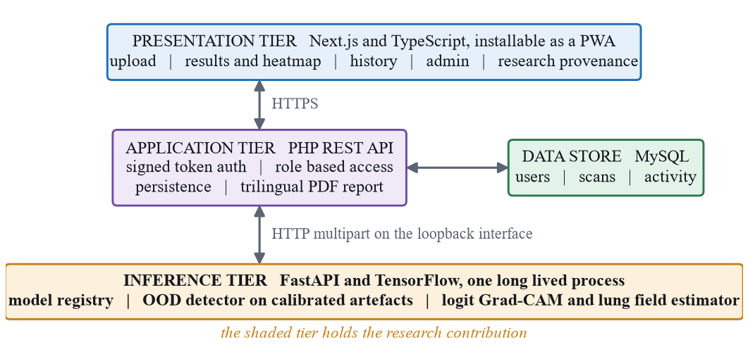
SYSTEM ARCHITECTURE
Three tiers, with the contribution isolated
Why inference is its own service
Model loading is expensive and must be amortised by a long lived process.
Isolating the models behind a narrow interface makes the safeguard a property of the system, not of one caller.
The application tier treats unavailability as an error rather than degrading to a placeholder.
Data design
The scans table holds one row per analysis with all four probabilities, the model identifier, and the verdict, score and reason as persisted columns, so a decision taken inside the service survives reload, reopening and export.
LungVision AI · G. C. M. Sewwandi · 29002
13

Slide 14
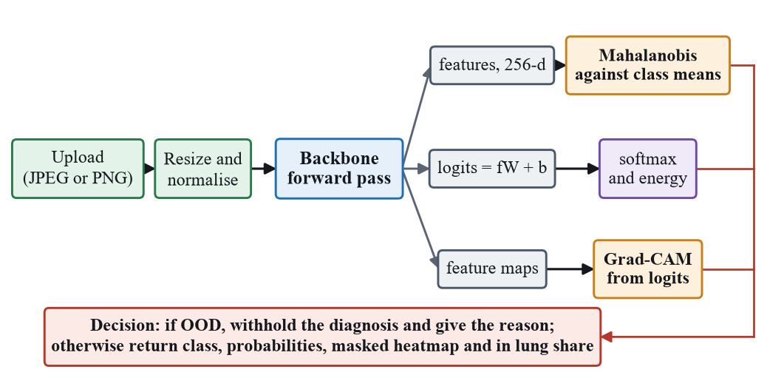
INFERENCE PIPELINE
One forward pass, three outputs
Penultimate features, 256-d
Logits, recovered as fW + b
Last convolutional feature map
feed the Mahalanobis distance to the nearest class conditional mean
give both the energy score and the probabilities shown to the user
gives Grad-CAM, differentiated on the logit, then lung restricted
The reconstruction reuses the parameters the model itself would apply, so the features, the logits and the probabilities all describe the same forward pass. It is that correspondence, not the saving in computation, that motivates the design.
LungVision AI · G. C. M. Sewwandi · 29002
14

Slide 15
CONTRIBUTION 1 · INPUT VALIDITY
The safeguard: fitted from genuine data, no retraining
DEPLOYED POLICY
REPORTED
REPORTED
Mahalanobis
Energy
Maximum softmax
feature space
output space
output space
Class conditional Gaussians on the 256-d penultimate features with a single tied covariance, shrunk by 0.01 on the identity. Score is the distance to the nearest class mean.
The negative log sum exp of the logits at temperature 1.0. Computed and reported for every scan.
The Hendrycks and Gimpel baseline. Computed and thresholded, ordering reversed because higher means more familiar.
Calibration runs once per model, on genuine data only
Statistics are fitted on 1,200 training images and thresholded on 600 validation images, at a target retention of 95 per cent of genuine scans.
The covariance is tied across classes because the fitting sample is only about 4.7 times the 256 dimensions, so four separate matrices would be rank deficient.
The safeguard never sees an invalid example during calibration. The operating point is set entirely from real radiographs.
When the verdict fires the response carries no diagnosis: no predicted class, no confidence, no probability bars.
LungVision AI · G. C. M. Sewwandi · 29002
15

Slide 16
CONTRIBUTION 2 · EXPLANATION
Grad-CAM, corrected in two places
Differentiate the logit, not the probability
Restrict to the lung field, and disclose the share
Grad-CAM is defined on the class score before the softmax.
The estimator is classical, not learned: Otsu thresholding on a contrast equalised copy, then at most two plausible air filled regions.
Differentiating the probability introduces a factor that approaches zero exactly when the model is confident.
For COVID-19 and Normal, predicted probabilities routinely exceed 0.97, so that factor falls below 0.03 and the map becomes numerical noise.
A learned segmenter would add a second set of weights and a second failure mode to a component meant to increase trust.
The in lung share is computed on the unmasked map, so it describes where the model actually looked. After masking it would be identically one.
Differentiating the logit removes the factor entirely.
Why it was implemented by hand
Library implementations were not used: they assume a flat graph and expose only the post softmax output. Both the detector graph and the explanation graph are rebuilt directly over the trained weights.
A caution is raised when the measured share falls below one half, and the value is returned for every response whether or not it triggers the caution.
LungVision AI · G. C. M. Sewwandi · 29002
16

Slide 17
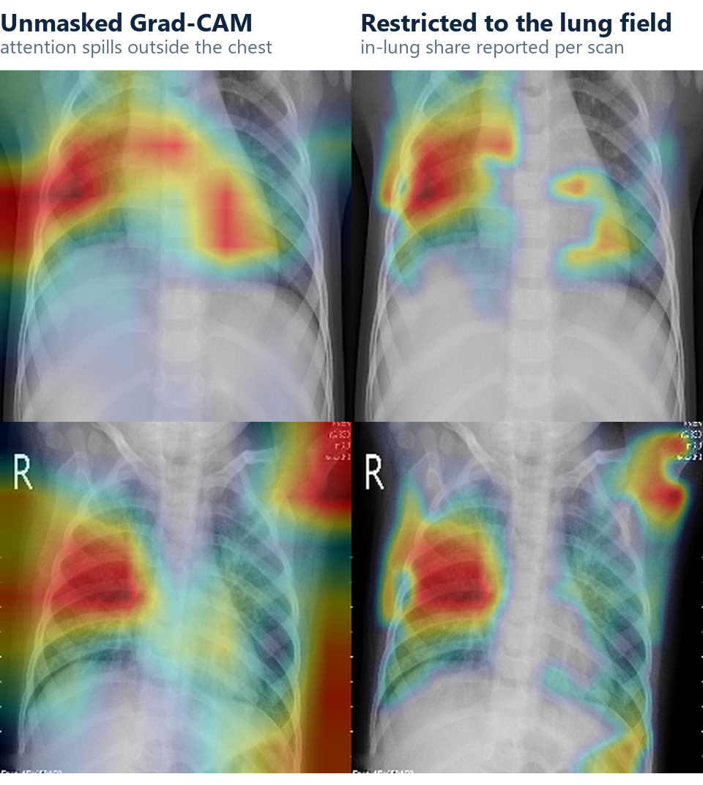
CONTRIBUTION 2 · IN PRACTICE
What lung restriction changes
Read left to right
Left: the raw map, with substantial mass on the image border and outside the chest entirely.
Right: the same map restricted to the estimated lung field.
The measurement is taken before masking, so the restriction cannot flatter the number.
The reason the number is disclosed
A plausible looking heatmap is not evidence that lung tissue was used. Masking made the maps look more convincing without changing the classifier at all, which is exactly why the measurement was added alongside it.
Verification runs retained in the inference service workspace.
LungVision AI · G. C. M. Sewwandi · 29002
17

Slide 18
03
The delivered platform
Not a notebook. A three tier web application in which the safeguard reaches the end user and survives persistence, reopening and export.
Next.js client, PHP REST tier, FastAPI inference service
Four enforced roles and a trilingual PDF report
Every screen that follows is the running system
18

Slide 19
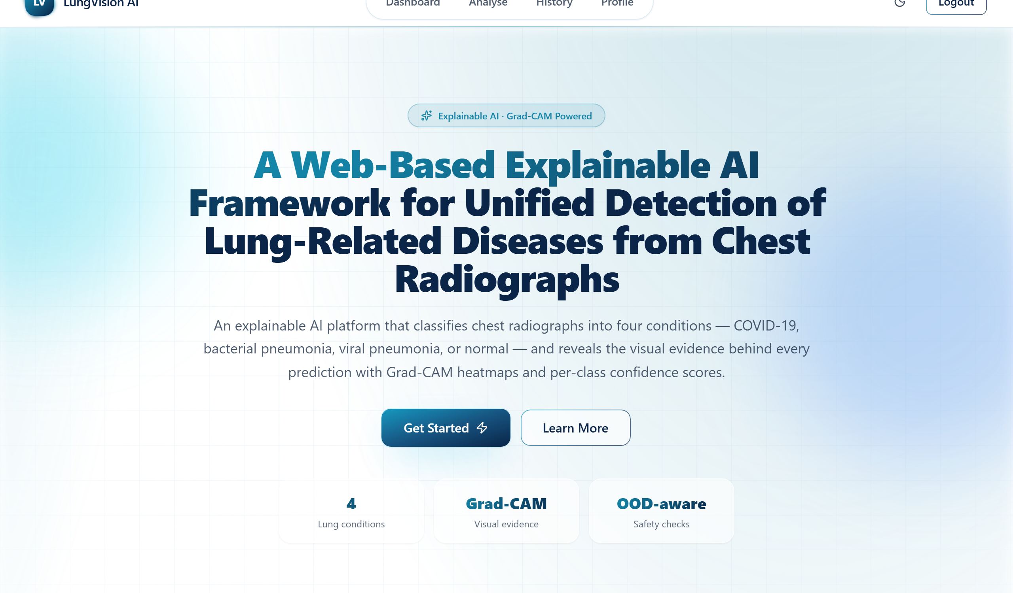
THE PLATFORM · LANDING PAGE
LungVision AI
What the platform offers
Four lung conditions from one frontal radiograph.
Grad-CAM visual evidence behind every prediction.
Out of distribution checks before any result is shown.
Per class confidence scores, not one number.
Scan history, reports and role gated research provenance.
Public landing page at localhost:3000, captured from the running system.
LungVision AI · G. C. M. Sewwandi · 29002
19

Slide 20
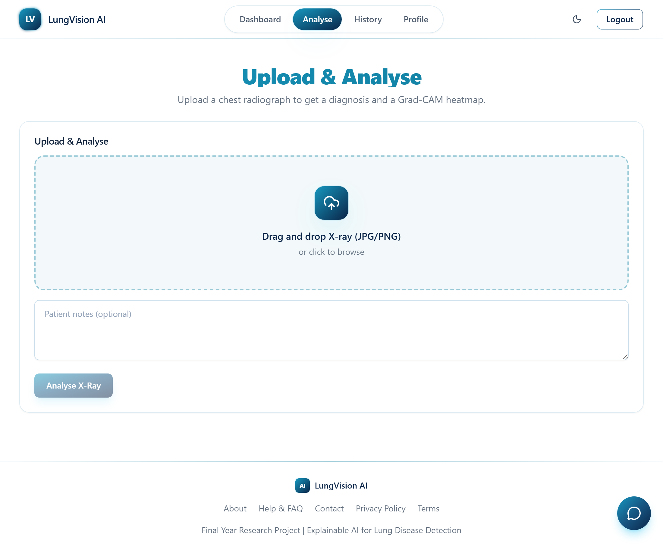
THE PLATFORM · STEP 1
Upload and analyse
FR1 · what is accepted
A frontal chest radiograph in JPEG or PNG, from an authenticated user.
Optional patient notes, stored with the record.
Uploads are written outside the executable web path.
Nothing about the upload path tells the system what kind of image it has been given. That is the whole reason the validity assessment has to run on the way out, not on the way in.
Measured latency
Median end to end response 3.18 s, maximum 3.33 s, on a development machine with no accelerator. NFR5 asks for under 5 s.
LungVision AI · G. C. M. Sewwandi · 29002
20

Slide 21
THE PLATFORM · STEP 2 · ACCEPTED SCAN
Detection result with Grad-CAM evidence
What the user is shown
The original radiograph beside the lung restricted Grad-CAM overlay.
The predicted class with a confidence capped below certainty.
A decision support statement on every result.
All four class probabilities, retained rather than discarded.
The validity assessment has already run at this point. A result is only ever rendered for an input the detector accepted, and the in lung share for this scan is computed and returned with it.
LungVision AI · G. C. M. Sewwandi · 29002
21

Slide 22
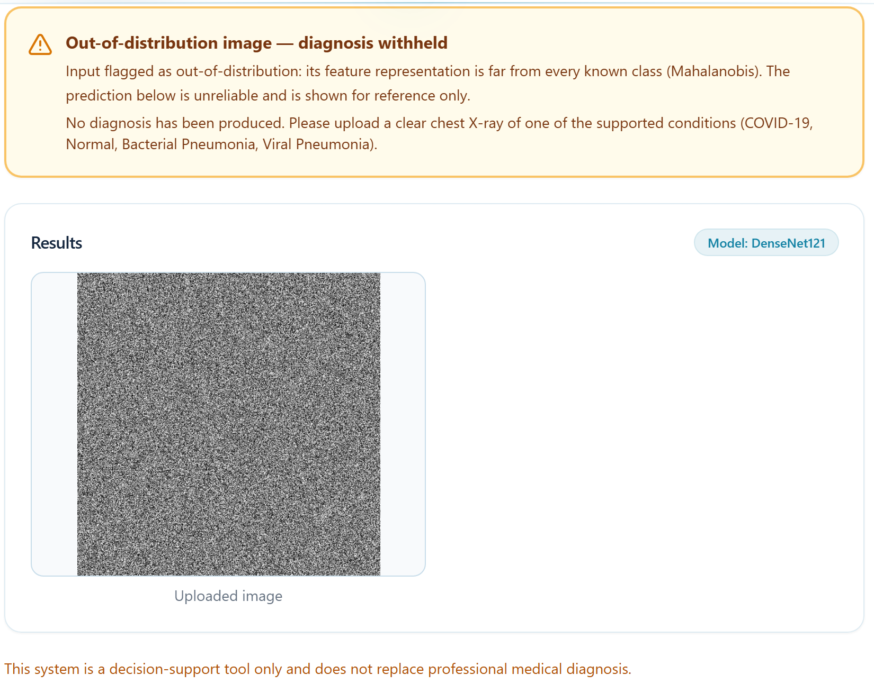
THE PLATFORM · THE SAFEGUARD FIRING
When the input is not something the model can assess, it says so
FR4 · withholding
No predicted class, no confidence value, no probability bars.
The banner names the feature space signal that fired.
The uploaded image is retained beside the notice.
It survives the round trip
Reopening the case from history still shows no diagnosis, and exporting it reproduces the notice in all three languages. The verdict is a property of the record.
Submitted through the ordinary upload path as any user would.
LungVision AI · G. C. M. Sewwandi · 29002
22

Slide 23
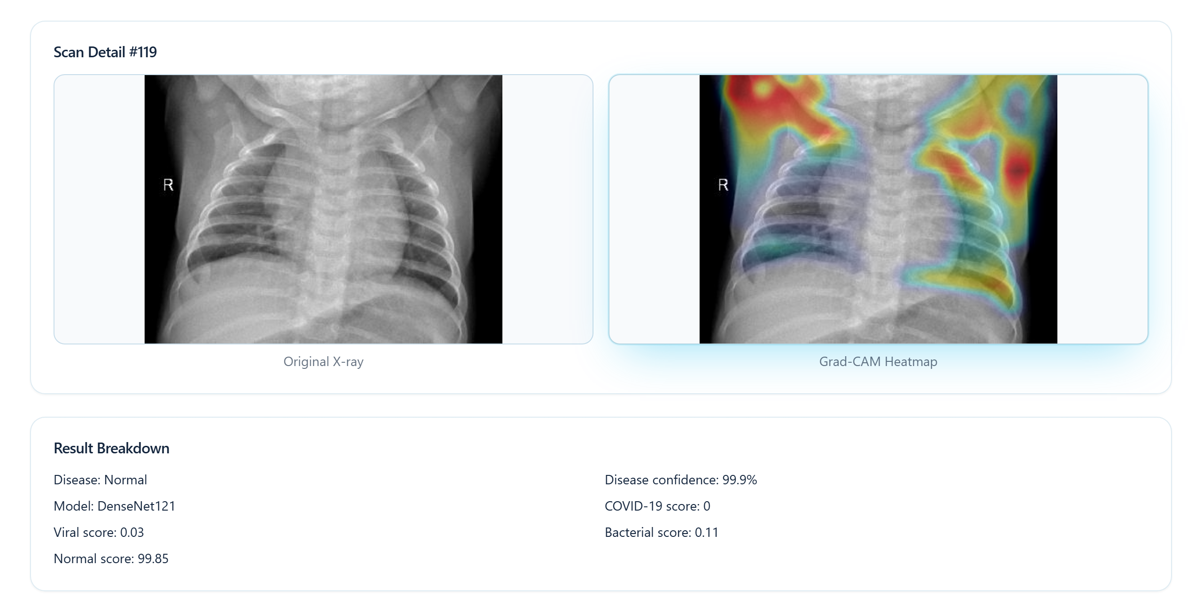
THE PLATFORM · HISTORY
The scan record: what is persisted, and what can be reopened
Persisted per analysis
Original image and Grad-CAM overlay paths.
Predicted class and confidence.
All four class probabilities.
Model identifier, so a result is attributable.
Validity verdict, score and reason.
Report export in three languages.
A verdict living only in the response would be lost on reload, and the record would revert to showing a diagnosis the system had declined to make.
LungVision AI · G. C. M. Sewwandi · 29002
23

Slide 24
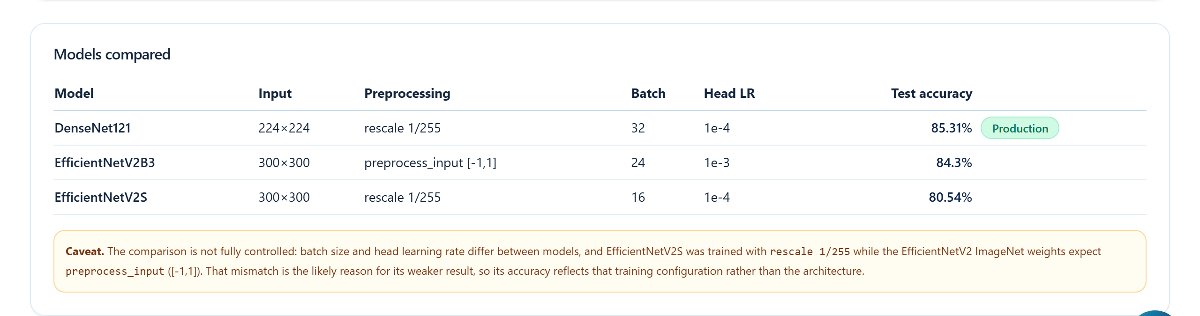
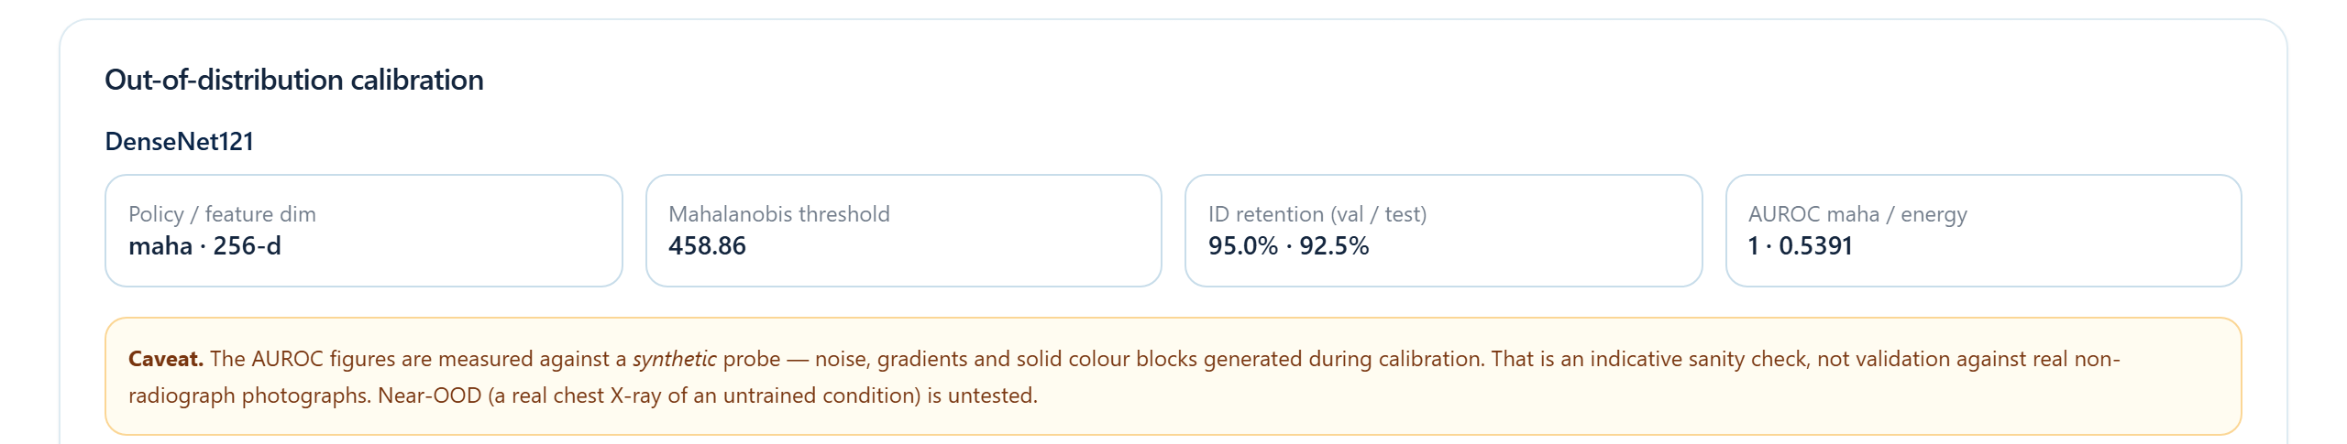
THE PLATFORM · RESEARCH ROLE
Provenance that cannot drift from the deployed model
Read live, not written by hand
Dataset composition comes from the realised split file.
Model configuration comes from the running inference service.
Training curves and confusion matrices come from the retained artefacts.
The calibration card shows the live thresholds and policy.
Model comparison and out of distribution calibration, as the research role sees them.
The page carries its own caveat about the synthetic probe, in the product, not only in the thesis.
LungVision AI · G. C. M. Sewwandi · 29002
24

Slide 25
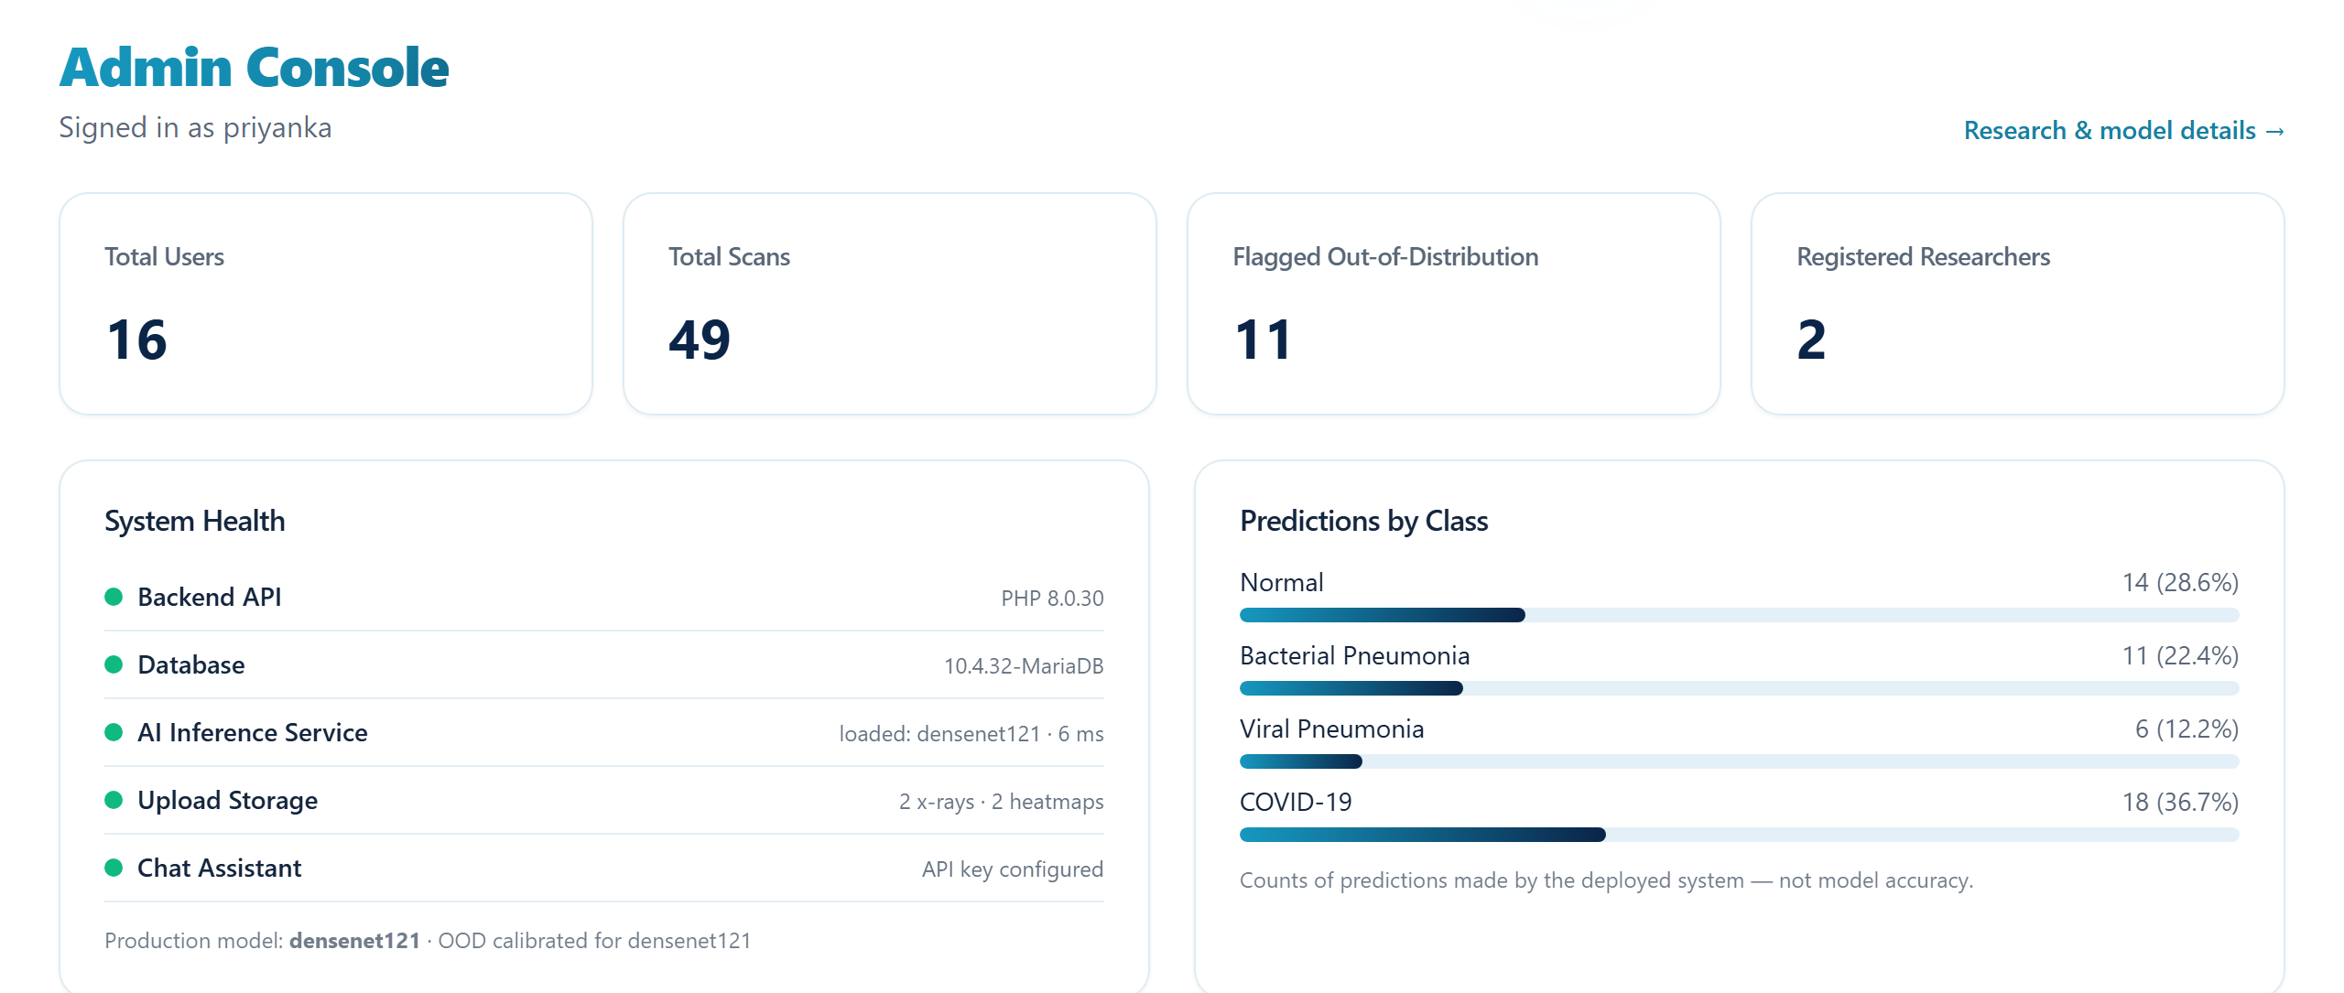
THE PLATFORM · ADMINISTRATOR ROLE
Oversight without clinical interpretation
Four roles, enforced server side
Patient uploads and views only their own results.
Clinician uses the output for preliminary triage.
Researcher inspects model and evaluation evidence.
Administrator oversees users, scans and service health.
Role checks live in middleware on the server. T9 and T10 verify that a cross user scan request and a provenance request from a patient are both refused.
Administrator console showing service health and the distribution of predictions made by the deployed system.
LungVision AI · G. C. M. Sewwandi · 29002
25

Slide 26
04
Evidence
Success criteria were the acceptance criteria written in Chapter 4, and were not revised once measurements were available.
Held out test set of 1,382 images, seen by no model in training
Calibration on genuine data, then a held out partition and a probe
Negative results reported alongside positive ones
26

Slide 27
RQ1 · CLASSIFICATION PERFORMANCE
Three architectures, one split, one protocol
Model | Accuracy | Macro precision | Macro recall | Macro F1 | Weighted F1 | Errors
DenseNet121 · deployed | 85.31 % | 0.843 | 0.845 | 0.844 | 0.851 | 203
EfficientNetV2B3 | 84.30 % | 0.834 | 0.825 | 0.828 | 0.838 | 217
EfficientNetV2S | 80.54 % | 0.798 | 0.812 | 0.798 | 0.803 | 269
The margin is not a finding
And one row is not an architectural result
The 1.01 point lead over EfficientNetV2B3 is fourteen images out of 1,382, from a single run.
EfficientNetV2S was trained with rescaling to the unit interval, while its ImageNet weights expect the interval from minus one to one.
The methodology committed in advance to treating a difference at that resolution as inconclusive.
Its frozen phase reached 68.07 per cent against 83.20, a gap capacity does not explain. This is disclosed, not buried.
NFR1 asked for at least 85 per cent and is met by 0.31 of a percentage point, a margin narrow enough that a different seed could plausibly have failed it.
LungVision AI · G. C. M. Sewwandi · 29002
27

Slide 28
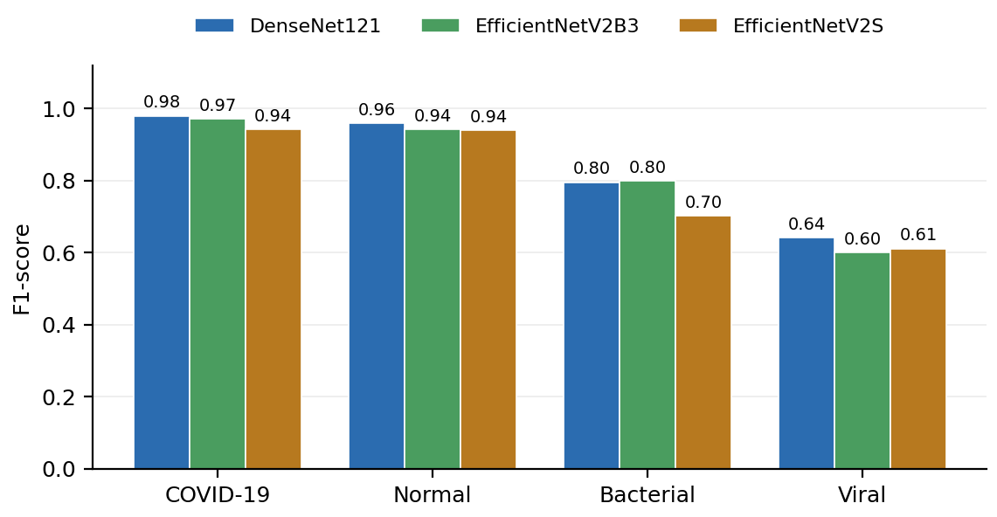
RQ1 · PER CLASS, DENSENET121
Class spread is far larger than architecture spread
Class | Precision | Recall | F1 | Support
COVID-19 | 0.974 | 0.984 | 0.979 | 192
Normal | 0.929 | 0.990 | 0.959 | 491
Bacterial pneumonia | 0.829 | 0.764 | 0.795 | 450
Viral pneumonia | 0.640 | 0.643 | 0.641 | 249
0.979
0.641
0.34
BEST CLASS · COVID-19 F1
WORST CLASS · VIRAL F1
F1 SPREAD BEST TO WORST
three errors in 192 cases
recall 0.643
concealed by the headline accuracy
The ordering of class difficulty is stable across all three architectures, so this is a property of the task rather than of one model.
LungVision AI · G. C. M. Sewwandi · 29002
28

Slide 29
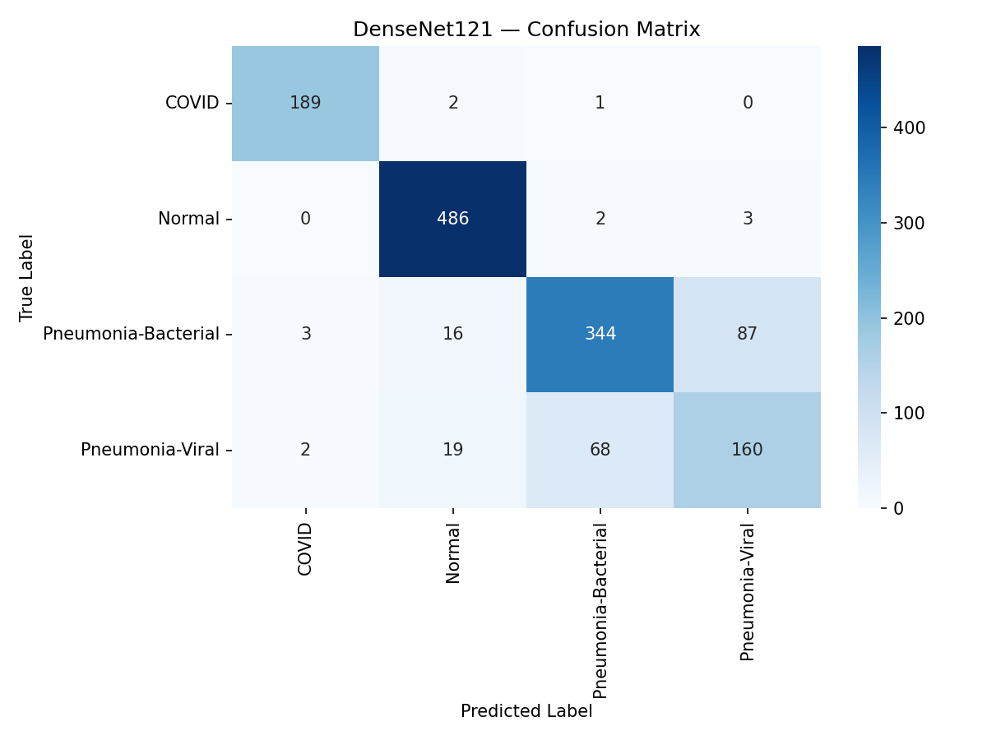
RQ1 · ERROR STRUCTURE
Where the errors actually are
Read the off diagonal
Bacterial mistaken for viral: 87 cases. Viral mistaken for bacterial: 68 cases.
Against those 155, only three of 192 COVID-19 cases and five of 491 Normal cases are missed.
The remaining classes are, for practical purposes, solved.
What the matrix says
An easy screening problem with one hard discrimination embedded inside it, and the hard one is the discrimination that drives the antibiotic decision.
Recast as abnormality screening: sensitivity 95.85 per cent, specificity 98.98 per cent.
LungVision AI · G. C. M. Sewwandi · 29002
29

Slide 30
RQ1 · CONCENTRATION OF ERRORS
The dominant error mode is the same in every architecture
Model | Total errors | Bacterial and viral confusions | Share of all errors
DenseNet121 | 203 | 155 | 76.4 %
EfficientNetV2B3 | 217 | 150 | 69.1 %
EfficientNetV2S | 269 | 187 | 69.5 %
Reference points
Always predicting Normal: 35.53 per cent accuracy, macro F1 0.131.
A random ranking: AUROC 0.500.
What follows for deployment
Between 69 and 76 per cent of every model’s errors are a single confusion between two classes, which matches radiological expectation: the two present with overlapping appearances.
The implication is specific rather than general. The system is defensible as a screening aid that flags radiographs warranting expert review.
It is not defensible as a classifier of aetiology, because a viral recall of 0.643 cannot guide an antibiotic decision.
This inverts the usual framing, The system is close to solved on the distinctions the headline accuracy is composed of, and concentrated in difficulty on the one that carries the consequence.
LungVision AI · G. C. M. Sewwandi · 29002
30

Slide 31
RQ2 · INPUT VALIDITY DETECTION
Both operating criteria met, and one signal fails
92.5 %
100 %
1.000
GENUINE SCANS RETAINED
FAR PROBE FLAGGED
MAHALANOBIS AUROC
test partition. NFR2 floor is 90 %
all 60 generated images. NFR3 floor is 95 %
against energy at 0.539
Quantity | Value
Feature dimensionality | 256
Calibration sample | 1,200 training and 600 validation
Retention on validation, where thresholds were set | 95.0 %
Retention on the test partition | 92.5 %
Far probe flagged | 100 % of 60 images
AUROC, Mahalanobis, far probe | 1.000
AUROC, energy, far probe | 0.539
Deployed decision policy | Mahalanobis
The negative result is the informative one
Energy is a function of the logits. If a model produces large logits for inputs it has never seen, energy cannot separate them.
That is exactly the documented overconfidence. Mahalanobis operates before that collapse, in feature space.
Which signal works has to be measured, not adopted on authority.
Stated limitation
Sixty generated images of noise, gradients and solid colour from a fixed seed. A far regime sanity check, not validation against real photographs.
LungVision AI · G. C. M. Sewwandi · 29002
31

Slide 32
SYSTEM TESTING
Ten test cases against the running stack, all passed
ID | Test | Expected | Result
T1 | Upload a genuine test radiograph | One class with four probabilities summing to 100 % | Pass
T2 | Upload a synthetic noise image | Diagnosis withheld, feature space signal named | Pass
T3 | Reopen a withheld case | Withholding persists, no diagnosis shown | Pass
T4 | Report a withheld case | Notice occupies the diagnosis position, all three languages | Pass
T5 | Upload where lung fields are found | Heatmap restricted to the lungs, fraction returned | Pass
T6 | Scan with low in lung attention | Caution states the measured percentage | Pass
T7 | Force the explanation path to fail | Prediction returned, explanation degraded | Pass
T8 | Stop the service and upload | Explicit error, upload removed, no record | Pass
T9 | Request another user scan | Request refused | Pass
T10 | Request provenance as a patient | Access refused | Pass
Measured latency, no accelerator
Forward pass: 0.36 s median.
Complete inference call: 2.94 s median.
End to end request: 3.18 s median, 3.33 s maximum.
NFR5 asks for under five seconds and is met, but with less margin than the design assumed. The forward pass is not what dominates; Grad-CAM, lung estimation and overlay encoding are.
T2, T3 and T4 matter most: together they establish that the safeguard is a property of the record rather than of the moment.
LungVision AI · G. C. M. Sewwandi · 29002
32

Slide 33
05
Conclusions
A bounded affirmative: a silent failure mode was converted into a visible one, at a stated and measured cost.
What the evidence supports, and what it does not
Limitations that bound the claims
Five lines of work that follow
33

Slide 34
ACCOMPLISHMENT
Objectives assessed against the evidence
Objective | Evidence | Outcome
RO1 | Thematic review producing nine derived requirements | Achieved
RO2 | Three architectures on a shared split at 85.31, 84.30 and 80.54 per cent with per class metrics | Achieved, with the EfficientNetV2S run confounded by preprocessing
RO3 | Safeguard integrated end to end, withholding verified by T2, T3 and T4 | Achieved
RO4a | Retention 92.5 %, flag rate 100 %, Mahalanobis AUROC 1.000 against energy 0.539 | Achieved for the far regime only
RO4b | Lung restricted maps fall on the regions clinically associated with each class | Achieved qualitatively; the in lung share is disclosed
RO5 | Conditions of applicability derived | Achieved
The main question, answered with a bounded affirmative
Every probe image was refused a diagnosis, at a cost of 7.5 per cent of genuine held out scans also being refused. Three boundaries constrain it: the far regime only, dependence on the signal being chosen empirically, and a safety rather than an accuracy improvement.
LungVision AI · G. C. M. Sewwandi · 29002
34

Slide 35
DISCUSSION
What the evidence supports
The safeguard works, in the regime it was tested in
A detector fitted entirely from the model’s own genuine training data separated a constructed far probe perfectly and kept 92.5 per cent of real held out scans. No retraining, no extra labelled data, no architectural change.
A published method is a hypothesis about your own system
Energy is well established, and on this model it scored 0.539 against a probe Mahalanobis separated at 1.000. The signal that works had to be discovered by measurement, not selected from the literature.
The task is a screening problem with one hard discrimination in it
Abnormality screening reaches 95.85 per cent sensitivity and 98.98 per cent specificity, while viral recall is 0.643. The defensible deployment is triage, not aetiology.
A qualitative reading of the explanations cannot by itself exclude shortcut learning. That is why the in lung share is computed and disclosed per scan rather than claimed as a result.
LungVision AI · G. C. M. Sewwandi · 29002
35

Slide 36
LIMITATIONS
Four threats bound these conclusions
COMPARISON
INPUT VALIDITY
Incompletely controlled
Bounded by the probe
Batch size varied across models, one used a different head learning rate, and one used normalisation inconsistent with its pretrained weights. The last invalidates the EfficientNetV2S result as an architectural claim.
Sixty synthetic images of noise, gradients and solid colour. A sanity check in the far regime. The near regime, a real chest radiograph of an untrained condition, is completely untested.
EXPLANATION
GENERALISABILITY
Qualitative
One dataset, one run
The localisation finding rests on reading the maps and on an unsupervised lung field estimator with no ground truth masks. The maximum softmax separability was never computed, and that omission is disclosed rather than left to be inferred.
A single curated collection with no demographic attributes, so fairness could not be evaluated, and one run per architecture, so no seed variance is available.
These bound what the results mean. They are distinct from the problems encountered, which bound what the project could do.
LungVision AI · G. C. M. Sewwandi · 29002
36

Slide 37
FUTURE WORK
Five lines of work follow from the limitations
1
Evaluate against the near regime
Assemble genuine radiographs of untrained conditions and real photographs, and re measure the detector. This regime determines whether the safeguard is clinically meaningful.
2
Retrain under matched preprocessing
Repeat EfficientNetV2S with the normalisation its weights expect, and repeat every run across multiple seeds.
3
Target the bacterial and viral confusion directly
It carries between 69 and 76 per cent of all errors and it is the distinction with the clinical consequence.
4
Train on lung segmented inputs
Test whether restricting the input, rather than the explanation, reduces reliance on regions outside the lungs.
5
Compute maximum softmax separability on the existing probe
This should be first, because it costs almost nothing and closes a disclosed gap in the comparison.
LungVision AI · G. C. M. Sewwandi · 29002
37

Slide 38
WHAT THIS THESIS DELIVERED
Conclusion
This thesis addressed the gap between a chest radiograph classifier that is accurate and one that is safe to deploy.
85.31 %
92.5 %
1.000
10 / 10
TEST ACCURACY
GENUINE SCANS RETAINED
MAHALANOBIS AUROC
TEST CASES PASSED
macro F1 0.844 on 1,382 held out images
while refusing every probe image
against energy at 0.539
against the running stack
What is new here
A four class explainable framework in which a post hoc safeguard, fitted without retraining, withholds the diagnosis for inputs the model cannot assess, and says why.
An explanation restricted to the lung fields whose localisation is measured on the unmasked map and disclosed for every scan.
Evidence rather than a new architecture: a per class characterisation of the four class task, and detection methods carried into a clinical setting where they are actually evaluated and one of them fails.
The practical value lies in the safeguard rather than in the classifier: it applies to a model already deployed.
LungVision AI · G. C. M. Sewwandi · 29002
38

Slide 39
Thank you
Questions and discussion
G. C. M. Sewwandi · Student ID 29002
BSc (Hons) Computer Science · Department of Computing
NSBM Green University, Homagama, Sri Lanka · 2026

