Slide 1

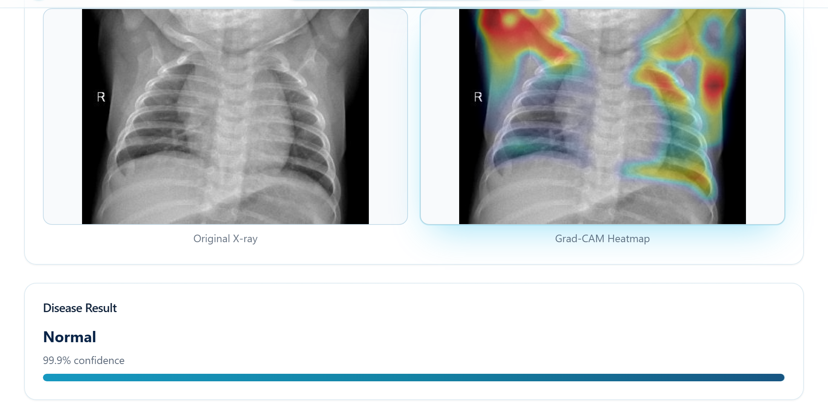
BSc (Hons) COMPUTER SCIENCE · FINAL YEAR RESEARCH PROJECT
Explainable Deep Learning Framework for Pneumonia Detection and Classification Using Transfer Learning and Grad-CAM
G. C. M. Sewwandi
Student ID 29002
Department of Computer and Data Science · Faculty of Computing
NSBM Green University, Homagama, Sri Lanka · 2026
Notes:
[00:00 - 00:30] TITLE
Say:
"Good morning. My name is G. C. M. Sewwandi, student number 29002. My research
is an explainable deep learning framework for pneumonia detection and
classification from chest X-rays, using transfer learning and Grad-CAM."
"The one sentence version is this. Building an accurate chest X-ray classifier
is no longer the hard part. Making one that is safe to put in front of a user
is. That gap is what this project is about."
Delivery:
- Do not read the title off the slide, they can see it. Say the one sentence
version instead and move on within thirty seconds.
- Stand still for this slide. Start moving from slide 2.

Slide 2
PROBLEM STATEMENT
Two deficiencies persist across the reported systems
General problem · trust tracks confidence, not reliability
Specific problem · granularity and the closed world
Automated support is trusted in proportion to how confident it appears rather than how reliable it is.
Most published chest radiograph systems are binary, so they cannot support the antibiotic decision.
Networks are confidently wrong, and calibration does not fix it.
Softmax is closed world: a photograph, or a radiograph of an untrained condition, still returns a confident diagnosis.
The consequence is a system that transfers risk to the patient while appearing to reduce it.
Post hoc detection methods are mature, yet none has been carried into an evaluated chest radiograph system.
The property this project is built around
Softmax redistributes probability across the classes it was trained on, for every input it is ever shown. It expresses relative preference among those classes and never the absence of evidence for all of them.
LungVision AI · G. C. M. Sewwandi · 29002
2
Notes:
[00:30 - 02:30] THE PROBLEM
Say:
"Pneumonia treatment depends on the cause. Bacterial pneumonia needs
antibiotics, viral pneumonia normally does not, and COVID-19 also needs
isolation. So the decision a clinician actually makes is not 'pneumonia or
not', it is 'which kind'."
"Two problems run through the published work. The first is general: we trust
these systems in proportion to how confident they look, not how reliable they
are. Networks are confidently wrong, and calibration does not fix that."
"The second is specific, and it is the one I built around. Most published chest
X-ray systems are binary, so they cannot inform the antibiotic decision at all.
And softmax is a closed world function."
Then explain closed world simply, this is the heart of the talk:
"Softmax always distributes one hundred per cent of the probability across the
four classes it was trained on. There is no option for 'none of these'. So if I
upload a photograph of a cat, the model does not say it does not know. It says
COVID-19, ninety seven per cent confident. In a clinical tool that is not a bug
you can tolerate."
Delivery:
- The cat example is the moment the panel understands the problem. Pause after
it. Do not rush.
- Expect: "why not just add a fifth class for everything else?" Answer: you
cannot enumerate everything the model might be shown, and you would have to
retrain. My method needs no retraining at all.

Slide 3
WHAT THE STUDY ASKS
Research question
To what extent can a post hoc and explainable framework that is aware of out of distribution inputs improve the clinical safety of automated four class pneumonia classification from chest radiographs, without retraining the underlying classifier?
RQ1
RQ2
RQ3
Performance and error structure
Input validity
Explanation localisation
What classification performance, and what per class error structure, do DenseNet121, EfficientNetV2B3 and EfficientNetV2S achieve under a common dataset and split?
Can inference time signals from an already trained classifier detect out of distribution inputs reliably enough to justify withholding a diagnosis, and at what cost to genuine scans?
Do the Grad-CAM explanations fall on the lung fields and on the regions clinically associated with each class?
LungVision AI · G. C. M. Sewwandi · 29002
3
Notes:
[02:30 - 04:00] RESEARCH QUESTION
Say:
"So the main question is: to what extent can a post hoc, explainable framework
that is aware of out of distribution inputs improve the clinical safety of four
class pneumonia classification, without retraining the underlying classifier?"
"Post hoc and without retraining are the load bearing words. Anyone can fix
this by training a better model. I wanted a method that works on a classifier
that is already trained and already deployed."
"That breaks into three sub questions. RQ1 is the baseline: what performance
and what error structure do three architectures give under one common split.
RQ2 is the safeguard: can signals taken at inference time detect invalid inputs
well enough to justify withholding a diagnosis, and what does that cost in
genuine scans refused. RQ3 is the explanation: do the Grad-CAM maps actually
fall on the lungs."
If asked about the objectives, they are five:
"RO1 review and derive requirements, RO2 compare three architectures, RO3 build
the safeguard and integrate it end to end, RO4 evaluate the safeguard and the
explanation, RO5 recommend where this is and is not suitable. Section 6.2 of
the thesis assesses each one against the evidence rather than against
intention."
Delivery:
- Read the main question slowly and exactly. It is the sentence the whole viva
hangs on.

Slide 4
METHODOLOGY
Research design
PARADIGM
Accuracy, recall, AUROC and in lung attention are objective quantities that can be estimated but not known exactly. Every measurement is reported with its sample size, and a disconfirming result is reported in the same terms as a confirming one.
Post positivist
APPROACH
The closed world property of softmax and the feature space method of Lee et al. yield a testable expectation, which was operationalised into thresholds and measured. The inductive element is kept separate.
Predominantly deductive
STRATEGY
The question asks to what extent a safeguard can improve safety, and that quantity does not exist until the safeguard has been built. Evaluation within it is experimental.
Design science
The freeze point
Calibration follows model selection and uses only training and validation data. Evaluation follows the freeze, so no result reported later was used to adjust the artefact that produced it.
LungVision AI · G. C. M. Sewwandi · 29002
4
Notes:
[04:00 - 05:30] METHODOLOGY
Say:
"Briefly, how the research was conducted."
"The paradigm is post positivist. Accuracy, recall, AUROC and in lung attention
are objective quantities, but they can only be estimated, never known exactly,
because of sampling error, label noise and the randomness of a single training
run. That position has consequences I held myself to: every measurement is
reported with its sample size, a difference smaller than the resolution of the
design is declared inconclusive, and a disconfirming result is reported in the
same terms as a confirming one. You will see me do all three later in this
talk."
"The approach is predominantly deductive. The closed world property of softmax
and the feature space method of Lee and colleagues give a testable expectation,
that a Mahalanobis signal should separate invalid inputs on this model. I
operationalised that into thresholds and measured it. There is one inductive
element, the failure of the energy signal, which came out of the measurements
rather than being predicted, and I keep the two clearly separate."
"The strategy is design science. The question asks to what extent a safeguard
can improve safety, and that quantity simply does not exist until the safeguard
has been built. So the artefact is built, and then evaluated experimentally."
Now the point that protects every number that follows:
"The freeze point matters. Calibration follows model selection and uses only
training and validation data. Evaluation follows the freeze. So no result I
report later was used to adjust the artefact that produced it. The test
partition was never touched until the artefact was final."
Delivery:
- The freeze point is the answer to "did you tune on your test set?". Say it
before they ask.

Slide 5
DATA
One stratified split, reused by every model and by calibration
9,209
70 / 15 / 15
4
RADIOGRAPHS AFTER AUDIT
STRATIFIED SPLIT
CLASSES
duplicate, corrupted and low resolution files removed first
6,446 train · 1,381 val · 1,382 test
Normal, COVID-19, bacterial, viral
Class | Total | Train | Validation | Test
COVID-19 | 1,281 | 897 | 192 | 192
Normal | 3,271 | 2,289 | 491 | 491
Bacterial pneumonia | 3,001 | 2,101 | 450 | 450
Viral pneumonia | 1,656 | 1,159 | 248 | 249
Total | 9,209 | 6,446 | 1,381 | 1,382
Design consequences
The audit precedes the split, because a duplicate spanning a partition boundary is a direct route to leakage.
The realised split file is reused by all three architectures and by calibration, so results are comparable.
The imbalance is addressed with stratified sampling and a class weighted loss.
Secondary data: curated public research collections, released for research use and carrying no patient identifiers. No human participants, so institutional ethics approval was not applicable.
LungVision AI · G. C. M. Sewwandi · 29002
5
Notes:
[05:30 - 07:30] THE DATA
Say:
"Nine thousand two hundred and nine chest radiographs from curated public
research collections, four classes: Normal, COVID-19, bacterial pneumonia and
viral pneumonia."
"Split seventy, fifteen, fifteen, stratified, so six thousand four hundred and
forty six train, one thousand three hundred and eighty one validation, one
thousand three hundred and eighty two test."
"Two design points matter here."
"First, the audit comes before the split. I removed duplicates, corrupted files
and low resolution files first, because a duplicate that lands on both sides of
a partition boundary is a direct route to leakage, and any accuracy after that
is fiction."
"Second, one split file is reused by all three architectures and by the
calibration of the safeguard. That is what makes the three models comparable to
each other, and it is why a difference between them is about the architecture
and not about the data they happened to get."
"The classes are imbalanced, COVID-19 has one thousand two hundred and eighty
one images against three thousand two hundred and seventy one Normal. That is
handled with stratified sampling and a class weighted loss."
"On ethics: this is secondary data, public research collections, no patient
identifiers, no human participants, so institutional ethics approval was not
applicable."
Delivery:
- Say the leakage point clearly. It is the question a good panel asks first.
- Weakness to own before they raise it: the split is file level, not patient
level. If the collections contain several images of the same patient, some
could span the split. Say so. Do not wait to be caught.

Slide 6
CONTRIBUTION 1 · INPUT VALIDITY
The safeguard: fitted from genuine data, no retraining
DEPLOYED POLICY
REPORTED
REPORTED
Mahalanobis
Energy
Maximum softmax
feature space
output space
output space
Class conditional Gaussians on the 256-d penultimate features with a single tied covariance, shrunk by 0.01 on the identity. Score is the distance to the nearest class mean.
The negative log sum exp of the logits at temperature 1.0. Computed and reported for every scan.
The Hendrycks and Gimpel baseline. Computed and thresholded, ordering reversed because higher means more familiar.
Calibration runs once per model, on genuine data only
Statistics are fitted on 1,200 training images and thresholded on 600 validation images, at a target retention of 95 per cent of genuine scans.
The covariance is tied across classes because the fitting sample is only about 4.7 times the 256 dimensions, so four separate matrices would be rank deficient.
The safeguard never sees an invalid example during calibration. The operating point is set entirely from real radiographs.
When the verdict fires the response carries no diagnosis: no predicted class, no confidence, no probability bars.
LungVision AI · G. C. M. Sewwandi · 29002
6
Notes:
[07:30 - 10:00] CONTRIBUTION 1, THE SAFEGUARD
Say:
"This is the first contribution. The model is unchanged. Nothing is retrained.
Everything here comes out of the forward pass that was happening anyway."
Explain the one pass, three outputs idea:
"I take the last dense layer, read its weights and bias, and build a small
auxiliary model that gives me the penultimate feature vector. From that vector
I recover the logits with the same affine map the model itself would apply, and
the probabilities follow from their softmax. So one evaluation gives me the
features the detector needs, the logits the energy score needs, and the
probabilities the user sees, and all three describe the same forward pass. That
correspondence is the point, not the saved computation."
"On those features I fit one Gaussian per class, with a single shared
covariance matrix, and score an input by its distance to the nearest class
mean. That is the Mahalanobis signal, from Lee and colleagues, 2018."
"I also compute two output space signals, energy and maximum softmax
probability, and report both. The deployed policy uses Mahalanobis alone, and
slide 9 shows the measurement that made me choose it."
"Calibration runs once per model, on one thousand two hundred training images,
thresholded on six hundred validation images, at ninety five per cent retention
of genuine scans. The covariance is tied across classes because twelve hundred
images is only about four and a half times the two hundred and fifty six
dimensions, so four separate matrices would be rank deficient."
"One detail I want to highlight. The safeguard never sees a single invalid
example during calibration. The operating point is set entirely from real
radiographs. It learns what normal looks like, not what abnormal looks like."
On the delivered system, since there is no separate platform slide:
"This is live in the platform, not a notebook. Next.js front end, PHP REST API,
a separate Python inference service and MySQL, with four user roles. When the
verdict fires the response carries no diagnosis at all: no predicted class, no
confidence, no probability bars, just a banner naming the signal that fired.
And it survives the round trip, so reopening the case from history still shows
no diagnosis and the exported PDF reproduces the notice in all three languages.
I am happy to demonstrate it after the talk."
Delivery:
- If they ask why not just threshold the softmax confidence: that is the MSP
baseline, it is computed, and slide 9 shows output space signals failing on
this model. That is the finding.

Slide 7
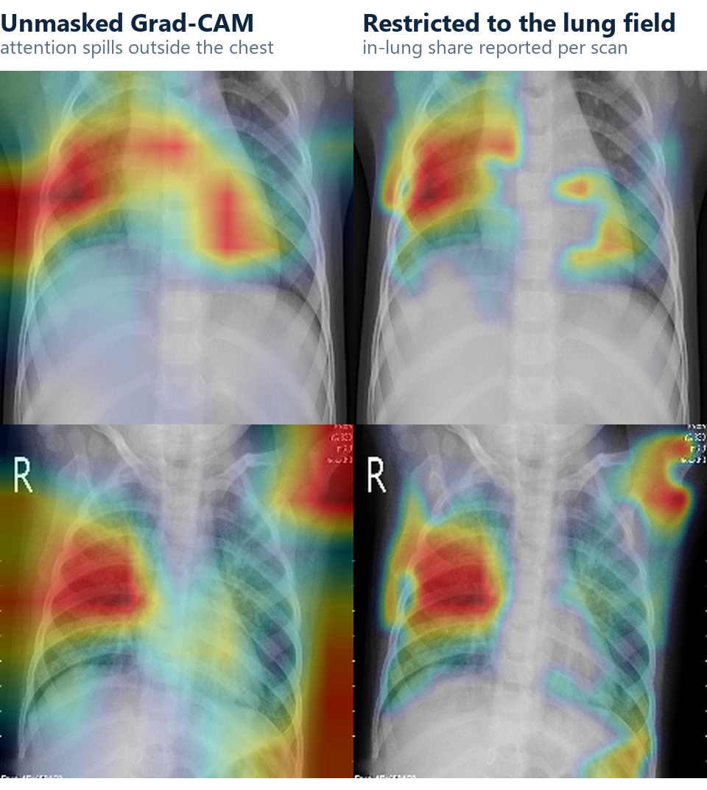
CONTRIBUTION 2 · IN PRACTICE
What lung restriction changes
Read left to right
Left: the raw map, with substantial mass on the image border and outside the chest entirely.
Right: the same map restricted to the estimated lung field.
The measurement is taken before masking, so the restriction cannot flatter the number.
The reason the number is disclosed
A plausible looking heatmap is not evidence that lung tissue was used. Masking made the maps look more convincing without changing the classifier at all, which is exactly why the measurement was added alongside it.
Verification runs retained in the inference service workspace.
LungVision AI · G. C. M. Sewwandi · 29002
7
Notes:
[10:00 - 12:00] CONTRIBUTION 2, THE EXPLANATION
Say:
"The second contribution is the explanation, and there are two corrections in
it."
"The first is numerical. Grad-CAM is defined on the class score before the
softmax. If you differentiate the probability instead, the chain rule brings in
a factor that goes to zero exactly when the model is confident. On COVID-19 and
Normal this model routinely exceeds point nine seven, so that factor drops
below point zero three and the heatmap is numerical noise. I rebuilt the
classifier as a linear layer carrying the same weights and differentiate the
logit, which removes the factor entirely."
"The second is anatomical, and it is the more interesting one. DeGrave and
colleagues showed in Nature Machine Intelligence that COVID classifiers often
key on shoulders, image borders and burnt in markers instead of lung tissue.
Teixeira and colleagues showed that restricting the map to the lung field is
the remedy. So I estimate the lung field with classical computer vision, no
extra trained weights, and restrict the displayed map to it."
Now the honest part, and say it deliberately:
"But masking only changes what is shown. It does not stop the classifier using
pixels outside the lungs. So I measure how much of the attention was inside the
lung field before masking, and I report that number with every scan. If it
falls below one half, the user gets a caution."
"The picture makes the point. On the left, the raw map, with real mass on the
image border and outside the chest. On the right, the same map restricted to
the lungs. It looks far more convincing, and that is exactly the danger. That
is why the number is disclosed rather than quietly dropped."
"On RQ3 itself, the finding is qualitative and I report it as such: the lung
restricted maps fall on the regions clinically associated with each class,
focal consolidation for bacterial cases and more diffuse bilateral activation
for viral ones."
Delivery:
- This is the slide that shows research maturity. You found a fix that makes
your own output look better and you refused to let it stand alone. Say that.

Slide 8
RQ1 · CLASSIFICATION PERFORMANCE
Three architectures, one split, one protocol
Model | Accuracy | Macro precision | Macro recall | Macro F1 | Weighted F1 | Errors
DenseNet121 · deployed | 85.31 % | 0.843 | 0.845 | 0.844 | 0.851 | 203
EfficientNetV2B3 | 84.30 % | 0.834 | 0.825 | 0.828 | 0.838 | 217
EfficientNetV2S | 80.54 % | 0.798 | 0.812 | 0.798 | 0.803 | 269
The margin is not a finding
And one row is not an architectural result
The 1.01 point lead over EfficientNetV2B3 is fourteen images out of 1,382, from a single run.
EfficientNetV2S was trained with rescaling to the unit interval, while its ImageNet weights expect the interval from minus one to one.
The methodology committed in advance to treating a difference at that resolution as inconclusive.
Its frozen phase reached 68.07 per cent against 83.20, a gap capacity does not explain. This is disclosed, not buried.
NFR1 asked for at least 85 per cent and is met by 0.31 of a percentage point, a margin narrow enough that a different seed could plausibly have failed it.
LungVision AI · G. C. M. Sewwandi · 29002
8
Notes:
[12:00 - 14:30] RESULTS, CLASSIFICATION
Say:
"DenseNet121 reached eighty five point three one per cent on the held out test
set, EfficientNetV2B3 eighty four point three zero, EfficientNetV2S eighty
point five four. DenseNet121 is the deployed model."
Now immediately undercut the headline, this is the point of the slide:
"I want to be careful about that ranking. The lead over EfficientNetV2B3 is one
point zero one percentage points. On one thousand three hundred and eighty two
test images that is fourteen images, from a single run with no seed
replication. The methodology committed in advance to treating a difference at
that resolution as inconclusive, so I am not claiming DenseNet is the better
architecture."
"And the third row is not an architectural result at all. EfficientNetV2S was
trained with simple rescaling to zero to one, while its ImageNet weights expect
minus one to one. The frozen phase shows the effect cleanly: sixty eight point
zero seven per cent against eighty three point two zero. That is a
preprocessing fault, not a capacity difference, and I have disclosed it rather
than quietly dropping the row."
"The error structure is the more useful finding. Between sixty nine and seventy
six per cent of every model's errors are the same single confusion, bacterial
against viral pneumonia. Per class, DenseNet separates COVID-19 and Normal
almost perfectly, F1 of point nine seven nine and point nine five nine, while
viral pneumonia reaches only point six four one."
"So recast as abnormality screening it gives ninety five point eight five per
cent sensitivity and ninety eight point nine eight per cent specificity. The
task it is good at is screening. The task it is weakest at is exactly the one
that carries the antibiotic decision, and that has to be said plainly."
Delivery:
- Owning the EfficientNetV2S fault yourself is worth more than defending it.
- NFR1 asked for at least eighty five per cent and is met by zero point three
one of a point. If they push, agree it is narrow.

Slide 9
RQ2 · INPUT VALIDITY DETECTION
Both operating criteria met, and one signal fails
92.5 %
100 %
1.000
GENUINE SCANS RETAINED
FAR PROBE FLAGGED
MAHALANOBIS AUROC
test partition. NFR2 floor is 90 %
all 60 generated images. NFR3 floor is 95 %
against energy at 0.539
Quantity | Value
Feature dimensionality | 256
Calibration sample | 1,200 training and 600 validation
Retention on validation, where thresholds were set | 95.0 %
Retention on the test partition | 92.5 %
Far probe flagged | 100 % of 60 images
AUROC, Mahalanobis, far probe | 1.000
AUROC, energy, far probe | 0.539
Deployed decision policy | Mahalanobis
The negative result is the informative one
Energy is a function of the logits. If a model produces large logits for inputs it has never seen, energy cannot separate them.
That is exactly the documented overconfidence. Mahalanobis operates before that collapse, in feature space.
Which signal works has to be measured, not adopted on authority.
Stated limitation
Sixty generated images of noise, gradients and solid colour from a fixed seed. A far regime sanity check, not validation against real photographs.
LungVision AI · G. C. M. Sewwandi · 29002
9
Notes:
[14:30 - 17:00] RESULTS, INPUT VALIDITY
Say:
"This is the result I care most about. Three numbers."
"Ninety two point five per cent of genuine held out scans are retained, against
a design floor of ninety. One hundred per cent of the far probe is flagged, all
sixty generated images, against a floor of ninety five. So both operating
criteria are met."
"And the third number is the interesting one. Mahalanobis separates the two
populations perfectly, AUROC of one point zero zero zero. Energy, computed from
the logits of the very same forward pass, reaches zero point five three nine.
That is essentially a coin flip."
Explain why, this is the insight:
"Energy is a function of the logits. If a model produces large logits for
inputs it has never seen, and that is precisely the documented overconfidence,
then energy has nothing to work with. Mahalanobis operates before that
collapse, in the feature space, where the input still looks unfamiliar."
"The practical lesson is that which signal works has to be measured on your own
model, not adopted from a paper. If I had taken energy on authority, I would
have shipped a safeguard that does not work."
Now state the limitation before they do:
"I want to be explicit about what that AUROC of one point zero zero zero is
against. Sixty generated images: uniform noise, smooth gradients and solid
colour blocks, from a fixed seed. That is a far regime sanity check. It is not
validation against real photographs, and it is not the near regime, a genuine
chest X-ray of a condition the model was never trained on. That case is
completely untested, and it is the first item in my future work."
Delivery:
- Say the limitation in your own voice before the panel asks. If they have to
drag it out of you it reads as a weakness; if you volunteer it, it reads as
judgement.

Slide 10
WHAT THIS THESIS DELIVERED
Conclusion
This thesis addressed the gap between a chest radiograph classifier that is accurate and one that is safe to deploy.
85.31 %
92.5 %
1.000
10 / 10
TEST ACCURACY
GENUINE SCANS RETAINED
MAHALANOBIS AUROC
TEST CASES PASSED
macro F1 0.844 on 1,382 held out images
while refusing every probe image
against energy at 0.539
against the running stack
What is new here
A four class explainable framework in which a post hoc safeguard, fitted without retraining, withholds the diagnosis for inputs the model cannot assess, and says why.
An explanation restricted to the lung fields whose localisation is measured on the unmasked map and disclosed for every scan.
Evidence rather than a new architecture: a per class characterisation of the four class task, and detection methods carried into a clinical setting where they are actually evaluated and one of them fails.
The practical value lies in the safeguard rather than in the classifier: it applies to a model already deployed.
LungVision AI · G. C. M. Sewwandi · 29002
10
Notes:
[17:00 - 18:30] CONCLUSION
Say:
"To close. This thesis addressed the gap between a chest X-ray classifier that
is accurate and one that is safe to deploy."
"Three things are new here."
"A four class explainable framework in which a post hoc safeguard, fitted
without any retraining, withholds the diagnosis for inputs the model cannot
assess and states why."
"An explanation restricted to the lung fields whose localisation is measured on
the unmasked map and disclosed for every scan, so the user is told how far to
trust it."
"And evidence rather than a new architecture. A per class characterisation of
the four class task, and established detection methods carried into a clinical
setting where they are actually evaluated, and where one of them fails."
"The practical value is in the safeguard rather than the classifier, because it
applies to a model that is already trained and already deployed. The whole
thing is delivered as a working four role platform, and all ten system test
cases passed against the running stack."
Bounded claim, say it in these words:
"What the evidence supports is supervised screening and triage support on
frontal radiographs of the kind it was calibrated on. What it does not support
is an autonomous diagnostic instrument. The binding constraint is the
evaluation, not the accuracy: one curated dataset, a file level split, and a
synthetic probe."
"Future work, in priority order: evaluation against the near regime with
genuine radiographs of untrained conditions and real photographs; external
validation at a second institution; a patient level split; seed replication;
and a corrected EfficientNetV2S run."
"Thank you. I am happy to take questions."
Delivery:
- Finish on the bounded claim, not on the accuracy number. That is the
sentence that shows you understand what your own work does and does not mean.
- Keep the future work list to five short items, do not elaborate.

