Slide 1


29002
Explainable Deep Learning Framework for Pneumonia Detection and Classification Using Transfer Learning and Grad-CAM
Presenter: <presenter name >
Authors and Affiliation: < author name>, <affiliation>
Notes:
Good morning everyone. My name is <presenter name>.
Today I will present our paper: "Explainable Deep Learning Framework for Pneumonia Detection and Classification Using Transfer Learning and Grad-CAM".
In simple words, we built a system that looks at a chest X-ray and says whether it is Normal, COVID-19, bacterial pneumonia or viral pneumonia. It also shows a heatmap of the lung areas that led to the answer, so a doctor can check the result.
I will cover the introduction, the related work, our method, the results, a short discussion, and the conclusion.

Slide 2
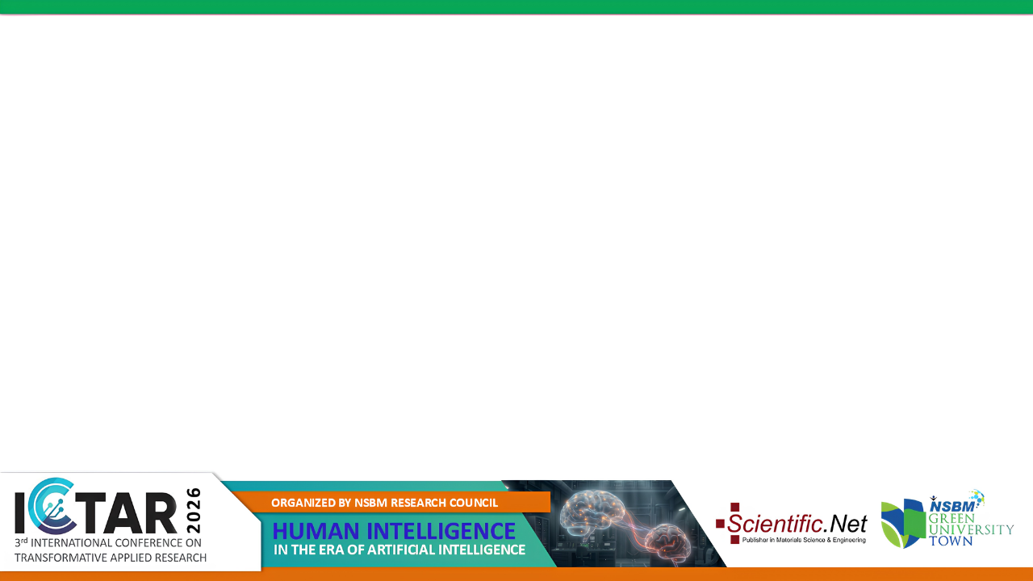




Introduction
Chest X-rays are the first test for pneumonia, but four conditions can look alike
Four classes we separate
Gaps this study addresses
Normal
COVID-19
1
Most studies are binary (normal vs. abnormal)
2
Few compare DenseNet121, EfficientNetV2B3 and EfficientNetV2S on one dataset and pipeline
Bacterial pneumonia
Viral pneumonia
3
Grad-CAM is usually an add-on, not part of the workflow
4
Few studies deliver a complete, deployable system
Different causes need different treatment: antibiotics, isolation or follow-up.
Our aim: four-class classification + Grad-CAM + an end-to-end web platform
Notes:
Pneumonia is still one of the main causes of illness and death in the world, especially for small children and older people.
A chest X-ray is usually the first test, because it is cheap, fast and available almost everywhere. But reading it is hard. Normal lungs, COVID-19, bacterial pneumonia and viral pneumonia can look very similar, and there are not enough radiologists, especially in busy or low-resource hospitals.
This matters because each cause needs a different treatment. Bacterial pneumonia needs antibiotics, viral pneumonia usually does not, and COVID-19 needs isolation.
When we looked at earlier work, we found four gaps. Most studies only answer normal or abnormal. Few compare these three networks on the same data. Grad-CAM is often just an extra picture. And very few studies build a complete system that a hospital could use.
So our aim was to do four-class classification, add Grad-CAM explanations, and deliver everything as one working web platform.

Slide 3




Literature Review
Four ideas from earlier work shape our design
DenseNet [18]
EfficientNet and V2 [19], [20]
Each layer reuses the features of all earlier layers. CheXNet [7] used DenseNet to reach radiologist-level pneumonia detection.
Scales depth, width and input size together. V2 adds Fused-MBConv blocks for faster training.
Transfer learning [11], [12]
Explainability [13]-[15]
Fine-tuning ImageNet-pretrained [22] networks beats training from scratch on small medical datasets.
Grad-CAM highlights the image regions behind a prediction, which clinicians need before they trust it.
Gap: COVID-19 studies [8]-[10] were binary or three-class; the four-class split, including bacterial vs. viral, was not covered in one framework.
Notes:
Our work builds on four ideas from earlier research.
First, DenseNet. In DenseNet every layer reuses the features from all the layers before it. This keeps small details, which is useful in X-rays. The well-known CheXNet study used DenseNet to detect pneumonia at the level of a radiologist.
Second, EfficientNet and EfficientNetV2. These networks grow depth, width and image size together in a balanced way. Version 2 adds Fused-MBConv blocks, so it trains faster.
Third, transfer learning. Medical datasets are small, so we start from networks that already learned from ImageNet and then fine-tune them. Research shows this works better than training from zero.
Fourth, explainability. Grad-CAM shows which parts of the image pushed the model to its answer. Doctors need this to trust a model.
Earlier COVID-19 studies were mostly binary or three-class. None of them handled all four classes, including bacterial versus viral, in one framework. That is the gap we address.

Slide 4
Methodology: Dataset and Preprocessing
9,209 chest X-rays in four classes, one shared 70/15/15 split
Shared stratified split
6,446
1,381
1,382
training
validation
test
Resized to 224×224 (DenseNet121) or 300×300 (EfficientNetV2)
Grayscale channel copied to 3 channels for ImageNet weights
Augmentation on training images only: rotation, shift, zoom, shear, flip
Balanced class weights in the loss for the class imbalance
Notes:
We used the public Mendeley curated chest X-ray dataset. Our copy has 9,209 images in four classes.
As you can see in the chart, the classes are not balanced. Normal and bacterial pneumonia have about three thousand images each, but COVID-19 and viral pneumonia have much fewer. To handle this, we used balanced class weights in the loss, so the small classes count more during training.
We split the data once into 70 percent training, 15 percent validation and 15 percent test, keeping the class ratio the same in every part. All three models use exactly this same split, so the comparison is fair.
Before training, images are resized: 224 by 224 for DenseNet121 and 300 by 300 for the EfficientNet models. X-rays are grayscale, so we copy the single channel three times to match the ImageNet input.
We used augmentation, like small rotations, shifts, zoom and flips, only on the training images. Validation and test images are not changed.

Slide 5


Methodology: Model Architectures and Training
Three pretrained backbones, one shared head design, two training stages
Setting | DenseNet121 | EffNetV2B3 | EffNetV2S
Input size | 224×224 | 300×300 | 300×300
Core block | Dense block | Fused-MBConv | Fused-MBConv
Head dense units | 512, 256 | 640, 320 | 512, 256
Total parameters | 7.70 M | 14.13 M | 21.12 M
Batch size | 32 | 24 | 16
Two-stage transfer learning
Stage 1: train the head
Backbone frozen, up to 10 epochs, learning rate 1×10⁻⁴ (1×10⁻³ for V2B3)
Stage 2: fine-tune
Top backbone layers unfrozen, up to 30 epochs, learning rate 1×10⁻⁵
Same head for all: global average pooling → batch norm → two dense layers with dropout → 4-class softmax
Adam, cross-entropy, early stopping on validation accuracy
Notes:
We compared three networks that were already trained on ImageNet: DenseNet121, EfficientNetV2B3 and EfficientNetV2S.
DenseNet121 is built from dense blocks, where each layer gets the outputs of all earlier layers. The EfficientNetV2 models use Fused-MBConv blocks in the early stages and MBConv blocks with channel attention later. EfficientNetV2S is the biggest, with about 21 million parameters.
For every model we removed the original ImageNet classifier and added the same kind of head: pooling, batch normalization, two dense layers with dropout, and a softmax layer with four outputs.
Training has two stages. In stage one, the backbone is frozen and only the new head learns. In stage two, we unfreeze the top layers of the backbone and fine-tune them with a very small learning rate, so the useful pretrained features are not destroyed.
All models use Adam, cross-entropy loss and early stopping. Some settings, like batch size, had to be different because of memory limits, and we report these openly in the paper.

Slide 6




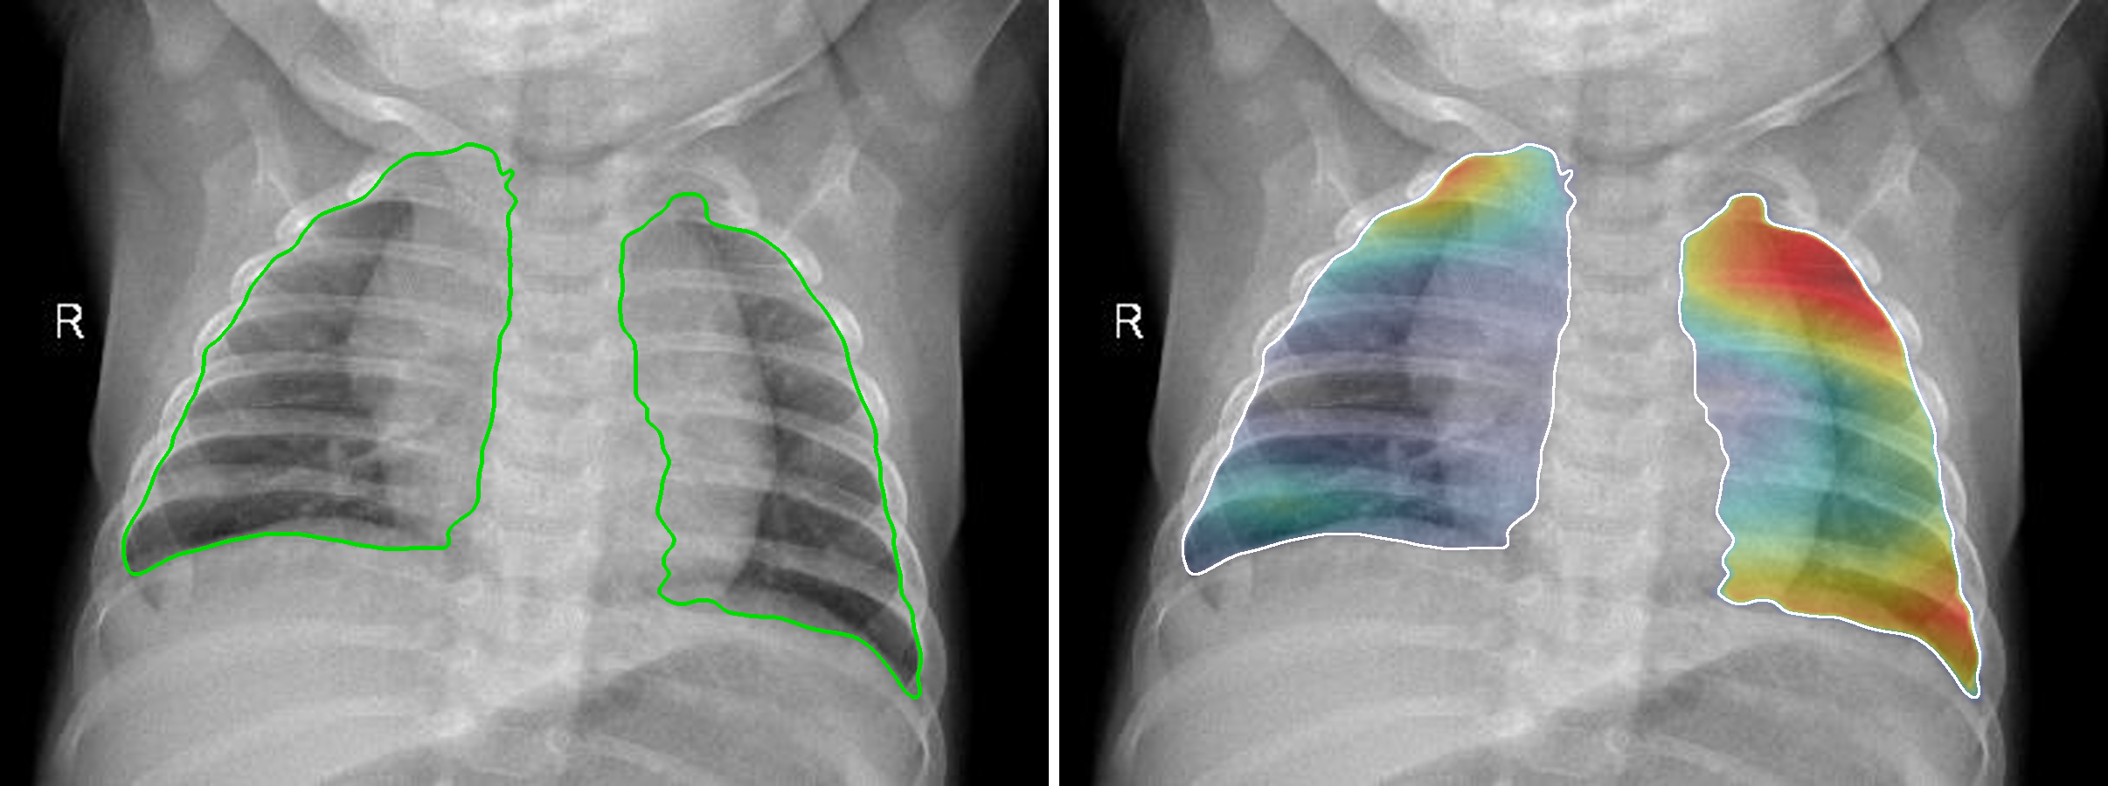
Methodology: Grad-CAM Explainability
Heatmaps from the logits, restricted to the lungs by a U-Net
Chest X-ray
DenseNet121
prediction
Logit gradients
(7×7 map)
U-Net lung
segmentation
Lung-only
heatmap
No heat outside the lungs: the map is masked to the segmented lung fields
Honest about attention: in-lung share is measured before masking; a caution is shown below 50%
Safe fallback: if no lungs are found, the unmasked map is shown
Notes:
Now the explainability part. For every prediction we make a Grad-CAM heatmap.
The steps are shown at the top. The X-ray goes into DenseNet121. We take the gradients of the predicted class score with respect to the last 7 by 7 feature map, and turn them into a heatmap.
One important detail: we use the score before the softmax, the logit. When the model is very confident, the softmax is flat and its gradients almost disappear, so the heatmap becomes useless. Using the logit fixes this.
Next, a pretrained U-Net finds the lungs in the X-ray. We keep the heatmap only inside the lungs. You can see this in the picture: on the left are the lung borders found by the U-Net, and on the right the heatmap stays completely inside the lungs.
But masking can hide a problem. So before masking we measure how much of the attention was really inside the lungs. If it is less than half, the system shows a caution to the doctor. And if the U-Net cannot find lungs, we simply show the normal heatmap.

Slide 7
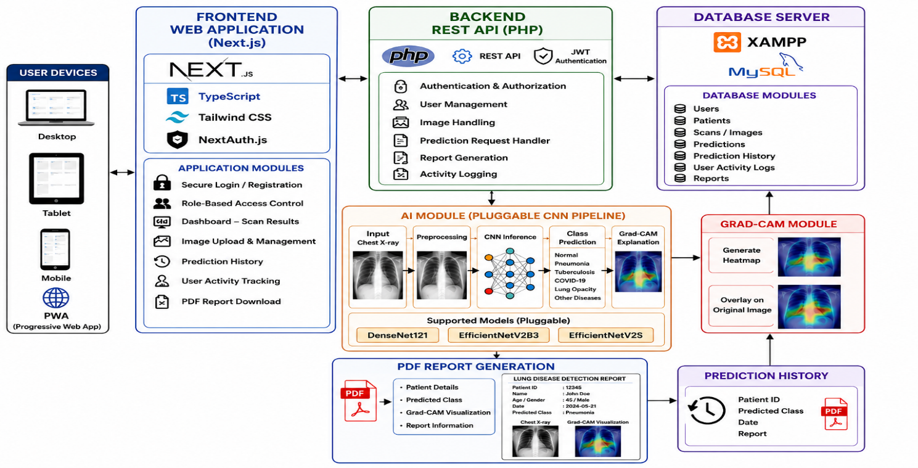




Methodology: System Deployment
An end-to-end web platform around the model
Next.js web app for desktop, tablet and mobile
PHP REST API, JWT login, four user roles, MySQL
Python FastAPI service runs the models
Out-of-distribution check withholds unsafe results
PDF reports in English, Sinhala and Tamil
Notes:
The model is not only an experiment. We built a full web platform around it, shown in this diagram.
Users open a Next.js web app that works on desktop, tablet and mobile. They log in securely with JWT, and there are four roles: patient, doctor, researcher and administrator. The PHP backend stores scans and results in MySQL, so every prediction is saved in the patient history.
The models run in a separate Python FastAPI service. It does the preprocessing, the prediction, the confidence score and the Grad-CAM.
We also added a safety check. If someone uploads something that is not a chest X-ray, for example a random image, an out-of-distribution check based on the Mahalanobis distance holds back the diagnosis and explains why.
Finally, the system creates a PDF report in English, Sinhala or Tamil, which is useful for patients in Sri Lanka.

Slide 8
Results and Comparative Analysis
DenseNet121 led, but the hard problem is bacterial vs. viral
0.97–0.99
recall for COVID-19 and Normal in all three models
0.55–0.79
recall for bacterial and viral pneumonia
Model | Accuracy % (95% CI) | F1 | AUC
DenseNet121 | 85.31 (83.3–87.1) | 0.84 | 0.977
EfficientNetV2B3 | 84.30 (82.3–86.1) | 0.83 | 0.970
EfficientNetV2S | 80.54 (78.4–82.5) | 0.80 | 0.960
76%
of DenseNet121 errors were bacterial ↔ viral confusions (155 of 203)
Notes:
Here are the results on the test set of 1,382 images, which were never used for training.
DenseNet121 gave the best accuracy, 85.31 percent, with an AUC of 0.977. EfficientNetV2B3 was very close at 84.30 percent, and EfficientNetV2S reached 80.54 percent.
But please note: the gap between the first two models is only about one percent, which is 14 images, and their 95 percent confidence intervals overlap. So we cannot say one is really better than the other. The lower EfficientNetV2S result is also partly due to an input scaling issue in its training, so it is not a fair judgement of that architecture.
The more useful finding is on the right. All models recognise COVID-19 and Normal very well, with recall between 0.97 and 0.99. The difficult part is bacterial versus viral pneumonia. For DenseNet121, 76 percent of all mistakes were confusions between these two classes.
So the system is strong at telling normal from abnormal, but bacterial versus viral still needs a doctor's decision.

Slide 9
Results: Grad-CAM Outcomes and Comparison
Explanations measured, not only shown; results placed beside earlier methods
Grad-CAM outcomes (deployed system)
Comparison with reported methods
467×
smaller gradient with softmax than with logits, so logits are used
Study | Model | Classes | Reported
Rajpurkar et al. [7] | DenseNet121 | 2 | F1 0.435
Apostolopoulos [8] | VGG19 | 3 | Acc. 93.48%
Ozturk et al. [9] | DarkCovidNet | 3 | Acc. 87.02%
Narin et al. [10] | ResNet50 | 2 | Acc. 96.1%
Chowdhury et al. [6] | DenseNet201 | 3 | Acc. 97.9%
This work | DenseNet121 | 4 | Acc. 85.31%
19%
of attention was inside the lungs on a confident Normal case, so a caution was shown
r = 0.30
weak agreement with occlusion tests inside the lungs
12 / 13
test X-rays with lungs found by the U-Net; none for noise or a logo
Different datasets and classes: an indicative, not head-to-head, comparison
Notes:
On this slide we look at the Grad-CAM results and compare our work with earlier studies.
First, Grad-CAM. We measured the explanations instead of only showing them. With the softmax score, the gradient was 467 times smaller than with the logit, which confirms why we use logits.
On a Normal X-ray that the model was 99.9 percent sure about, only 19 percent of the attention was inside the lungs. So the system correctly showed a caution. This is exactly why we report this number: a nice looking heatmap can hide the fact that the model was looking elsewhere.
Grad-CAM also agreed only weakly with an occlusion test, so we treat heatmaps as supporting evidence only. The U-Net found the lungs in 12 of 13 test X-rays, and found nothing in a noise image or a logo.
On the right is a comparison with earlier methods. Their numbers are higher, but they solved easier binary or three-class problems on different data. The closest three-class result, 87 percent, is similar to our 85 percent on the harder four-class task.

Slide 10



Discussion
Useful for screening, with three honest qualifications
Architectures are close
Screening, not aetiology
Where, not why
Accuracy differences are small compared with their uncertainty and partly reflect training settings. No design is proven superior.
Normal vs. abnormal is reliable. Bacterial vs. viral is not yet accurate enough to guide treatment.
Grad-CAM shows where the model looked, not why. Even confident predictions can look outside the lungs.
A decision-support tool that supports, not replaces, doctors. External validation across hospitals, devices and patient groups is needed before clinical use.
Notes:
What do these results mean? Our framework works, but we want to be honest about three things.
First, the architectures are very close. The differences in accuracy are small compared with the uncertainty, and some training settings were different. So we do not claim that one network design is better. We deployed DenseNet121 simply because it was best on every metric we measured.
Second, the system is good for screening, but not for finding the exact cause. It separates normal from abnormal X-rays reliably. But telling bacterial from viral pneumonia is not accurate enough yet to decide on antibiotics.
Third, Grad-CAM shows where the model looked, not why. And as we saw, even a very confident prediction can look mostly outside the lungs. That is why we show the in-lung share to the doctor.
Overall, this is a decision-support tool. It helps doctors; it does not replace them. Before real clinical use, it must be tested on data from other hospitals, machines and patient groups.

Slide 11

Conclusion
An explainable four-class framework, delivered as a working platform
Contributions
Limitations and future work
Four-class comparison of DenseNet121 (85.31%), EfficientNetV2B3 (84.30%) and EfficientNetV2S (80.54%) under one protocol
Limits: one public dataset, one training run per model, settings not fully equal, no radiologist check of heatmaps
Next: external validation on other datasets and hospitals
Next: repeated, fully controlled training
Next: radiologist review of explanations and multimodal clinical data
Logit-based Grad-CAM restricted to the lungs, with the in-lung share disclosed
End-to-end platform: web and mobile access, secure login, history, out-of-distribution check, multilingual PDF reports
Notes:
To conclude. We presented an explainable deep learning framework that classifies chest X-rays into four classes: Normal, COVID-19, bacterial pneumonia and viral pneumonia.
Our contributions are three. First, a fair comparison of three networks on the same data and protocol, where DenseNet121 reached 85.31 percent. Second, Grad-CAM explanations computed from the logits, kept inside the lungs, and with the in-lung share shown honestly. Third, a complete platform with web and mobile access, secure login, patient history, a safety check for invalid inputs, and reports in three languages.
The study also has limits. We used one public dataset and trained each model once. The settings were not fully equal, and no radiologist checked the heatmaps.
In the future we plan to test the system on data from other hospitals, repeat the training in a fully controlled way, ask radiologists to review the explanations, and add other clinical data.

Slide 12

Thank You
Questions and discussion are welcome
Questions?
Paper ID 29002 · ICTAR 2026
Notes:
Thank you very much for listening.
I am happy to answer any questions.

