Slide 1
Car Price Prediction Project
Submitted by :
CHAMLIN NAJIR RAHMAN

Slide 2
PROBLEM STATEMENT
With the covid 19 impact in the market, we have seen lot of changes in the car market. Now some cars are in demand hence making them costly and some are not in demand hence cheaper. One of our clients works with small traders, who sell used cars. With the change in market due to covid 19 impact, our client is facing problems with their previous car price valuation machine learning models. So, they are looking for new machine learning models from new data. We have to make car price valuation model.
AIM :
To build a new machine learning model for the car price evaluation from the scrapped data.

Slide 3
Web Scrapping
First I scrapped data for used cars from “CarDekho” website, using selenium.
A total of 12608 rows and 20 columns of data was scrapped.
The data was scrapped from various locations like maharashtra, tamil nadu, kerala, bangalore, ahmedabad, chennai, delhi, gurgaon, hyderabad, jaipur, kolkata, noida and pune.
The features scrapped are : Car_Name', 'Fuel_type', 'Running_in_kms', 'Endine_disp', 'Gear_transmission', 'Milage_in_km/ltr', 'Seating_cap', 'color', 'Max_power', 'front_brake_type', 'rear_brake_type', 'cargo_volume', 'height', 'width', 'length', 'Weight', 'Insp_score', 'top_speed', 'City_url', 'Car_price‘.
All these features were stored in a dataframe and at last saving the dataframe into an excel file.

Slide 4
EDA STEPS
Exploratory Data Analysis.
Here we clean, analyze and visualize the given data, and then draw conclusions.
Step 1 : Importing the required libraries, like numpy, pandas, matplotlib and seaborn.
Step 2 : Importing the excel dataset into jupyter notebook.
Step 3 : Gather information about the dataset, like, columns, shape, datatype, null values, skewness, unique value count for each feature, statistical information using describe(), etc.

Slide 5
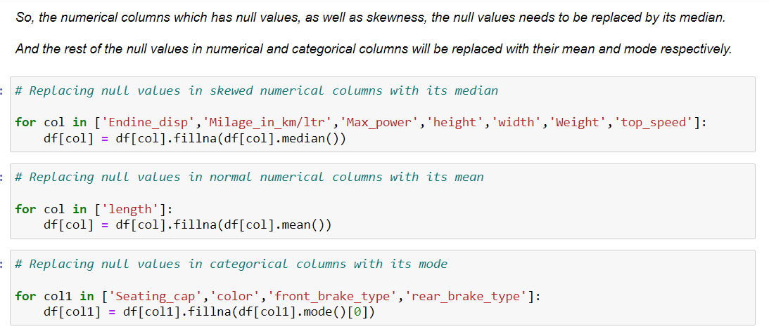
Handling Null Values There were null values in several columns. So this is how I removed them :

Slide 6
VISUALIZATIONS :
Countplot for all object datatype features, to visualize the count for each category present in these features.
Distribution plot for all the continuous numeric features, to know their skewness also
Bivariate Analysis : Finding relation between 2 features.
Pairplot , for multivariate analysis
Example : Barplot, Lineplot, and Stripplot are used mostly in this project to find the relation between two features :

Slide 7
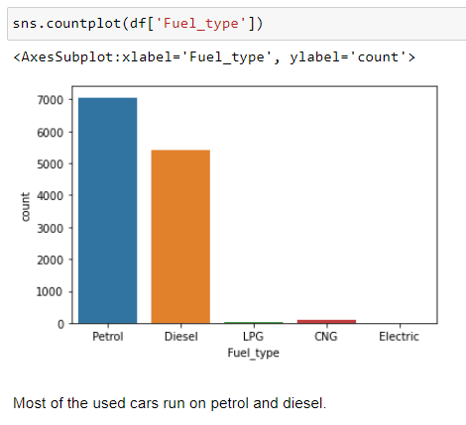
Example of Univariate Countplot for categorical feature :

Slide 8
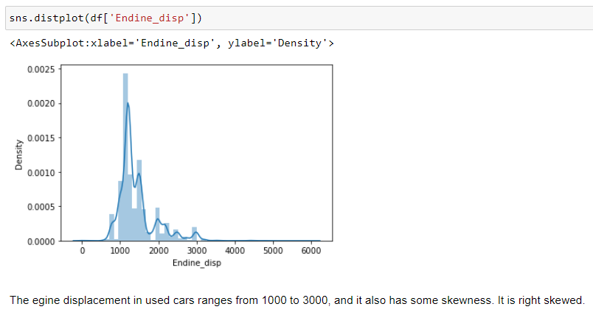
Example of Univariate Distribution plot for numerical feature :

Slide 9
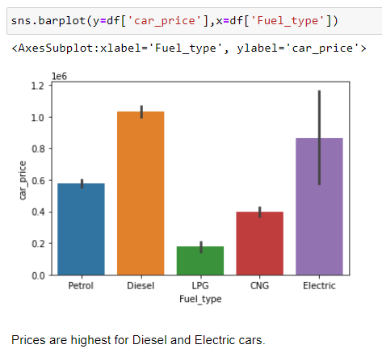
Example of Bivariate Barplot :

Slide 10
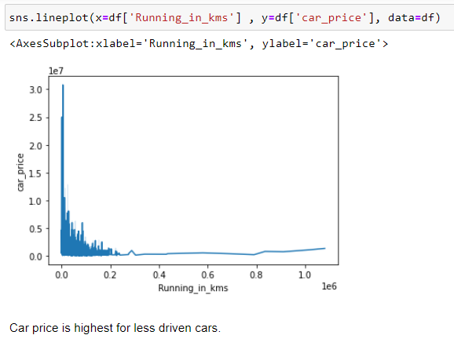
Example of Bivariate Lineplot :

Slide 11
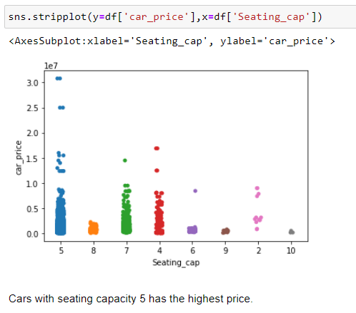
Example of Bivariate Stripplot :

Slide 12
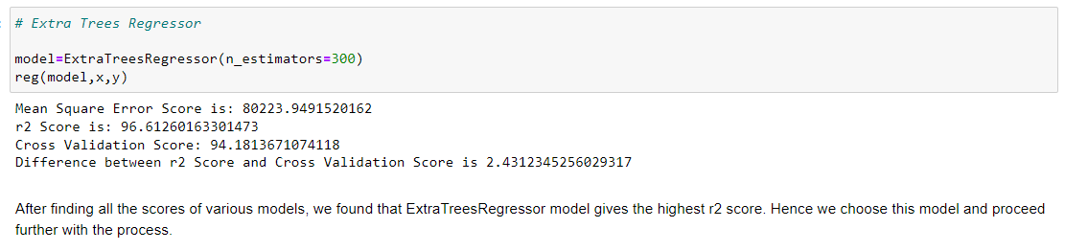
Best ML Model

Slide 13
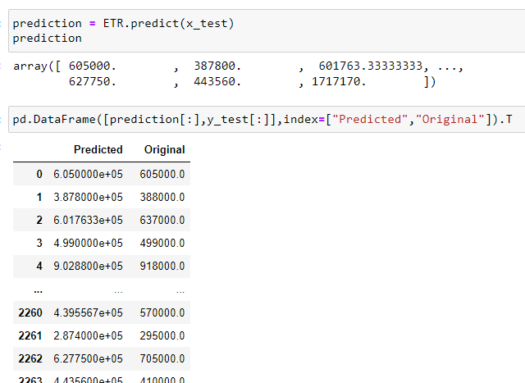
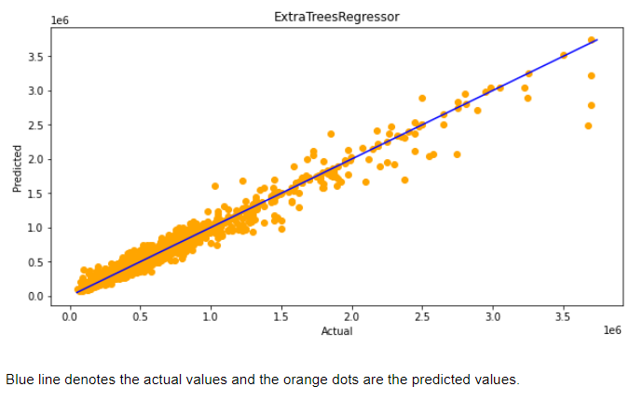
Predictions

