Slide 1
Flight Price Prediction Project
Submitted by :
CHAMLIN NAJIR RAHMAN

Slide 2
PROBLEM STATEMENT
Anyone who has booked a flight ticket knows how unexpectedly the prices vary. The cheapest available ticket on a given flight gets more and less expensive over time. This usually happens as an attempt to maximize revenue based on -
Time of purchase patterns (making sure last-minute purchases are expensive)
Keeping the flight as full as they want it (raising prices on a flight which is filling up in order to reduce sales and hold back inventory for those expensive last-minute expensive purchases)
AIM :
To build a new machine learning model for the flight price evaluation from the scrapped data.

Slide 3
Web Scrapping
First I scrapped data for used cars from “yatra.com” website, using selenium.
A total of 6730 rows and 8 columns of data was scrapped.
The data was scrapped for various locations like bangalore, kolkata, pune, mumbai, jammu, goa, bagdogra.
The features scrapped are : 'Airline', 'Source', 'Destination', 'Dep_Time', 'Arrival_Time', 'Duration', 'Total_Stops', 'price'.
All these features were stored in a dataframe and at last saving the dataframe into an excel file.

Slide 4
EDA STEPS
Exploratory Data Analysis.
Here we clean, analyze and visualize the given data, and then draw conclusions.
Step 1 : Importing the required libraries, like numpy, pandas, matplotlib and seaborn.
Step 2 : Importing the excel dataset into jupyter notebook.
Step 3 : Gather information about the dataset, like, columns, shape, datatype, null values, skewness, unique value count for each feature, statistical information using describe(), etc.

Slide 5
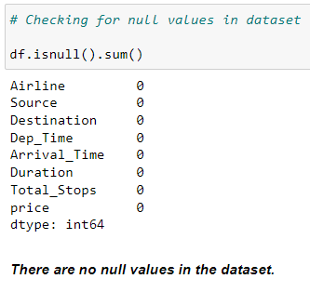
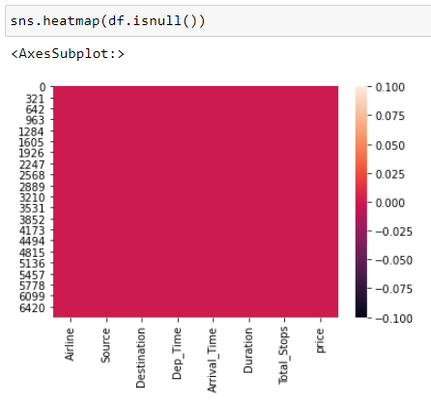
Handling Null Values There were no null values in the dataset.

Slide 6
VISUALIZATIONS :
Countplot for all object datatype features, to visualize the count for each category present in these features.
Distribution plot for all the continuous numeric features, to know their skewness also
Bivariate Analysis : Finding relation between 2 features.
Pairplot , for multivariate analysis
Example : Barplot, and Stripplot are used mostly in this project to find the relation between two features :

Slide 7
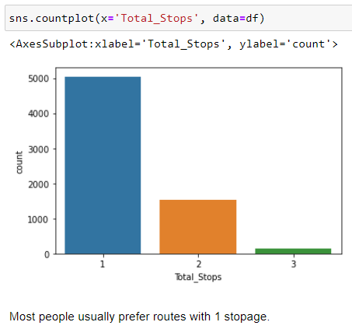
Example of Univariate Countplot for categorical feature :

Slide 8
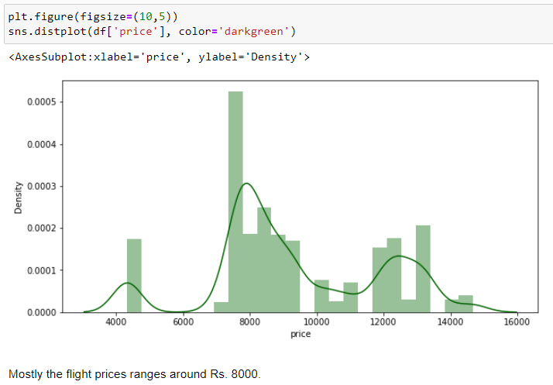
Example of Univariate Distribution plot for numerical feature :

Slide 9
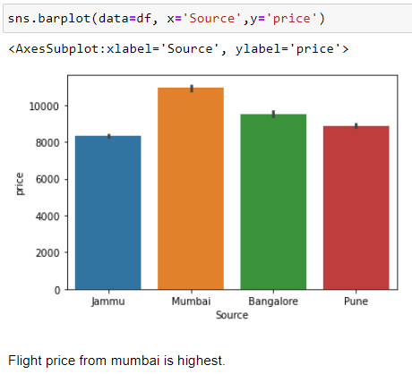
Example of Bivariate Barplot :

Slide 10
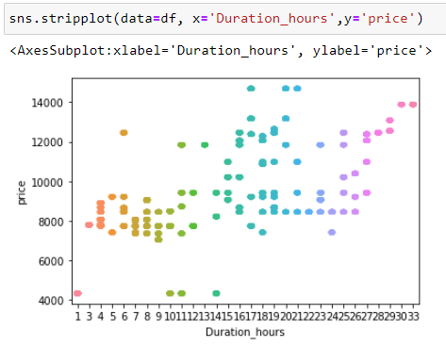
Example of Bivariate Stripplot :

Slide 11
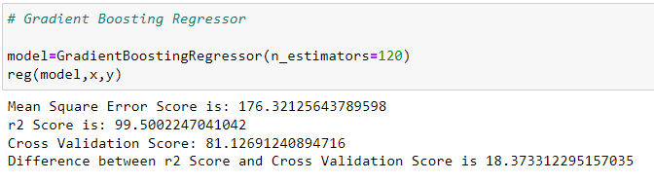
Best ML Model

Slide 12
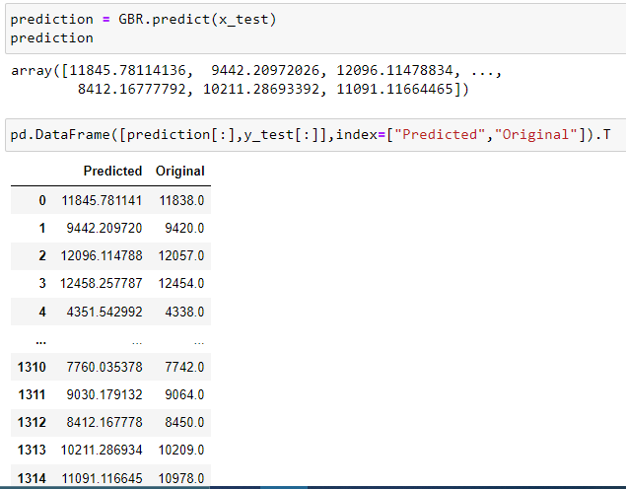
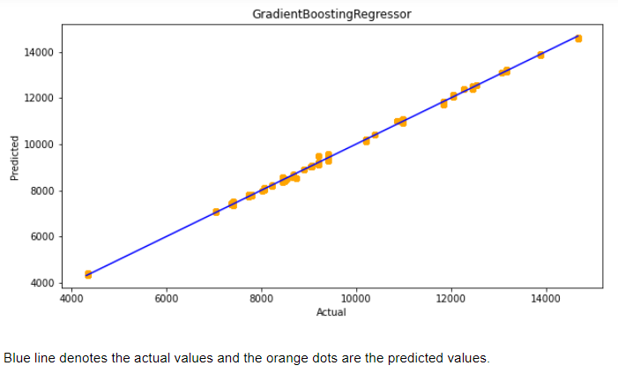
Predictions

