Slide 1
Malignant Comments Classifier Project
Submitted By :-
Chamlin Najir Rahman
Internship 25
Batch 1838

Slide 2
Problem Statement
The proliferation of social media enables people to express their opinions widely online. However, at the same time, this has resulted in the emergence of conflict and hate, making online environments uninviting for users. Although researchers have found that hate is a problem across multiple platforms, there is a lack of models for online hate detection.
There has been a remarkable increase in the cases of cyber bullying and trolls on various social media platforms. Many celebrities and influences are facing backlashes from people and have to come across hateful and offensive comments. This can take a toll on anyone and affect them mentally leading to depression, mental illness, self-hatred and suicidal thoughts.
The problem we sought to solve was the tagging of internet comments that are aggressive towards other users. This means that insults to third parties such as celebrities will be tagged as inoffensive, but “u are an idiot” is clearly offensive.
Our goal is to build a prototype of online hate and abuse comment classifier which can used to classify hate and offensive comments so that it can be controlled and restricted from spreading hatred and cyber bullying.

Slide 3
Dataset description
The data set contains the training set, which has approximately 1,59,000 samples.
All the data samples contain 8 fields which includes ‘Id’, ‘Comments’, ‘Malignant’, ‘Highly malignant’, ‘Rude’, ‘Threat’, ‘Abuse’ and ‘Loathe’. The label can be either 0 or 1, where 0denotes a NO while 1 denotes a YES. There are various comments which have multiple labels. The first attribute is a unique ID associated with each comment.
The data set includes:
Malignant: It is the Label column, which includes values 0 and 1, denoting if the comment is malignant or not.
Highly Malignant: It denotes comments that are highly malignant and hurtful.
Rude: It denotes comments that are very rude and offensive.
Threat: It contains indication of the comments that are giving any threat to someone.
Abuse: It is for comments that are abusive in nature.
Loathe: It describes the comments which are hateful and loathing in nature.
ID: It includes unique Ids associated with each comment text given.
Comment text: This column contains the comments extracted from various social media platforms.

Slide 4
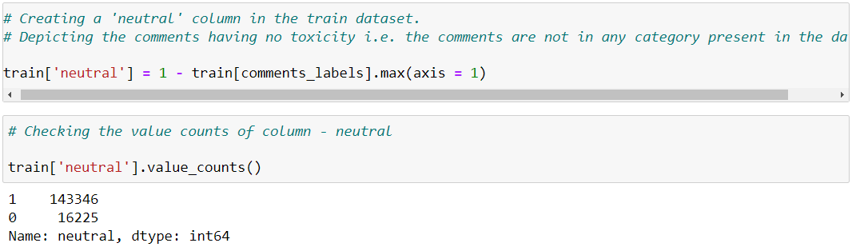
Eda steps
Firstly, gather information about the dataset, like, columns, shape, datatype, null values, skewness, unique value count for each feature, statistical information using describe(), etc.
Creating a new column

Slide 5
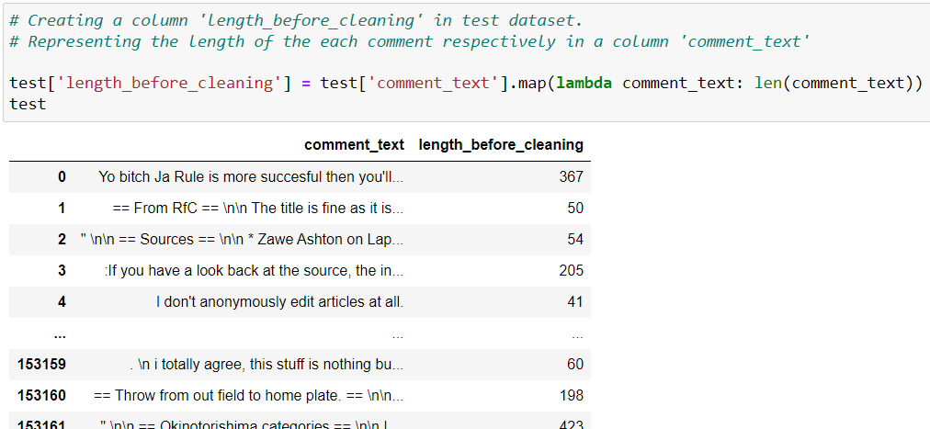
Another new column

Slide 6
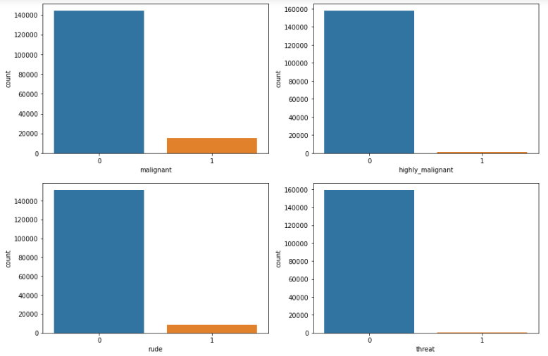
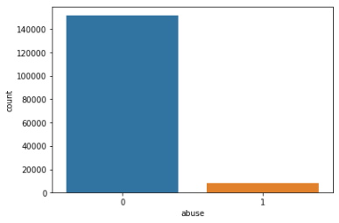
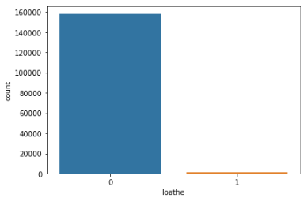
Univariate analysis of categorical data

Slide 7
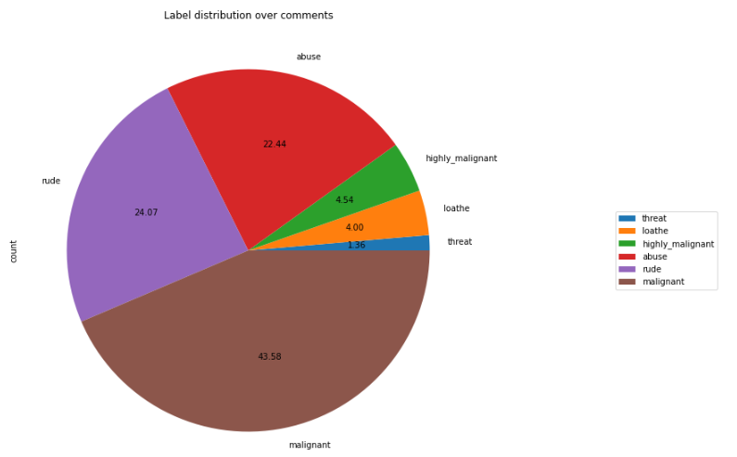
Pie chart

Slide 8
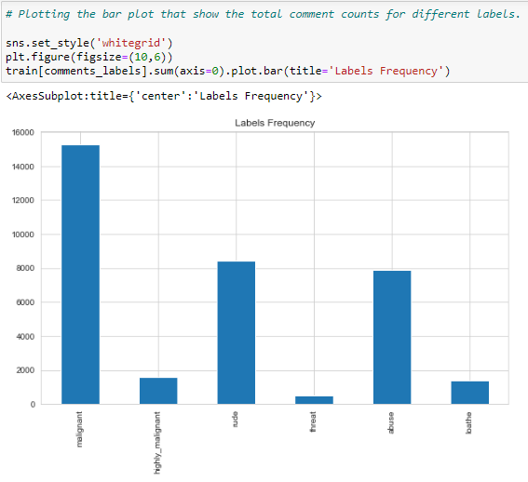
Bar plot

Slide 9
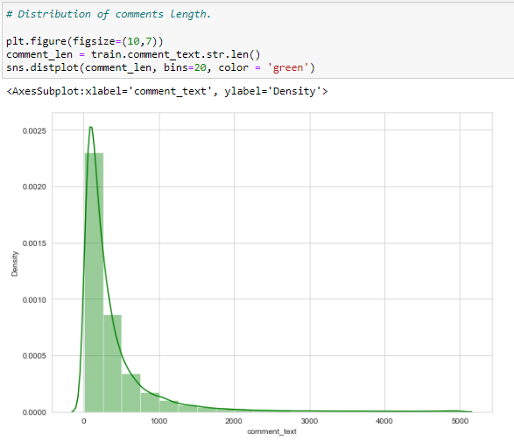
Distribution plot

Slide 10
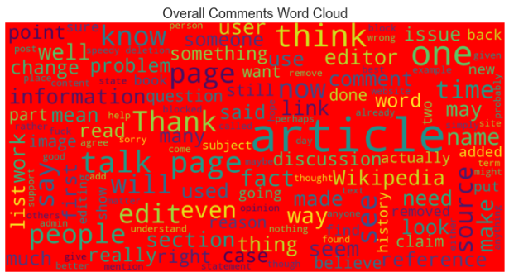
wordclouds

Slide 11
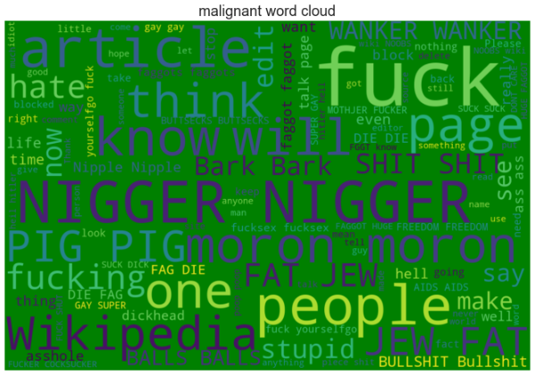
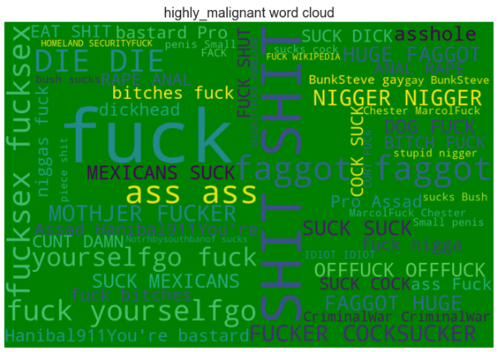

Slide 12
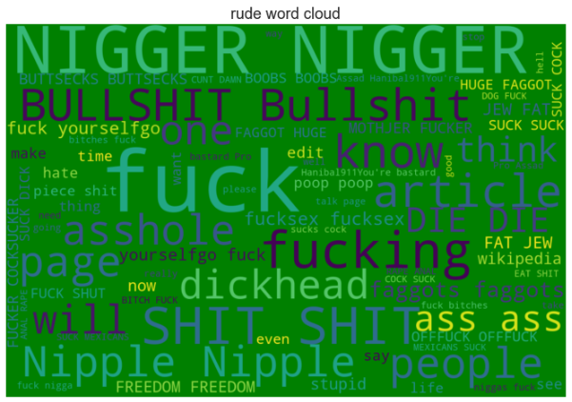
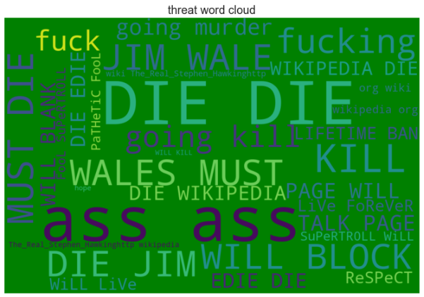

Slide 13
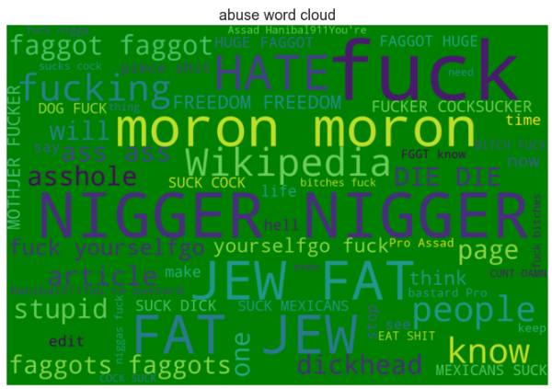
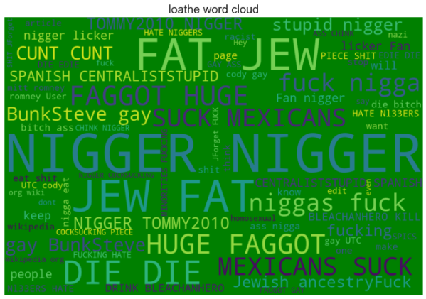

Slide 14
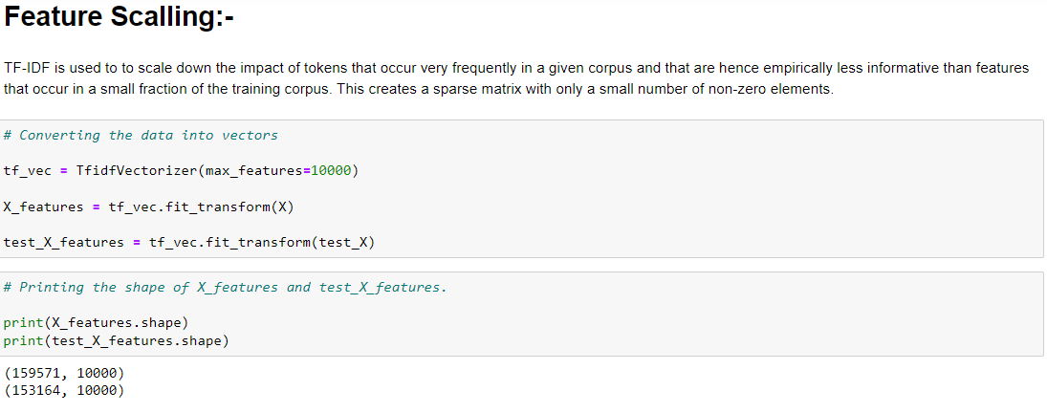
Feature scaling

Slide 15
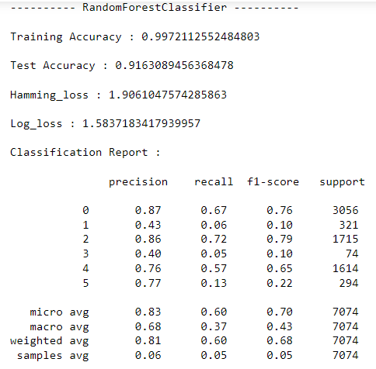
Best model

Slide 16
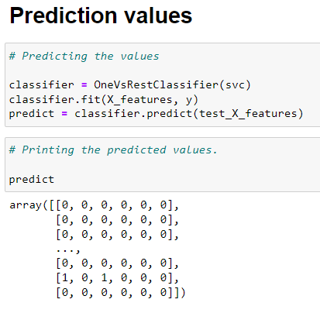
predictions

