Slide 1

Android Baby Bunch
Simple Squad
Chamaka Wimalarathne 14209073
Layan Adikari 14208869
Nethmi Hettiarachchi 14208927
Gayathri Munasinghe 14210452
Sandani Jayamaha 14208851

Slide 2

What is Baby Bunch?
Baby Bunch
Paint App
Interactive gaming app
Baby Piano
Audio Player
Interactions with colors and sounds are important for a child’s growth .
There are several apps for this purpose but separately . Baby bunch is the solutions for it.
We have combined collection of sound and color based interactive app.
Recognizing colors and responding to music will be developed by this app

Slide 3
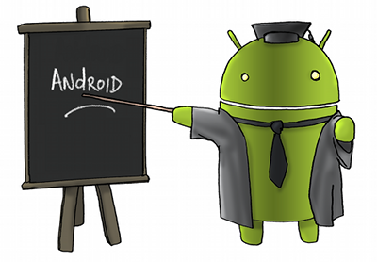
Baby piano
A Typical toy piano
Baby player
Select a song and play
Stop function Is introduced(Never seen in a android media players)
Choose color
Press speak and get a color , Press repeat to repeat it
Select the correct color and get a Horaaaay!!!
Paint app functions
can color , save , erase .
Name of the color will be spoken when selected

Slide 4



Whom is this for?
Kids up to age 10(Recommended)
But a fun loving Adults can also use

Slide 5
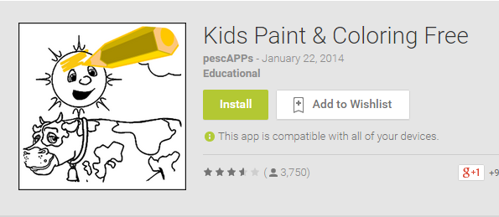
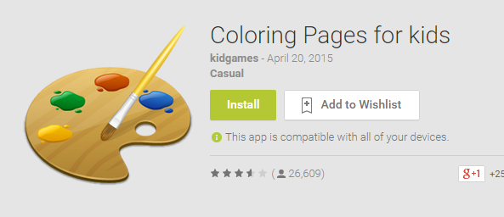
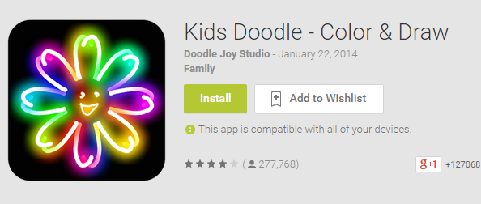
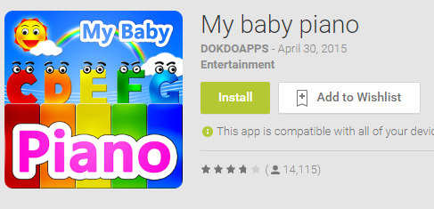
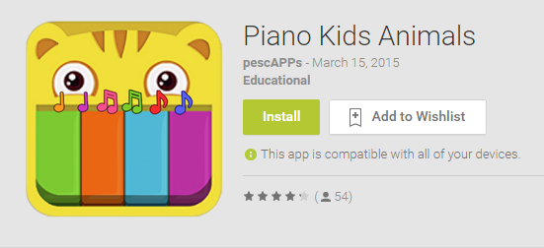
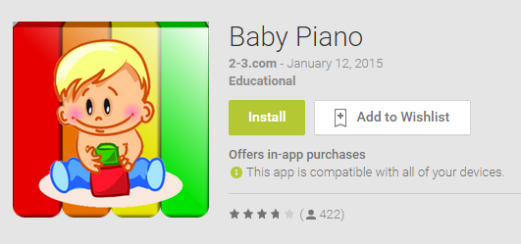
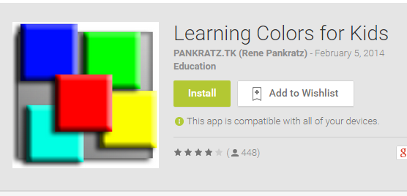
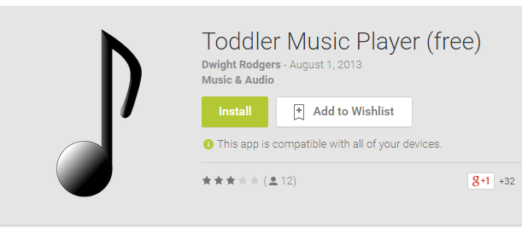
Similar Apps in the market

Slide 6
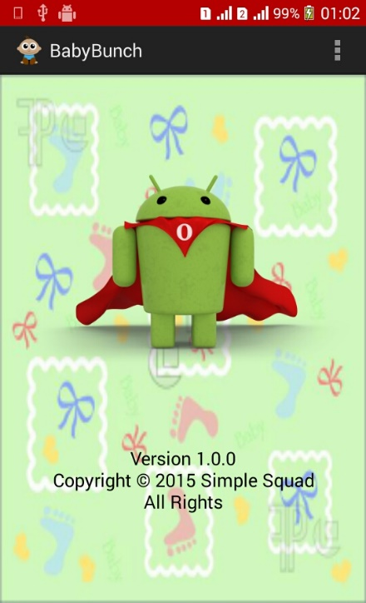
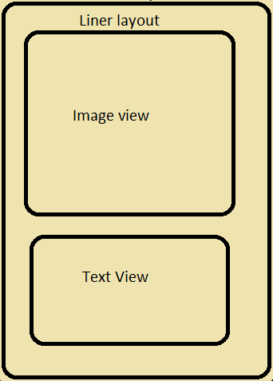
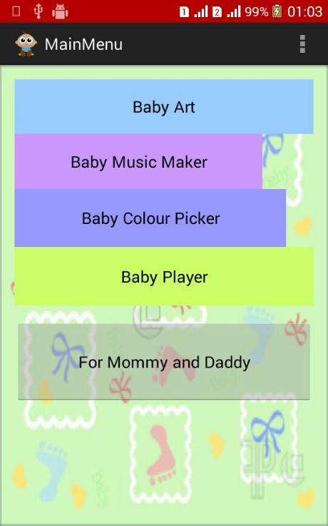
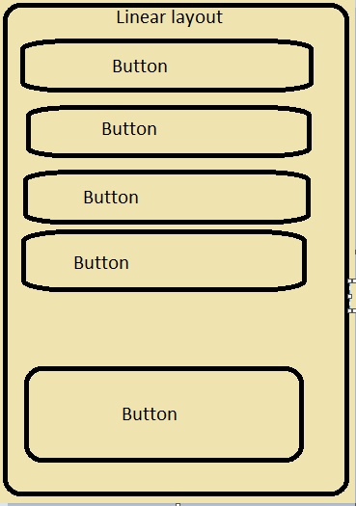
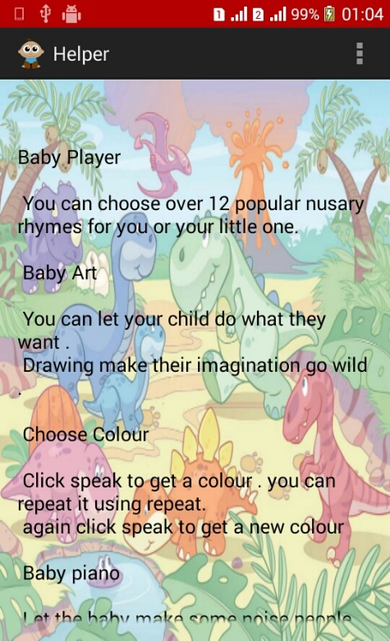
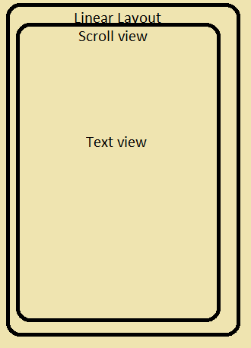

Slide 7
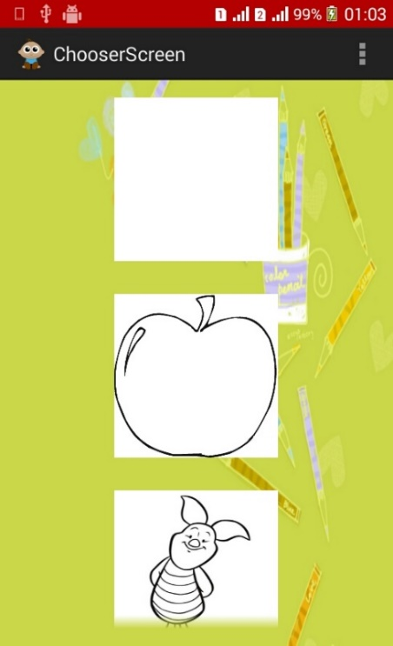
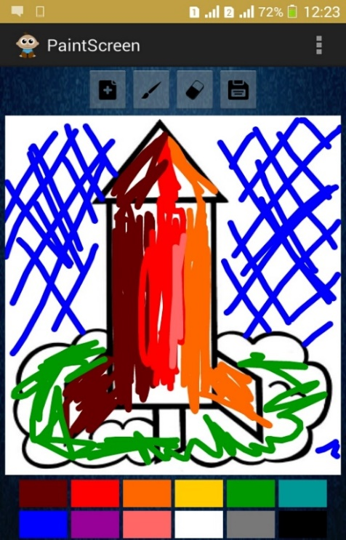
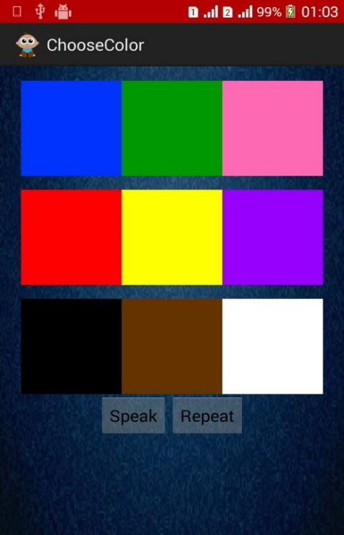
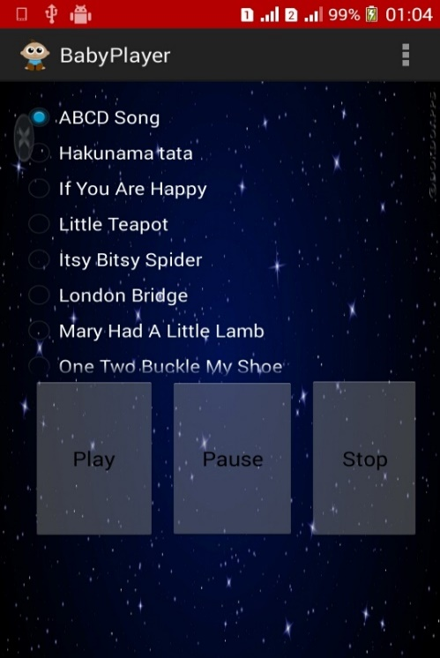
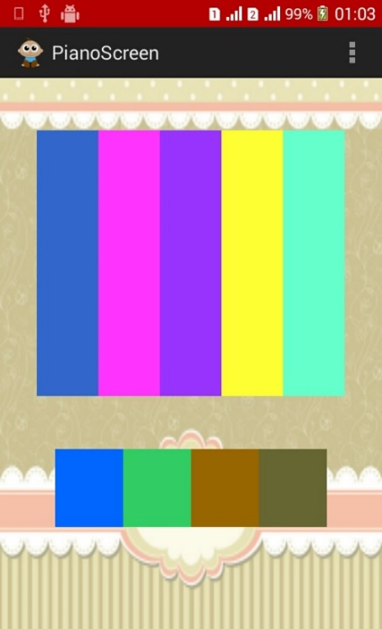
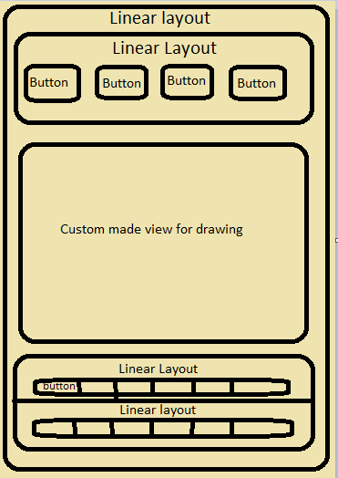
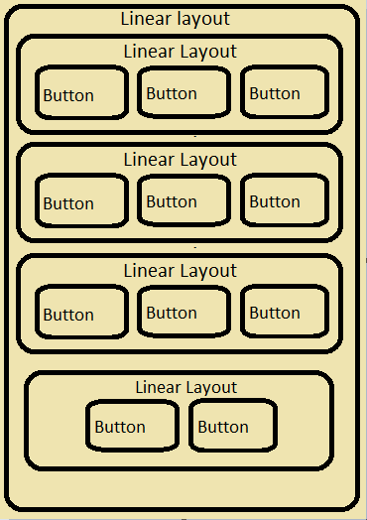
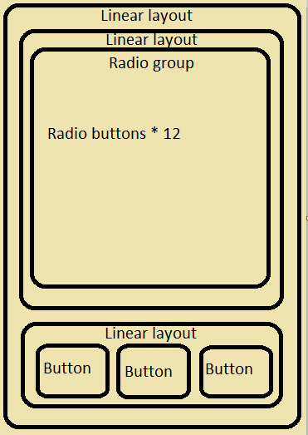
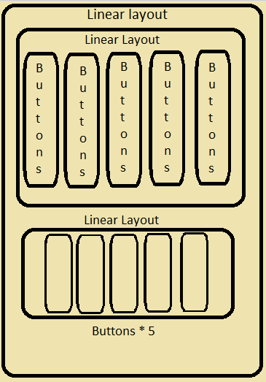
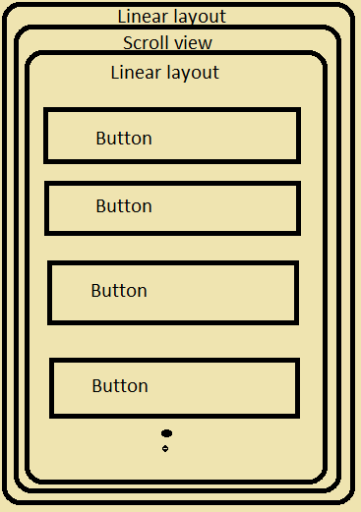

Slide 8
Splasher Screen
Main Menu
Template Chooser
Color Chooser
Baby Piano
Baby Player
Help screen
Coloring app

