Slide 1
Elephant Learn A sentimental analysis system for Thai stock market
953499 SE Senior Project

Slide 2
Agenda
Background
Problems
Solutions
Technology Review
Aim and Objectives
System Architecture
Features
Limitations

Slide 3


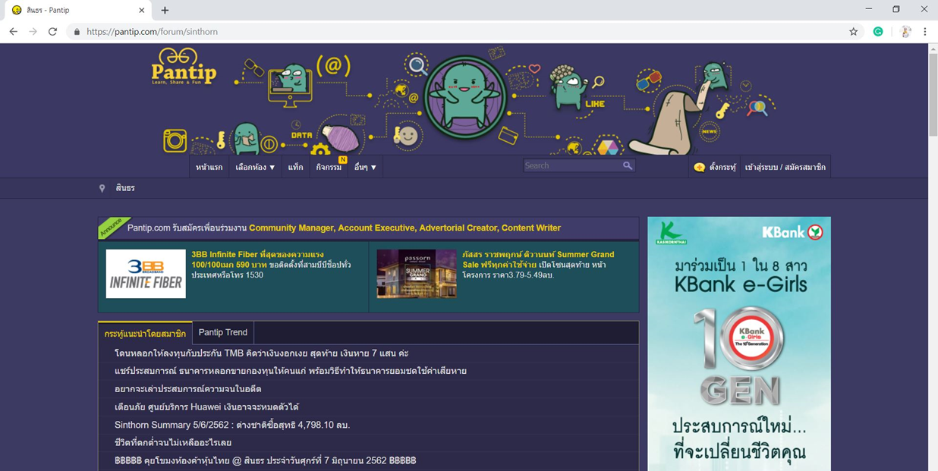
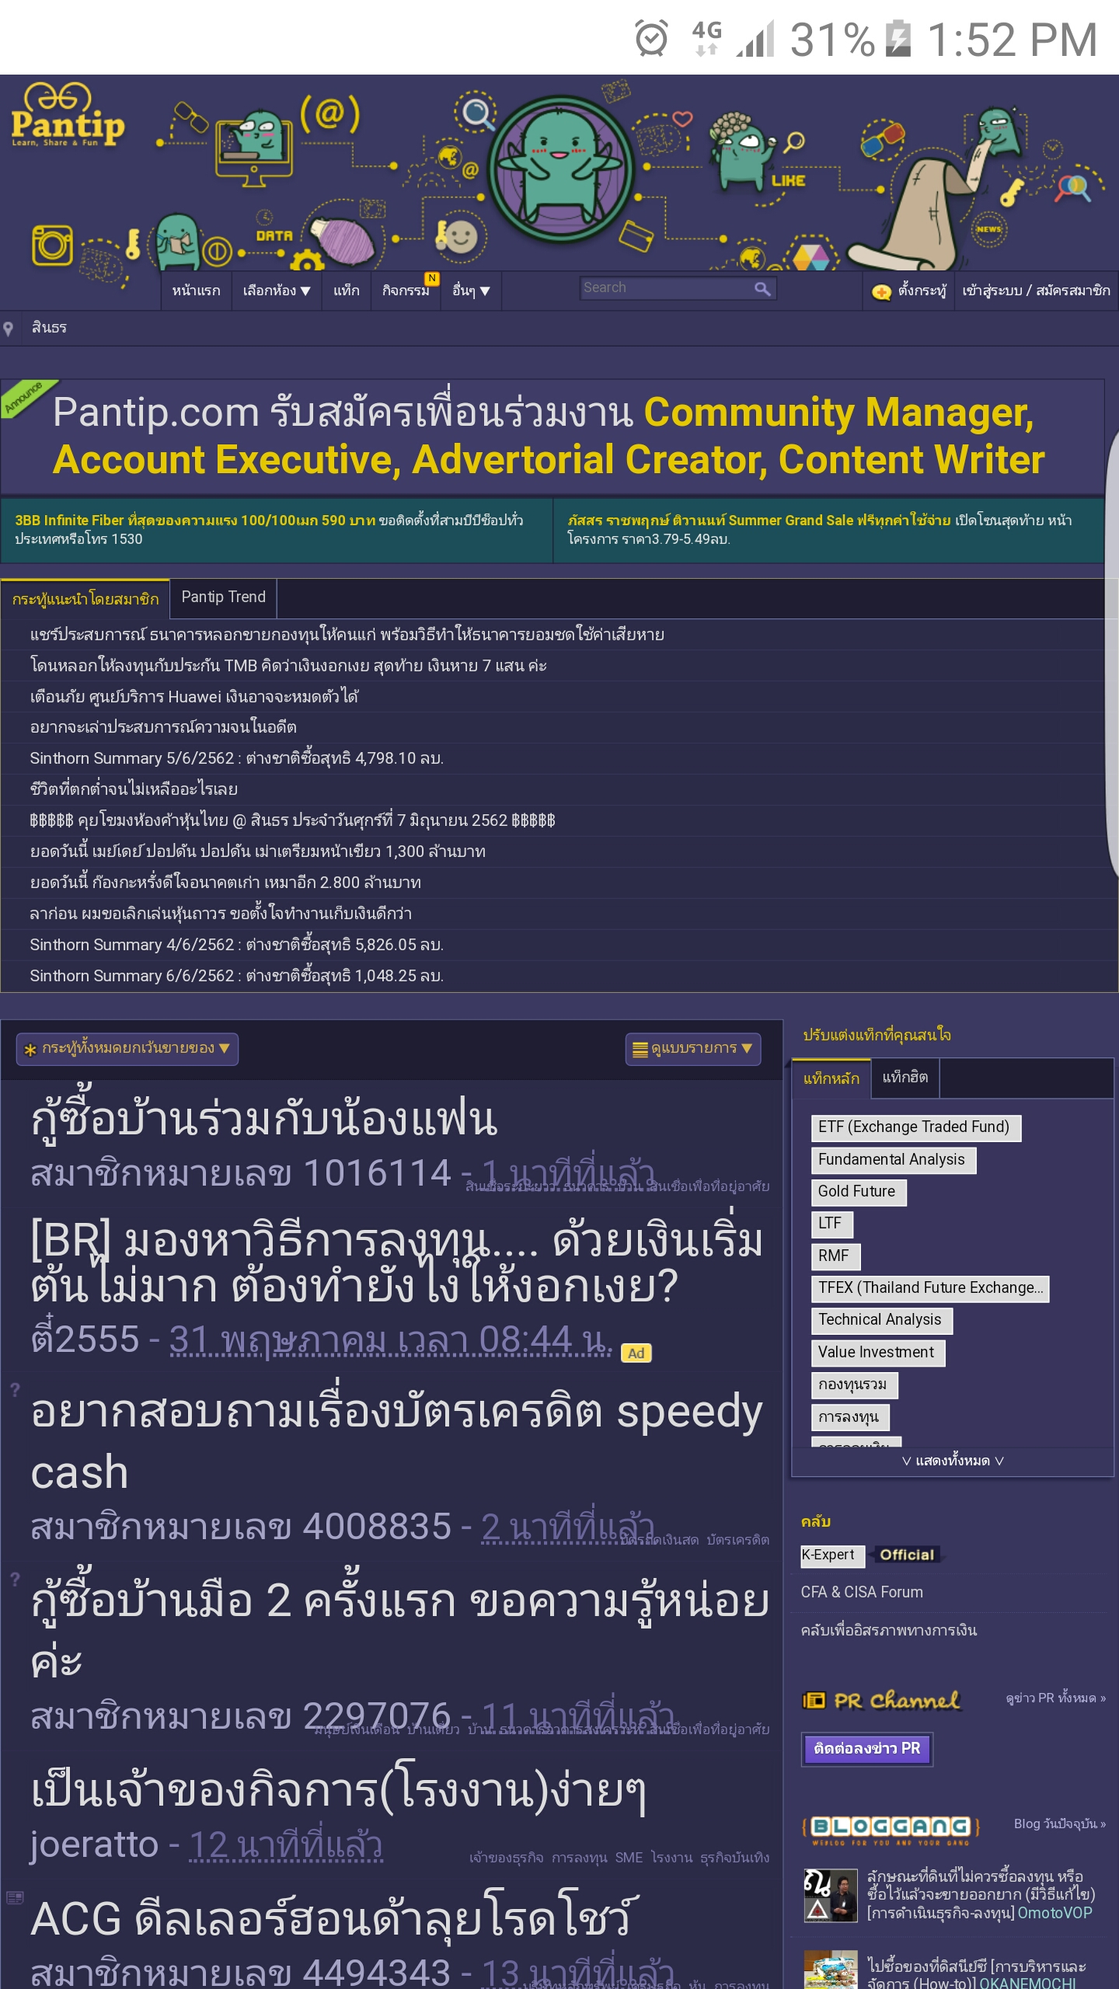
Background

Slide 4

Problems

Slide 5
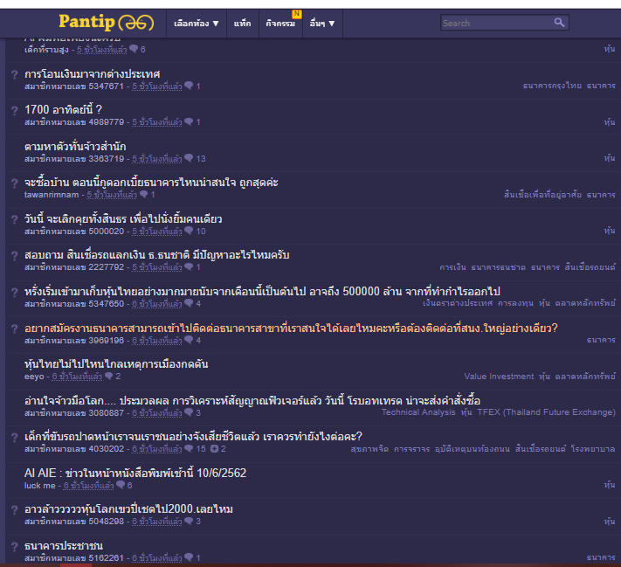


Problems

Slide 6
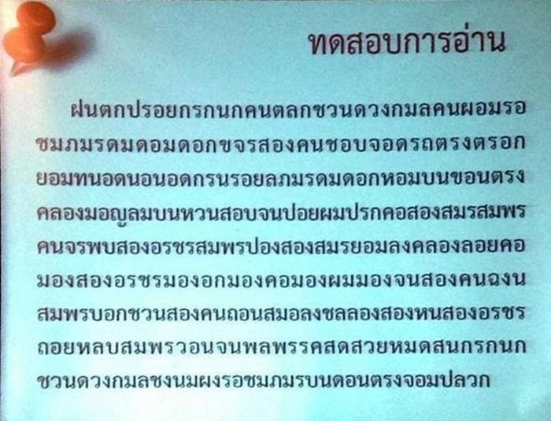
Problems

Slide 7
Problems
1
2
Thai language → คุณเป็นอย่างไรบ้าง
The 18 vowels, diphthongs and triphthongs
- ก + ะ + น = กัน
change from ะ to ั
Uppercase and lowercase
- ก + ◌ิ + น = กิน
- ง + ◌ ู = งู
English → How are you?
No space between words
Space → end of sentence

Slide 8
Problems
3
4
The compound words
- ไฟ + ฟ้า = ไฟฟ้า
- น้ำ + แข็ง = น้ำแข็ง
The compound vowels
- อี + อา = เอีย
- อิ + อะ = เอียะ
The special letters อ and ห
- อย่าง, อยาก, อยู่
- อร่อย, อนาคต
- เหมือน, หญิง, หมอ
- หอม, หอ, หิน

Slide 9
Problems
The special letter and word such as letter ทร are pronounce like ซ
- ทราบ
- ทราย
The royal words
- พระพักตร์ = หน้า
- พระหัตถ์ = มือ
The region language
- สวัสดี
Northern Thailand = สวัสดีเจ้า
Central Thailand = สวัสดี
Isan (Northeastern Thailand) = ไปไส
Southern Thailand = พรือ
The slang words
- แอ๊บแบ้ว = น่ารัก
- แห้ว = ไม่สมหวัง

Slide 10
Solutions

Slide 11

Solutions

Slide 12
Solutions
A text sentimental analysis system
Automatedly retrieving web textual data of comments
Data preprocessing
Tokenization
POS tagging
Bag of words
Data analysis
Fix Thai language problems

Slide 13
Technology Review

Slide 14



Technology review

Slide 15




Technology review

Slide 16




Technology review

Slide 17
Aim and objectives
Aim
Detecting negative comment problem
Objectives
Automatedly scraping text data website
Sentimental analysis processing
Responsive interface showing the result of descriptive and predictive analysis in percentage of the comments

Slide 18
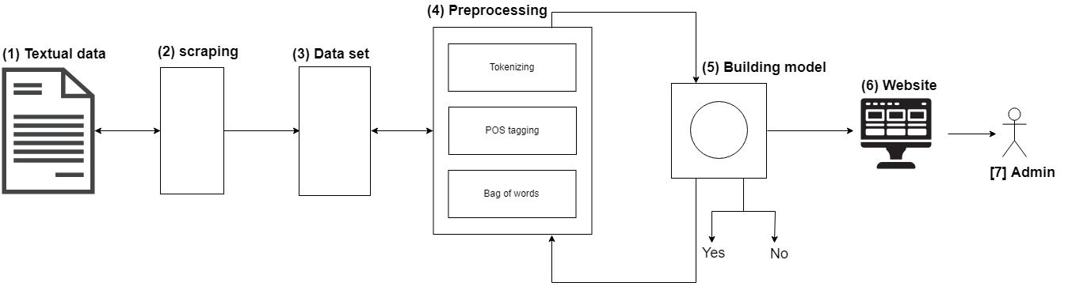
System Architecture

Slide 19

Features

Slide 20
Features
Feature #01: Retrieve comments
Automatedly scraping text data from Pantip
Feature #02: Data cleaning, Data preprocessing, Data analysis
The textual data cleaning
Making model from data preprocessing
Analysis data from model

Slide 21
Features
Feature #03: View percentage
Analyze the comment
Show the number of percentages in scale of 0% - 100%
Feature #04: View statistic
Receive the information from Pantip
Analyze the information
Show the result of statistic

Slide 22
Features
Feature #05: Pending new comments
Receive the new comments
Show the new comment
Feature #06: Delete comment
Show the number of percentage of comment
Admin can delete the comment

Slide 23
Features
Feature #07: Authentication
Admin can log in to the system
Admin can log out from the system
Feature #08: Save data
Save the analyzed result

Slide 24
Limitations
Internet connection is always required
Support only Thai Language
Can not guarantee 100% accuracy
Time limited
Resources limited

Slide 25
Thanks!
Members:
Pakarat Matmarurat 592115022
Chamnol Yin 592115519

Slide 26
Q&A

