Slide 1
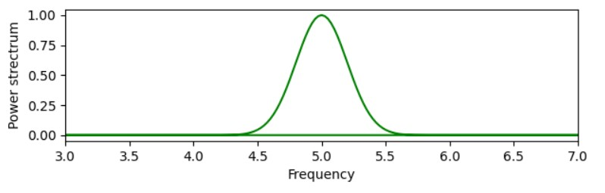
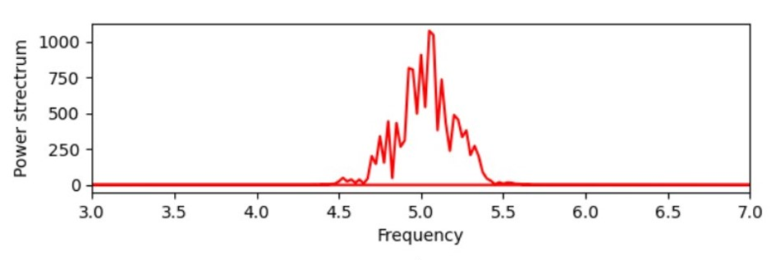
(a)
(b)

Slide 2
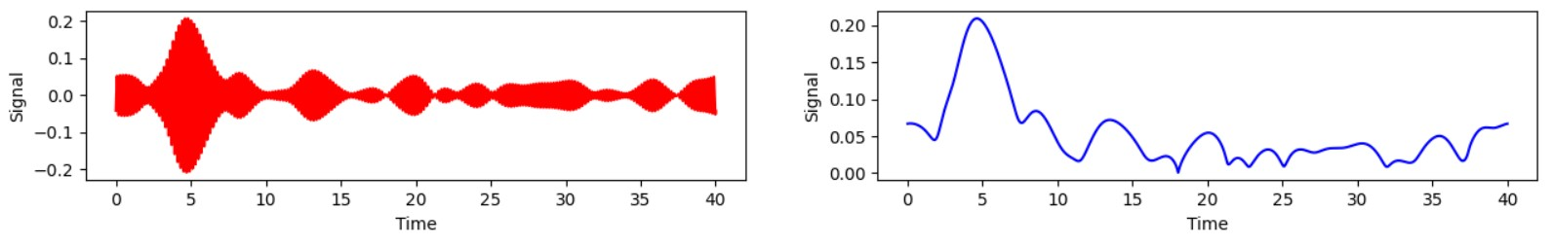
(a)
(b)

Slide 3
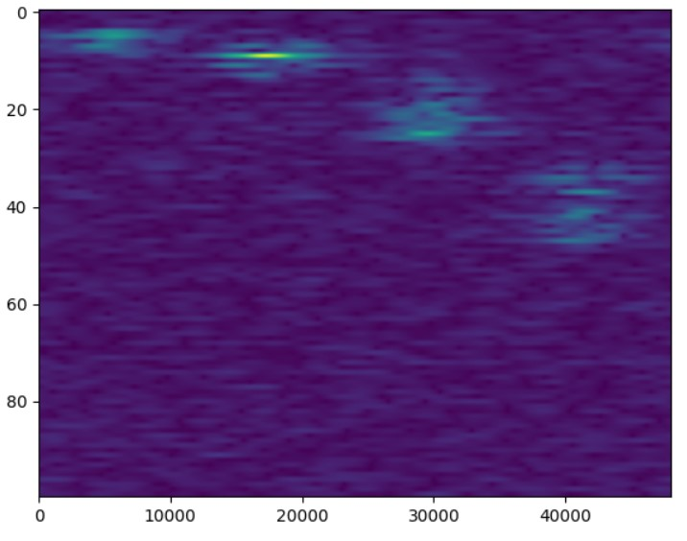
0
20
40
Frequency (Hz)
60
80
0
10
20
30
40
Time (s)

