Slide 1
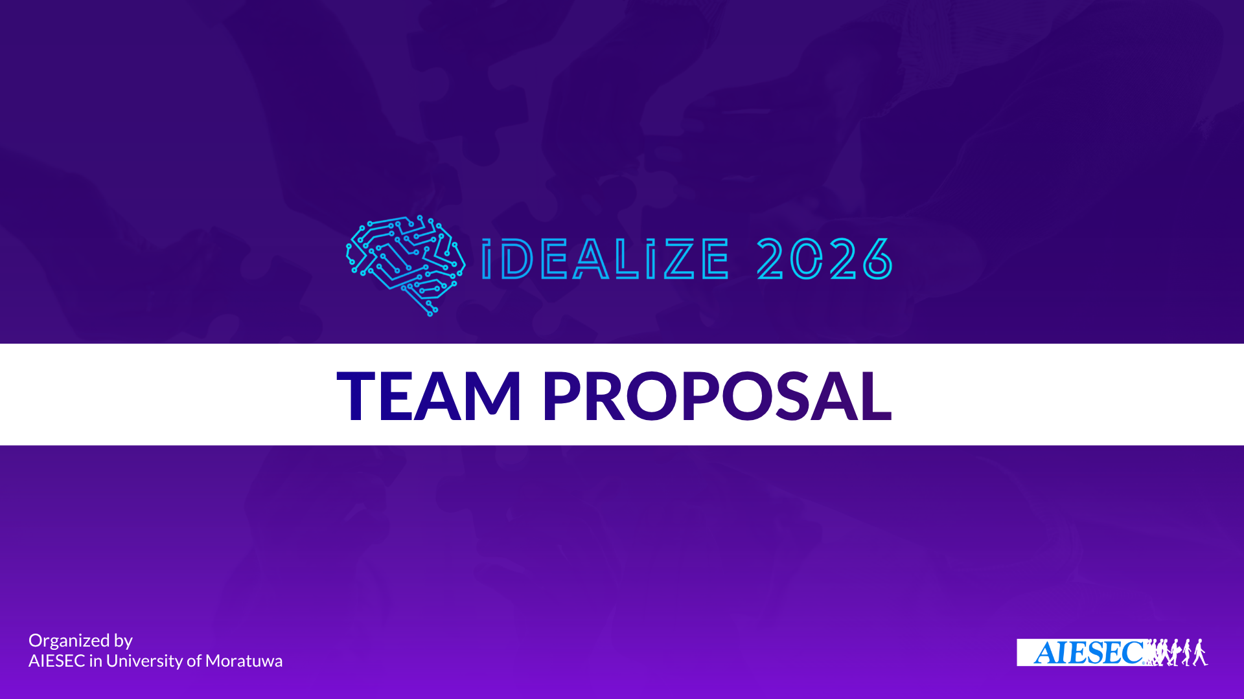
ZENITH — Agentic AI Cheque & Cash-Flow for Sri Lankan SMEs
Team Name: [FILL IN]

Slide 2
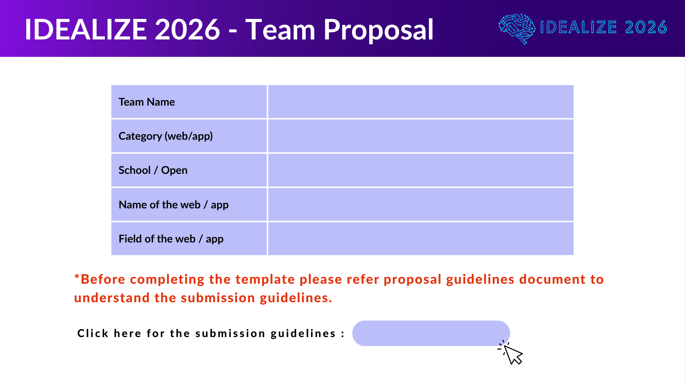
[FILL IN — your team name]
Web App
Open Category
Zenith
FinTech / SME Cash-Flow & Cheque Management
Proposal Guideline

Slide 3
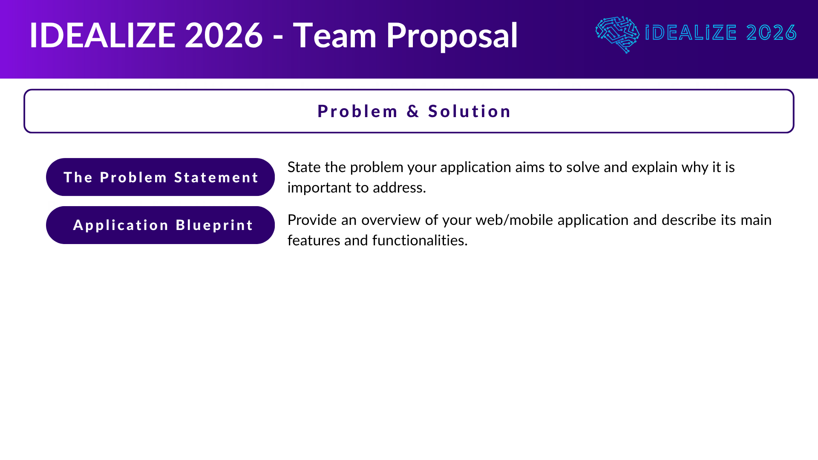
Sri Lankan SMEs receive supplier invoices daily but struggle to time cheque payments against CBSL bank holidays and interbank clearing rules. Grouping invoices under LKR cheque ceilings is manual and error-prone. Cashiers need a simple mobile channel while finance teams require verified records before cheques are written.
Zenith is a Flask + SQLite web app with WhatsApp intake (Twilio). Cashiers send invoice photos; Gemini extracts fields; merchants verify on the dashboard. Python bundles invoices under an LKR ceiling, applies guardrails, and computes CBSL-aware liquidity dates. Features: invoice verification, cheque bundling chat, cash-flow deposit alerts, and analytics reports.

Slide 4
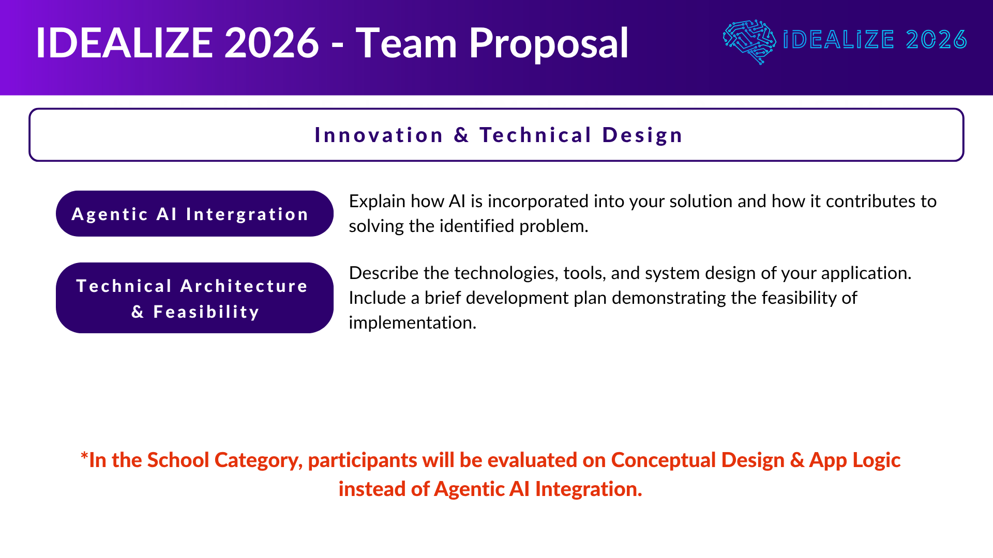
Five specialized agents: (1) Ingestion — Gemini vision reads invoices/cheques and supplier details; (2) Cheque Assistant — OpenAI bundling chat emits proposed_actions JSON; (3) Analyst — post-commit markdown reports; (4) Guide — in-app help only; (5) Liquidity Reviewer — audits bundles for max legal float. Python guardrails validate every action; humans verify before database commit.
Stack: Python 3.12, Flask, SQLite, Google Gemini, OpenAI, Twilio WhatsApp. Core modules: guardrails.py, liquidity_engine.py (CBSL holidays), bundling.py, cash_flow.py. Feasibility: working prototype with web UI, WhatsApp webhook, multi-agent chat, and pending invoice verification flow.

Slide 5
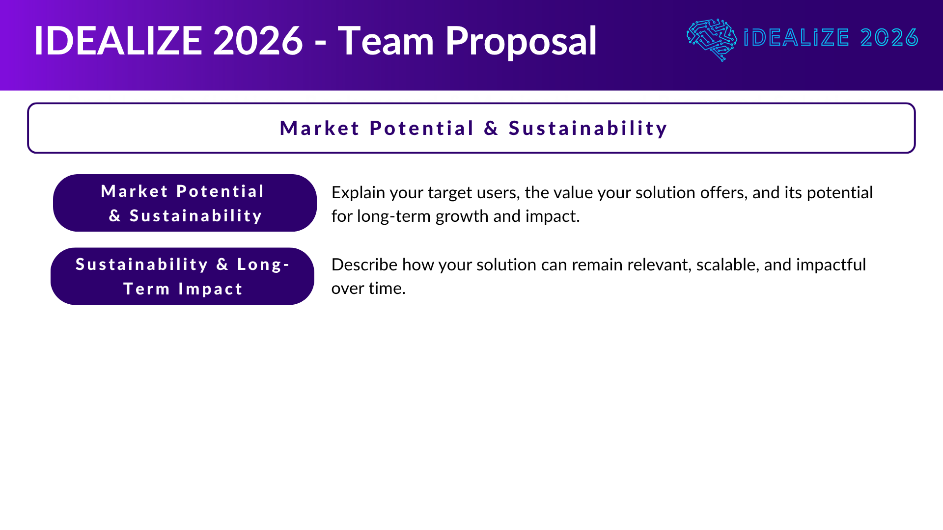
Target users: Sri Lankan hardware merchants, finance staff, and field cashiers. Value: faster invoice intake via WhatsApp, smarter cheque dates, fewer surprise bank deposits, and extra working-capital float from holiday-aware scheduling.
Subscription or per-merchant licensing for SMEs; expandable to more banks and suppliers. CBSL holiday sync keeps rules current. Agent prompts and guardrails can extend to payroll, supplier payments, and multi-branch operations without replacing human approval.

Slide 6
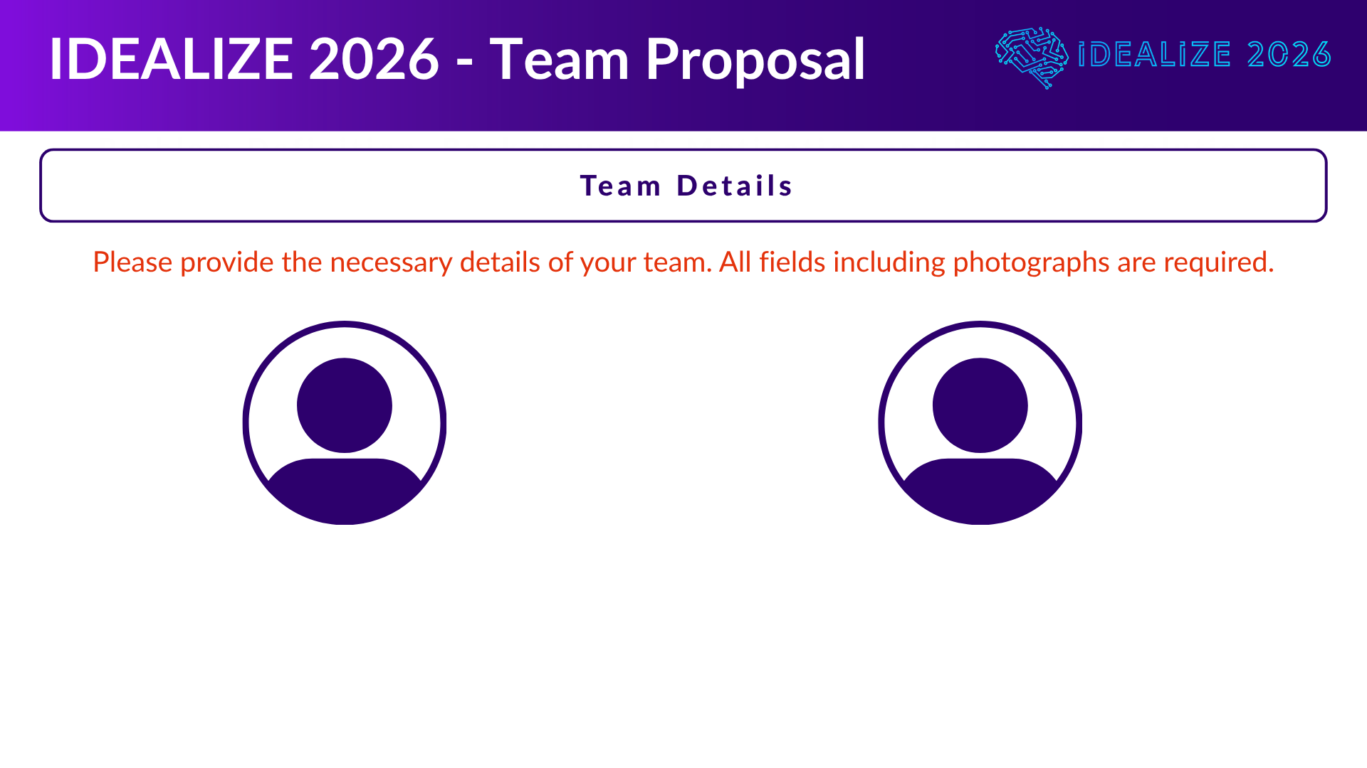
Member 1 Name: University / School: NIC No: Email: Contact Number:
Member 2 Name: University / School: NIC No: Email: Contact Number:

Slide 7
Member 3 Name: University / School: NIC No: Email: Contact Number:
Member 4 Name: University / School: NIC No: Email: Contact Number:

Slide 8
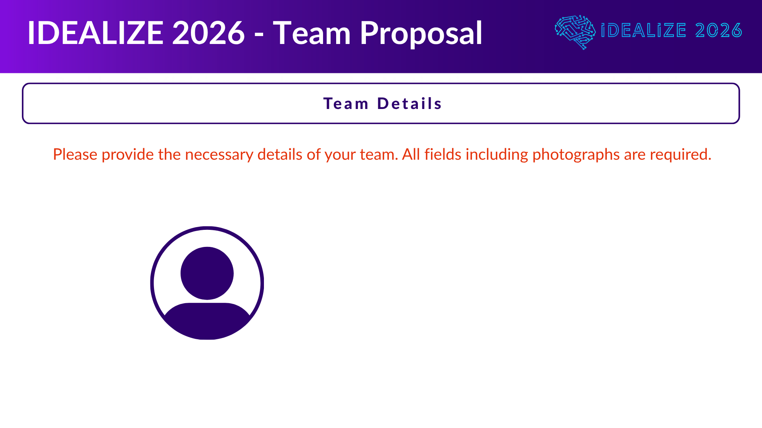
Member 5 Name: University / School: NIC No: Email: Contact Number:

Slide 9
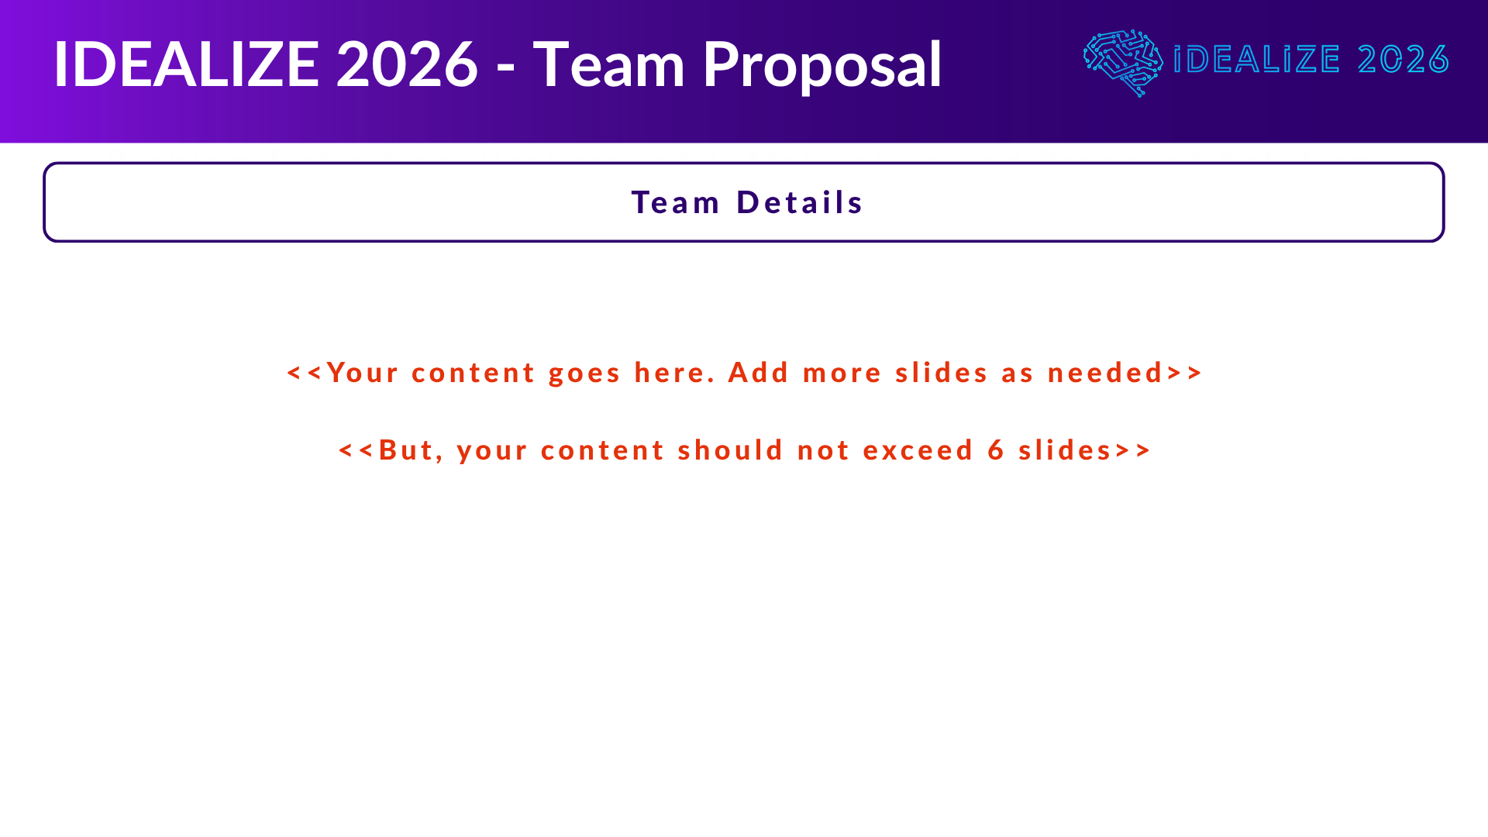
Pitch: Zenith is a multi-agent SME finance copilot that reads invoices on WhatsApp, bundles cheques under guardrails, and maximizes legal cash float using CBSL clearing rules.

Slide 10
