Slide 1

ANALYSIS OF VARIOUS ASPECTS OF EDUCATION IN INDIA
CONTENTS :-
Database Source
Aspects Taken Into Consideration
Power BI Visualisation
Information Extracted
Suggestions

Slide 2
Database Source :-
https://www.education.gov.in/sites/upload_files/mhrd/files/statistics-new/udise_21_22.pdf
Aspects Taken Into Consideration :-
%age of Govt. Schools having Co-curricular activity room/arts and crafts room as well as functional Smart Classrooms used for teaching with Smart Boards/ Virtual Classrooms
%age of girls enrolment in Schools
Pupil Teacher Ratio (PTR) in Primary, Upper Primary, Secondary and Higher Secondary Schools
Dropout Rate in Primary, Upper Primary and Secondary Schools among Boys & Girls
Transition Rate from Upper Primary to Secondary Schools and Secondary to Higher Secondary Schools among Boys & Girls

Slide 3
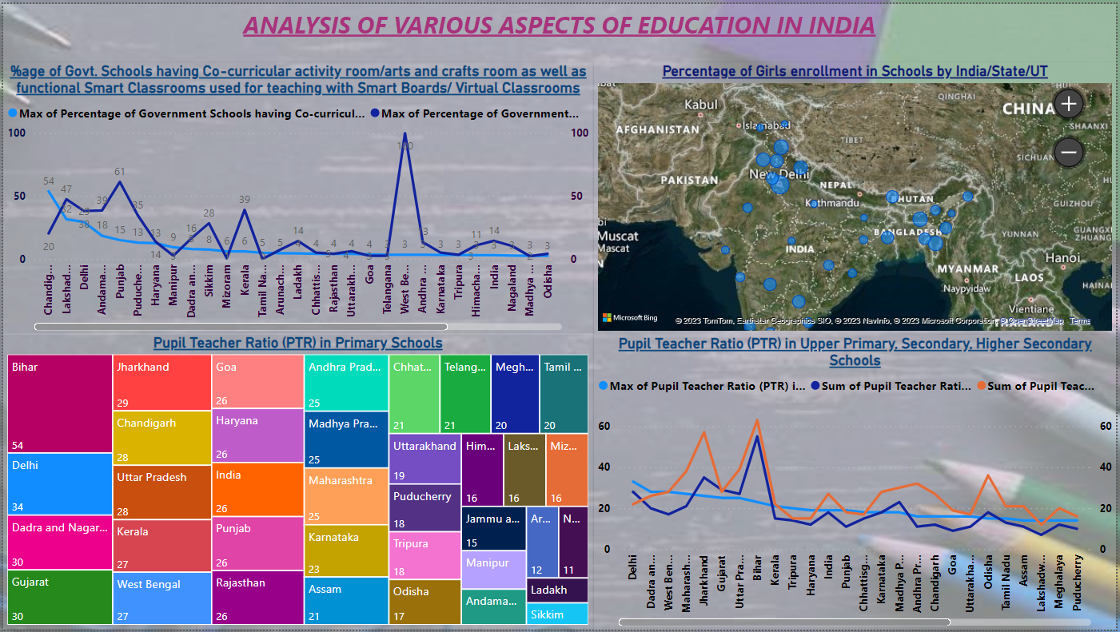
Power BI Visualisation

Slide 4
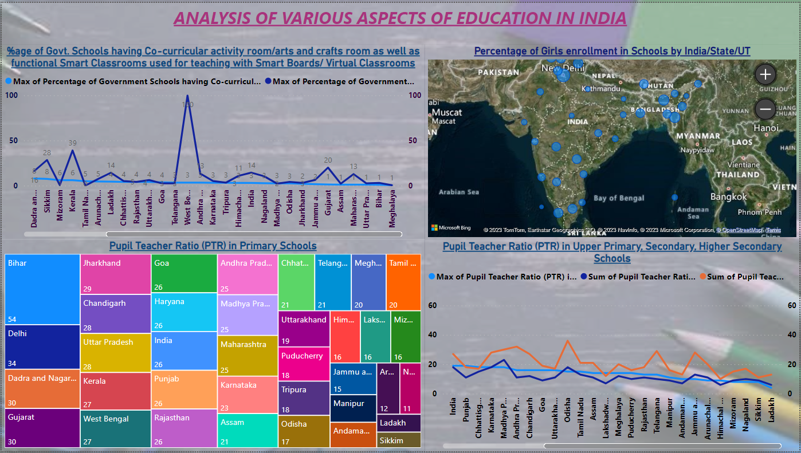

Slide 5
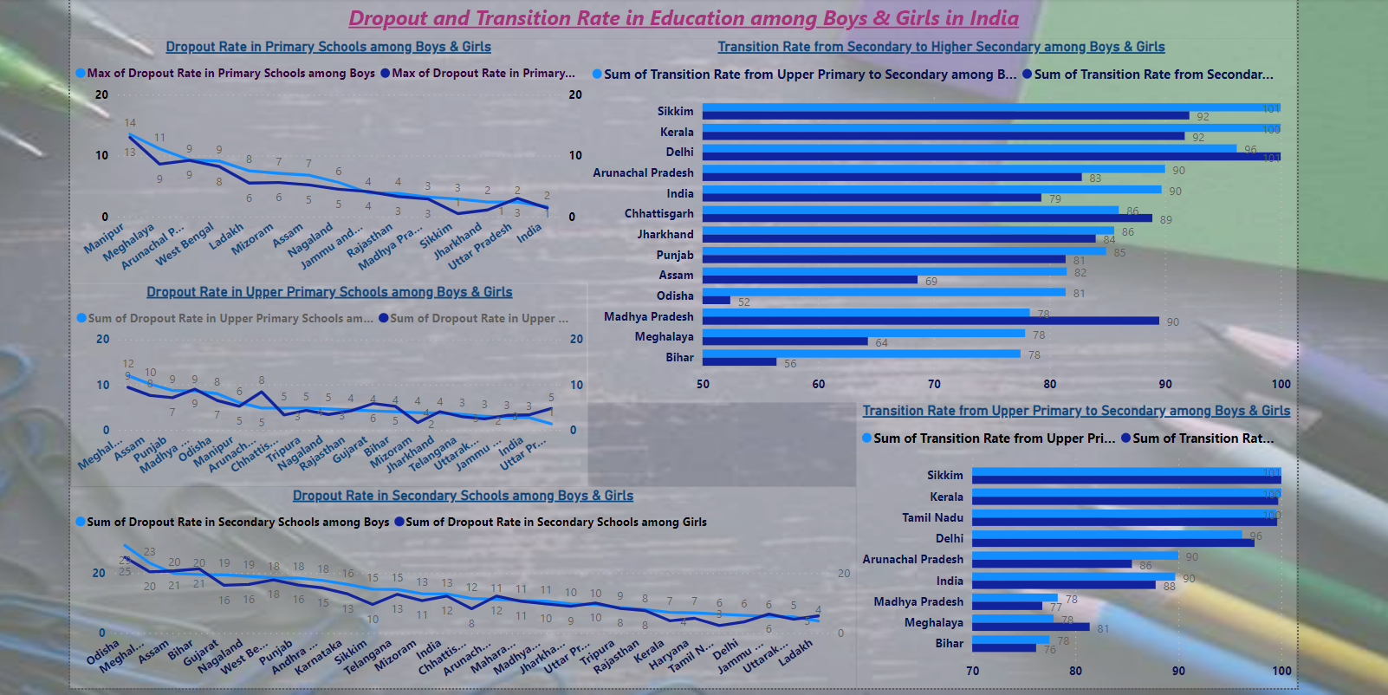

Slide 6
Information Extracted
– More than 20% of Govt. Schools with Co-curricular activity
room/arts and crafts room.
3 States/UTs
(Delhi, Chandigarh and Lakshadweep)
6 States/UTs
Only 4 States/UTs
18 State/UTs
Lowest girls enrolment - Bihar (only 40%)
Only 2 States/UTs
(Bihar and Delhi)
Only 2 States
(Bihar and Jharkhand)
- More than 20% of Govt. Schools having functional Smart
Classrooms used for teaching with Smart Boards/Virtual
Classrooms.
- More than 60% of girls enrolment in schools .
- Not even 50% of girls enrolment
- Not achieved the standard value of PTR in Primary Schools
- More PTR than standard value in Secondary and Higher
Secondary Schools

Slide 7
Highest PTR : In Primary Schools – Bihar (54)
In Secondary Schools – Bihar (55)
In Higher Secondary Schools – Bihar (63)
Dropout Rates more than 10% :-
In Primary Schools – Only 2 States (Manipur, Meghalaya)
In Upper Primary Schools – Only 1 state (Meghalaya)
In Secondary Schools – Over 17 States/UTs
Avg. Transition Rate from Secondary to Higher Secondary Schools in India - Approx 86%
Significant Gap – Boys (90%) & Girls (79%)
3 States/UTs (Sikkim, KL and DL) - More than 95%. (For B&G)
3 States (MP, ML and BR) - Less than even 80% (For B)
3 States (Orissa , ML and BR) – Less than even 65% (For G)
Lowest : For Girls – Odisha (52) & For Boys – Bihar (78%)
Avg. Transition Rate from Upper Primary to Secondary Schools in India - Approx 89%
4 States/UTs (Sikkim, KL, TN and DL) - more than 95%.
3 States (MP, Meghalaya and Bihar) - less than even 80%.

Slide 8
SUGGESTIONS
Build more and more co-curricular activity rooms and arts and crafts rooms in government schools
Reason : -
Identify and nurture hidden talents
Foster teamwork and leadership
Holistic development of students
Ways :-
Change in public perception
Allocate specific budget for such rooms
Making students aware of these fields
Increase in %age of girls enrolment of schools
Reason :-
To educate and empower girls to fight against social challenges as well as to participate and lead in different fields.
Ways :-
Lots of govt schemes and initiatives are already there, so focus should be on their proper implementation.
Focus on installing Smart Classrooms in as many schools as possible.
Reason :-
Practical Knowledge makes a subject interesting and helpful in getting clarity in concepts with ease.
4. PTR in Schools
Appreciable throughout the country
Bihar – Increase Teacher Recruitment + Utilise
Technology + Incentives for Rural Posting

Slide 9
Improve the transition rate
Ways :-
Identification and Targeted Support
Effective communication of knowledge
Reduce the Dropout Rate in Secondary Schools
Reason :-
Over 17 States/UTs have more than 10% dropout rate.
Ways :-
Financial Support and Scholarships
Life skills education and career guidance
Parents engagement
Quality teaching and learning
Dropout Rate in Primary and Upper Primary Schools
Appreciable throughout the country

Slide 10
THANK YOU !

