Slide 1


KidBirght & Blynk

Slide 2

What is Kidbright?

Slide 3

1
ສະໝອງຝັງກົນຂະໜາດນ້ອຍທີ່ສາມາດຮັບຂໍ້ມູນມປະມວນຜົນແລະສັ່ງງານຜ່ານເຄື່ອງອີເລັກໂທຣນິກ
Kidbright
ຊຸດຄຳສັ່ງແບບ ​Blocky ຫຼື ລາກວາງແລ້ວສາມາດກຳນົດເງື່ອນໄຂໄດ້
2
3
ໃຊ້ງານສະດວກແລະປອດໄພ

Slide 4

1
ເປັນແອັບພີເຄຊັ້ນ (Application) ທີ່ຖືກອອກແບບເພື່ອເຊື່ອມກັບອຸປະກອນອີເລັກໂຕຣນິກ.
Blynk
2
ຄວບຄຸມຜ່ານໄລຍະໄກໄດ້ເຊັ່ນ: Wifi , Bluetooth, ..

Slide 5
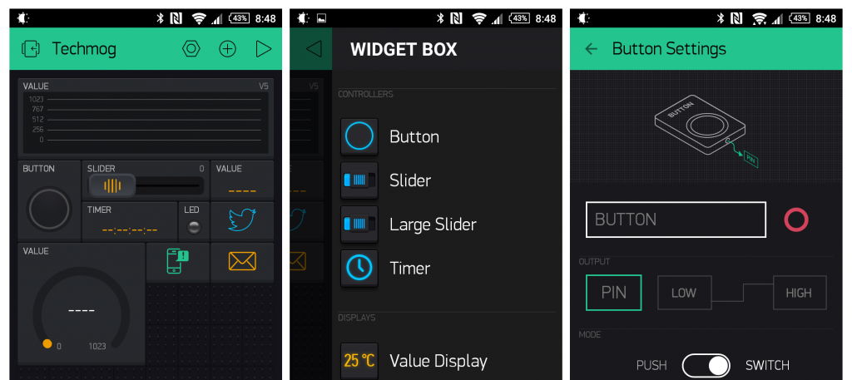
ໜ້າຕາຂອງໂປຣແກຣມ

Slide 6
Are you ready?
ຂັ້ນຕອນໃນການເຮັດ

Slide 7
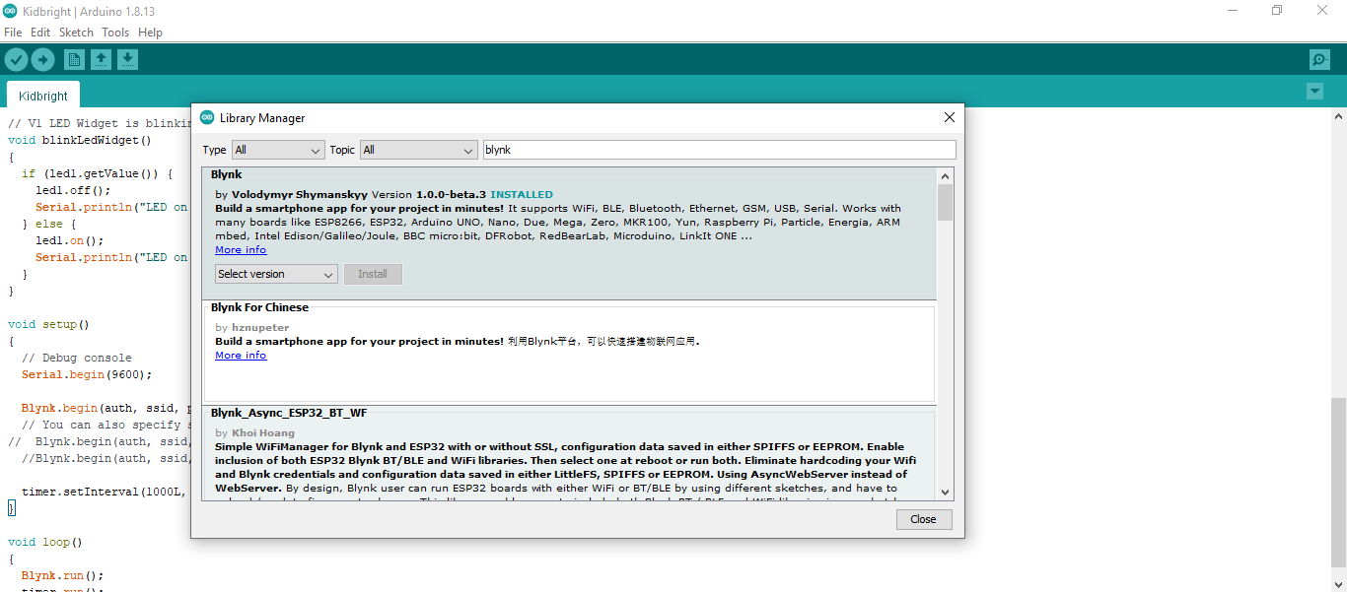
ດາວໂຫຼດ Libraries

Slide 8
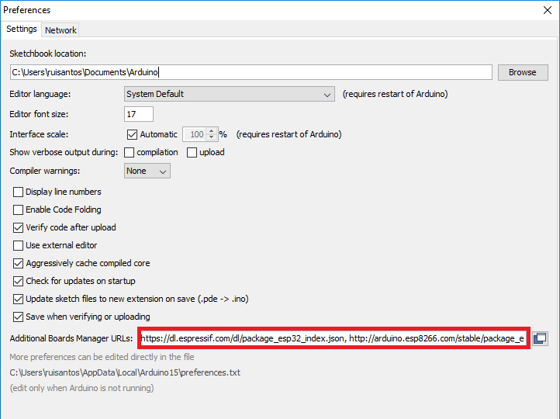
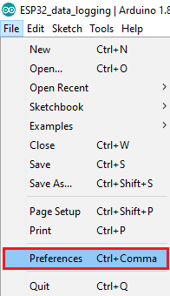





ຂັ້ນຕອນການກຳນົດບຣອດ
1
2

Slide 9
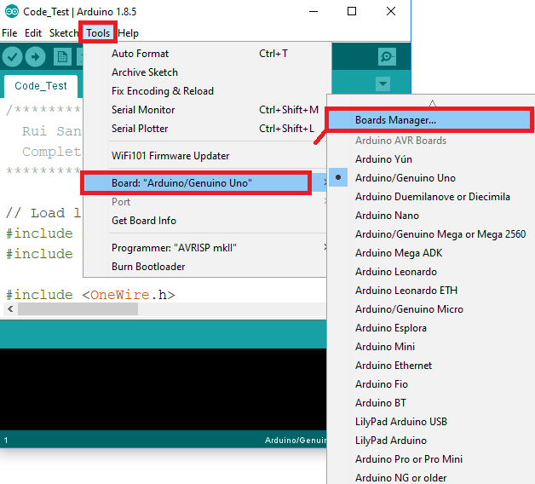
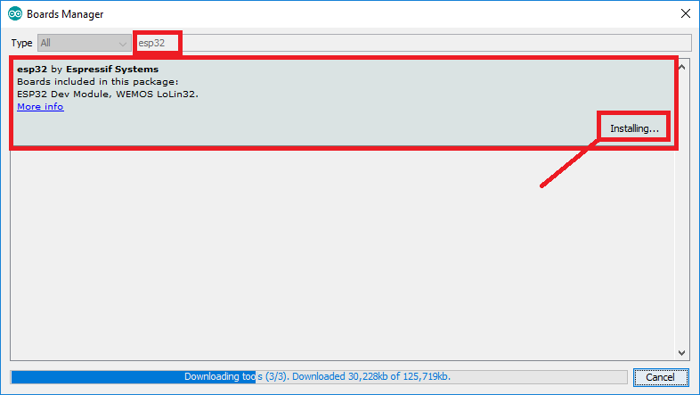
ຂັ້ນຕອນການກຳນົດບຣອດ
3
4

Slide 10
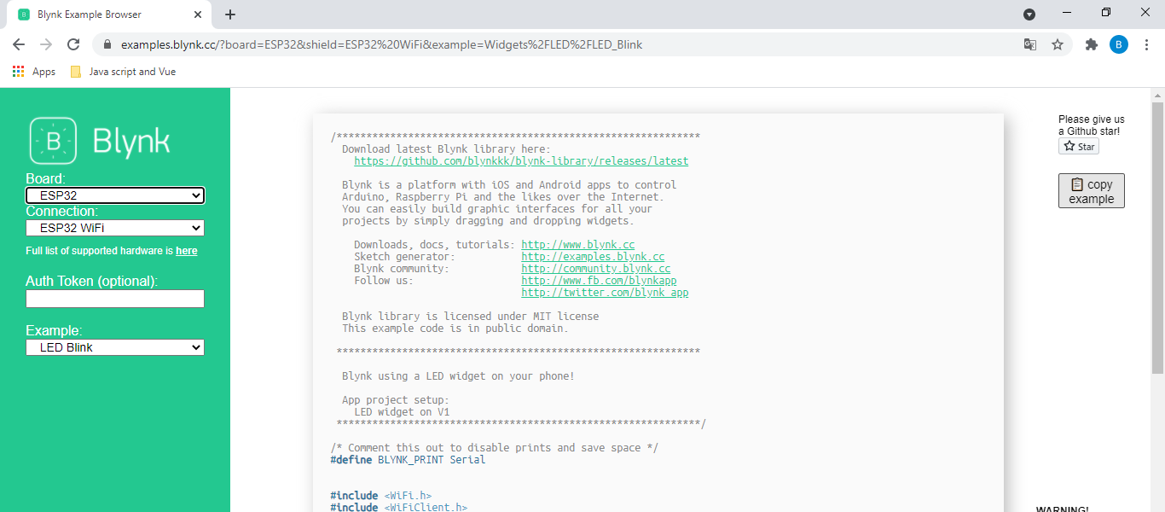
ການເຊື່ອມຕໍ່ກັບ Blynk

Slide 11
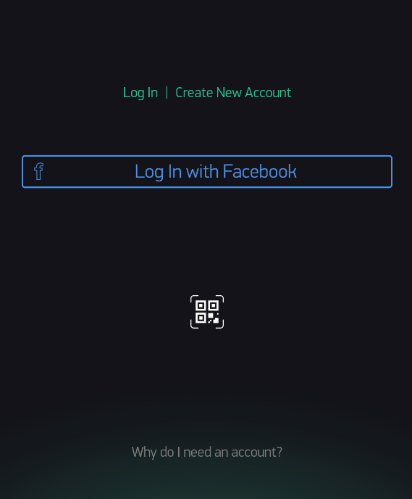
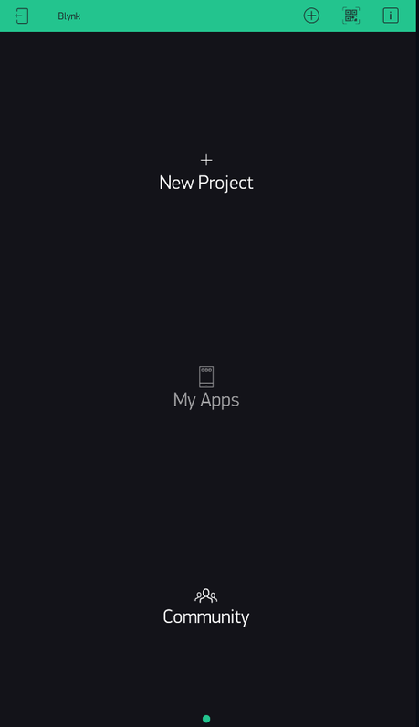
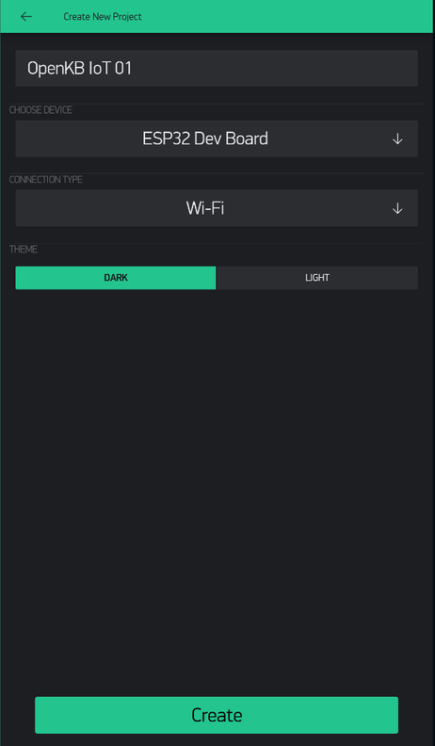
Blynk
1
Add your thought here
Add your thought here
Add your thought here
2
3
Copy a sticky note and write down your thoughts.
yes!
Vote for your favorite
ideas with these stars or stickers.
Circle or
mark up any promising ideas.
this is great
Add your thought here
Add your thought here
Add your thought here

Slide 12
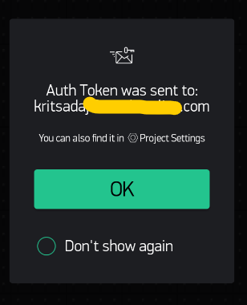
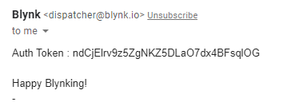
Blynk
Add your thought here
Add your thought here
Add your thought here
yes!
this is great
Add your thought here
Add your thought here
Add your thought here

Slide 13

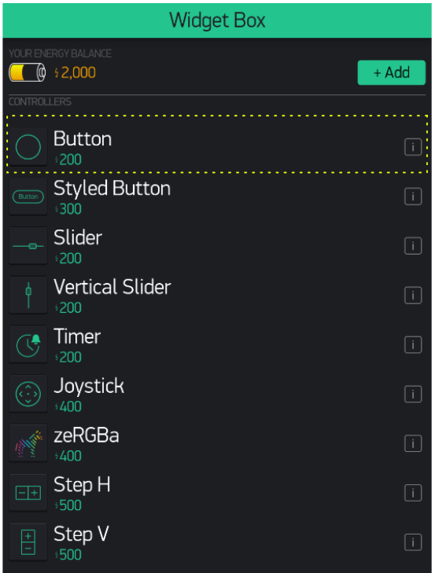
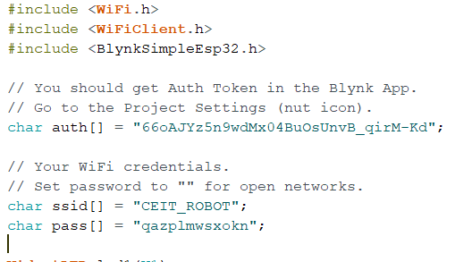
Blynk
Add your thought here
Add your thought here
Add your thought here
yes!
Add your thought here
this is great
Add your thought here
Add your thought here

Slide 14
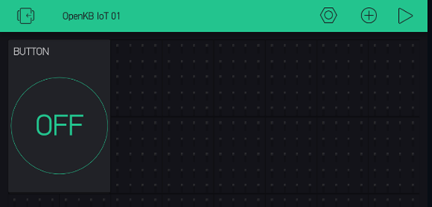
Add your thought here
Add your thought here
Add your thought here
yes!
this is great
Add your thought here
Add your thought here
Add your thought here

Slide 15
ລຸຍກັນເລີຍ

