Slide 1
Java external course Car park service
Student: Oleh Havrylchenko
Coach: max veres
Variant: 11

Slide 2
Car Park Service (Spring & Hibernate/JPA)
Description
The purpose of this service to store and control information about bus routes, assign buses to routes, assign users to buses.
Any bus can be assigned to one route only.
Any driver can be assigned to one bus only.
Any route can contain multiple buses assigned.
Drivers and Admins could login. There are buses and routes you can find in the service.
Admin can assign available drivers in the same buses and available buses to the routes, also he can decline drivers and buses assignments, again making them available for another assignment.
Driver can look through his place of work, furthermore he must accept or decline his assignment.

Slide 3
Project requirements
Create entity based classes that describe entities of subject area
Classes and methods must have names reflecting their functionality and must be competently structured by packages.
Store subject area information in the database (MySql is recommended)
Application must support internationalization including data in the database
The code must be documented //self documented I hope
Application must be covered by Unit-tests
Process events in the system using Log4j
According to the project must be implemented Transaction
Application must correctly respond to various errors and exceptions
Authorization and Authentication system must be implemented
Use hibernate to access the data
Use HTML for the frontend part
Implement the functionality proposed by specific task using Spring framework

Slide 4
Project architecture
Web Browser
html
Spring Servlet Dispatcher Filters / Interceptors
View Resolver
jsp
Model
E
N
T
I
T
I
E
S
View
Controllers
Page name
Controller
Services
Repository
MySql
Database

Slide 5
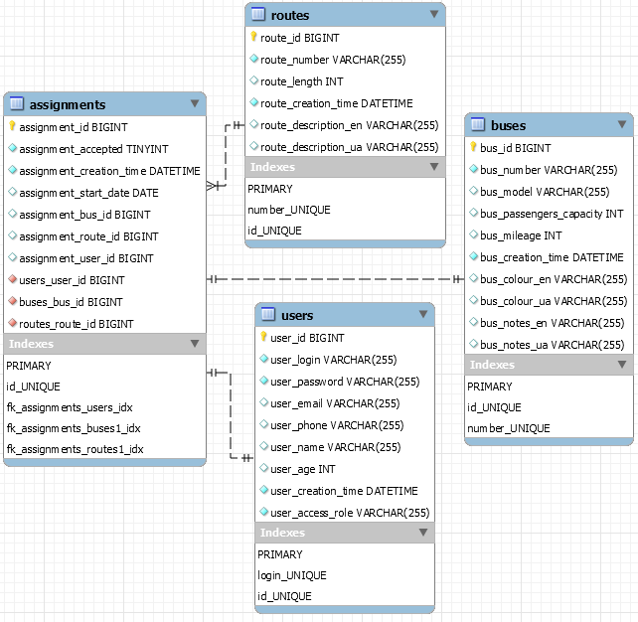
Data Base structure
Tables : -users -assignments -buses -routes
Relations user-assignment 1:1 bus-assignment 1:1 route-assignment 1:ထ

