Slide 1
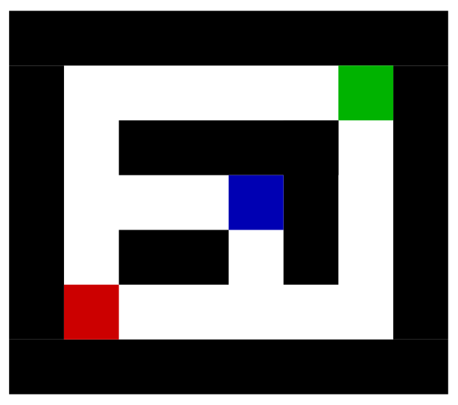
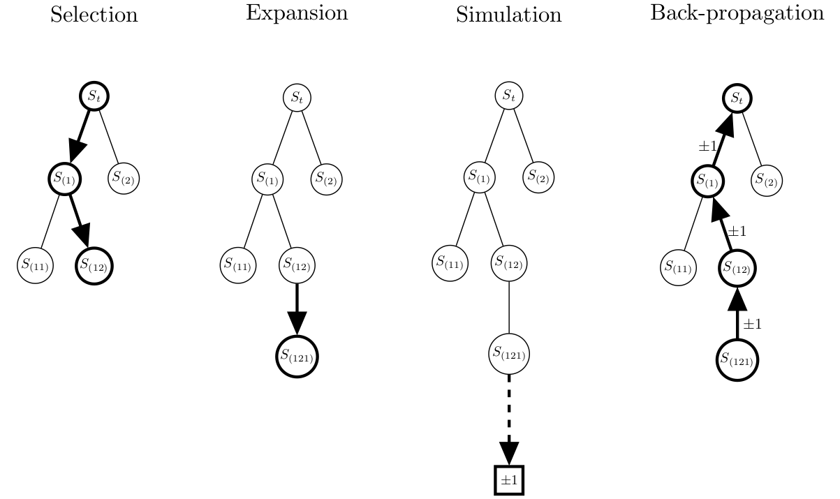
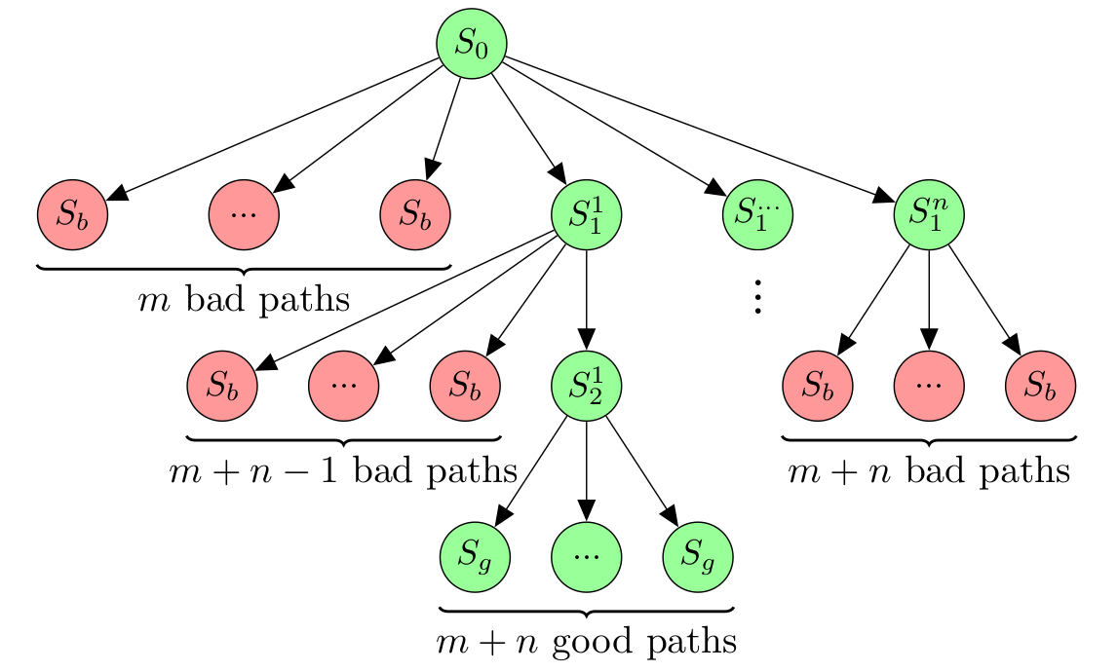
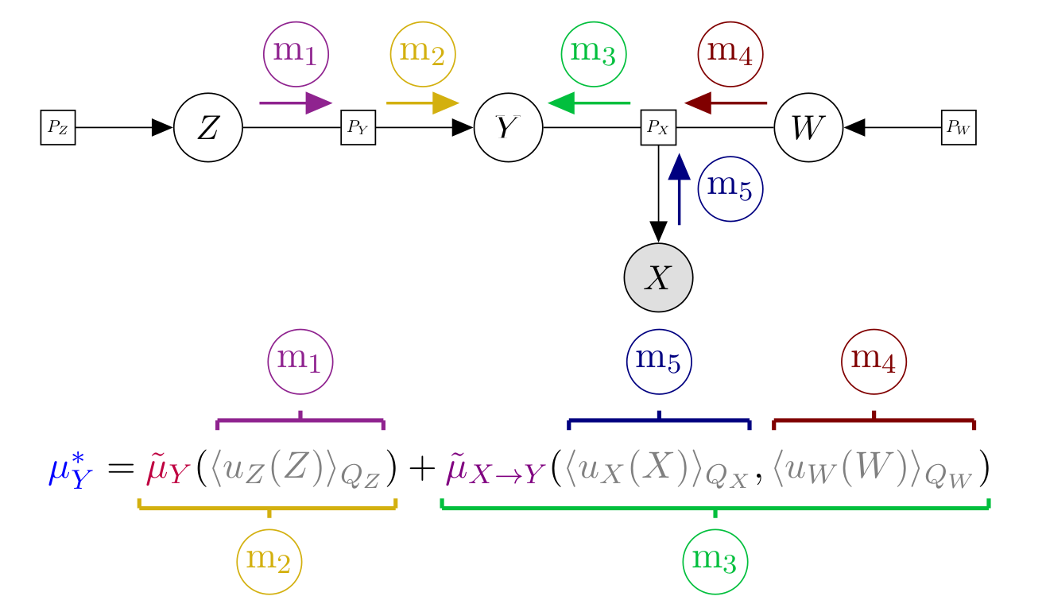
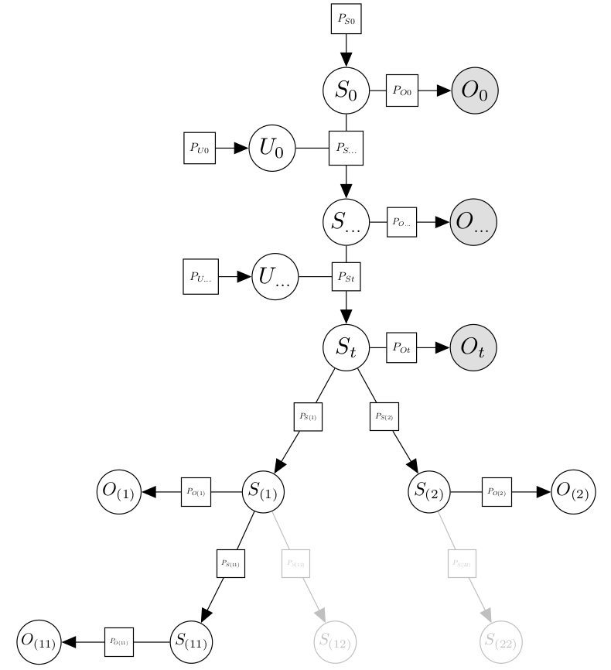

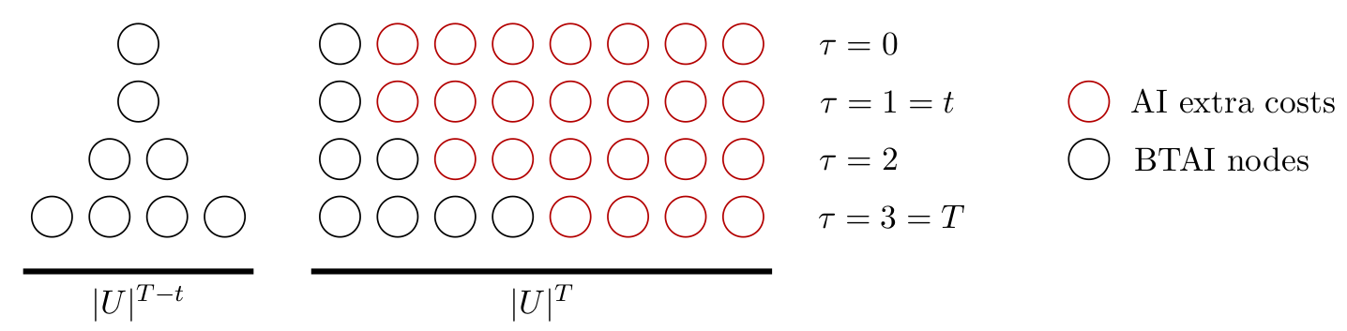

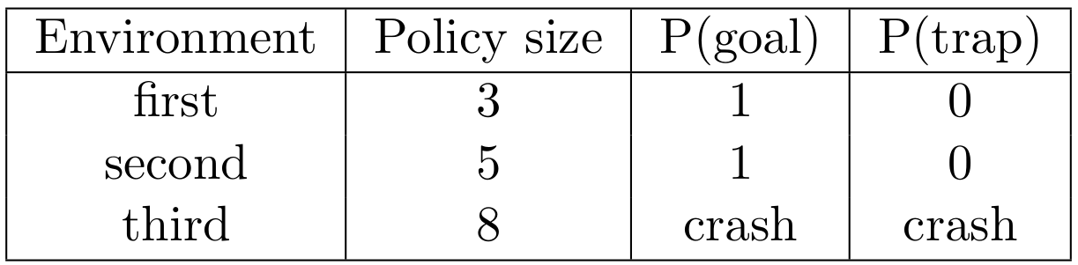

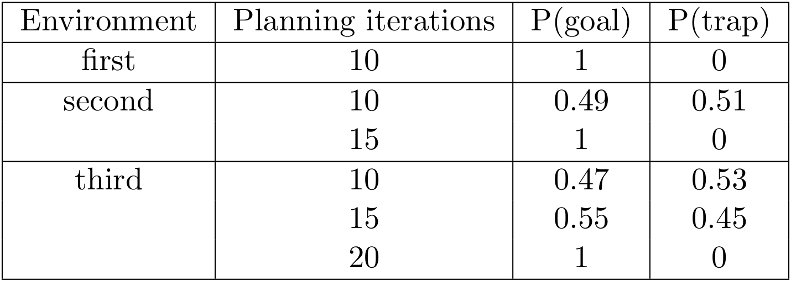
Branching Time Active Inference
Maze Environment
Théophile Champion, Lancelot Da Costa, Howard Bowman and Marek Grześ
Active inference is a unified framework for action and perception that can be scaled up using Monte Carlo tree search to expand the generative model dynamically.
→ starting position in red.
→ exit in green.
→ local minimum in blue.
Overview
Deep Reward Environment
→ Tree search is performed by dynamically expanding the generative model of the agent.
→ The node selection is based on the upper confidence bound for tree (UCT).
→ bad states in red.
→ good states in green.
Generative Model
→ Inference of the latent variables is performed by variational message passing.
Result: Complexity Classes
→ Active Inference (AI).
→ Branching Time Active Inference BTAI.
Result: BTAI outperforms AI
→ squares are factors.
→ white circles are latent variables.
→ gray circles are observed variables.

