Slide 1
Is recycling wasted? The Circular Economy and the Material Rebound Effect
Presentation at SLU, 11 June 2025
Rasmus K. S. Berg,
Peter K. Kruse-Andersen, and Thor D. Noe

Slide 2
Introduction
Linear economy
Natural resources
Production
Consumption
Waste

Slide 3


Introduction
Linear economy
Natural resources
Externalities
Production
Consumption
Externalities
Waste

Slide 4
Introduction
Circular economy
Natural resources
Production
Consumption
Recycling
Waste

Slide 5
Introduction
Circular economy
Remanufacturing
Natural resources
Production
Waste as a resource
Consumption
Repair og reuse
Recycling
Waste

Slide 6






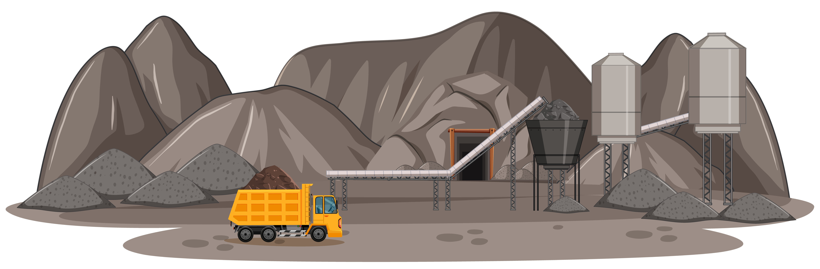
Introduction
A typical macroeconomic model
Production sectors
Labour and capital inputs
Consumers

Slide 7
Introduction
A typical macroeconomic model
Production sectors
Labour and capital inputs
Consumers

Slide 8
Introduction
A typical macroeconomic model
Production sectors
Labour and capital inputs
Input
Consumers

Slide 9
Introduction
A typical macroeconomic model
Production sectors
Labour and capital inputs
Input
Output
Consumers

Slide 10
Introduction
A typical macroeconomic model
Production sectors
Labour and capital inputs
Input
Output
Consumers
No waste
No pollution emissions
Virgin natural resources cannot be substituted by recycled materials

Slide 11










Introduction
A typical macroeconomic model
$$Y$$
CES aggregate
Leontief assumption
$$KL$$
$$Z$$
$$L$$
$$K$$
$$X_{1}$$
$$…$$
$$X_{i}$$
$$…$$
$$X_{I}$$
No substitution possibilities between recycled materials and virgin materials

Slide 12



Introduction
Our framework
Production sectors
Labour and capital inputs
Consumers
Output
Input

Slide 13
















Introduction
Our framework – A simplified picture
$$Y^{regular}$$
$$Y^{Material}$$
$$Y$$
$$KL$$
$$Z$$
$$L$$
$$K$$
$$X$$
$$Z^{M}$$
$$X_{1}$$
$$…$$
$$X_{i}$$
$$…$$
$$X_{I}$$
$$Z^{V}$$
$$Z^{R}$$
Other intermediate goods
(measured in value terms)
Virgin and recycled materials
(measured in mass units)

Slide 14



Introduction
Our framework – A simplified picture
$$W^{recycled}$$
Valuable waste
$$Y^{regular}$$
$$Y^{Material}$$
$$Y$$
$$W$$
Waste
Transferred to waste management sector
$$KL$$
$$Z$$
$$W^{treatment}$$
$$L$$
$$K$$
$$X$$
$$Z^{M}$$
$$X_{1}$$
$$…$$
$$X_{i}$$
$$…$$
$$X_{I}$$
$$Z^{V}$$
$$Z^{R}$$
Other intermediate goods
(measured in value terms)
Virgin and recycled materials
(measured in mass units)

Slide 15
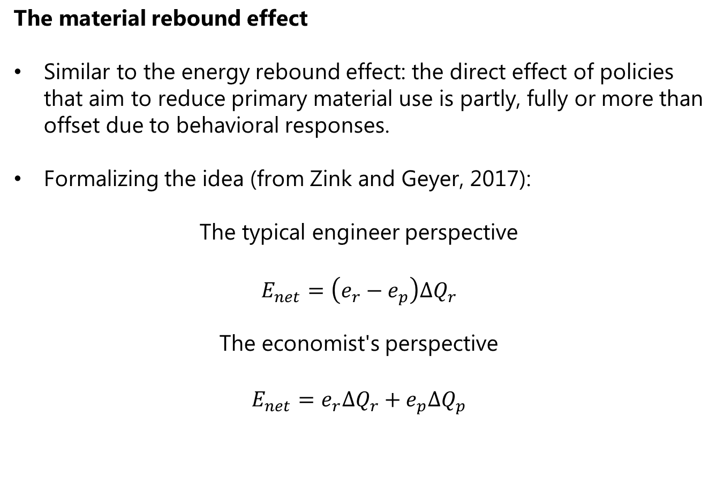
Introduction
The material rebound effect
Similar to the energy rebound effect: the direct effect of policies that aim to reduce primary material use is partly, fully or more than offset due to behavioral responses.
Formalizing the idea (from Zink and Geyer, 2017):
The typical engineer perspective
$$E_{net}=\left(e_{r}−e_{p}\right)ΔQ_{r}$$
The economist's perspective
$$E_{net}=e_{r}ΔQ_{r}+e_{p}ΔQ_{p}$$

Slide 16
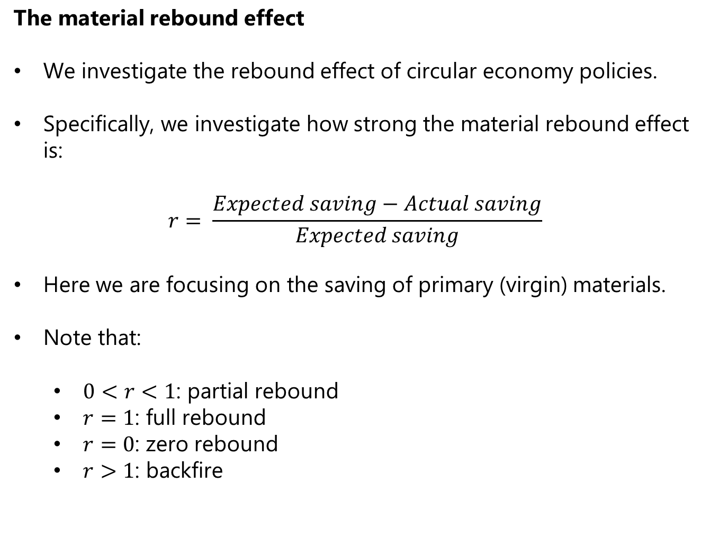
Introduction
The material rebound effect
We investigate the rebound effect of circular economy policies.
Specifically, we investigate how strong the material rebound effect is:
$$r= \frac{Expected saving−Actual saving}{Expected saving}$$
Here we are focusing on the saving of primary (virgin) materials.
Note that:
$0<r<1$: partial rebound
$r=1$: full rebound
$r=0$: zero rebound
$r>1$: backfire

Slide 17
Introduction
The material rebound effect
Production
Virgin natural resource input
Recycled materials (positive value)
Recycled materials
Waste
(negative value)

Slide 18
Introduction
The material rebound effect
Production
Virgin natural resource input
Recycled materials (positive value)
Recycled materials
Policy or
technological shock
Waste
(negative value)

Slide 19
Introduction
The material rebound effect
Production
Virgin natural resource input
Recycled materials (positive value)
Recycled materials
Policy or
technological shock
Waste
(negative value)
Price of production
Demand for materials
Demand for virgin materials

Slide 20
Introduction
The material rebound effect
Production
Virgin natural resource input
Recycled materials (positive value)
Recycled materials
Policy or
technological shock
Waste
(negative value)
Price of production
Demand for materials
Demand for virgin materials
Supply of recycled materials
Demand for virgin materials

Slide 21
Literature
xxx

Slide 22
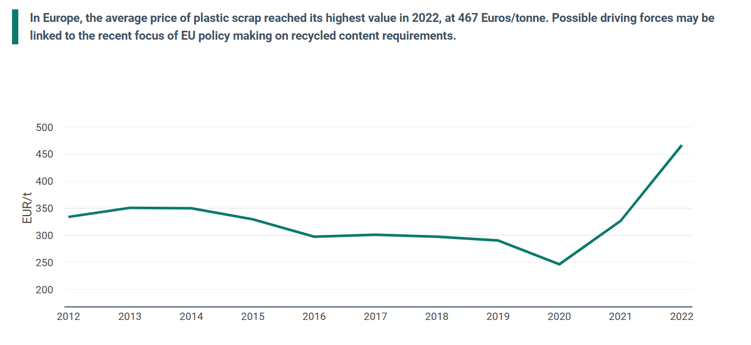
Small macro model
Observation: Waste can be valuable
Source: Eurostat.

Slide 23
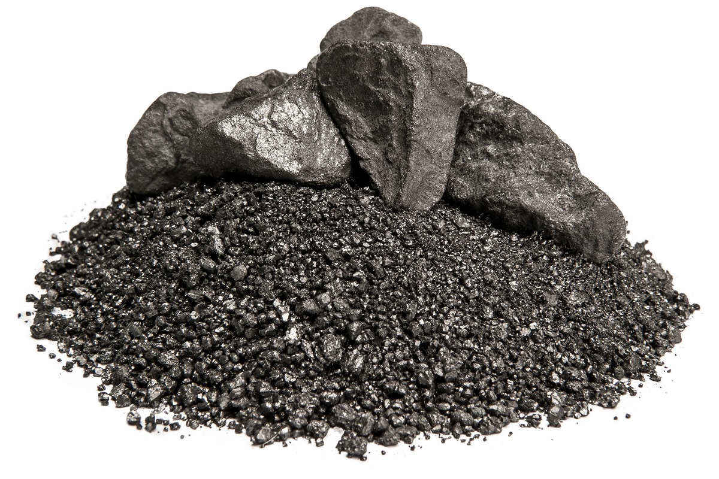
Small macro model
Overview
Production sectors
Labour and natural resources
Consumers

Slide 24
Small macro model
Overview
Production sectors
Labour and natural resources
Consumers
Virgin materials
Recycled materials

Slide 25
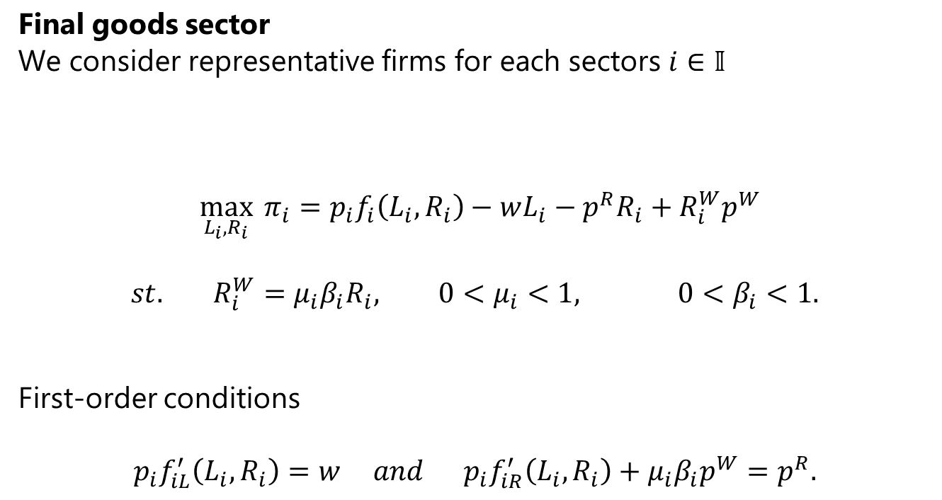
Small macro model
Final goods sector
We consider representative firms for each sectors $i∈𝕀$
$$\max_{L_{i},R_{i}}{π_{i}}=p_{i}f_{i}\left(L_{i},R_{i}\right)−wL_{i}−p^{R}R_{i}+R_{i}^{W}p^{W}$$
$$st. R_{i}^{W}=μ_{i}β_{i}R_{i}, 0<μ_{i}<1, 0<β_{i}<1.$$
First-order conditions
$$p_{i}f_{iL}^{′}\left(L_{i},R_{i}\right)=w and p_{i}f_{iR}^{′}\left(L_{i},R_{i}\right)+μ_{i}β_{i}p^{W}=p^{R}.$$

Slide 26
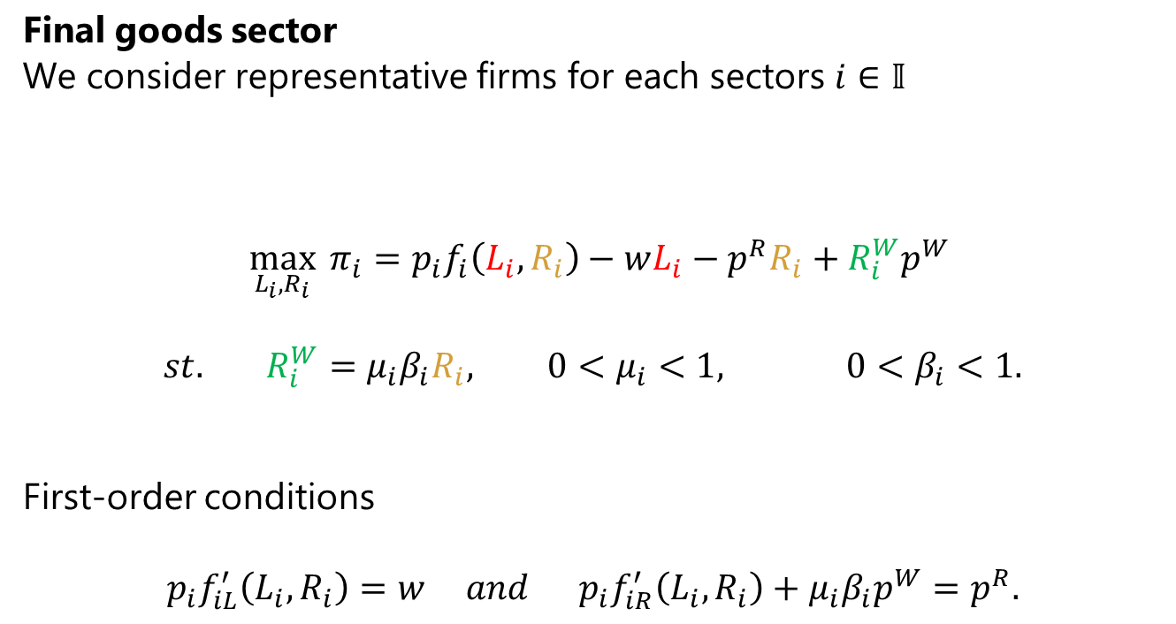
Small macro model
Final goods sector
We consider representative firms for each sectors $i∈𝕀$
$$\max_{L_{i},R_{i}}{π_{i}}=p_{i}f_{i}\left(L_{i},R_{i}\right)−wL_{i}−p^{R}R_{i}+R_{i}^{W}p^{W}$$
$$st. R_{i}^{W}=μ_{i}β_{i}R_{i}, 0<μ_{i}<1, 0<β_{i}<1.$$
First-order conditions
$$p_{i}f_{iL}^{′}\left(L_{i},R_{i}\right)=w and p_{i}f_{iR}^{′}\left(L_{i},R_{i}\right)+μ_{i}β_{i}p^{W}=p^{R}.$$
Natural resource input
Labour input
Recyclable waste

Slide 27
Small macro model
Final goods sector
We consider representative firms for each sectors $i∈𝕀$
$$\max_{L_{i},R_{i}}{π_{i}}=p_{i}f_{i}\left(L_{i},R_{i}\right)−wL_{i}−p^{R}R_{i}+R_{i}^{W}p^{W}$$
$$st. R_{i}^{W}=μ_{i}β_{i}R_{i}, 0<μ_{i}<1, 0<β_{i}<1.$$
First-order conditions
$$p_{i}f_{iL}^{′}\left(L_{i},R_{i}\right)=w and p_{i}f_{iR}^{′}\left(L_{i},R_{i}\right)+μ_{i}β_{i}p^{W}=p^{R}.$$
Marginal revenue from increased valuable waste output
Marginal revenue from increased production

Slide 28
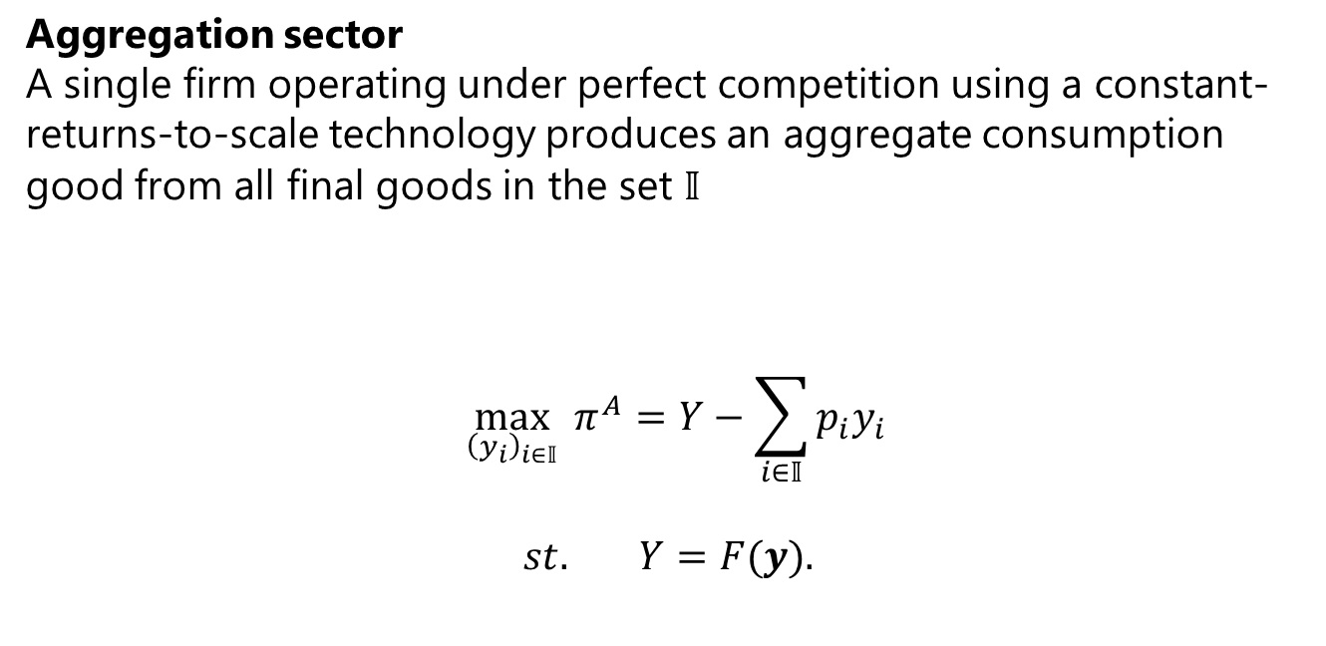
Small macro model
Aggregation sector
A single firm operating under perfect competition using a constant-returns-to-scale technology produces an aggregate consumption good from all final goods in the set $𝕀$
$$\max_{{\left(y_{i}\right)}_{i∈𝕀}}{π^{A}}=Y−\sum_{i∈𝕀}{p_{i}y_{i}}$$
$$st. Y=F(y).$$

Slide 29
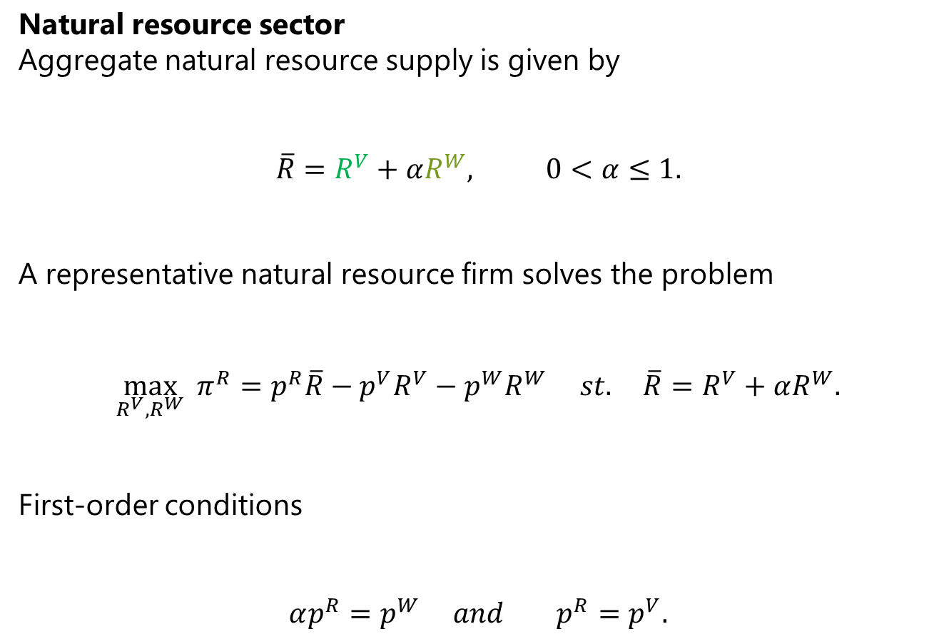
Small macro model
Natural resource sector
Aggregate natural resource supply is given by
$$\overline{R}=R^{V}+αR^{W}, 0<α≤1.$$
A representative natural resource firm solves the problem
$$\max_{R^{V}, R^{W}}{π^{R}}=p^{R}\overline{R}−p^{V}R^{V}−p^{W}R^{W} st. \overline{R}=R^{V}+αR^{W}.$$
First-order conditions
$$αp^{R}=p^{W} and p^{R}=p^{V}.$$
Recycled materials
Virgin natural resources/primary materials

Slide 30
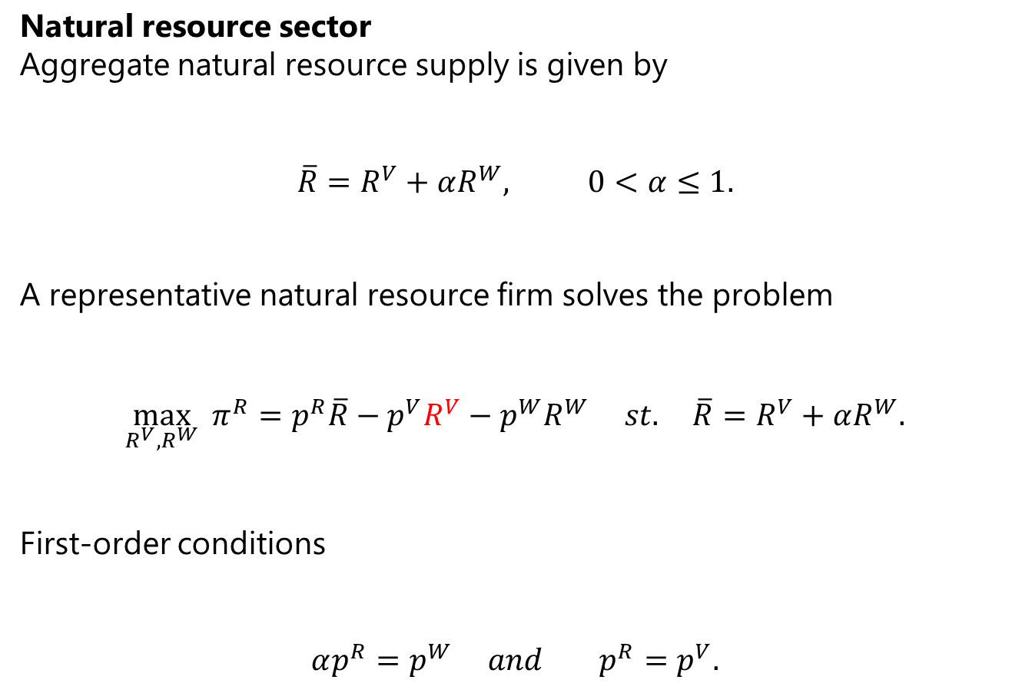

Small macro model
Natural resource sector
Aggregate natural resource supply is given by
$$\overline{R}=R^{V}+αR^{W}, 0<α≤1.$$
A representative natural resource firm solves the problem
$$\max_{R^{V}, R^{W}}{π^{R}}=p^{R}\overline{R}−p^{V}R^{V}−p^{W}R^{W} st. \overline{R}=R^{V}+αR^{W}.$$
First-order conditions
$$αp^{R}=p^{W} and p^{R}=p^{V}.$$
Produced at a constant price $p^{V}$ or imported from abroad at a constant price $p^{V}$

Slide 31

Small macro model
Household sector
$$\max_{C}{u(C)} st. w\overline{L}+\sum_{i∈𝕀}{π_{i}}+π^{A}+π^{R}=C.$$
Equilibrium conditions
$$y_{i}=f_{i}(L_{i},R_{i})$$
$$\overline{R}=\sum_{i∈𝕀}{R_{i}}$$
$$R^{W}=\sum_{i∈𝕀}{R_{i}^{W}}$$
$$\overline{L}=\sum_{i∈𝕀}{L_{i}}$$

Slide 32
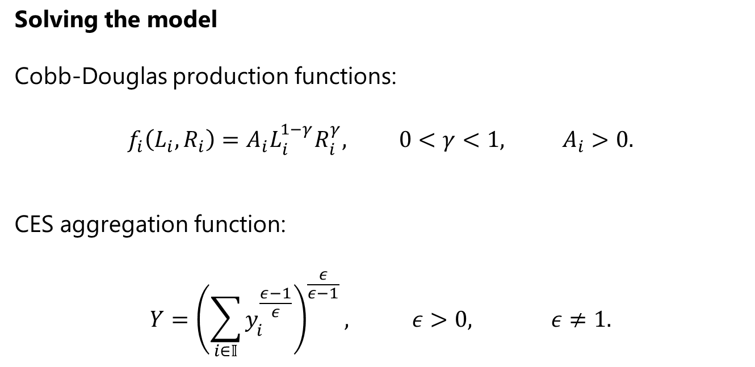
Small macro model
Solving the model
Cobb-Douglas production functions:
$$f_{i}\left(L_{i},R_{i}\right)=A_{i}L_{i}^{1−γ}R_{i}^{γ}, 0<γ<1, A_{i}>0.$$
CES aggregation function:
$$Y={\left(\sum_{i∈𝕀}{y_{i}^{\frac{ε−1}{ε}}}\right)}^{\frac{ε}{ε−1}}, ε>0, ε≠1.$$

Slide 33
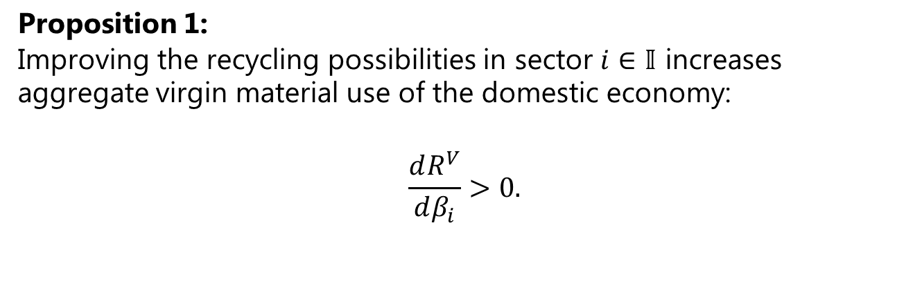
Small macro model
Proposition 1:
Improving the recycling possibilities in sector $i∈𝕀$ increases aggregate virgin material use of the domestic economy:
$$\frac{dR^{V}}{dβ_{i}}>0.$$

Slide 34
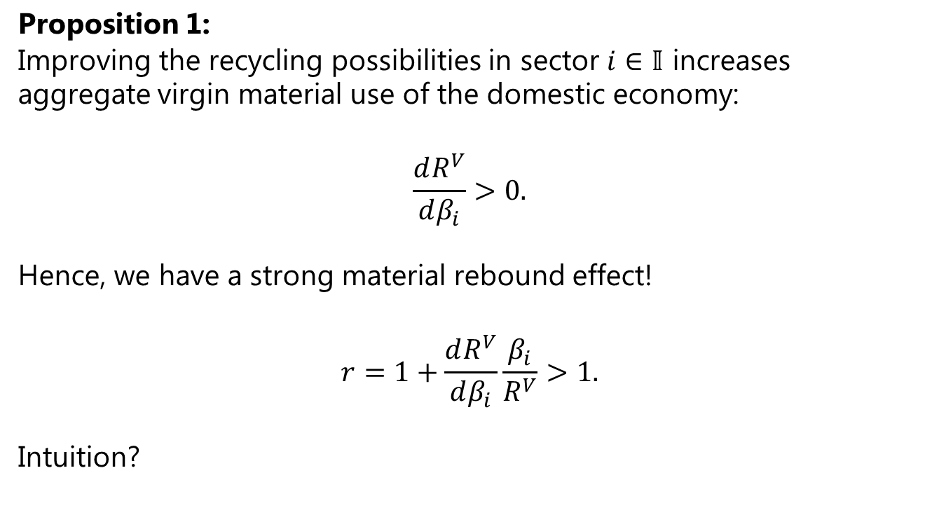
Small macro model
Proposition 1:
Improving the recycling possibilities in sector $i∈𝕀$ increases aggregate virgin material use of the domestic economy:
$$\frac{dR^{V}}{dβ_{i}}>0.$$
Hence, we have a strong material rebound effect!
$$r=1+\frac{dR^{V}}{dβ_{i}}\frac{β_{i}}{R^{V}}>1.$$
Intuition?

Slide 35
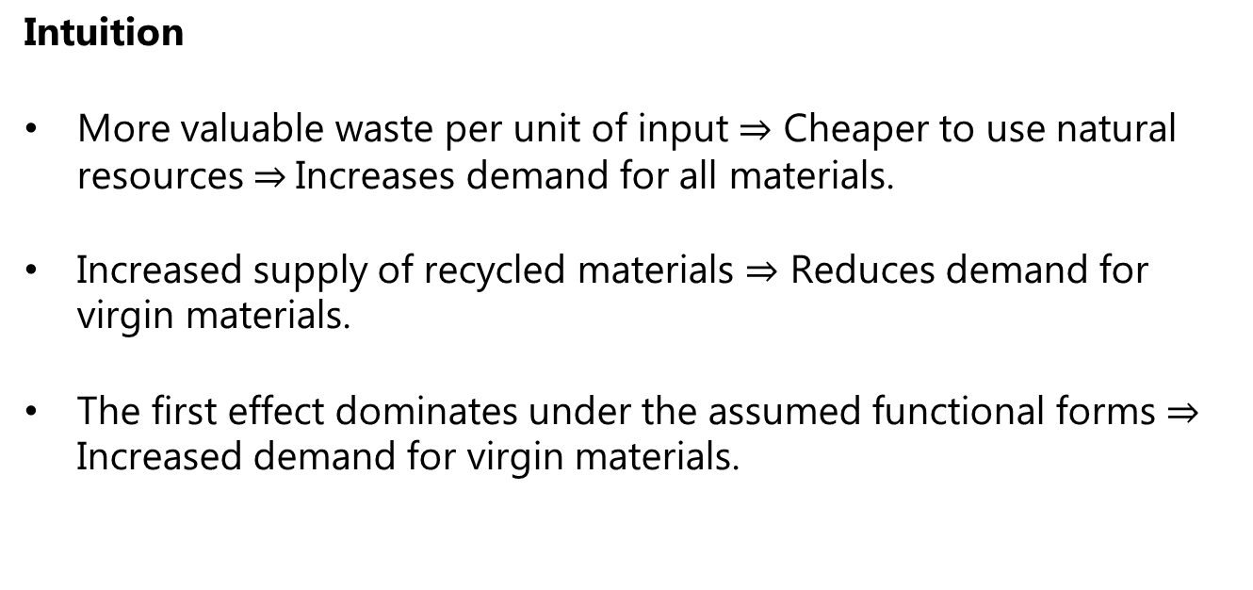
Small macro model
Intuition
More valuable waste per unit of input $⇒$ Cheaper to use natural resources $⇒$Increases demand for all materials.
Increased supply of recycled materials $⇒$ Reduces demand for virgin materials.
The first effect dominates under the assumed functional forms $⇒$ Increased demand for virgin materials.

Slide 36
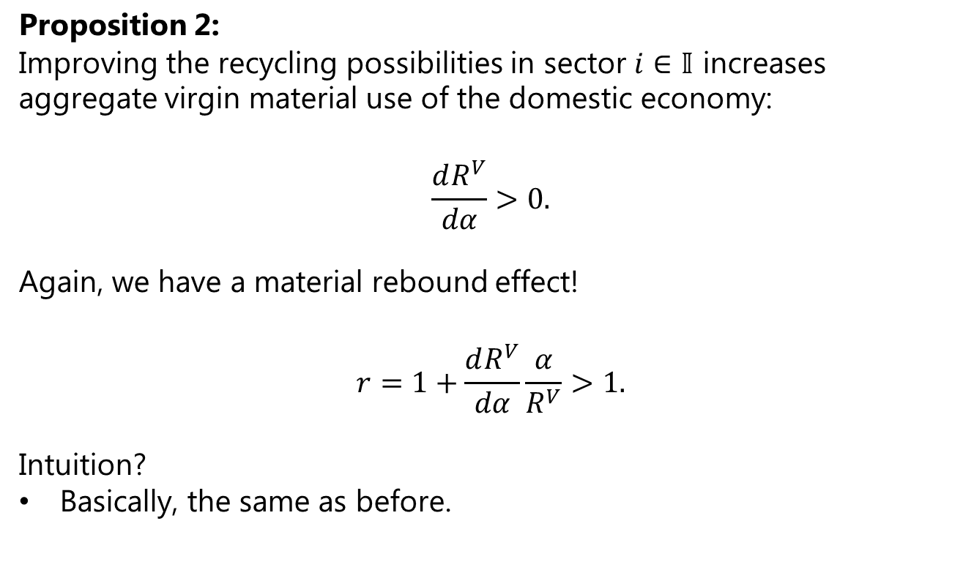
Small macro model
Proposition 2:
Improving the recycling possibilities in sector $i∈𝕀$ increases aggregate virgin material use of the domestic economy:
$$\frac{dR^{V}}{dα}>0.$$
Again, we have a material rebound effect!
$$r=1+\frac{dR^{V}}{dα}\frac{α}{R^{V}}>1.$$
Intuition?
Basically, the same as before.

Slide 37
Small macro model
What did we learn and where to go?
We learned that we can get a strong rebound effect in a small macroeconomic model without imposing controversial assumptions.
Next, we want to develop an advanced numerical model calibrated to national accounts and material flow account data to compute likely rebound effects for a real-world economy.

Slide 38
Data
xxx
xxx

Slide 39
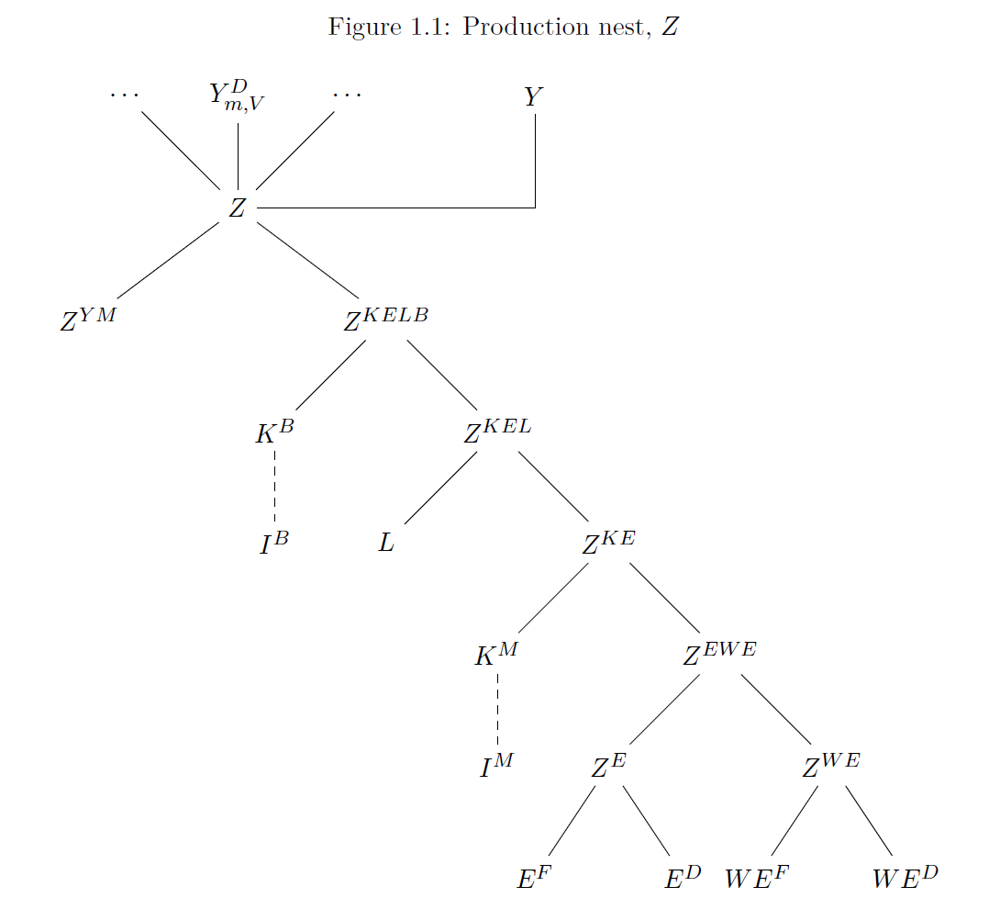
Numerical model
xxx
xxx

Slide 40
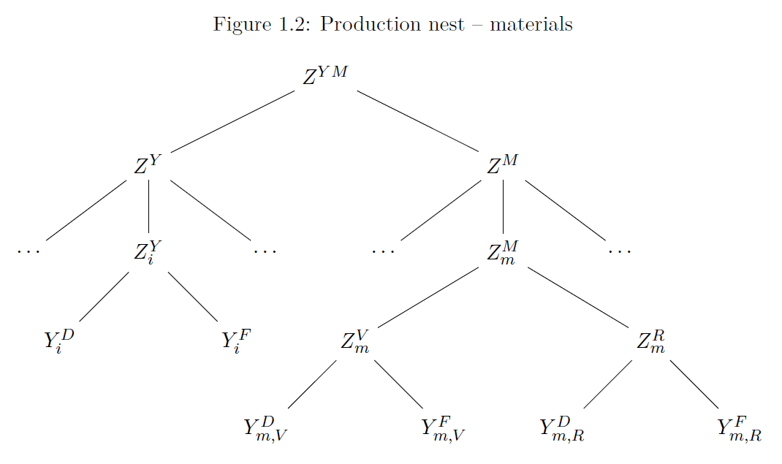
Numerical model
xxx
xxx

Slide 41
Numerical model
Waste generation
Waste generation depends on production inputs.
A fraction is “internal recycling” meaning that the sector ensures that it can be sold on the international market.
The remaining fraction is sent to the waste management sector for further treatment.
Waste intensities vary over time, industry, goods, and waste types.

Slide 42
Numerical model
Waste treatment
xxxx

Slide 43
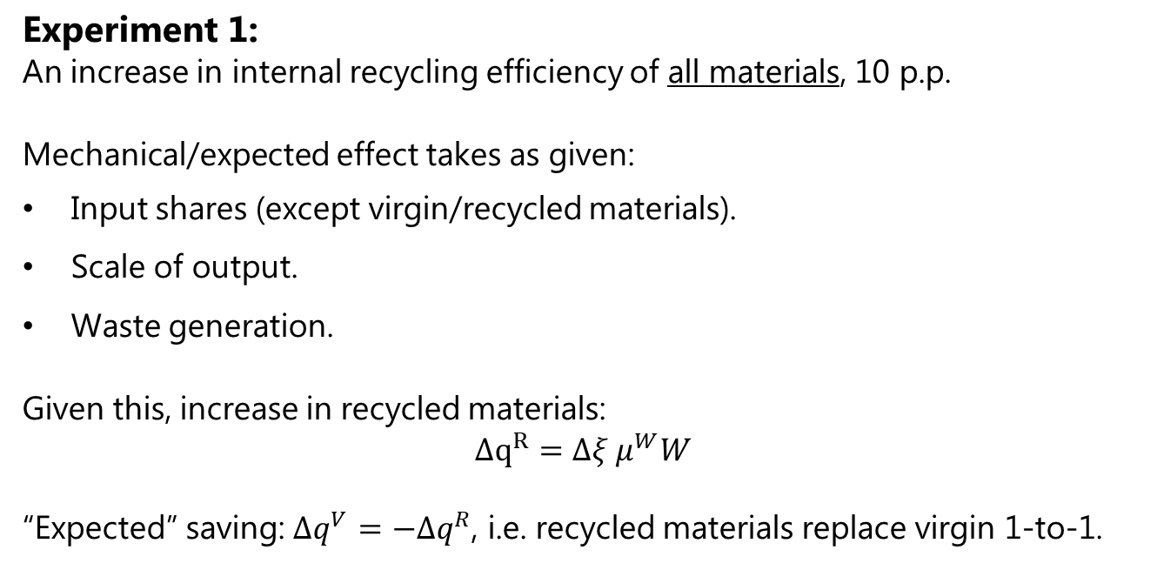
Numerical model
Experiment 1:
An increase in internal recycling efficiency of all materials, 10 p.p.
Mechanical/expected effect takes as given:
Input shares (except virgin/recycled materials).
Scale of output.
Waste generation.
Given this, increase in recycled materials:
$$Δq^{R}=Δξ μ^{W}W$$
“Expected” saving: $Δq^{V}=−Δq^{R}$, i.e. recycled materials replace virgin 1-to-1.

Slide 44
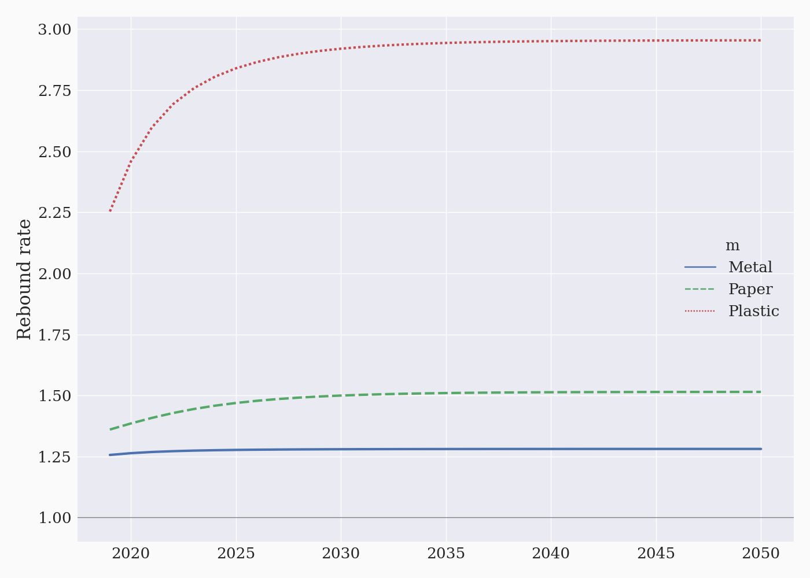
Numerical model
Experiment 1:
Huge rebound rates – in particular for plastic.

Slide 45
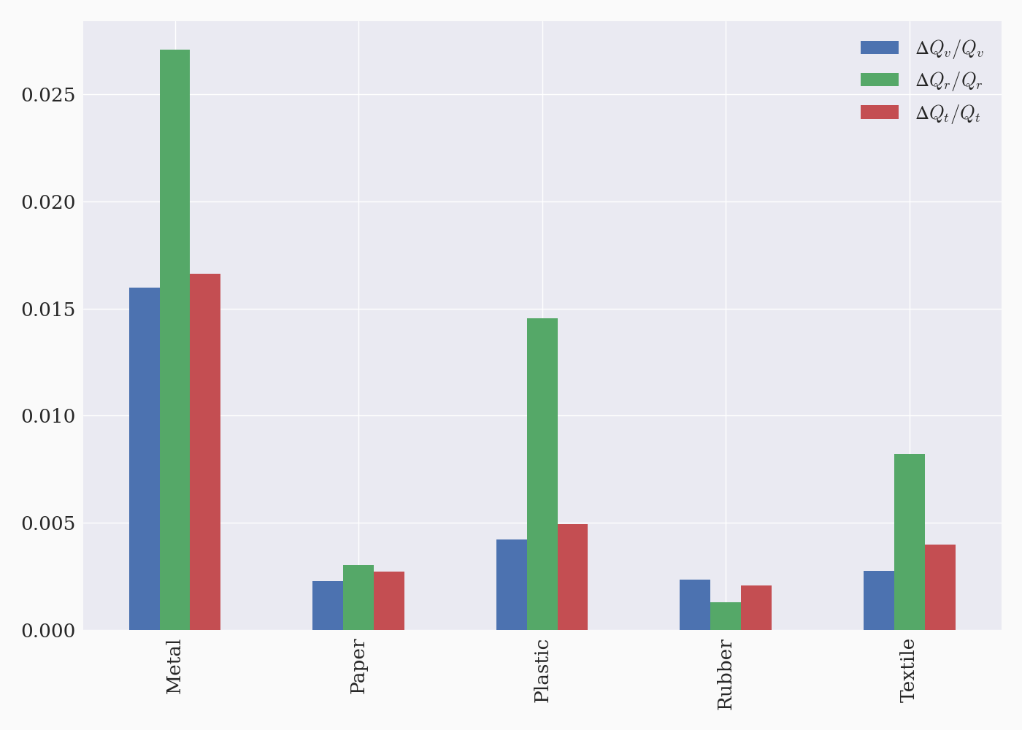
Numerical model
Experiment 1:
Recycled materials generally increase more (relatively) than virgin.

Slide 46
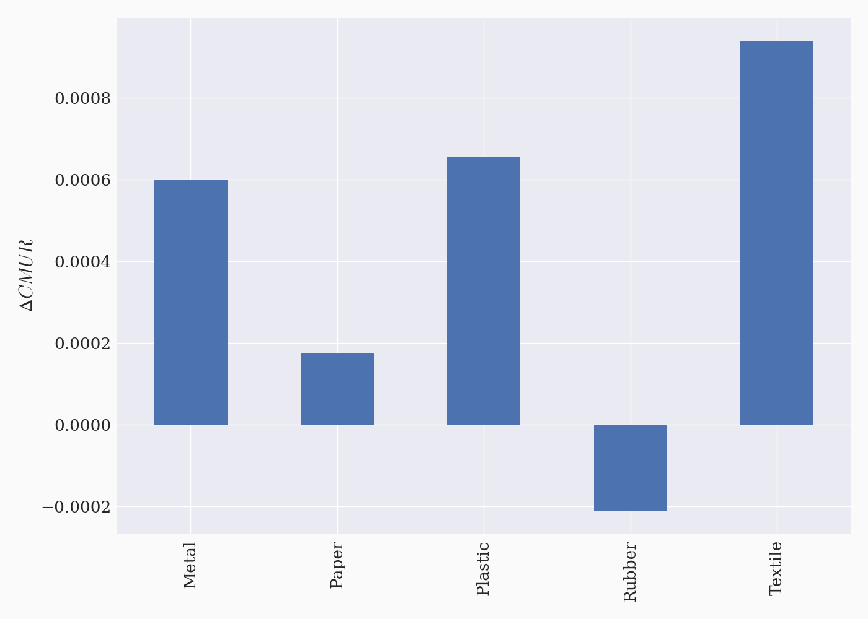
Numerical model
Experiment 1:
Circular material use rates (CMUR) increase marginally (except for ‘Rubber’).

Slide 47
Numerical model
Experiment 1:
An increase in internal recycling efficiency of all materials, 10 p.p.
Result:
More recycled materials (also relative to virgin).
CMUR indicates progress (albeit marginal).
But: Rebound effect backfires across the board (>1).

Slide 48
Numerical model
Experiment 2:
An increase in internal recycling efficiency of one material only, 10 p.p.

Slide 49
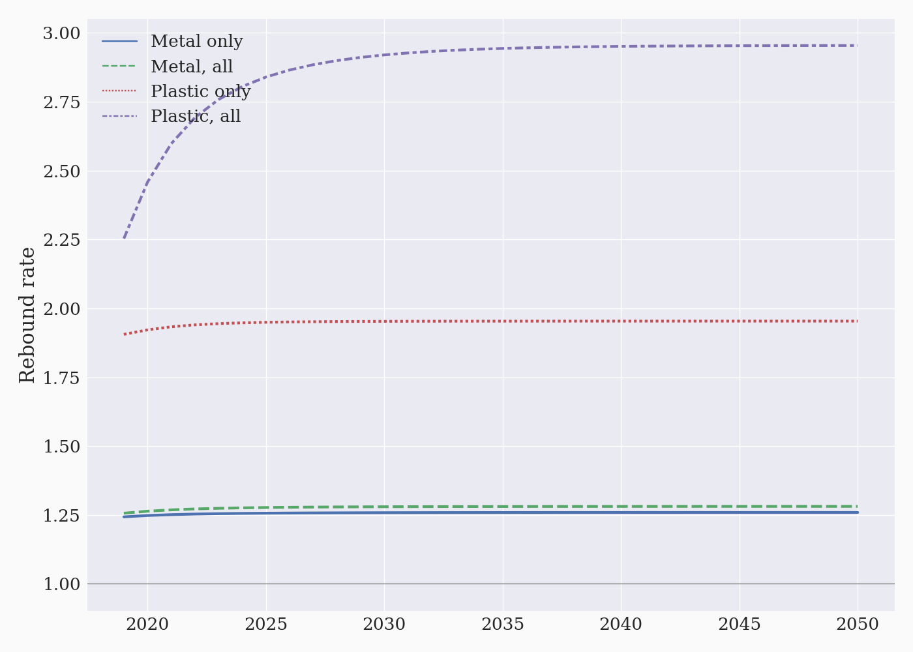
Numerical model
Experiment 2:
Huge effects on plastic, less so on metal

Slide 50
Numerical model
Experiment 2:
An increase in internal recycling efficiency of one material only, 10 p.p.
Result: Scale effects are compounding
More recycled metal increases scale of production and demand for all materials.
Whereas virgin metal is a substitute for recycled metal, other materials are generally complementary inputs (elasticity of subst. <1).
Metal drives up scale significantly → demand for plastic inputs increase significantly.

Slide 51
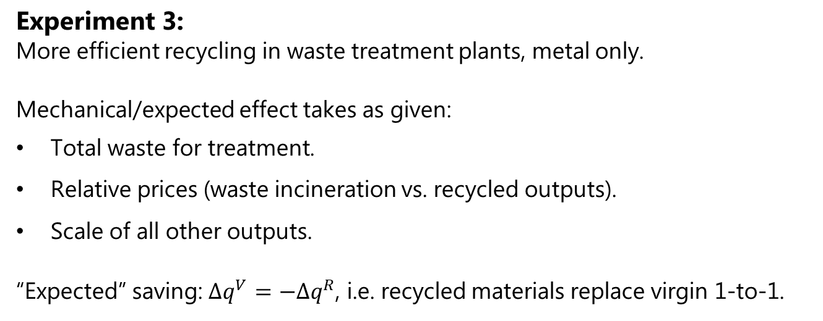
Numerical model
Experiment 3:
More efficient recycling in waste treatment plants, metal only.
Mechanical/expected effect takes as given:
Total waste for treatment.
Relative prices (waste incineration vs. recycled outputs).
Scale of all other outputs.
“Expected” saving: $Δq^{V}=−Δq^{R}$, i.e. recycled materials replace virgin 1-to-1.

Slide 52
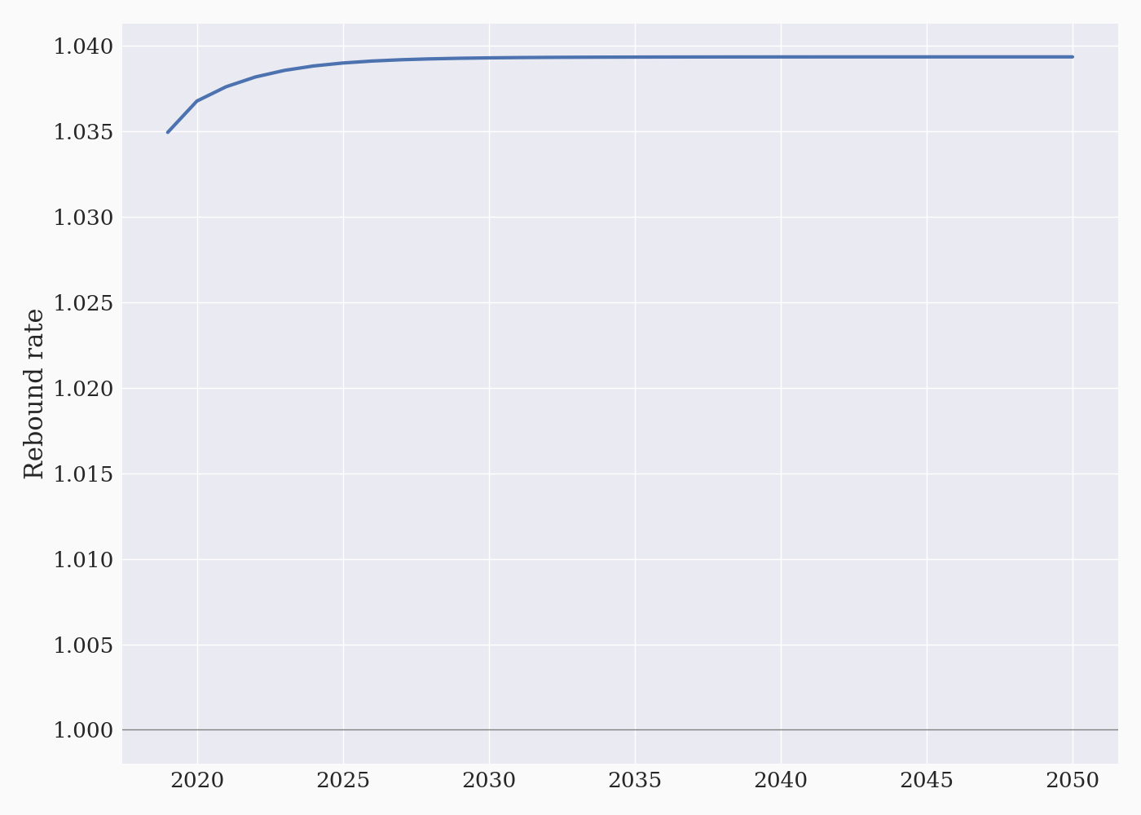
Numerical model
Experiment 3:
Rebound effect backfires again – less pronounced than internal recycling.

Slide 53
Numerical model
Experiment 4:
Add ad-valorem tax demand for virgin materials, 10%.

Slide 54
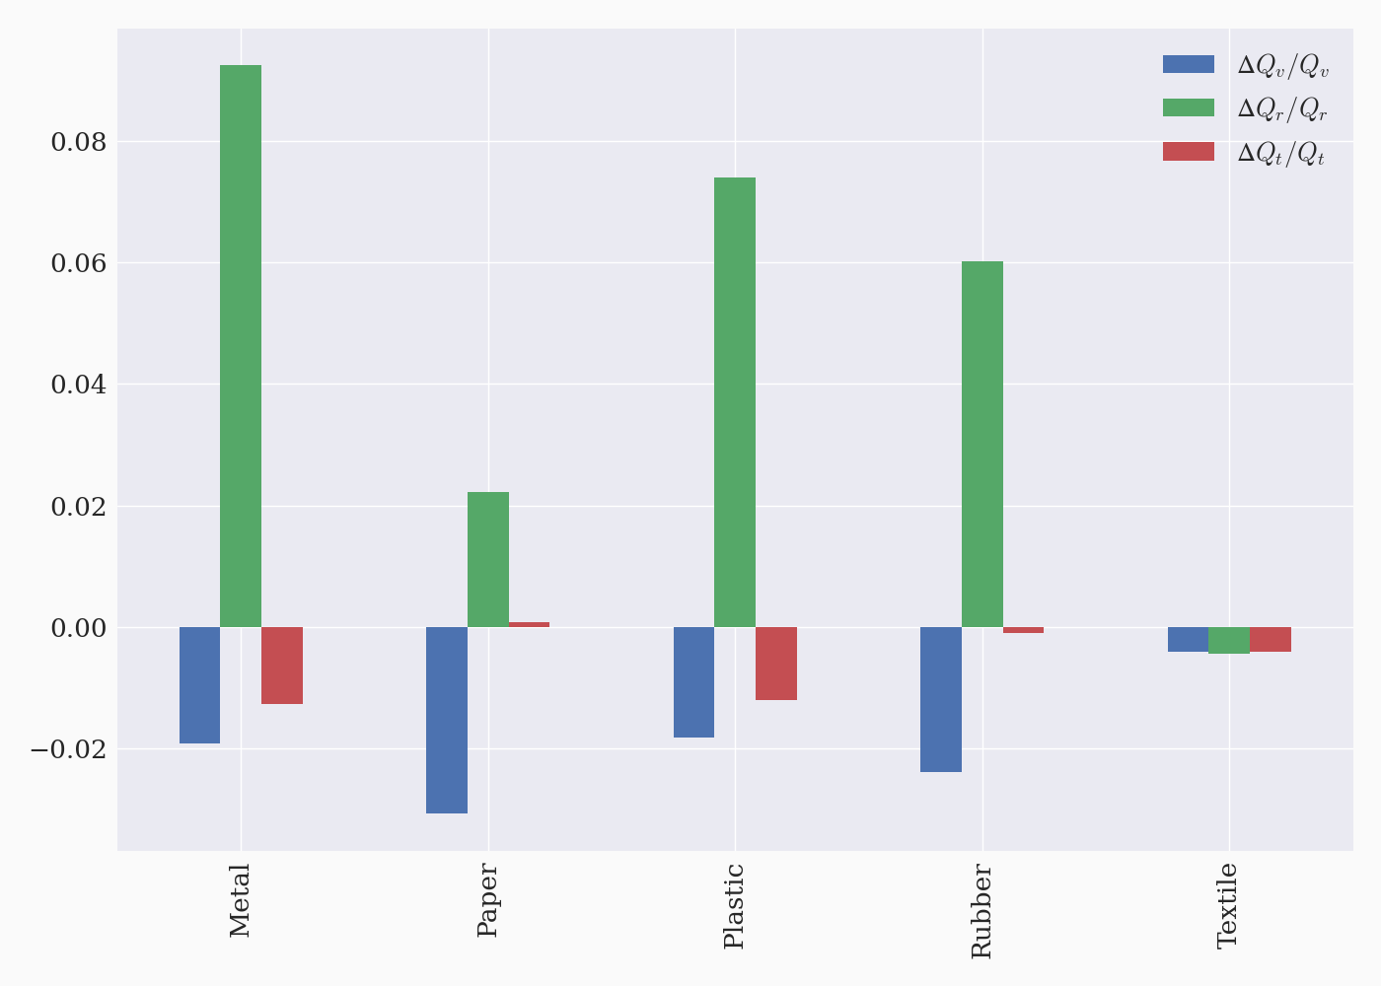
Numerical model
Experiment 4:
Substitution away from virgin materials, towards recycled.

Slide 55
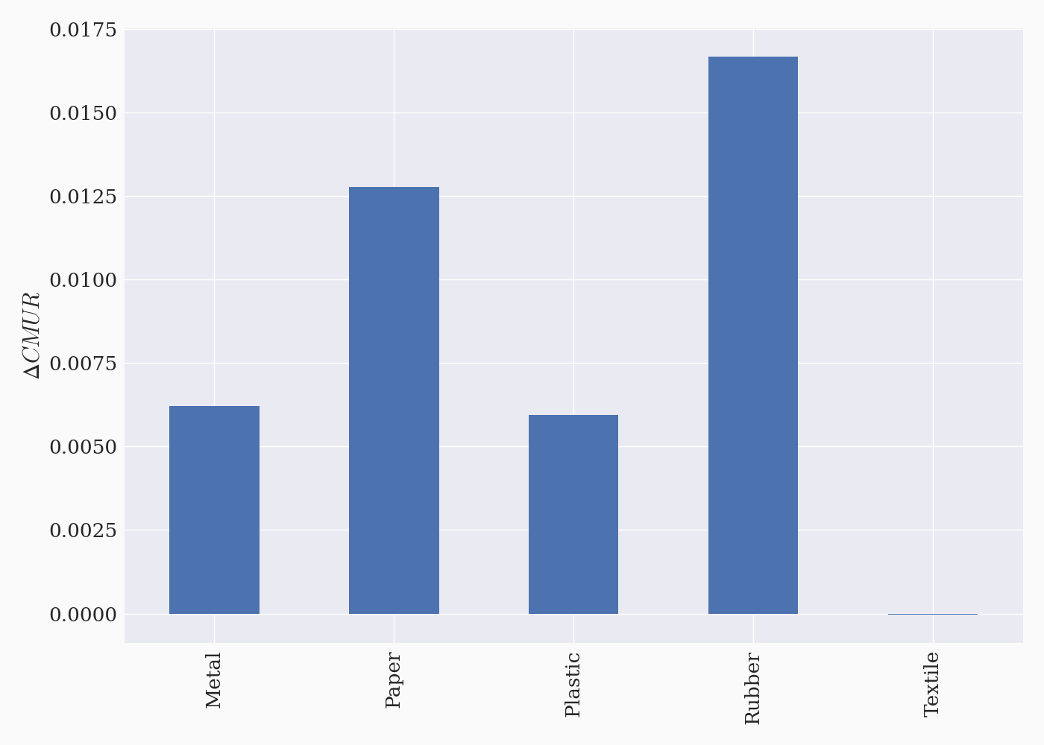
Numerical model
Experiment 4:
Circular Material Use Rate “improves” as well.

Slide 56
Numerical model
Experiment 4:
Add ad-valorem tax demand for virgin materials, 10%.
Result:
Increases recycling, decreases virgin material consumption.
Recycling may go down (‘textile’)
Substitution effect: Use recycled textile instead of virgin.
Scale effect: More expensive production → lower output → material demand in general.
Cross-substitution: Total metal demand is lower → less demand for textile (complementary input).

Slide 57
Discussion
xxxx
xxxx

Slide 58
Concluding remarks
xxxx
xxxx

