Slide 1







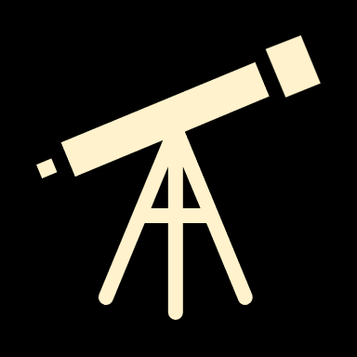

Astrometrica provides the ability to easily compare astrometrical images for the purpose of moving object detection.
The International Astronomical Search Collaboration (IASC) is a citizen science initiative that empowers individuals worldwide to engage in astronomical discoveries, particularly the identification of asteroids.
Established in 2006 by Professor Patrick Miller, IASC provides participants with high-quality astronomical data and the necessary tools to analyze it, fostering hands-on involvement in astronomy.

Slide 2
IASC's primary focus is on Asteroid Search Campaigns, which are month-long events where teams examine time-lapse images of the sky to detect moving objects.
Participants utilize the free Astrometrica software to analyze these images, identifying potential asteroids that may include main belt asteroids, near-Earth objects (NEOs), or trans-Neptunian objects. This process not only contributes to scientific research but also provides educational experiences for schools and community groups.

Slide 3
Over the years, IASC has achieved significant milestones. As of 2024, more than 50,000 citizen scientists from 96 countries have participated, leading to the detection of approximately 12,000 main-belt asteroids and about five NEOs.
Notably, IASC participants have discovered objects that were initially missed by automated survey software, highlighting the valuable contributions of citizen scientists to the field of astronomy.
Participation in IASC is accessible and free, requiring only a Windows-compatible computer and an internet connection. The program offers comprehensive tutorials, making it suitable for individuals with varying levels of astronomical knowledge.
By engaging in these campaigns, citizen scientists can earn certificates recognizing their contributions, further motivating public involvement in astronomical research.

Slide 4
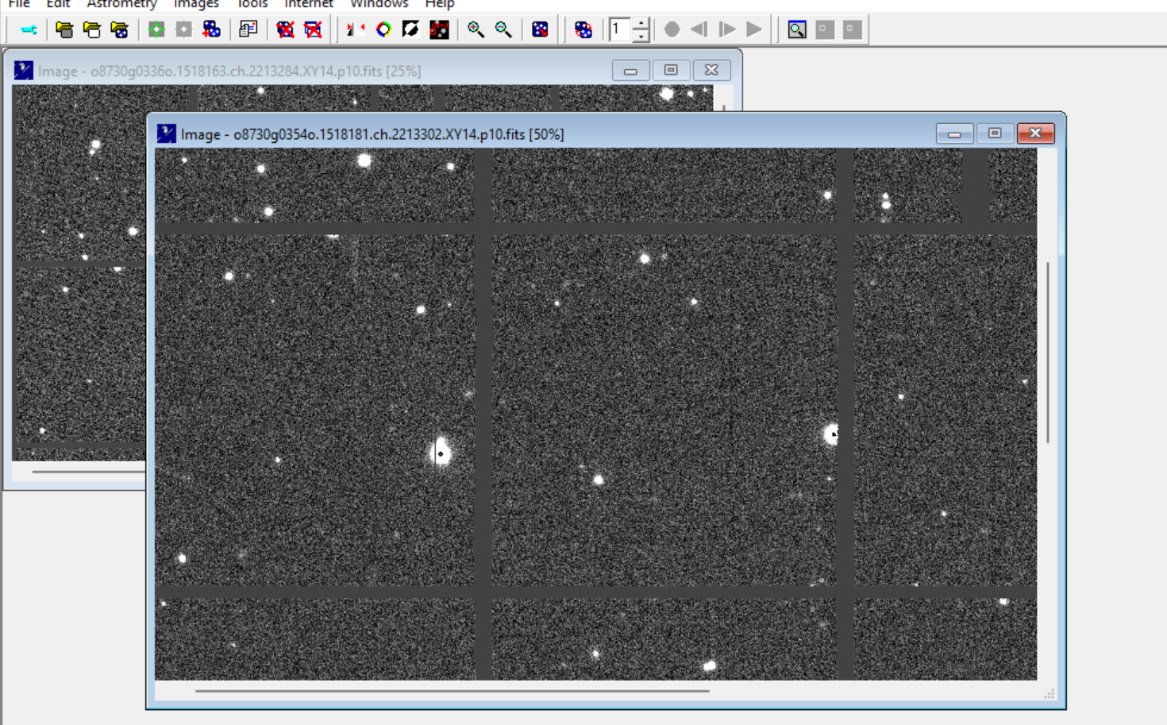
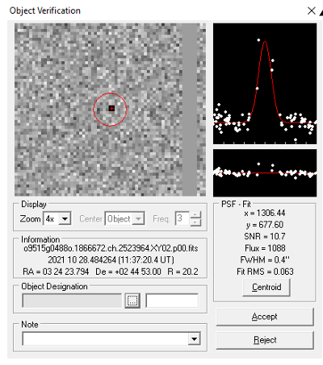
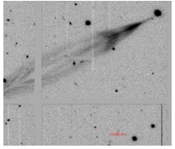
Astrometrica is software for detecting and analyzing celestial objects like asteroids and comets. It helps users measure object positions (astrometry) and brightness (photometry) from telescope images.
Key features include image calibration, integration with star catalogs like Gaia, and tools to detect moving objects in time-lapse images.

Slide 5
How to Use Astrometrica Easily:
Prepare Your Images: Capture time-lapse images of the sky using a compatible telescope or camera.
Load Images: Import them into Astrometrica for processing.
Calibrate: Use reference stars from catalogs for precise measurements.
Detect Objects: Highlight moving objects by comparing images over time.
Submit Results: Export your findings to organizations like the Minor Planet Center.
Astrometrica is user-friendly, with tutorials guiding beginners through the process. It’s ideal for citizen science programs like asteroid discovery, offering a hands-on experience in astronomy.

Slide 6
:MPCORB refers to the Minor Planet Center Orbit Database, a publicly available catalog maintained by the International Astronomical Union's Minor Planet Center (MPC). It contains detailed orbital and physical data for over one million known asteroids, including their positions, velocities, and other parameters, helping in identifying near-Earth objects (NEOs), and studying long-term orbital changes.
PS1.CFG:This is a configuration file used by Astrometrica and other software to integrate star catalogs like those from the Pan-STARRS (Panoramic Survey Telescope and Rapid Response System) project. The file contains metadata to correctly load and align data from the Pan-STARRS catalog for astrometric analysis. It ensures accurate calibration by mapping star positions in your images with high-precision reference data.
Pan-STARRS Telescope: The Pan-STARRS system is a cutting-edge survey telescope located at the Haleakalā Observatory in Hawaii. Pan-STARRS specializes in wide-field imaging, tracking transient astronomical events, and detecting NEOs, asteroids, and comets. Its contributions include creating the Pan-STARRS catalog, which provides high-precision star positions and magnitudes for use in professional and amateur astronomy.
These tools together enable astronomers to precisely identify and study celestial objects, contributing to discoveries and planetary defense initiatives.

Slide 7
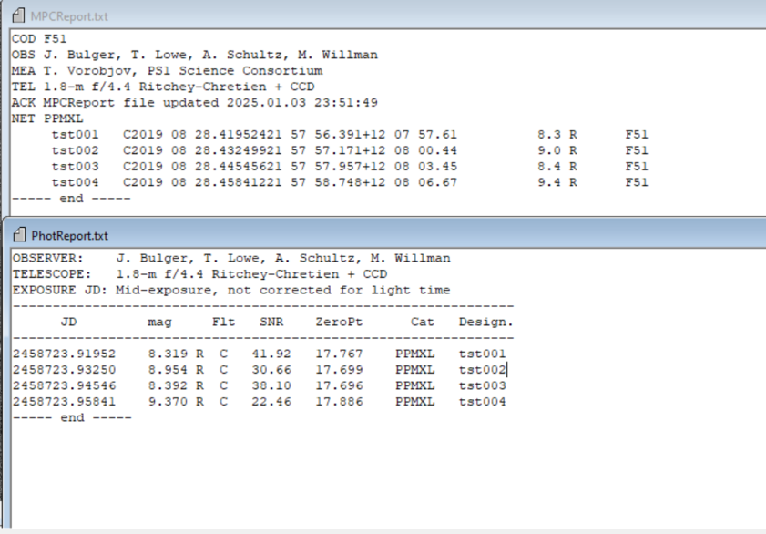
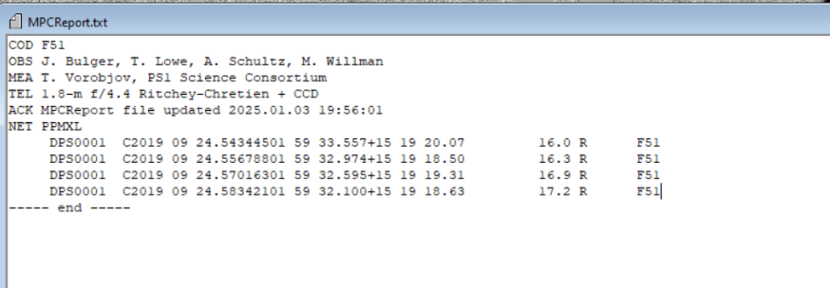
:Some Reports We have already prepared as practice and learning

Slide 8
That’s it ! In summary, IASC serves as a bridge between professional astronomy and the public, enabling citizen scientists to make meaningful contributions to the discovery and tracking of asteroids, thereby enhancing our understanding of the solar system and supporting planetary defense efforts.
Our Group
Debanjan Bandopadhya (XI-H)
Khushil Varshney (XI-H)
Nikhil Katiyar (XI-H)

