Slide 1
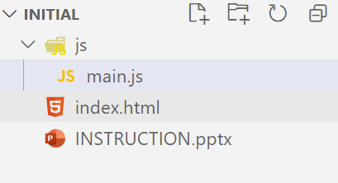
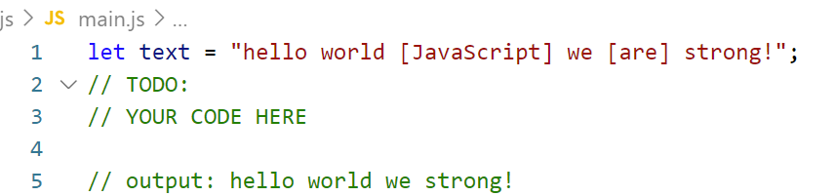
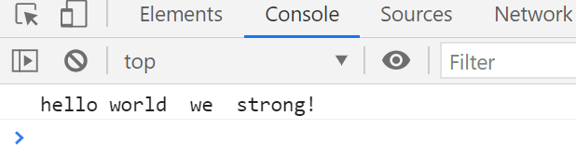
Write code to get the only text outside brackets [ ] from paragraph.
Example:
Input: hello [2021] JS
Output: hello JS
Step:
1. Open exercises folder in Vscode
2. Run index.html file
3. Open Console on browser ( Ctrl + shift + i)
4. Open main.js file and write your JavaScript code

