Slide 1
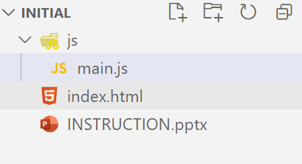
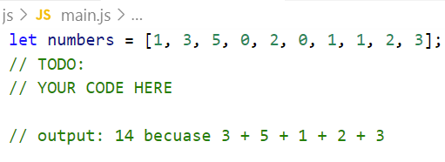
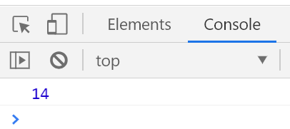
Write code to sum number after number 1 until number 0.
Example:
Input: [0, 1, 1, 3, 4]
Output: 8
Because 1 + 3 + 4
Step:
1. Open exercises folder in Vscode
2. Run index.html file
3. Open Console on browser ( Ctrl + shift + i)
4. Open main.js file and write your JavaScript code

