Slide 1
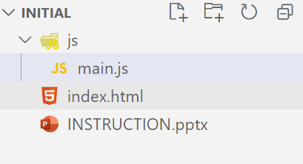
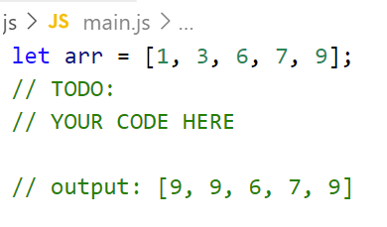
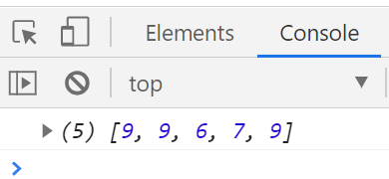
Write code to find maximum number and replace all number that less than 5 with maximum number.
Example:
Input: [1, 2, 7, 5, 8]
Output: [8, 8, 7, 5, 8]
Because :
1 < 5 => replace with 8
2 < 5 => replace with 8
7 > 5 => keep the same value
5 < 5 => keep the same value
8 > 5 => keep the same value
Step:
1. Open exercises folder in Vscode
2. Run index.html file
3. Open Console on browser ( Ctrl + shift + i)
4. Open main.js file and write your JavaScript code

