Slide 1
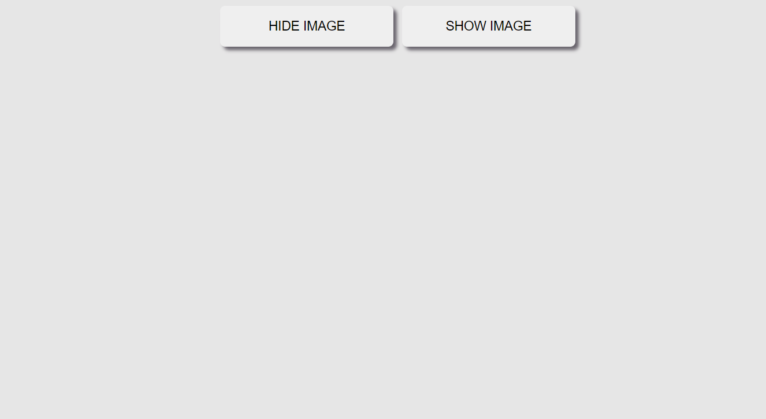
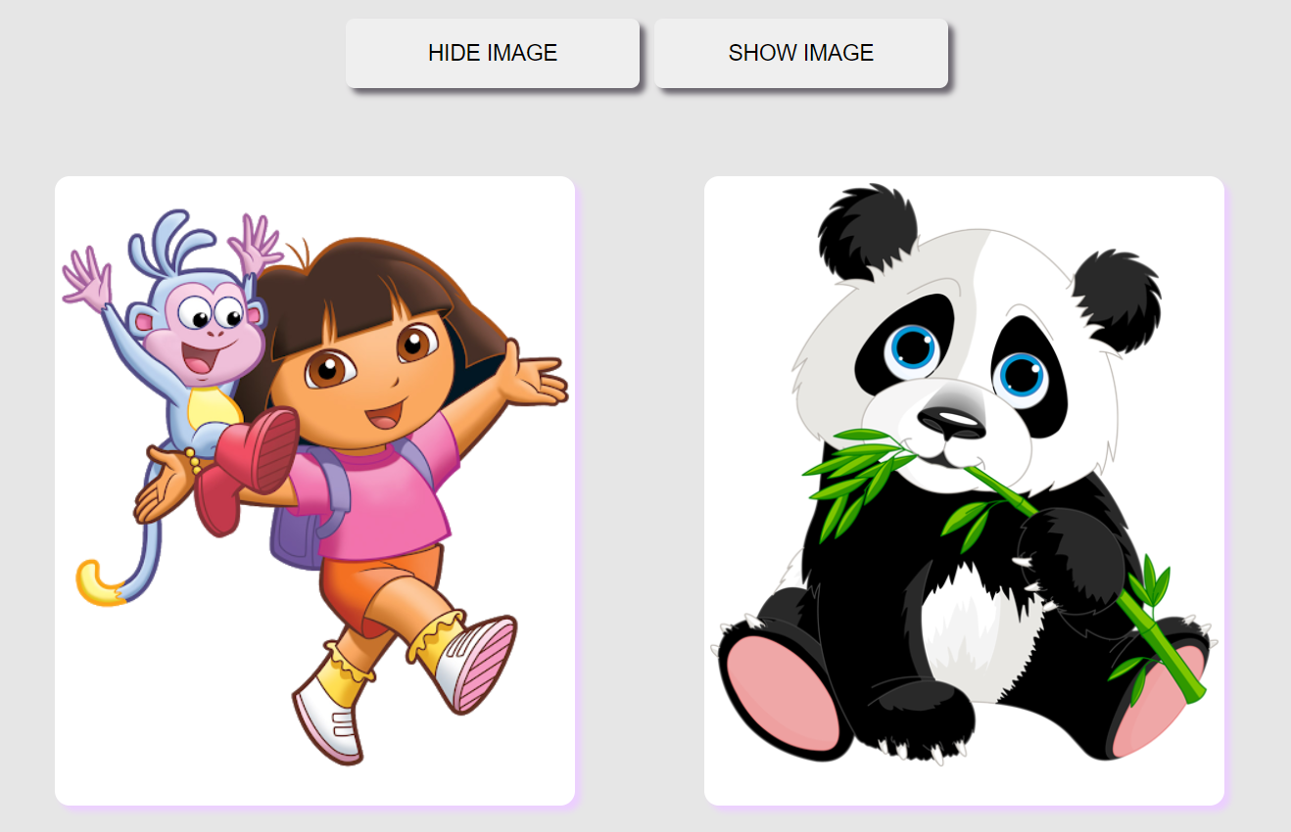
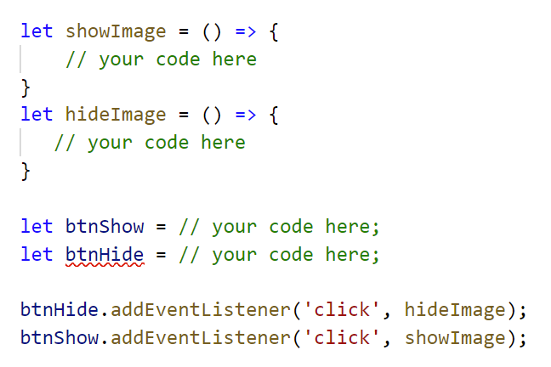
Click on
hide button!
Click on
show button!
Instruction
Start Code
Write code to hide or show images
Help
https://www.w3schools.com/jsref/tryit.asp?filename=tryjsref_style_display_toggle

