Slide 1
Instructions
When clicking INCREASE the box with shall be set to 300px
300 PX
Click on
increase
When clicking DECREASE the box with shall be set to 100px
100 PX
Click on
decrease

Slide 2
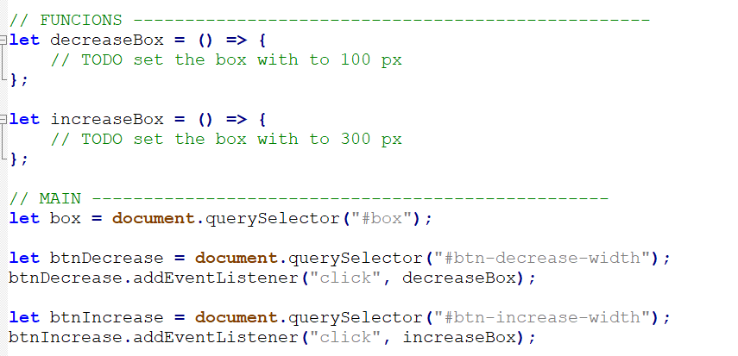
Start code explanation
Help
https://www.w3schools.com/jsref/prop_style_width.asp

