Slide 1
Instructions
When clicking INCREASE the box with shall be INCREASED of 100px
100 PX
200 PX
300 PX
Click on
increase
Click on
increase
When clicking DECREASE the box with shall be DECREASED of 100px
300 PX
200 PX
100 PX

Slide 2
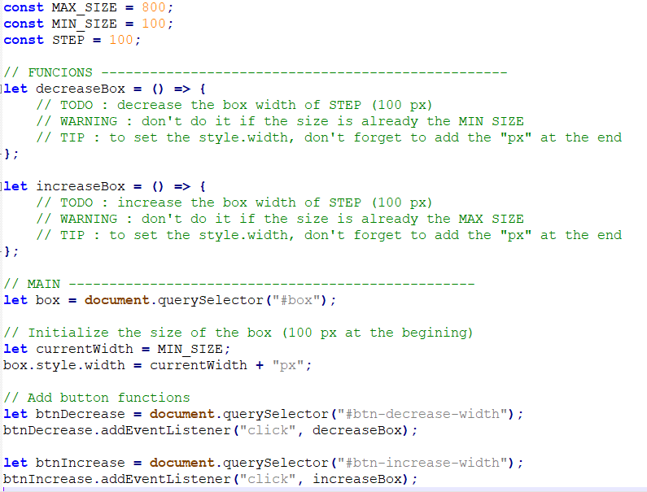
Start code explanation

