Slide 1
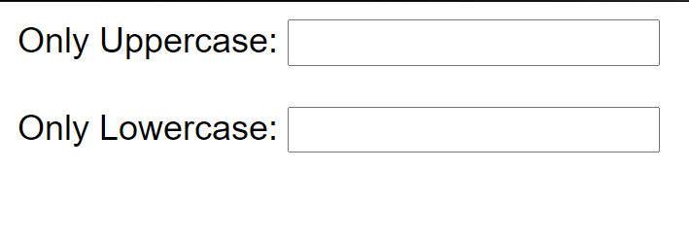
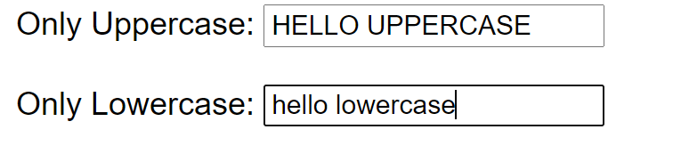

Instruction
The result shall be display
In HTML you have to input form:
To-do:
Write the JS to convert character that have input in the first input to Uppercase letter.
Write JS to convert character that have input in the second input to Lowercase letter.
Warning:
The text must be convert during input.

