Slide 1
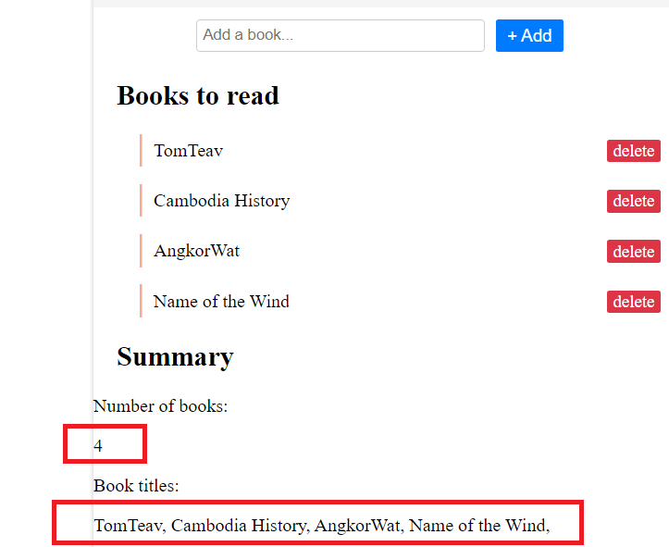
Instructions
You need to print
After number of book : the number of book in the list of book
After book titles : the list of book titles, separated by comma
WARNING
You need to get those information
From the DOM !!
(don’t write directly “4” …)

