Slide 1

PREDICTING INTERNATIONAL ESCALATIONS AND NARRATIVE SHIFTS IN CONFLICT
NAME: CHAMUNDESHWARI KOTTUR

Slide 2
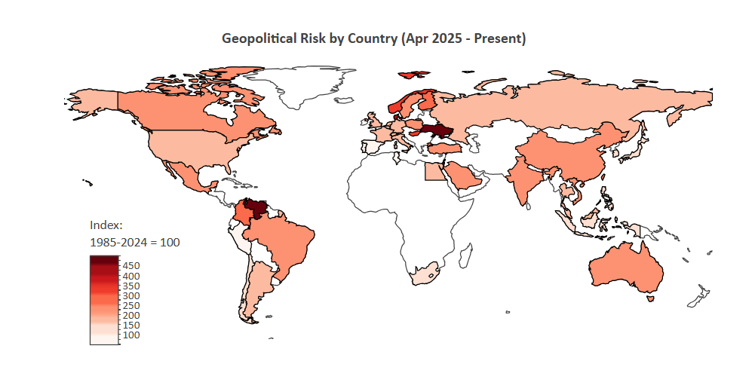
This project examines how conflict events and geopolitical risk signals drive escalation and how media narratives reflect these dynamics.

Slide 3


DATA SOURCES
1. ACLED Dataset (Armed Conflict Location & Event Data)
Acquisition: CSV data exported from acleddata.com
Conflict events processed : 1,554,214
Date range: Jan 2015 → Mar 2025
Countries: 52
2. GPR Index - Geopolitical Risk Index (goes up when more newspapers write about wars and crises.)
Acquisition: XLS file downloaded from matteoiacoviello.com
Daily file rows: 15,050 (1985 → 2026)
Monthly file rows: 494
After filtering from date(jan 2015- mar 2025) and week wise- 531 week rows
Countries: 44

Slide 4



New York Times (393 articles)
API Text + Metadata
Acquisition: developer.nytimes.com API key
Fields: headline, abstract, pub_date, section
Returns JSON files
Reddit (297 posts)
Captured using PRAW API
Subreddits: r/geopolitics, r/worldnews
Fields: title, selftext, score (upvotes), num_comments, post_date
YouTube Data (287 uploads)
Json from YouTube Data API
Fields: Title, Description, Views, Likes
collected from channels including Al Jazeera, DW, CGTN, and BBC

Slide 5
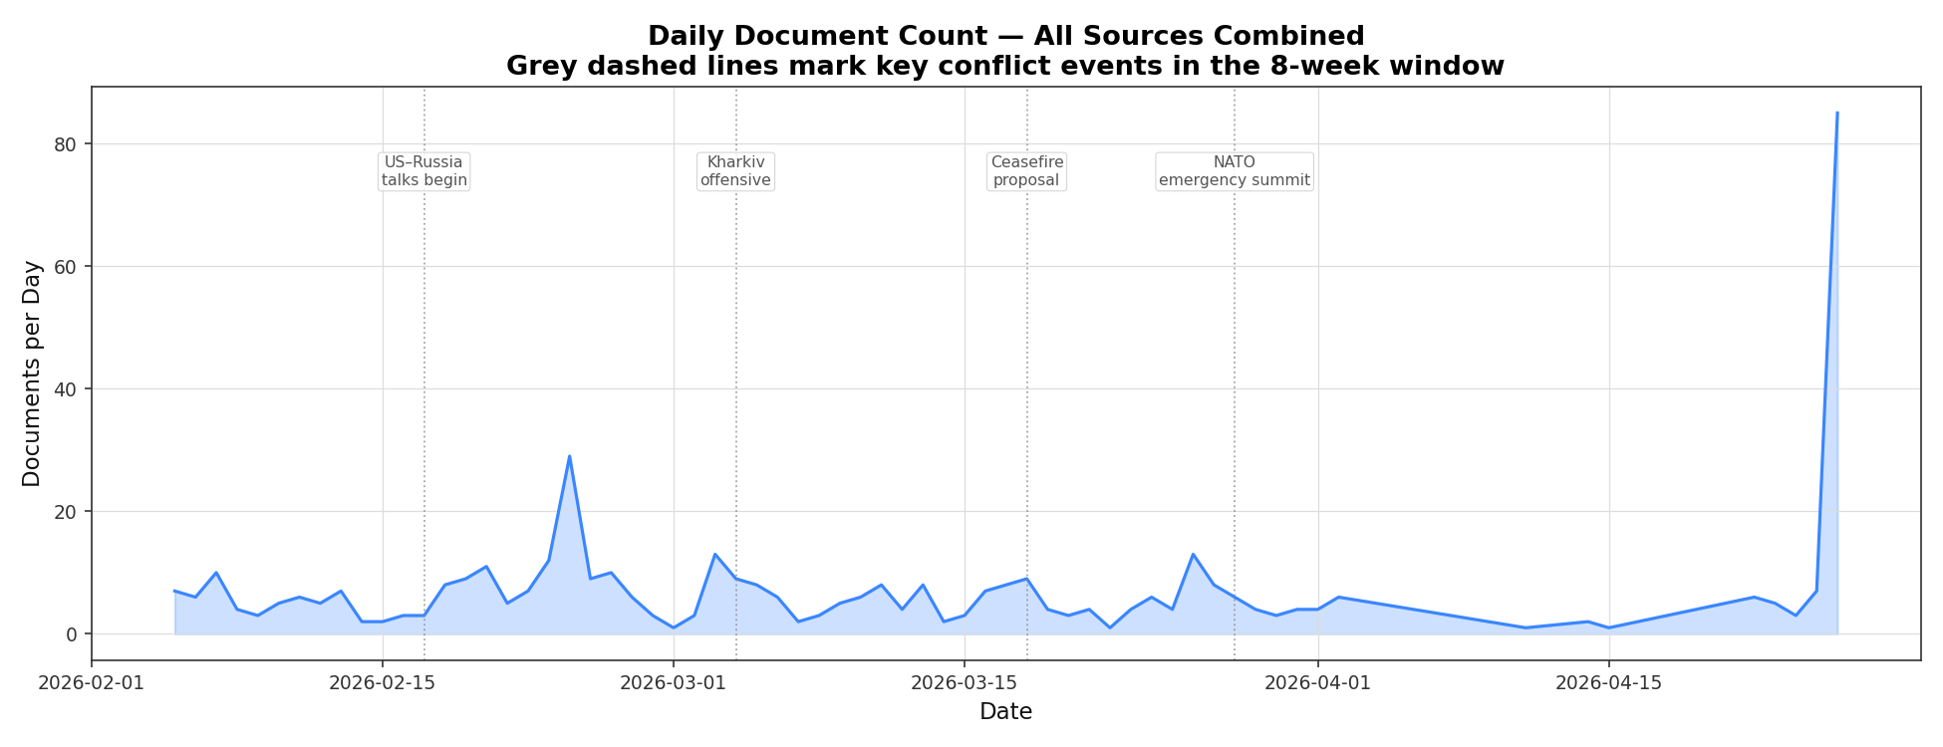
Media activity shows clear spikes during major conflict events

Slide 6
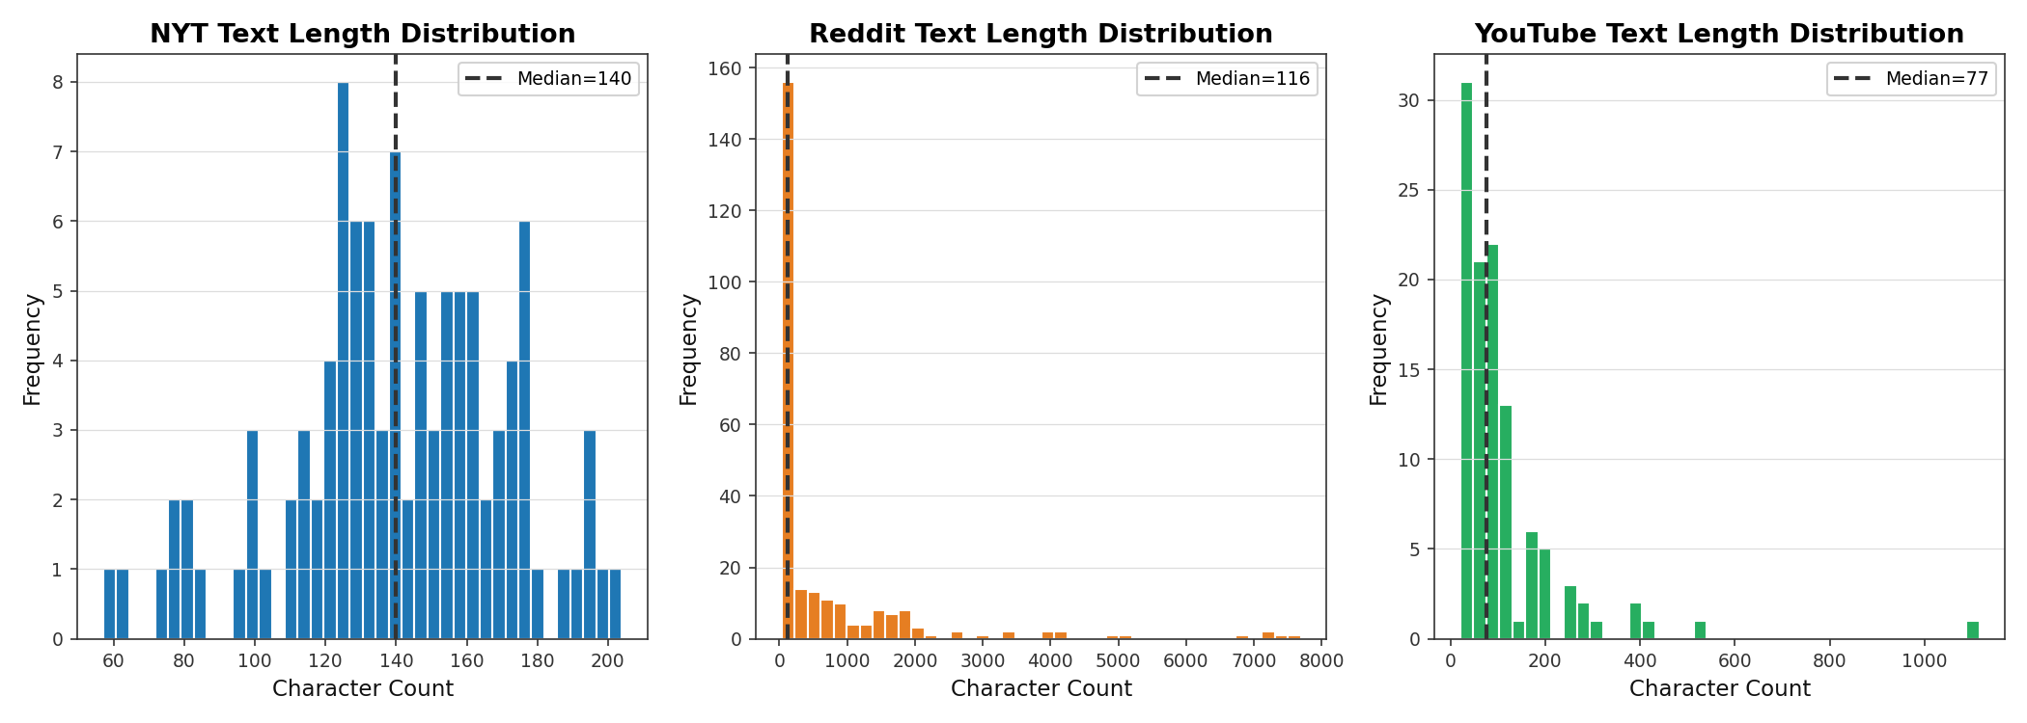
NYT
Articles are consistent and structured
Reddit
Highly skewed distribution with extreme long posts (up to ~7000 chars)
YouTube (Comments)
Mostly short, reactive, and opinion-based comments
Captures real-time public sentiment and emotional reactions

Slide 7
Data Preprocessing
• Text cleaning: removed URLs, HTML tags, and non-alphabetic characters • Converted all text to lowercase
• Tokenization using NLTK • Lemmatization applied
• Example: RAW: "war!!! http link" CLEAN: "war"
BERT( ro-BERT-a) model for sentiment analysis:
Transformer-based models (RoBERTa) capture context better than lexicon methods:
Example:
“airstrike launched after failed peace talks”
Match words against lexicons:
Negative sentiment - "airstrike"
Positive sentiment - "peace", "talks"
lexicon-based topic classification method:
Escalation lexicon → words related to conflict
Diplomacy lexicon → words related to peace
"escalation": ["attack","bomb","airstrike","invasion","war","troops","military"]
"diplomacy": ["ceasefire","talks","agreement","peace","negotiation","truce"]

Slide 8
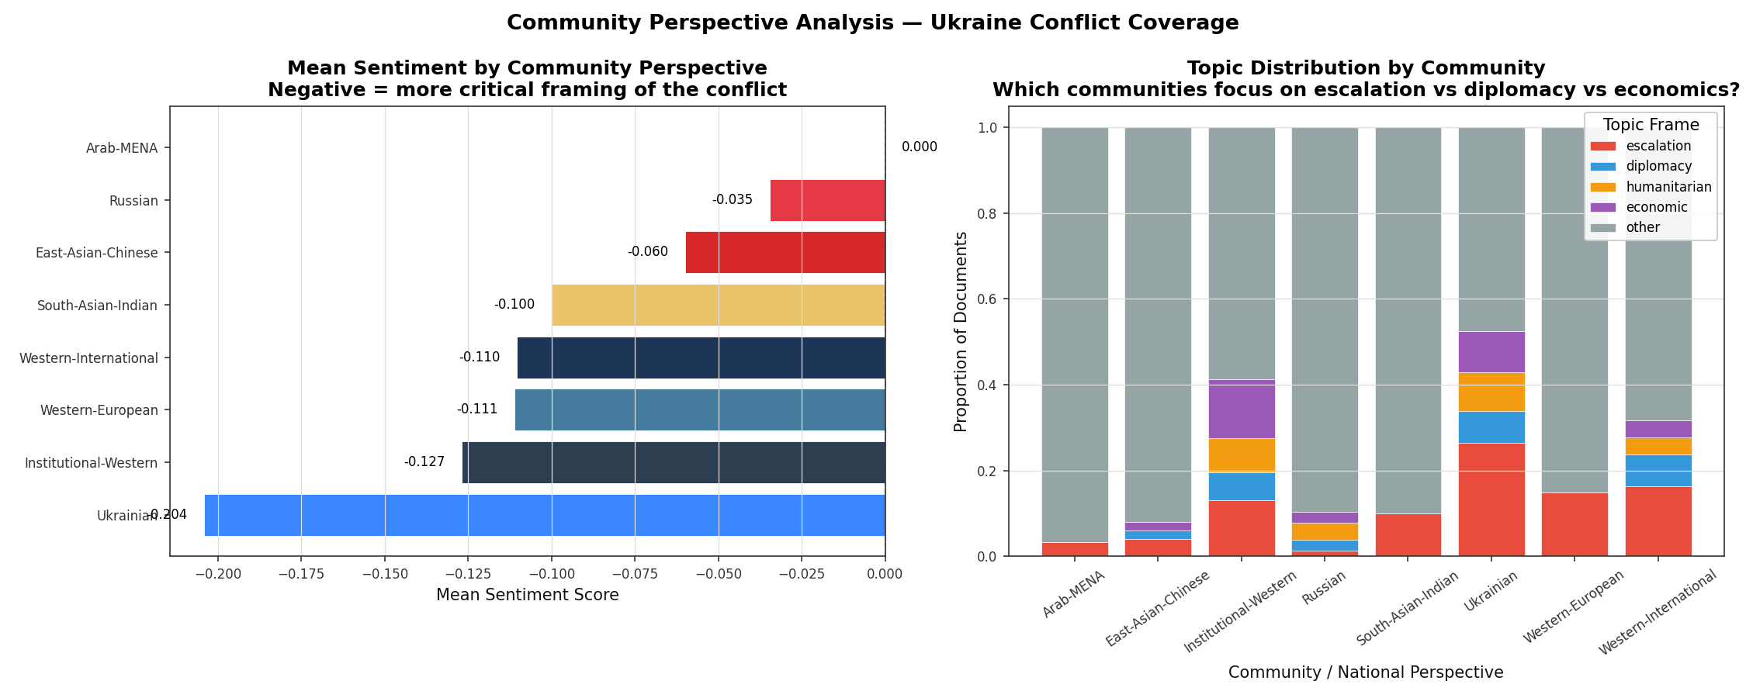
Negative sentiment reflects conflict-heavy framing, while variations across communities indicate differing geopolitical perspectives.

Slide 9
Feature Engineering:
Aligned datasets on: Country, weekly
Created unified dataset: gpr indices + Conflict metrics
Created weekly features:
ACLED-derived weekly features
total_events: Count of events that week — numerical
total_fatalities: Sum of deaths — numerical integer
fatality_rate: Deaths per event — lethality signal
battle_fraction: Share of events that are battles
multi_country_spike: How many countries spiking at once
GPR-derived weekly features
gpr_mean: Weekly average GPR index
gpr_threat_mean: Threat-component average
gpr_act_mean:Actual-events component avg
threat_act_ratio: Threat ÷ Act — pre-escalation signal
formula:
Augmented GPR = GPR (most recent) + Media Signal
Where:
Media Signal = Narrative Shift + Negative Sentiment
final version:
Augmented GPR = GPR + (Narrative Shift + Negative Sentiment)
NLP media features (from APIs)
narrative_shift_score: Escalation topic% − Diplomacy topic%
mean_sentiment: Avg sentiment [−1, +1]

Slide 10
Escalation Label Design
ESCALATION = 1 IF:
(FATALITIES IN 30 DAYS > 2 × AVERAGE FATALITIES OVER PAST 12 WEEKS) AND (TENSION IN 30 DAYS > 2 × AVERAGE TENSION OVER PAST 30 DAYS)
0 – STABLE
1 - ESCALATION
Version | Criteria | T-value | positives | remarks
1.a | OR | 1.5 | 297/531 | Too loose (HIGH FALSE POSITIVES)
1.b | AND | 1.5 | 210/531 | Loose
2.a | OR | 3.0 | 62/531 | Strict (MISSES EVENTS)
2.B | AND | 3.0 | 7/531 | Too strict
3.a | OR | 2.0 | 182/531 | Moderate
3.B | AND | 2.0 | 130/531 | Optimal

Slide 11
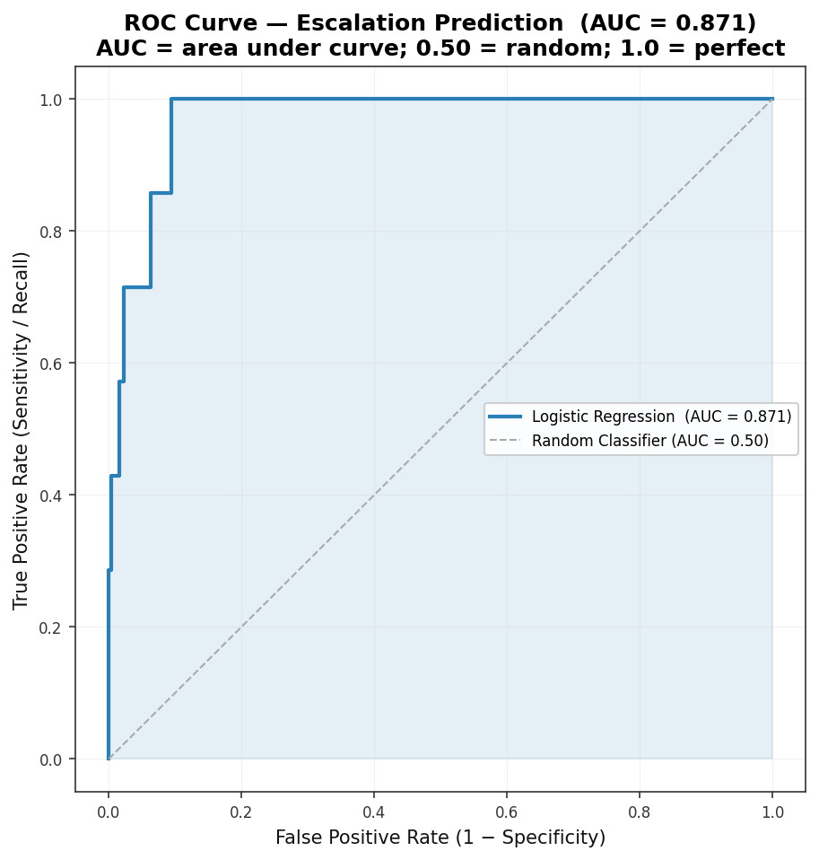
OUTPUT
model | AUC
Logistic Regression | 0.871
Gradient Boosting | 0.541
XG Boost | 0.693
Random Forest | 0.57

Slide 12
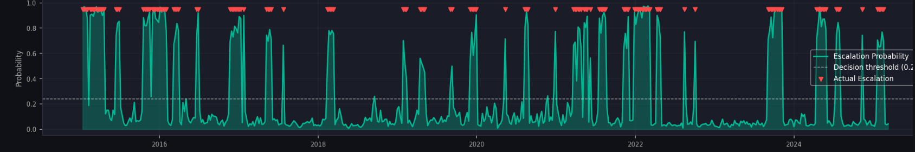
Escalation Risk Probability [version 3.b]- optimal

Slide 13
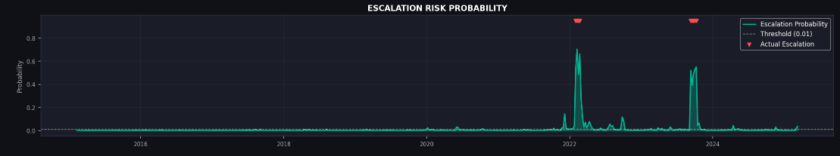
Failed version[2.b]

Slide 14
Thank you

