Slide 1

Fresh. Pure. Delivered Daily.
Premium Vegetarian Pre-Order Meal Service
Presented by [Your Name]
·
June 2026

Slide 2

WHO WE ARE
A New Standard for Daily Vegetarian Meals
Brahma Kalasha is a premium vegetarian food business built around one promise — freshly prepared home-style meals, delivered to your door the next morning, every single day.
AT A GLANCE
Founded
[Year]
We are not a restaurant. We are not a food aggregator.
Location
We are a purpose-built, technology-powered food operation that knows exactly how much to cook every day — because every meal is pre-ordered before the kitchen lights up.
[City]
Cuisine Focus
South Indian Tiffins · Veg Lunches · Chaats · Indian Sweets · Healthy Specials

Slide 3
THE PROBLEM
Clean Vegetarian Food Is Surprisingly Hard to Find
01
Restaurants compromise when it gets busy
02
Aggregator apps hide the kitchen
Ingredients are swapped under pressure — you never really know what is in your food.
Food arrives from kitchens you have never seen, prepared hours before it reaches you.
03
Home cooking takes time families don't have
04
Vegetarian diners are an afterthought
Working households are forced to compromise on food, daily.
Veg menus are rarely the focus — they are added on, not designed for.
Millions of vegetarian households settle every day — not because they want to, but because there is no better option.

Slide 4
OUR SOLUTION
Pre-Order Tonight. Fresh on Your Doorstep Tomorrow.
1
2
3
4
Menu published every evening
Customers pre-order by 9 PM
We cook only what is ordered
Delivered fresh the next morning
Admin curates tomorrow's menu — seasonal, nutritious, traditional.
Order placed, payment confirmed, quantity locked.
No excess. Every meal is accounted for before the first vegetable is cut.
By our own delivery team, tracked in real time.
THE GUARANTEE
"If you ordered it, it was made for you today."

Slide 5


WHAT MAKES US DIFFERENT
This Is Not Another Food Delivery App
Brahma Kalasha
Restaurants
Aggregator Apps
100% vegetarian, always
Rarely
Never guaranteed
Freshly prepared the same day
Sometimes
Zero food-waste model
Own delivery team
Sometimes
You know exactly what you get
Inconsistent
Pre-order = guaranteed availability

Slide 6
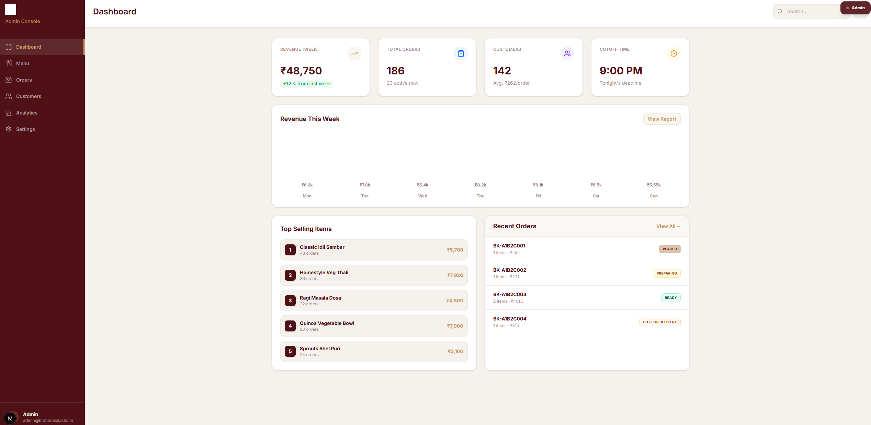
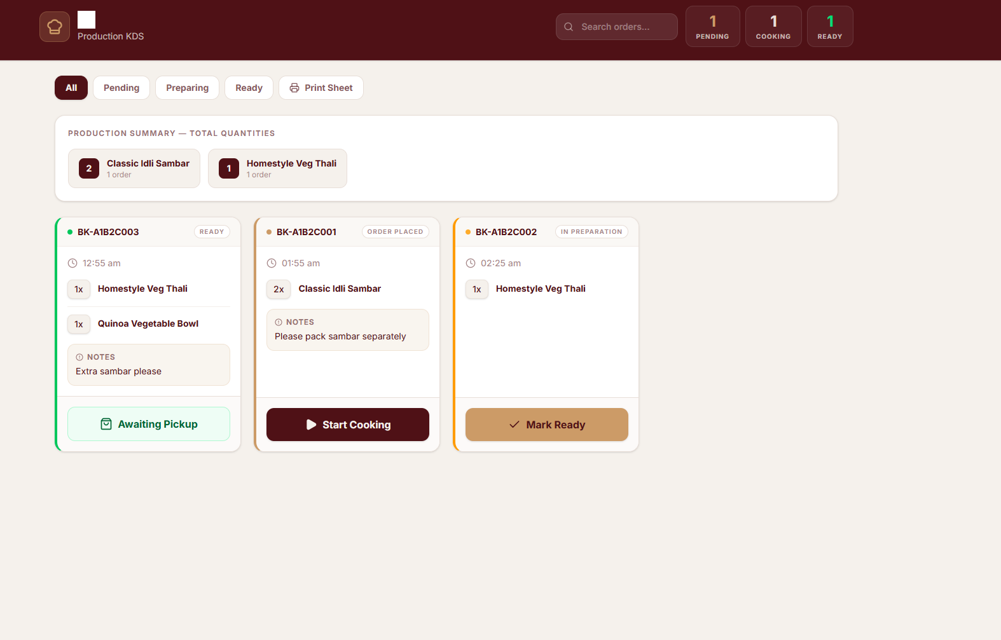
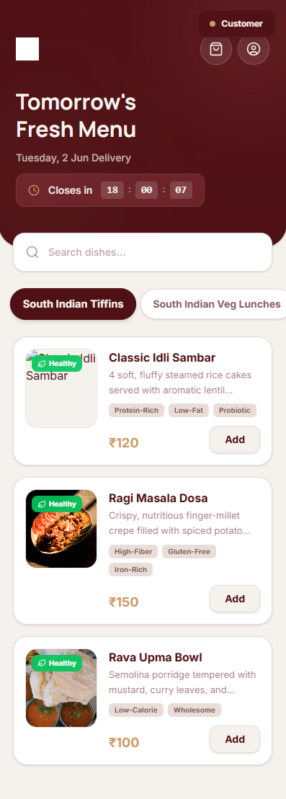
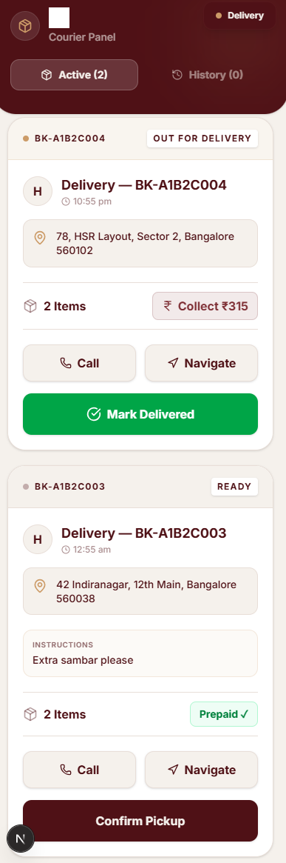
THE PLATFORM
Enterprise-Grade Technology, Built and Owned
Admin Dashboard · Publish menus, set limits, view analytics
Kitchen KDS · Exact quantities, production flow, print sheets
Customer App · Browse, order before cutoff, track delivery
Delivery App · Assigned drops, status updates, payment collection
All four platforms are live, tested, and operational — no development cost pending.

Slide 7
OUR MENU
Rooted in Tradition. Designed for Today.
South Indian Tiffins
South Indian Veg Lunches
Idli · Dosa · Pongal · Upma · Vada
Full meals · Sambar · Rasam · Rice · Curries
Indian Veg Chaats
Indian Sweets
Bhel · Pani Puri · Sundal · Sprout bowls
Halwa · Payasam · Ladoo · Seasonal specials
Healthy Specials
Seasonal Specials
Millets · Grain bowls · Low-oil options
Festival menus · Regional rotating dishes
Small, curated, rotating. Customers trust what we offer — because we offer only what we do best.

Slide 8
WHO WE SERVE
A Loyal, Recurring Customer Base
WHO ORDERS FROM US
Working professionals aged 25–50 who eat vegetarian daily
Families wanting reliable home-style food without the daily cooking burden
WHY THEY STAY
Senior citizens seeking clean, light, traditional meals
Vegetarian food is not a trend for our customers — it is a daily necessity tied to culture, health, and belief.
Health-conscious individuals tracking nutrition and ingredients
Office groups and small teams arranging daily meals
Once trust is earned, customers return every single day. This is a recurring, high-retention base by its very nature.

Slide 9
BUSINESS MODEL
Simple, Lean, and Built to Scale
01
02
03
Daily Pre-Orders
Weekly & Monthly Plans
Catering & Bulk Orders
Customers pay at the time of ordering. Revenue arrives before food is prepared.
MONTH 4
Offices, temples, events and schools — high volume on the same kitchen.
Customers commit upfront. Predictable, advance-collected revenue.
WHY THE ECONOMICS WORK
Cook only what is ordered — ingredient cost matches revenue exactly
No commission paid to any third-party platform
Own delivery team — full control over cost and experience
Low menu complexity — bulk procurement, lower per-unit cost

Slide 10
PROJECTIONS
Conservative Growth, Realistic Milestones
Figures based on operational estimates — actual performance subject to market conditions.
Phase
Timeline
Daily Orders
Monthly Revenue
Soft Launch
Month 1–2
₹
Early Growth
Month 3–6
₹
Steady State
Month 7–12
₹
Year 2 Target
Month 13–24
₹
Year 3 Target
Month 25–36
₹
Avg. Order Value
Est. Gross Margin
Break-Even At
Key driver: once 30% of customers shift to weekly & monthly plans, monthly revenue becomes largely predictable and advance-collected.
₹
%
orders/day

Slide 11
OPERATIONAL READINESS
Ready to Run From Day One
ALREADY IN PLACE
Full technology platform — built, tested, live
WHAT LAUNCHES OPERATIONS
Menu designed and categorised
Kitchen space and equipment
Order management and real-time tracking operational
Initial procurement
Four-role system — customer, kitchen, delivery, admin
2–3 kitchen staff
Database seeded with products, categories and pricing
2 delivery personnel
Business identity — brand, logo, name, domain
This is an operationally ready business — not a concept.

Slide 12
THE ROAD AHEAD
Phase-by-Phase Growth Plan
PHASE 1
PHASE 2
PHASE 3
PHASE 4
Local Launch
Subscription Push
Scale
City-Wide Presence
Months 1–3
Months 4–6
Months 7–18
Year 2–3
3–5 km radius · 30–50 daily customers · build word-of-mouth and reviews
Launch weekly & monthly plans · lock recurring revenue · expand zones
Expand kitchen capacity · add delivery staff · onboard corporate & catering
Multiple kitchen hubs · franchise-ready model · full subscription base

Slide 13
WHY WE WIN
The Right Product, for the Right Customer, at the Right Time
1
Demand is daily and non-negotiable
2
Trust compounds
Vegetarian households eat every day — not occasionally.
One good meal brings the next order. The model rewards consistency.
3
Pre-order removes the #1 risk
4
Technology is built and owned
No unsold inventory, no waste — the failure point of most food businesses.
No recurring development cost, full operational control.
5
The market has no reliable incumbent
This segment is wide open.

Slide 14
Fresh Food. Every Day. Without Compromise.
We have built the platform. We have designed the menu. We have the systems in place. We are ready.
[Your Name]
[Phone Number]
[Email Address]
[Website / App]

