Slide 1
Facial Emotion Recognition
Expressions videos set:
Happy
Sad
Angry
Fear
Surprise
Disgust
Videos starts from neutral expression to desired expression
Each video is labeled with expression index
Motive: CNN -> LSTM using 3 conditions (E1, E2, E3 also called spatio- temporal features)
Begin: Compute CNN over frames to obtain expression vector[happy, sad, angry, fear, Surprise, disgust] as f_{t.}
E1: minimizing expression sequence classification error
E2: Minimizing the expression intensity prediction error
E3: clustering spatio-temporal features obtained at each frame, by the LSTM, into perceived expression clusters.

Slide 2
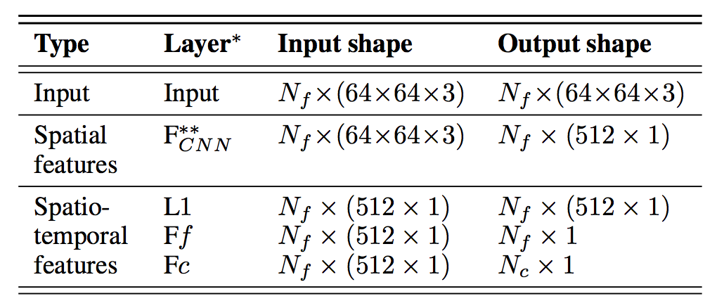
Fully connect layer of CNN
E1 computed spatio- temporal layer
Cossimilarty on output vector of CNN
Gradient E1 + Gradient E2 computed
spatio-temporal layer

Slide 3
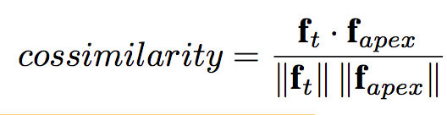
Cossimilarity
Considering a video from a set of videos of a particular expression
From CNN, obtain output, f_{t} as spatial feature vector of frame, [ happy, sad, angry, fear, Surprise, disgust]
f_{apex} is the spatial feature vector obtained from the apex frame, [ happy, sad, angry, fear, Surprise, disgust]
Compute for each frame,
F_intensity = Max-min normalize cossimilarity of till given frame of video.
0:less intense to 1: High intense
Till given frame of video, F_{f} (spatio-temporal layer 2 )is denoted for F_intensity
(Neutral face is first ever apex frame. )

Slide 4


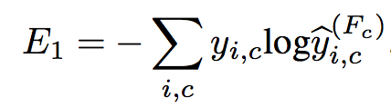
E1: minimizing expression sequence classification error
Last fully connected layer before output is y_{i} [Nf x 520 x 1]for frame f_{i} eg: [Nf][x1, x2, x3 ,x4,……….,x520]
(N_{f} : number of frames)
is probability(y_{i} ) for expression class c.
, is 1 for class c, else 0 for other class.
eg: let c be happiness, we get [1,0,0,0,0,0]
Compute,
We get, E₁ for set of video till present frame [Nf x 512 x 1].
finally, L₁ (spatio-temporal layer 1) denoted for is E1.

Slide 5
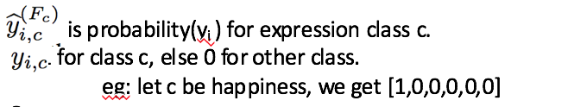
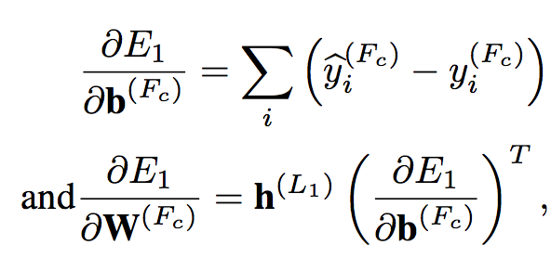
h(L1)= Get LSTM of L1(previous frames value of L1)
For present frame transition to compute Fully connected layer gradient variation formula should be:
b(Fc) and W(Fc) denote the biases and weights of the layer “Fully connected”.
As mentioned earlier,
Thus, past experience of set of frames is added into present frame and let this gradient be g1.
Fc(spatio-temporal layer 3) output will be computed using above gradient vanishing(g1) in softmax function.

Slide 6
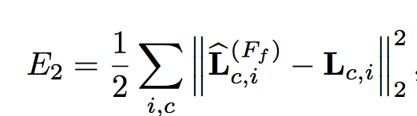


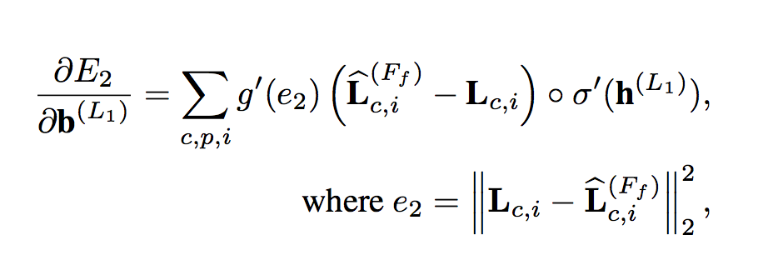
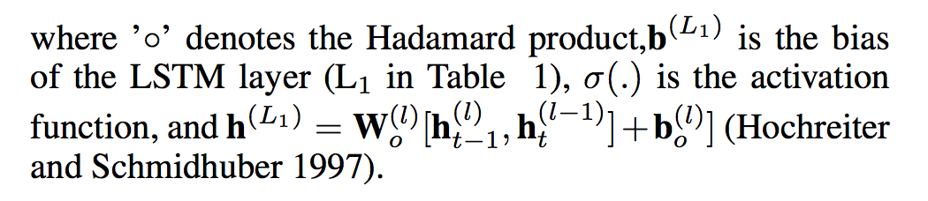
E2: Minimizing the expression intensity prediction error
:vector of predicted vector of expression intensity at each frame. (was calculated by cossimilarity of spatial vector) : vector of expression intensity labels of present frame
h(L1)= Get LSTM of L1(previous frames value of L1) as did before
Fc(spatio-temporal layer 3) output will also be computed using above gradient vanishing(g2) in softmax function
Fc(spatio-temporal layer 3) output is now computed using gradient vanishing(g2 + g1) in softmax function

Slide 7
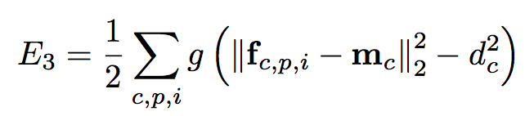
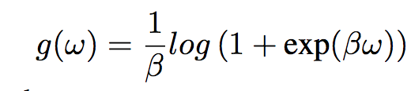
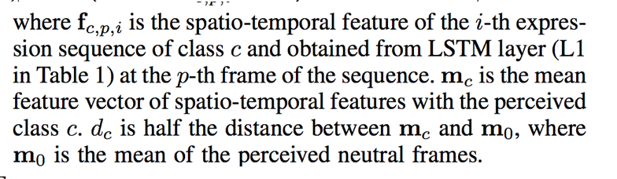
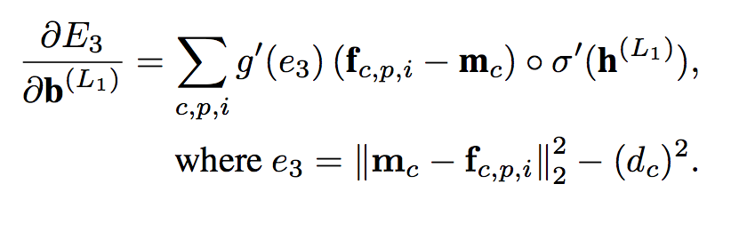
E3: clustering spatio-temporal features obtained at each frame, by the LSTM, into perceived expression clusters.
Frames of video are clustered into two classes using K- means (a threshold is applied towards neutral region)
2 classes: neutral and particular expression
Neutral face is first ever apex frame.
Thus, LSTM final layer is recomputed and is desired output.

Slide 8
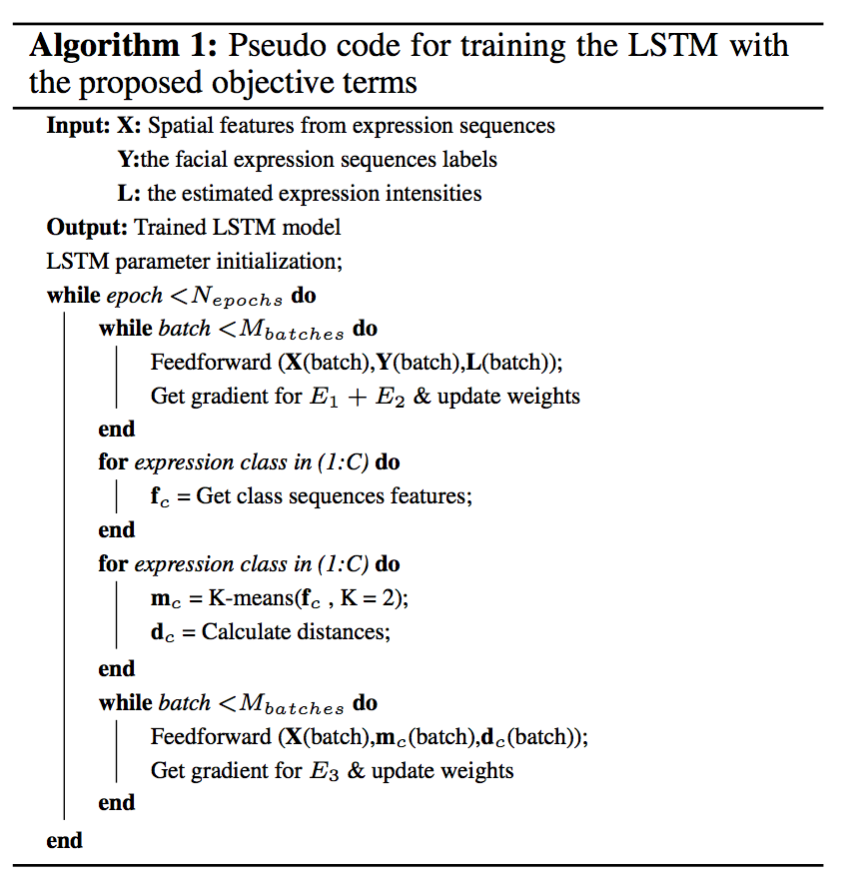
Brief Pseudo Code
For each frame from 0 to Nf of each class
Cossimilarity
Computing E1
Computing gradient vanishing(g1) from E1
Computing E2 using cossimilarity
Computing gradient vanishing(g2) from E2
Applying g1 +g2 for upgradation of weights
For each class
Thus, computed features for each class
K-mean clustering in 2 with a threshold
For each frame from 0 to Nf of each class
Compute E3
Computing gradient vanishing(g3) from E3
Applying g3 for upgradation of weights
Output
Epoch++

